Slide 1
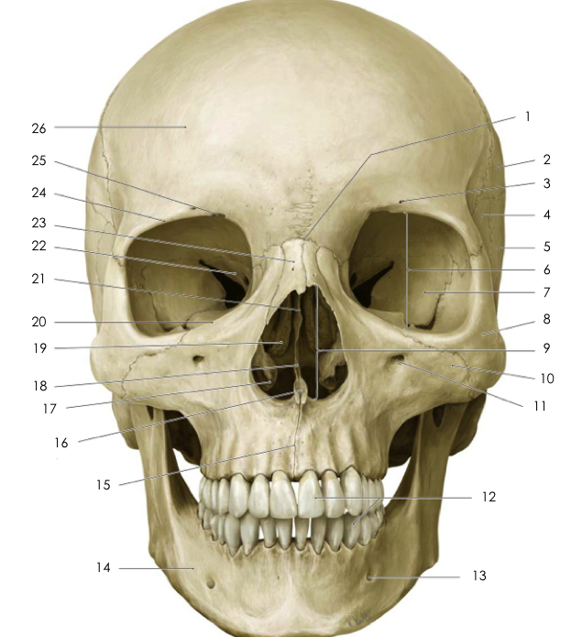
Maxilla, maxillary sinus, mandible
Dr Gallatz Katalin

Slide 2
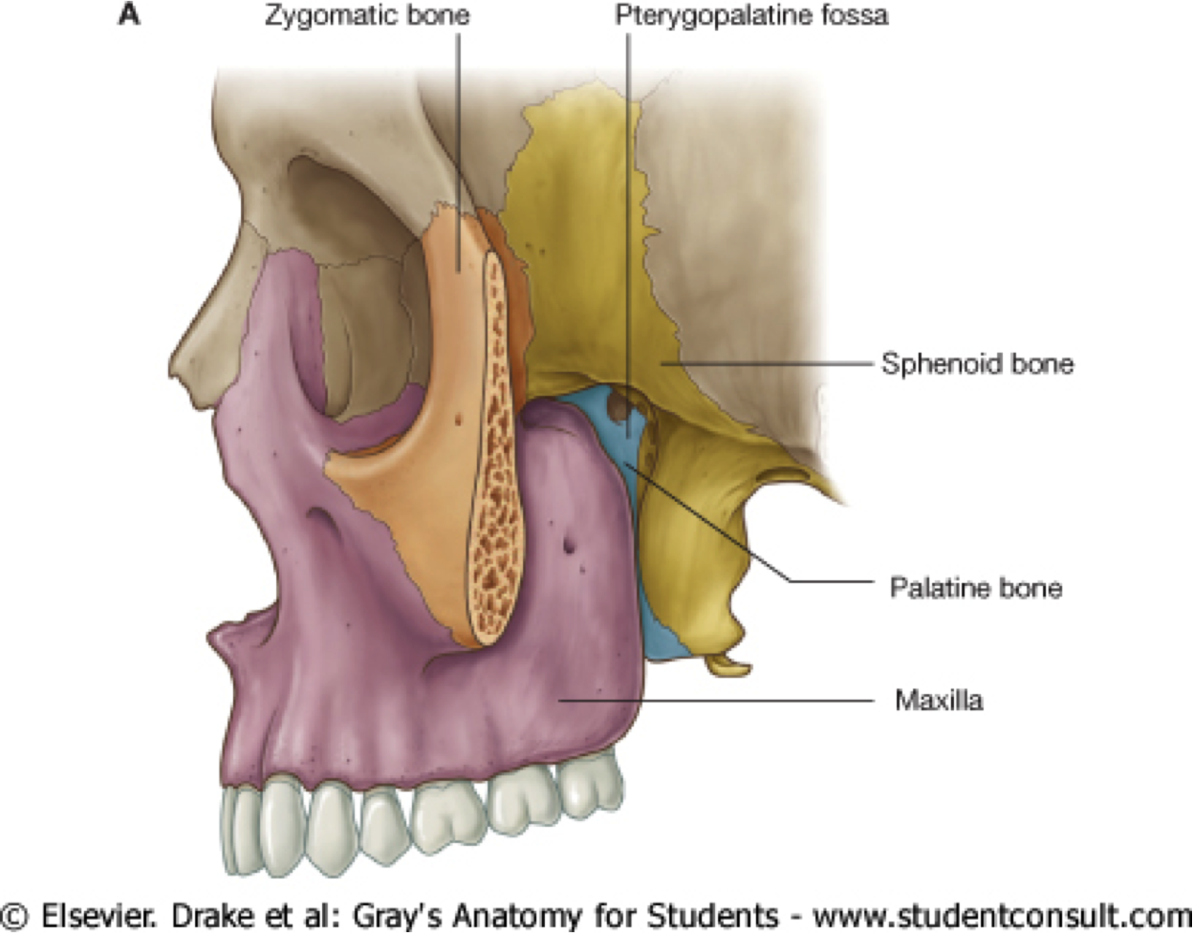
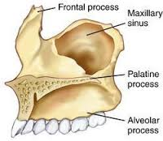
Parts of the maxilla:
1. body
2. processes
frontal process
zygomatic process
alveolar process
palatine process
Surfaces of the body of the maxilla
anterior
infratemporal
nasal
orbital

Slide 3
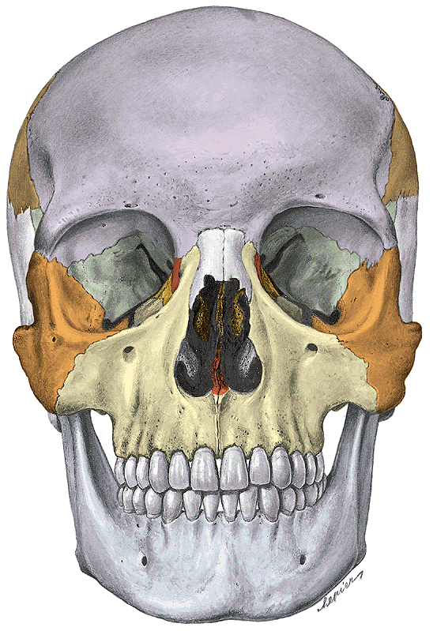
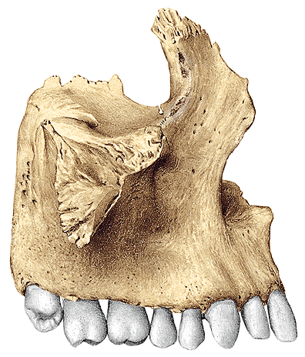
Anterior, orbital and infratemporal surface
frontal process
orbital surface
infraorbital
foramen
post.alveolar
foramina
alveolar process
maxillary tuber
zygomatic process
canine fossa

Slide 4
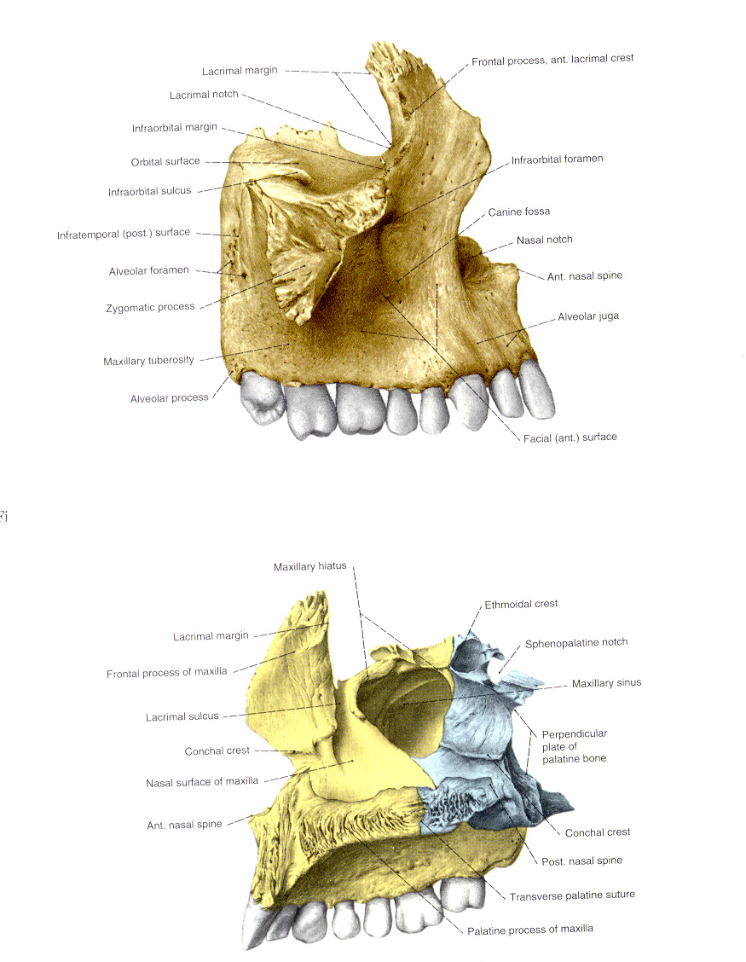
ANTERIOR AND
INFRATEMPORAL
SURFACE
INFRAORBITAL FORAMEN
CANINE FOSSA
MAXILLARY HIATUS
NASAL SURFACE

Slide 5
NASAL SURFACE
maxillary hiatus
lacrimal sulcus → nasolacrimal canal
conchal crest → inf.nasal concha.
INCISIVE CANAL
PALATINE PROCESS

Slide 6
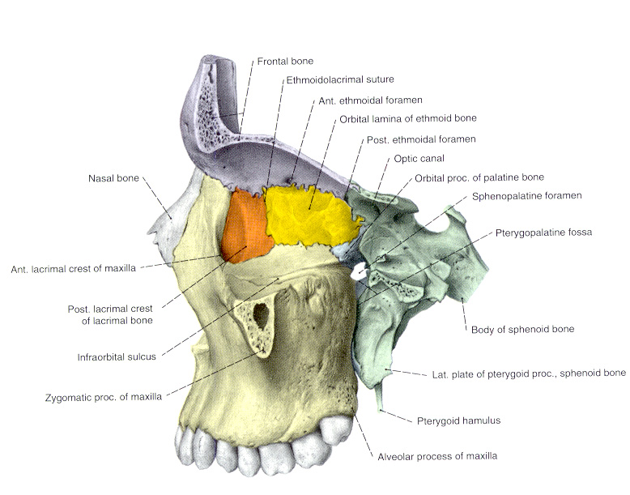
ANTERIOR, INFRATEMPORAL AND ORBITAL SURFACE
forms the anterior wall of the pterygopalatine fossa
forms the inferior surface of the orbit

Slide 7
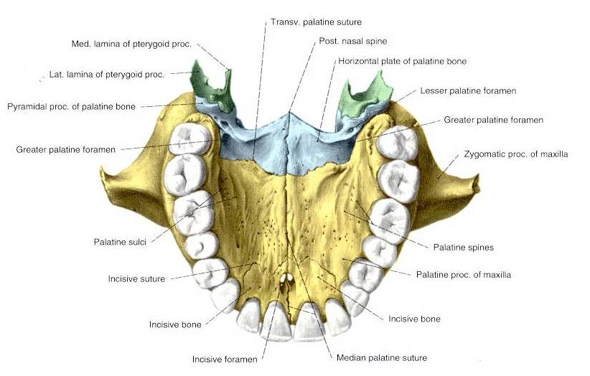
HARD PALATE
PALATINE PROCESS OF THE MAXILLA
HORIZONTAL PLATE OF PALATINE BONE

Slide 8
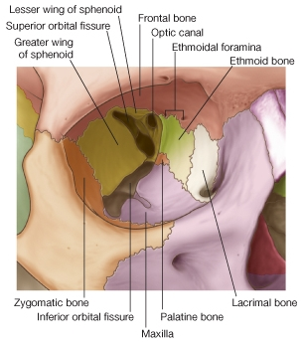
Orbital surface
Inferior orbital fissure
infraorbital sulcus
infraorbital canal
infraorbital foramen

Slide 9
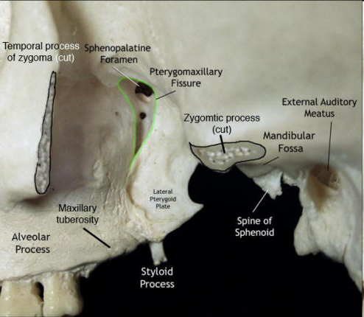
PTERYGOPALATINE FOSSA
Infratemporal surface of the MAXILLA,
maxillary surface of the GREATER WING and PTERYGOID PROCESS
perpendicular plate of PALATINE BONE

Slide 10
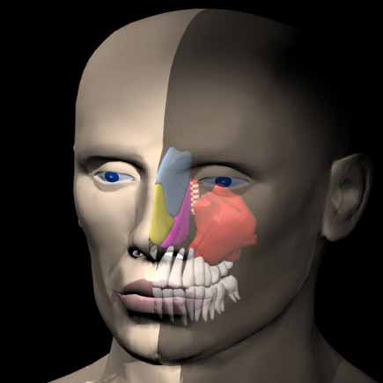
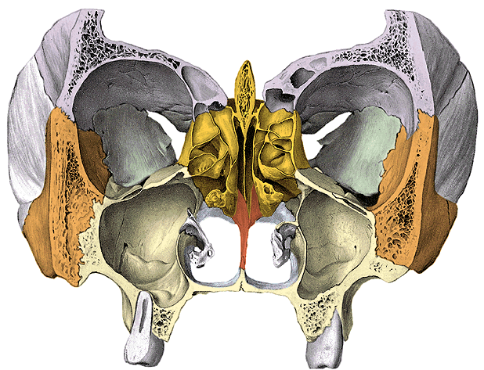
MAXILLARY SINUS
1. The maxillary sinus is the largest paranasal sinus.
2. It is intimately related to the upper teeth,
tear duct, and the floor of the orbit.

Slide 11
Recesses of the maxillary sinus
1.infraorbital recess
2. zygomatic recess
3. alveolar recess
frontal recess
basal recess
tuberal recess

Slide 12
Maxillary sinus
has infraorbital, zygomatic and alveolar recesses.

Slide 13
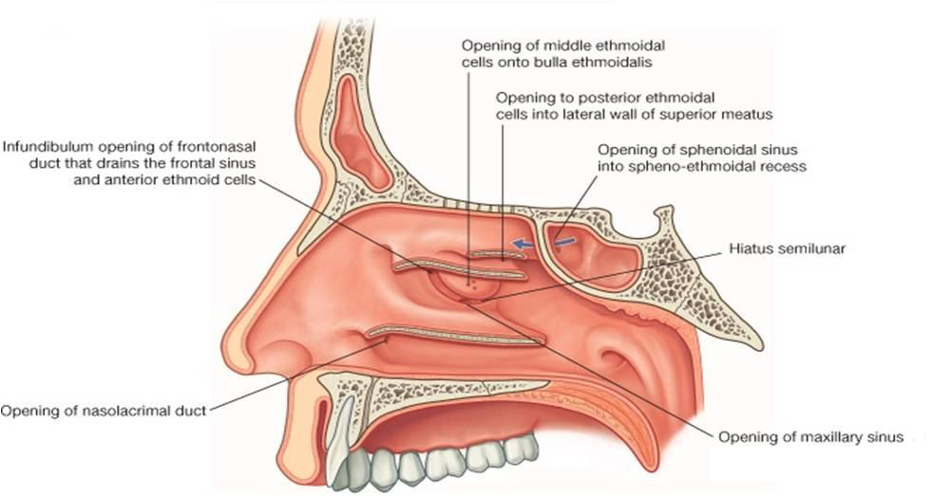
Maxillary sinus opens at its top into the middle nasal meatus through
the posterior one-third of the semilunar hiatus.
SEMILUNAR HIATUS bordered by the uncinate process and the ethmoidal bulla.

Slide 14
MAXILLARY SINUS
Nasal wall/base
On the nasal wall,( or base )a large, irregular aperture the maxillary hiatus can be seen
The maxillary hiatus is reduced in size by the following bones:
- ethmoidal bulla and uncinate process of the ethmoid above,
- the ethmoidal process of the inferior nasal concha below,
- inferior nasal concha below
- the perpendicular plate of the palatine bone behind,
a small part of the lacrimal bone above and in front.
The sinus communicates through an opening into the semilunar hiatus
Maxillary sinusitis is imflammation of the maxillary sinuses.

Slide 15
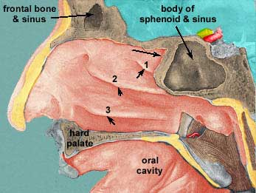
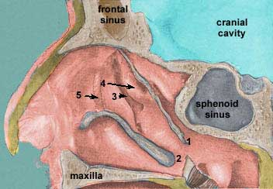
Ethmoidal bulla
Uncinate process

Slide 16
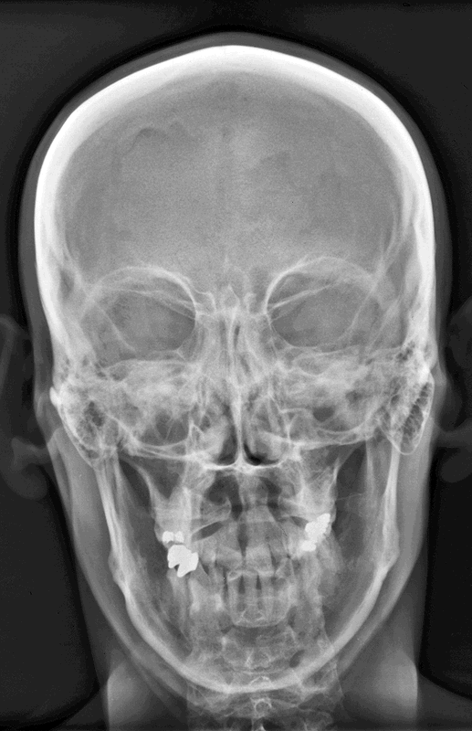
coronal section

Slide 17
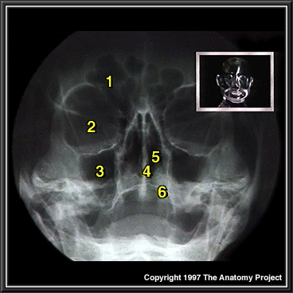
1. Frontal sinus
2. Orbit
3. Maxillary sinus
4. Nasal septum
5. Nasal cavity
6. Hard palate

Slide 18
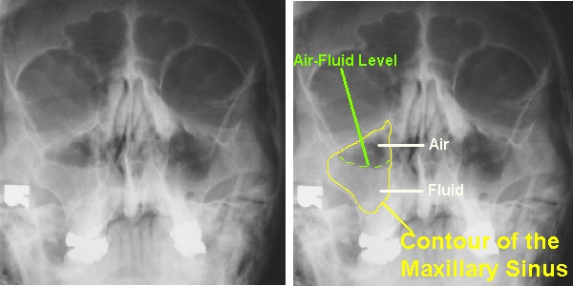
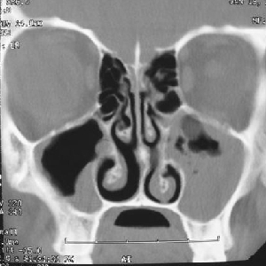
Maxillary sinusitis

Slide 19
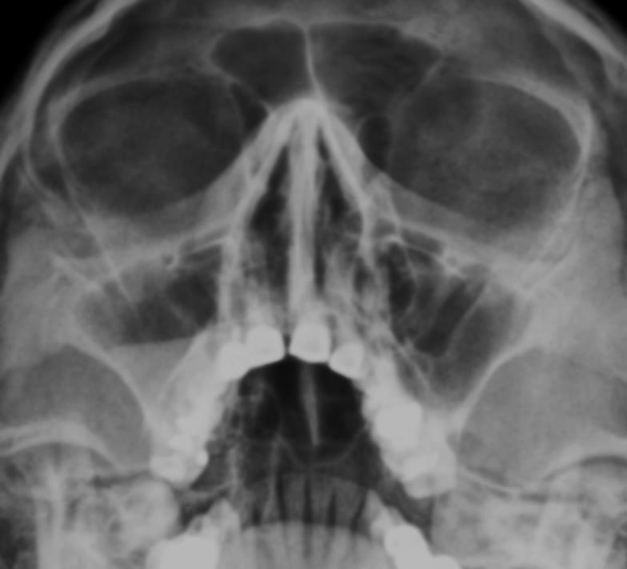
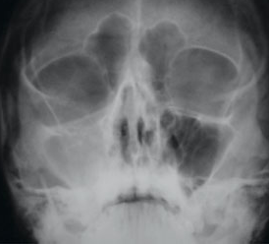
Maxillary sinusitis

Slide 20
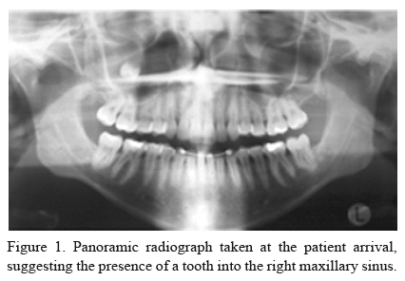
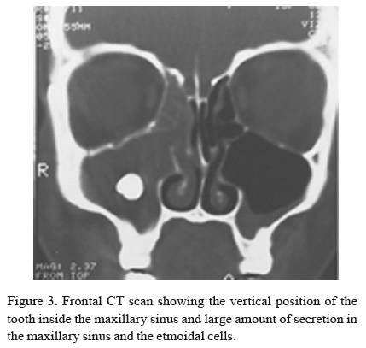

Slide 21
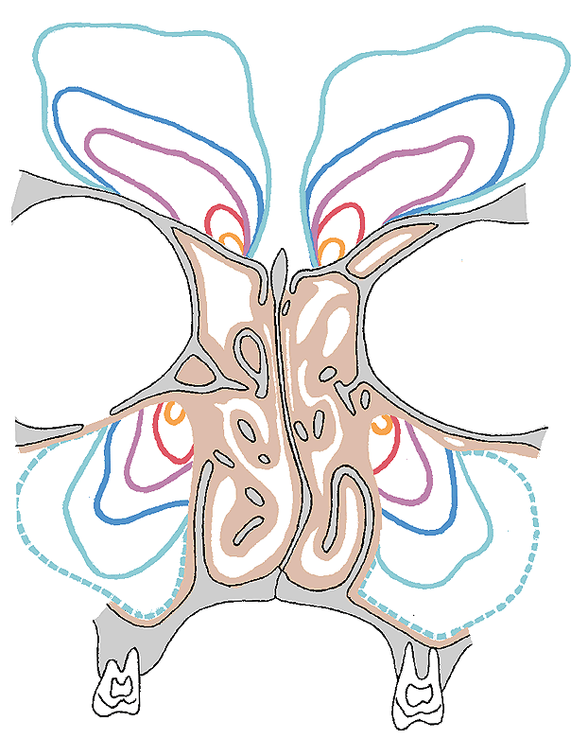
Frontal and maxillary sinuses are
almost completly missing at the
time of birth but it grows continuosly.
1 year
4 years
8 years
12 years
20 years
60 years

Slide 22
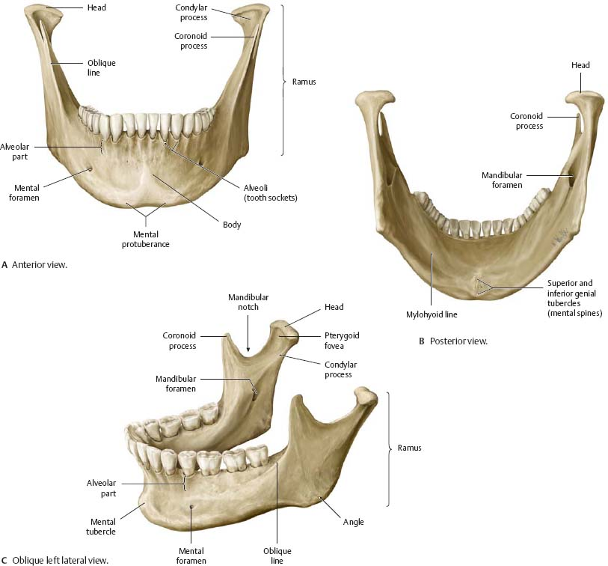
MANDIBLE

Slide 23
Parts of the mandible
Corpus or body
base of the mandible
alveolar process
Ramus
coronoid process
condylar process

Slide 24
Mandible – external surface
masseteric tuberosity,
oblique line
mental foramen,
mental protuberance
mental tubercle
alveolar juga
mental protuberance
masseteric tuberosity

Slide 25
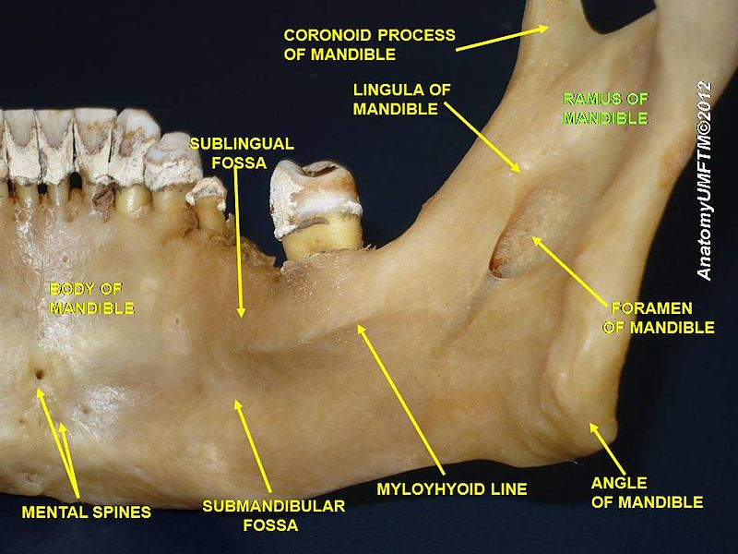
Mandible - inner surface
pterygoid tuberosity,
pterygoid fovea
mandibular foramen,
lingula,
mylohyoid sulcus
mylohyoid line,
submandibular fossa,
sublingual fossa,
digastric fossa,
mental spines,

Slide 26
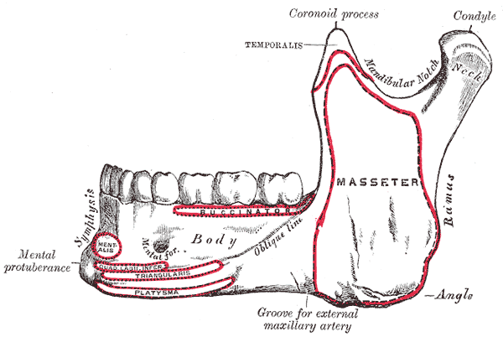
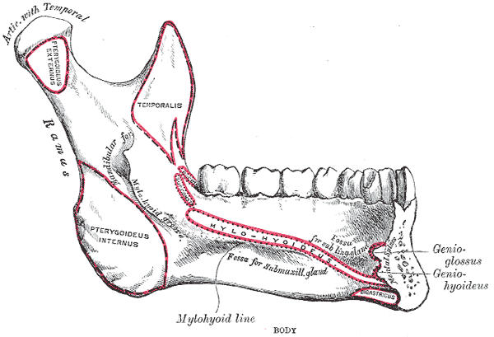
INSERTION SURFACES, LINES OF THE MUSCLES

Slide 27
TRAJECTORIAL STRUCTURE OF THE MANDIBLE
MANDIBULAR CANAL

Slide 28
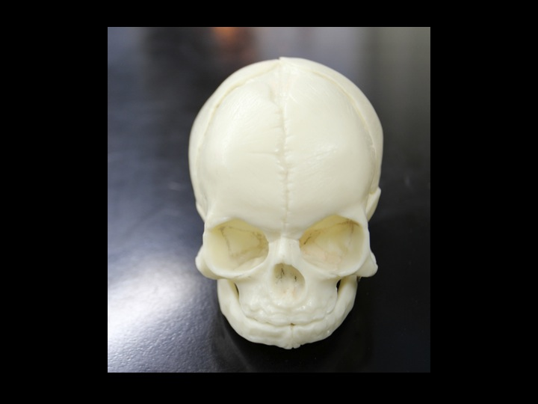
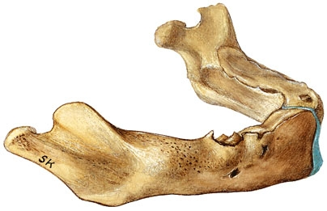
Neonatal mandible
Mental symphysis
Angle of the mandible: ~150°
No alveolar process

Slide 29
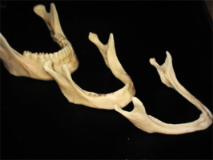

Slide 30
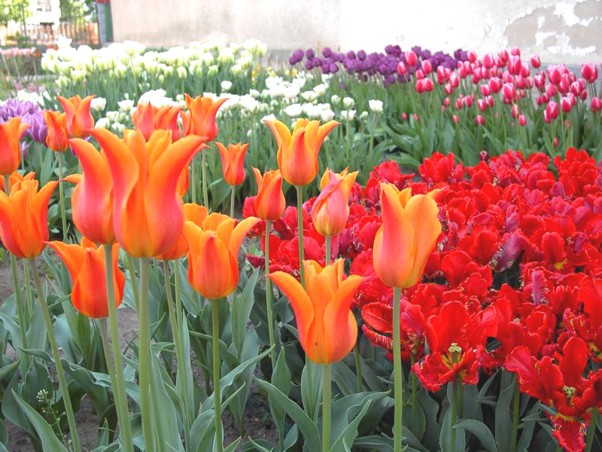
Thank you for your attention!

