Slide 1
Nervous system III.
dr. Vanda Halász
Sensory Systems, Eye, Visual Pathway, Eye Movements, Ear, Auditory and Vestibular System, Gustatory System

Slide 2
Receptors
stimulus
answer
receptor
electric, mechanical,
chemical, temperature etc.
a.p., 2nd messenger
etc.
exteroceptor
communication with the outer world
interoceptor
receptors of the internal organs

Slide 3
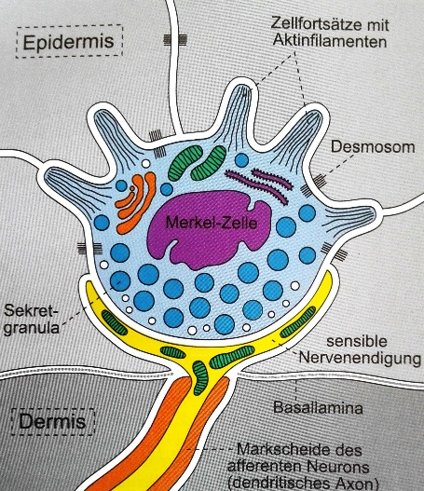
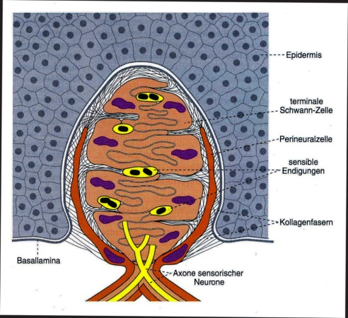
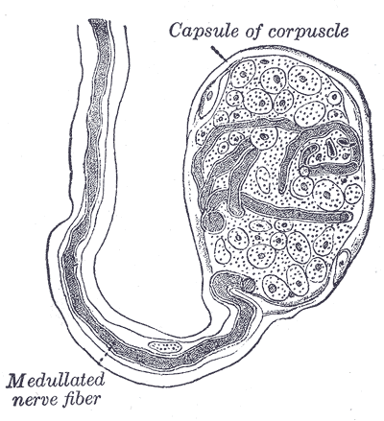
Mechanoreceptors in the Skin
Meissner corpuscle
Merkel disc
and cell
(Vater- )Pacinian
corpuscle
Krause endbulb

Slide 5
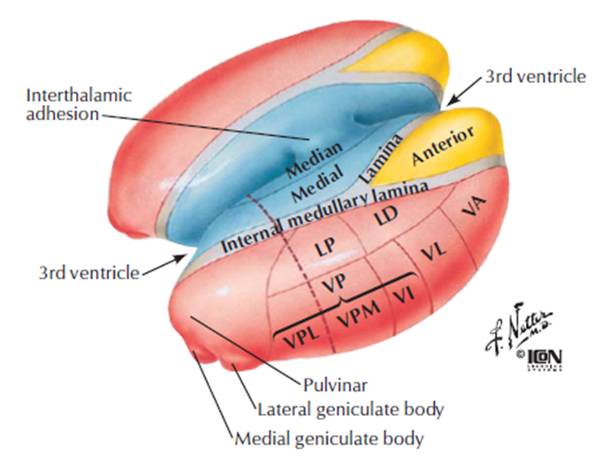
Thalamus

Slide 6
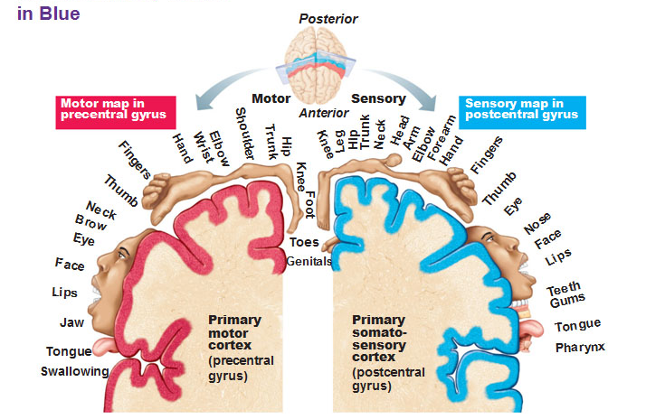

Slide 7
Pain
Periphery:
Nociceptor: unspecialized nerve endings
no myelin sheath/ slightly myelinated axons -> slow conduction
the receptive field is large
only discharge when the stimulus is large enough
primary pain: sharp
secondary pain: more diffuse, dull, longer lasting
Injury ->cytokines ->COX2 activation -> PG synthesis ->sensitization
Central:
discriminative component: location, intensity, quality
spinothalamic tracts
targets primary and secondary sensory cortex
affective- motivational component: unpleasentness
projection to RF (periaqueductal grey matter)
hypothalamus -> autonomous ns reactions
amygdala

Slide 8
Descending Control of Pain
circumstances affect pain perception
all senses are subjuect to some modulation
Central:
periaqueductal grey matter ->analgesia
dorsal raphe ncl.
medullary RF
endogenous opioid system
Peripheral:
Gate theory: activation of low threshold mechanoreceptors reduce sensation of sharp pain (i.e.: rubbing the toe after kicking the table)
endogenous opioid system: inhibitory interneurons

Slide 9
Eye

Slide 10
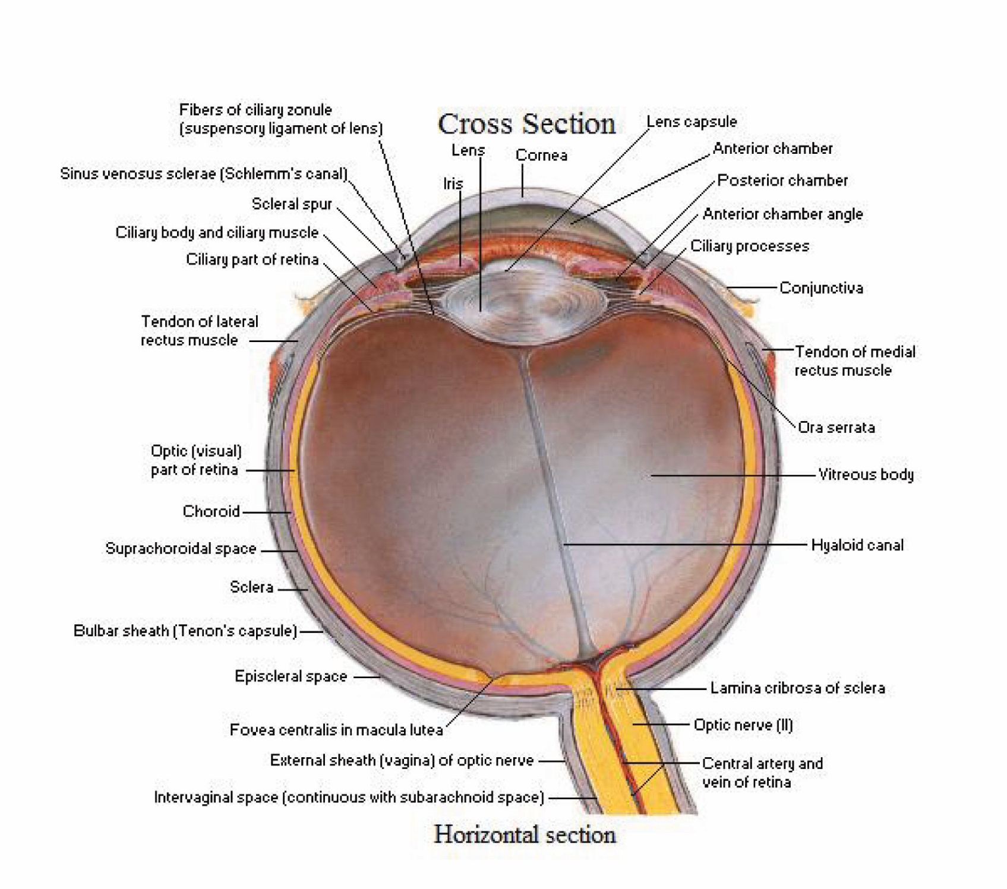

Slide 11
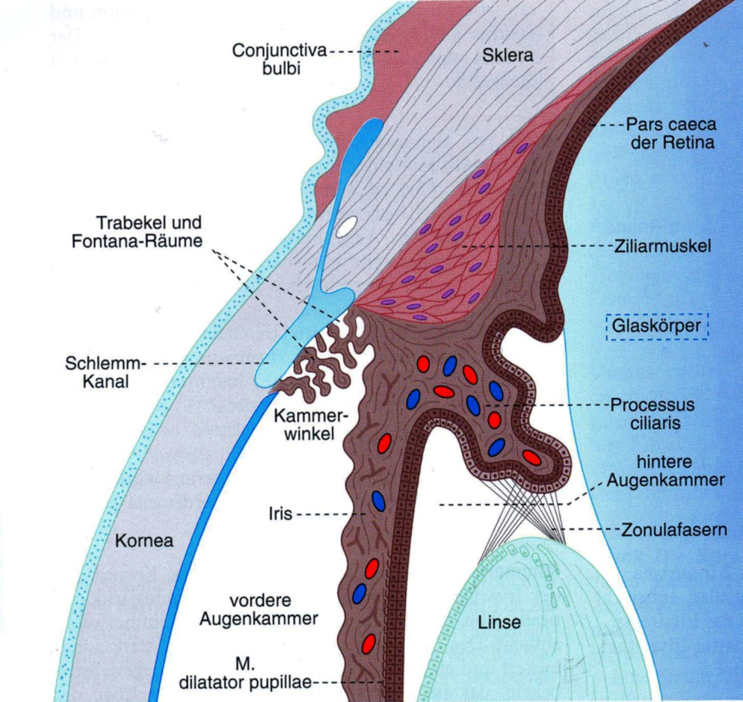

Slide 12
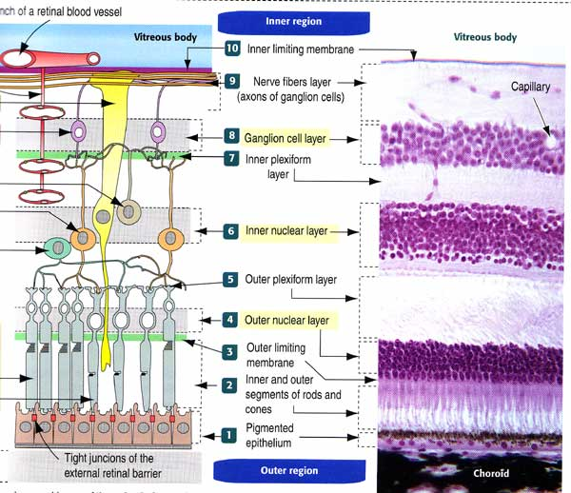

Slide 14
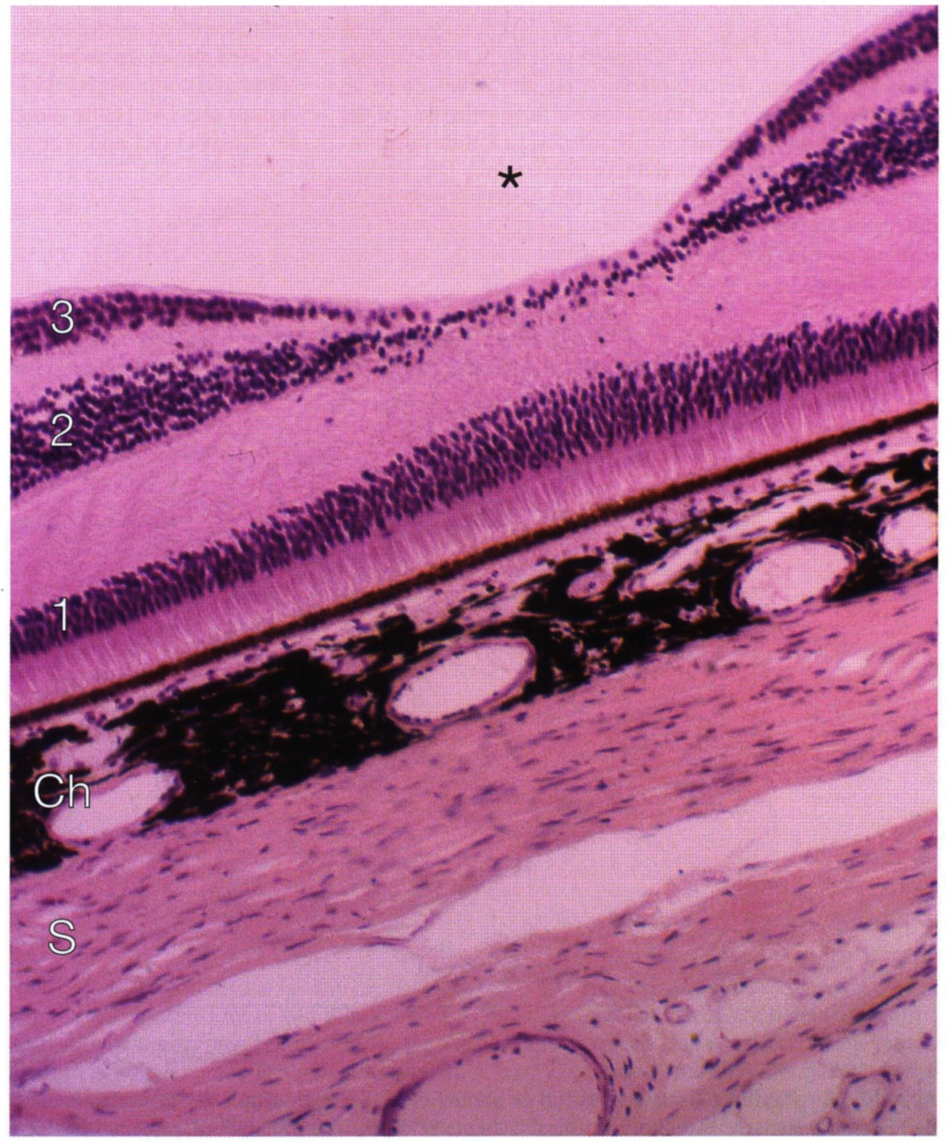
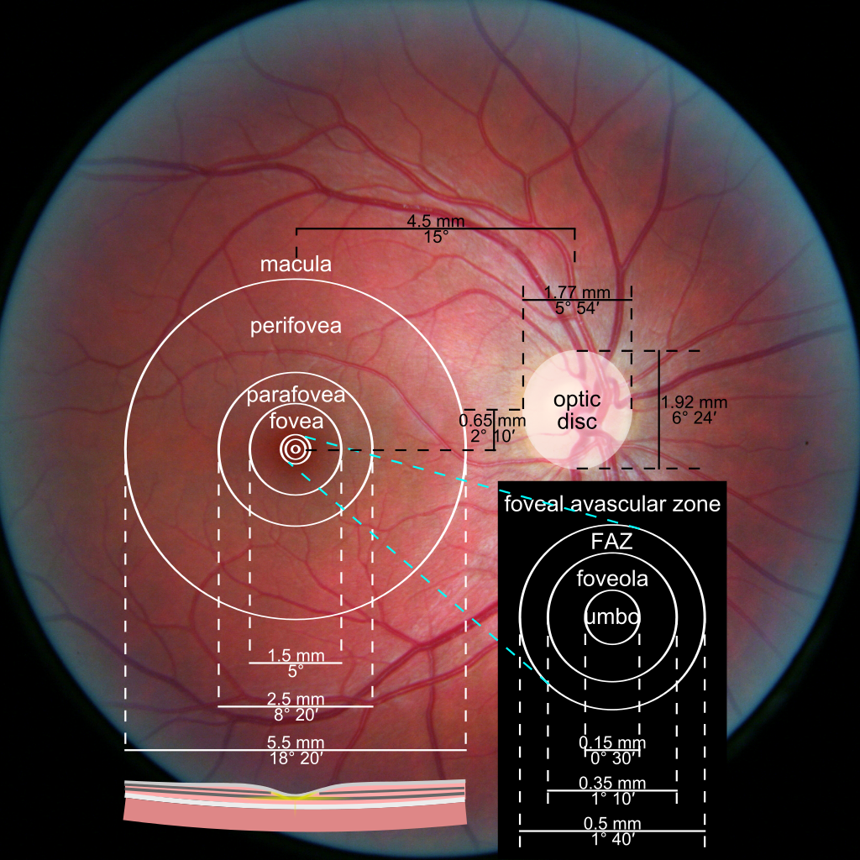
Yellow Spot (macula lutea)

Slide 15
Blind spot (optic disc)

Slide 16
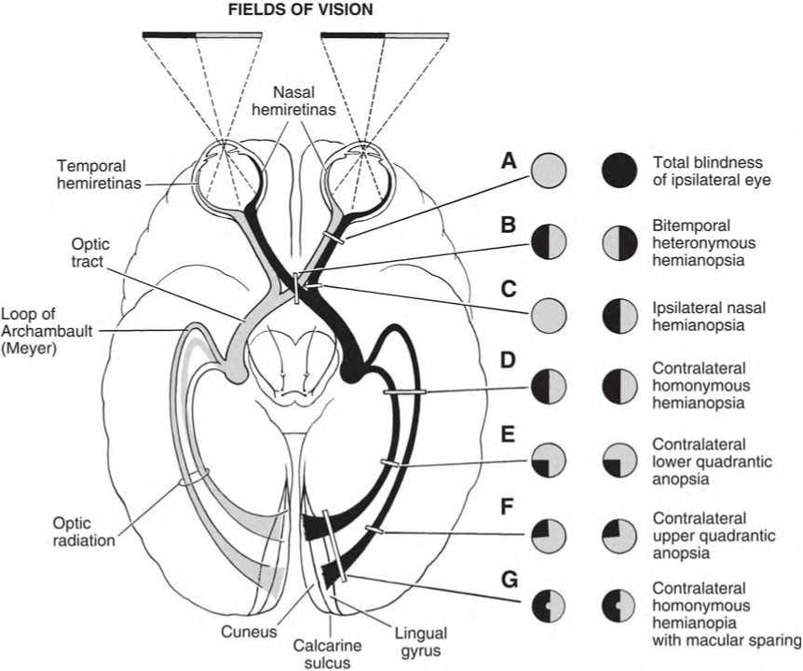
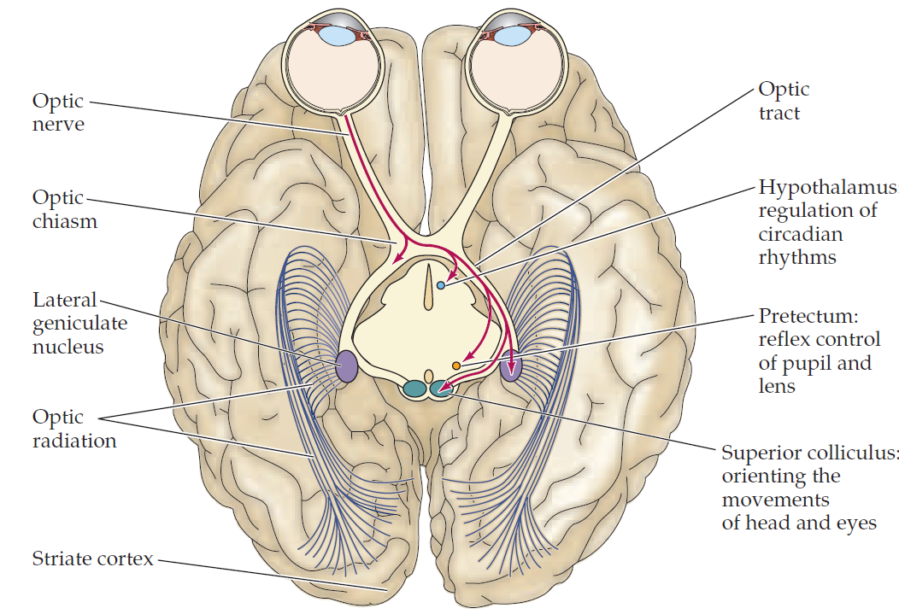

Slide 18
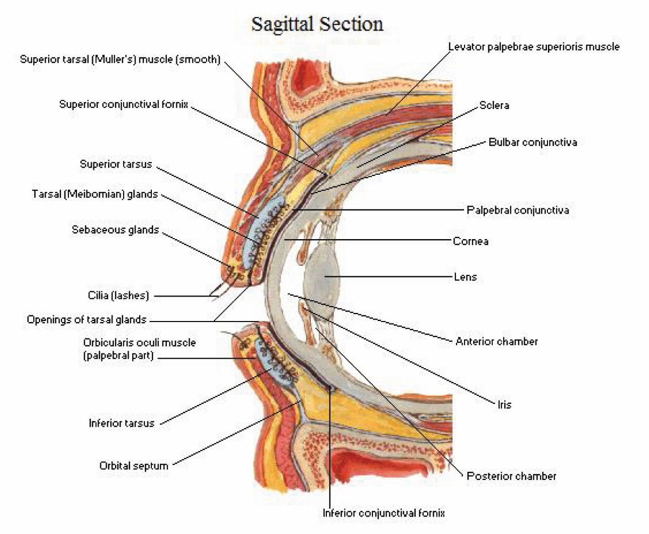
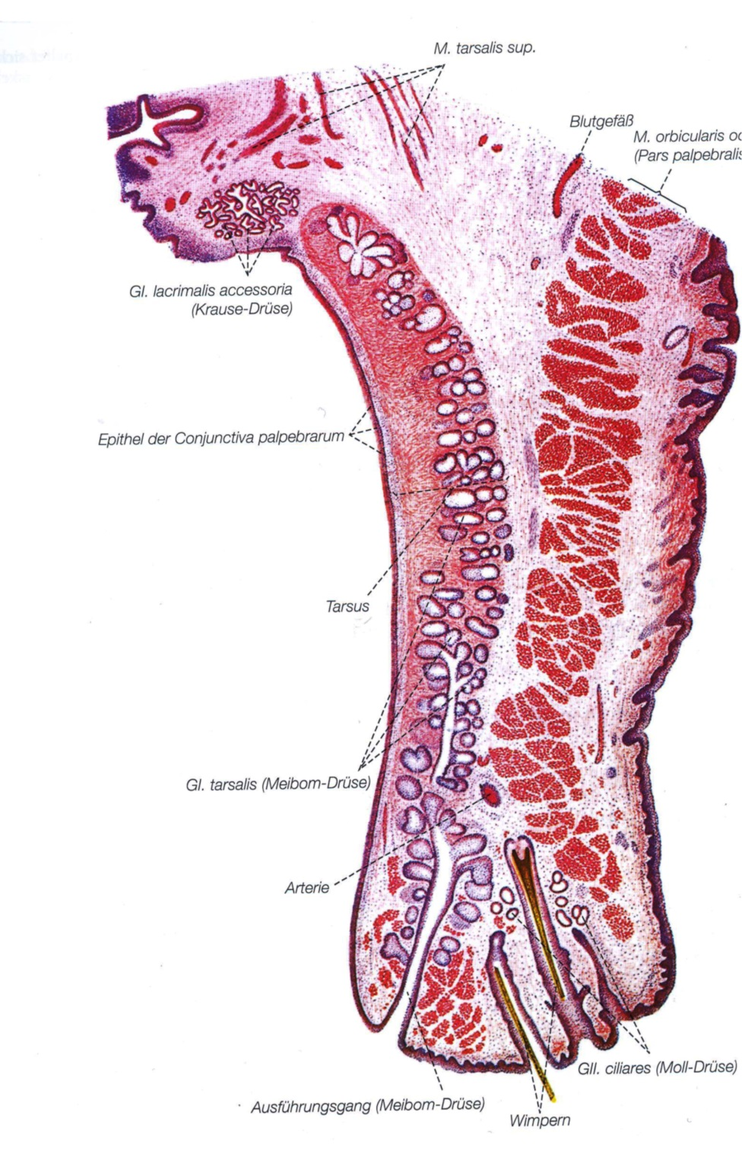

Slide 21
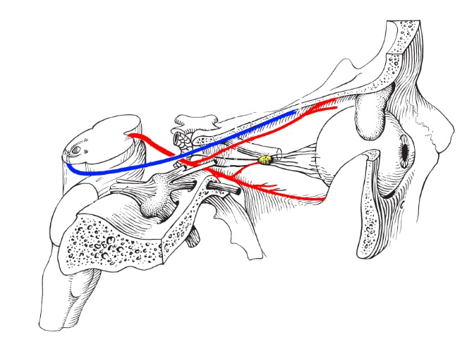
III. Occulomotor nerve
VI. Abducens nerve
IV. Trochlear nerve

Slide 22
Movements of Extraoccular Muscles
sup.
m. obliquus inf.
N.III.
m. rectus sup.
N.III.
med.
m. rectus med.
N.III.
m. rectus lat.
N.VI.
lat.
m. obliquus sup.
N.IV.
m. rectus inf.
N.III.
inf.

Slide 23
Eye Movements
Saccades: quick ballistic movements to align the foveas with point of interest
Smooth Pursuit Movements: slower, to keep moving target on fovea
Nystagmus: saccade+ smooth pursuit movement, reflexive response to large scale movement of the visual scale
Vergence movement: to align the fovea of each eye with the target located at different distances from the observerver
Vestibulo-occular movements: to stabelize the eyes reletive to the external world

Slide 24
Reflexes of the Visual system
Lightreflex/ pupillary reflex

Slide 25
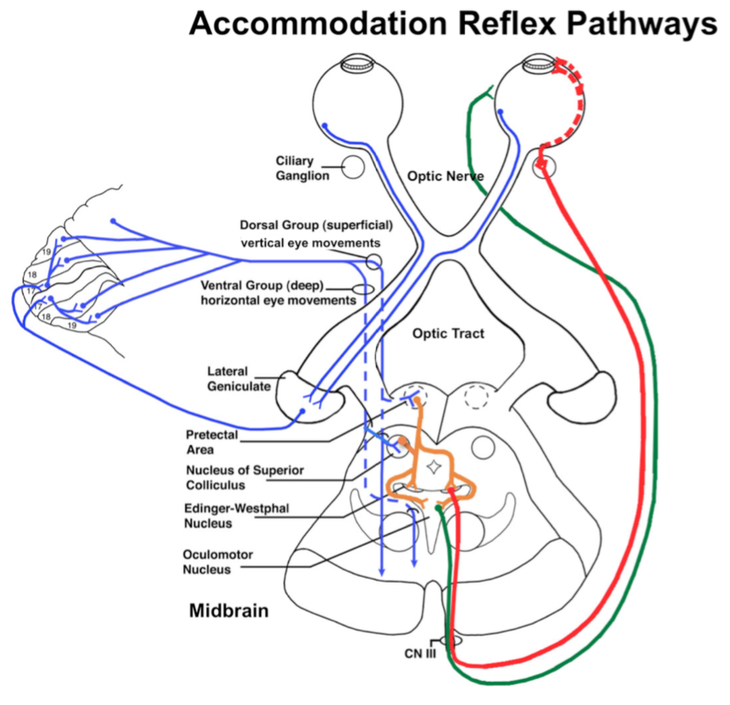
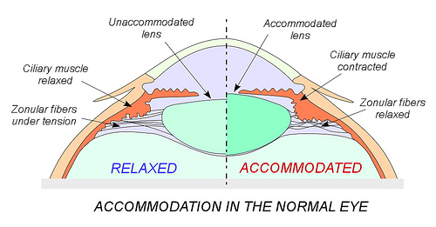
Accomodation and convergence

Slide 26
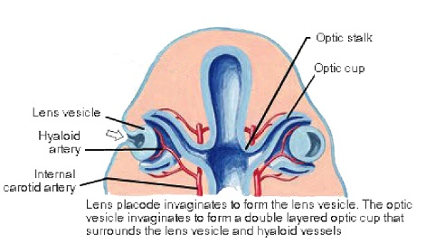
Development of the Eye

Slide 27
Ear

Slide 29
Auditory System

Slide 32
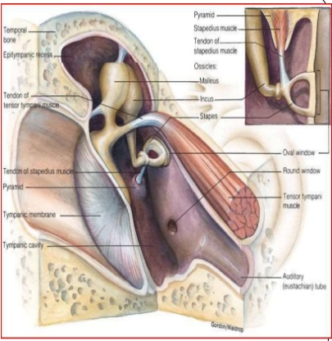

Slide 33
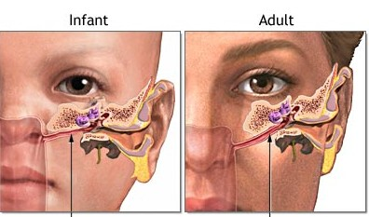
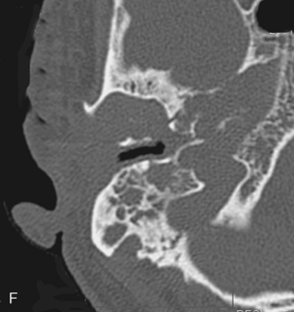

Slide 34
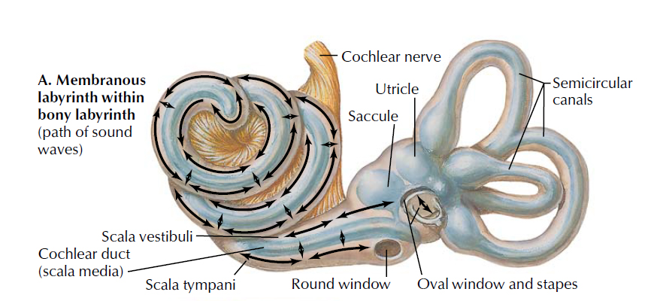

Slide 36
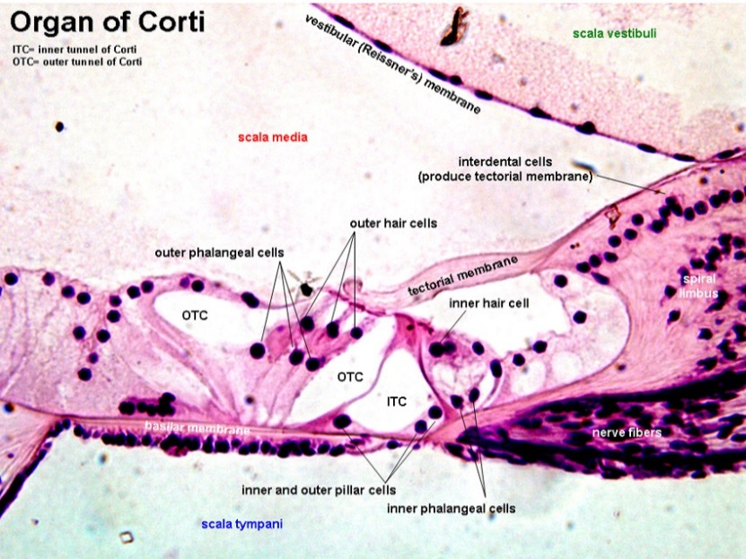
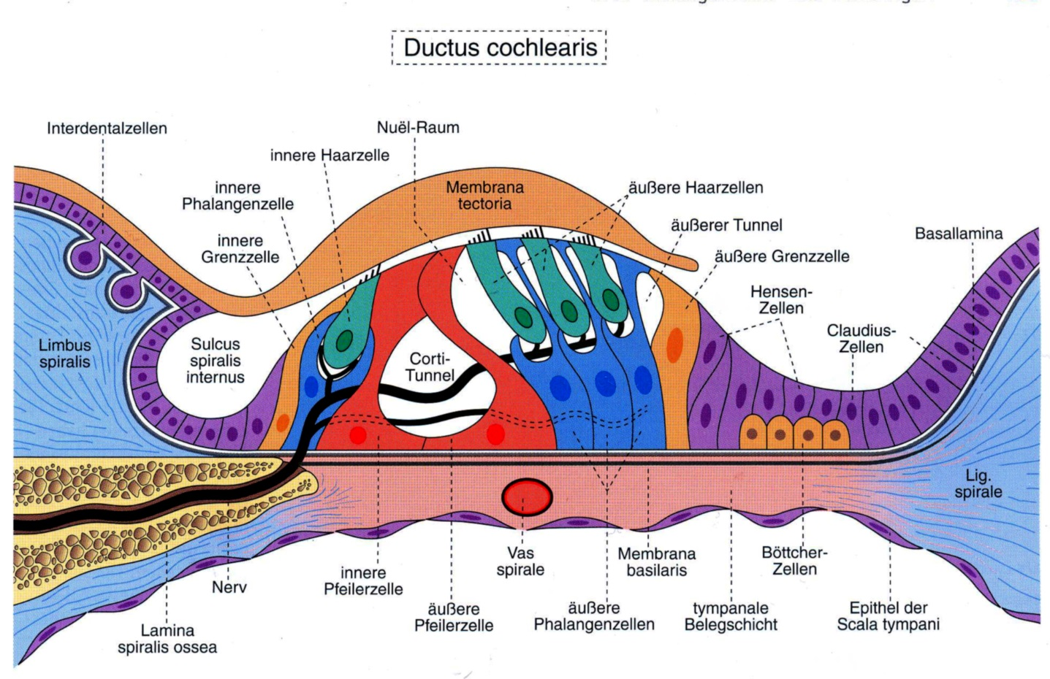

Slide 37
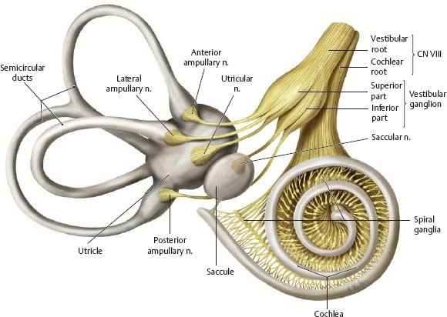

Slide 38
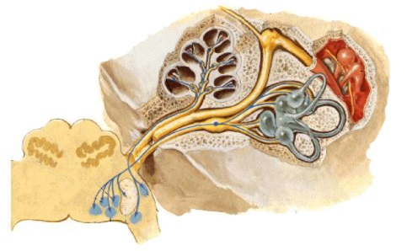

Slide 39
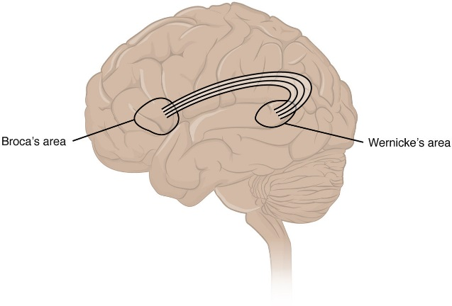
Aphasia
primary motor
speech center
primary sensory
speech center

Slide 40
Vestibular System

Slide 46
Medial Longitudinal Fascicle
Vestibulo- Occular Reflex

Slide 47
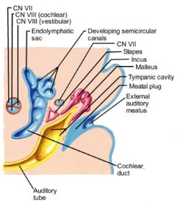
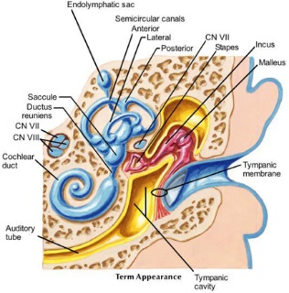
Development of
the Ear

Slide 48
Gustatory System

Slide 50
References:
Netter: Atlas of Human Anatomy
Netter: Atlas of Embriology
Netter: Atlas of Neuroanatomy and Neurophysiology
Langman: Embriology
Welsch: Lehrbuch Histologie
Hajdu: Vezérfonal a neuroanatómiához
SH Atlasz: Anatómia III.
Purves: Neuroscience

