Slide 1
Vessels, conducting system, surface projection of the heart, pericardium. Auscultation points. Divisions of the mediastinum.
Semmelweis University,
Faculty of Medicine 1st year 2nd semester
Department of Anatomy, Histology and Embryology
Katalin Kocsis
2018.03.06-09.

Slide 2
Blood supply of the heart I.
Coronary arteries

Slide 3
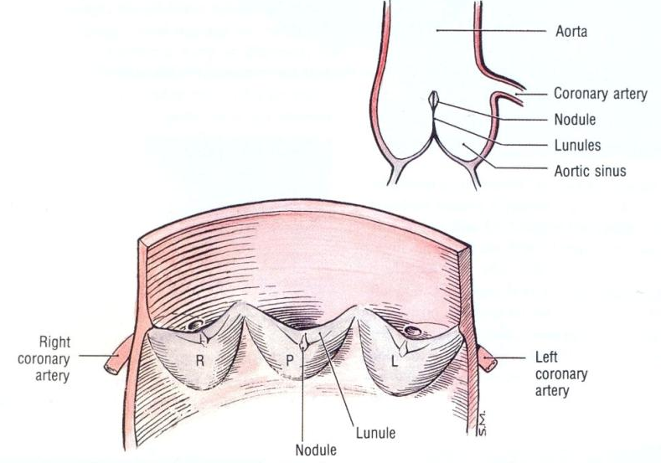
CARDIAC VALVES
(semilunar valves/cusps))
pars tensa
pars flaccida (lunula)
nodulus
pars tensa
pars tensa

Slide 4
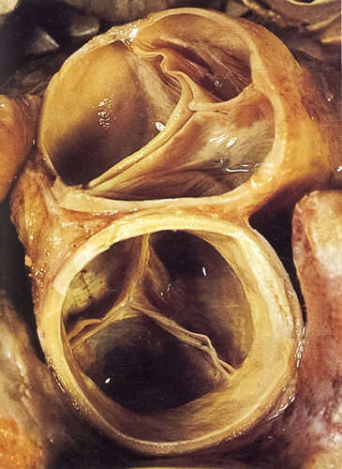
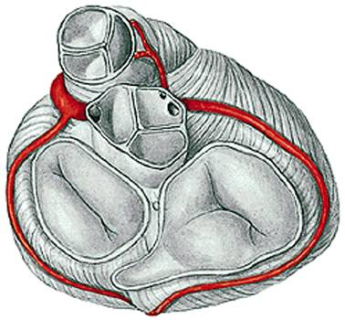
CARDIAC VALVES
(semilunar valves)
-pulmonary valve
A
R
L
L
R
P
-aortic valve

Slide 5
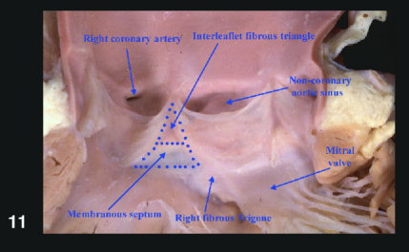
Aa. coronariae

Slide 6
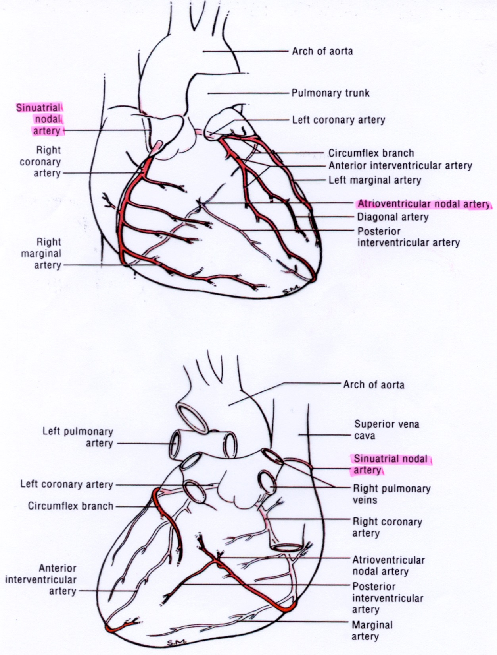

Blood supply of the heart
Left coronary artery:
from the left aortic sinus,
passes between left auricle and pulmonary trunk
a. coronaria sinistra
ant. interventr. a.
circumflex a.
left marginal
left ventricle, left atrium, interventricular septum

Slide 7
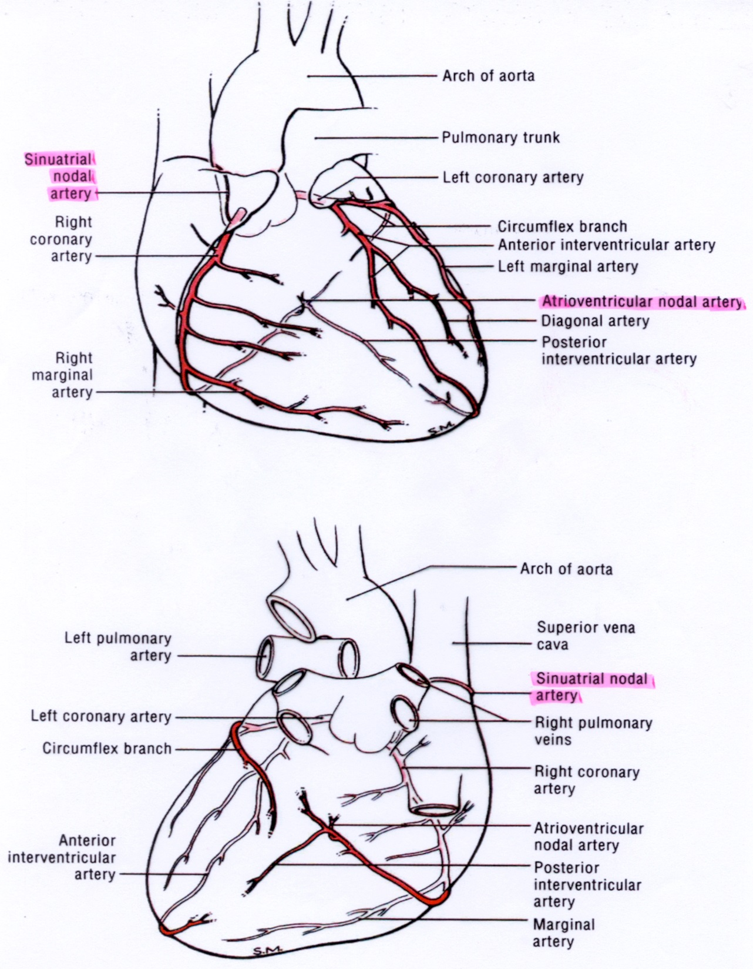
Blood supply of the heart
Right coronary artery:
from the right aortic sinus
a. coronaria dextra
r. marginalis
r. interventr. post.
right ventricle, right atrium, interventricular septum,
SA and AV nodes

Slide 8
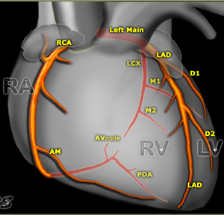
Left Main or left coronary artery (LCA)
  Left anterior descending (LAD)
    diagonal branches (D1, D2)
    septal branches
  Circumflex (Cx)
    Marginal branches (M1,M2)
Right coronary artery
  Acute marginal branch (AM)
  AV node branch
  Posterior descending artery (PDA)

Slide 9
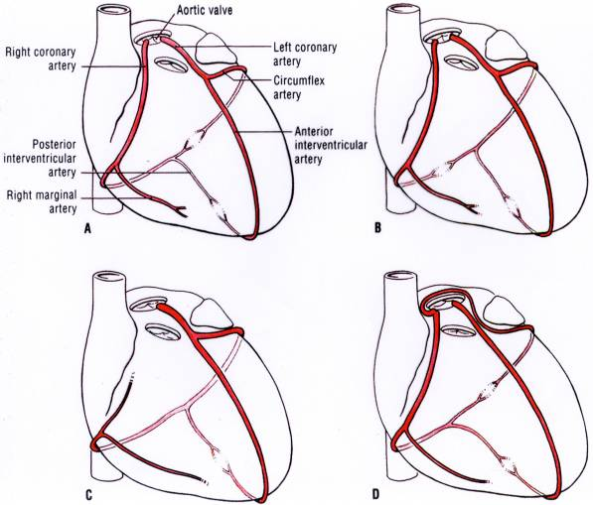
Variations
right coronary dominance: 50%
left coronary dominance: 20%
balanced: 30%

Slide 10
Blood supply of the heart II.
Cardiac veins

Slide 11
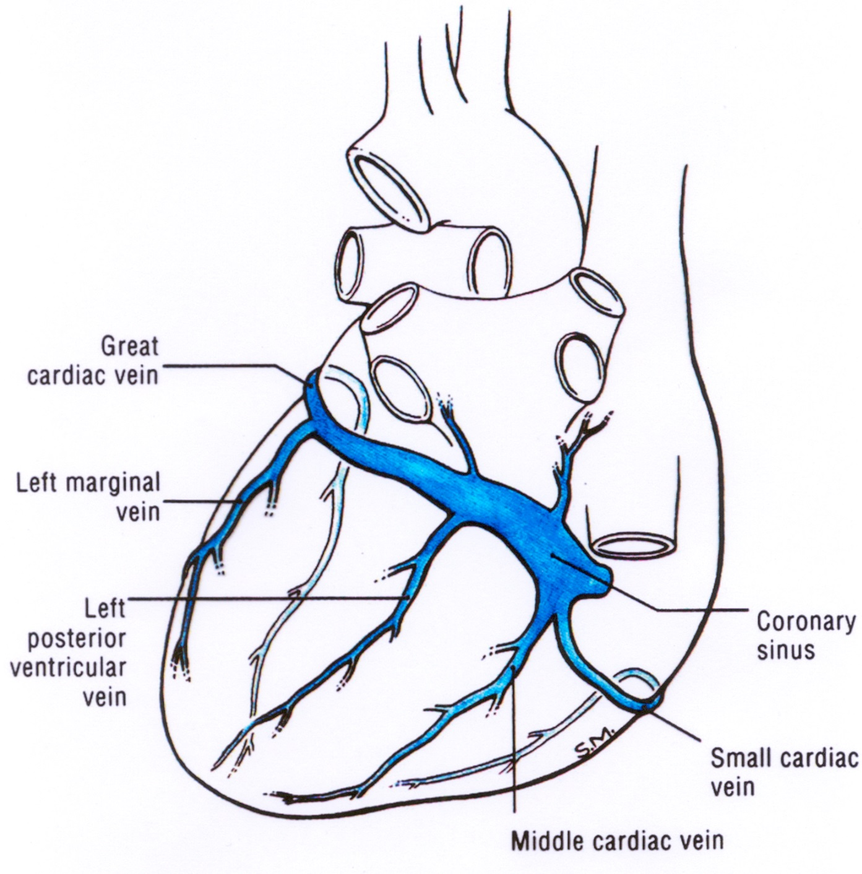
Venous drainage of the heart
Coronary sinus:
from left to right in the posterior part of the coronary groove
opens into the right atrium immediatelly to the left of the inf. v. cava, posterior to the right atrioventricular orifice
v. obliqua atrii sinistri

Slide 12

Venous drainage of the heart
great cardiac vein: ant. interventr. groove
main tributary of the coronary sinus (valve)
middle cardiac vein: post. interventr. groove
small cardiac veins: coronary groove
(usually it terminates in the coronary sinus,
but it may open directly to the right atrium)
left post. cardiac vein: inf surface
of the left ventricle
anterior cardiac veins: small, ant. surface of the right ventricle
vv. cordis minimae: directly into the chambers of the heart, left atrium
oblique vein of the left atrium: post.
surface of the left atrium
v. obliqua atrii sinistri

Slide 13
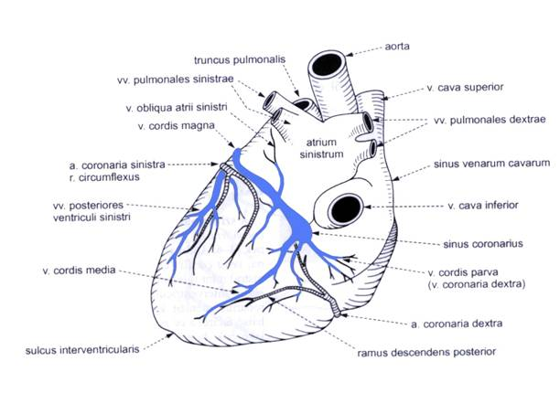
Cardiac veins

Slide 14
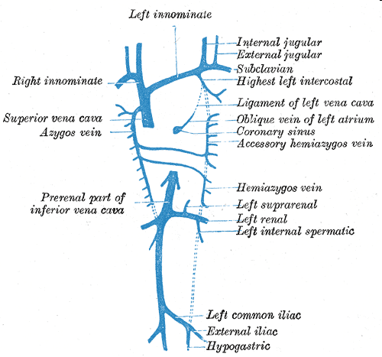
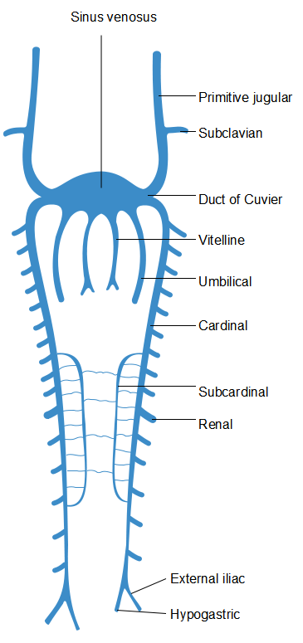
Development of the oblique vein of left atrium (Marshall)

Slide 15
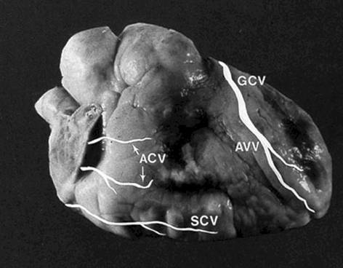
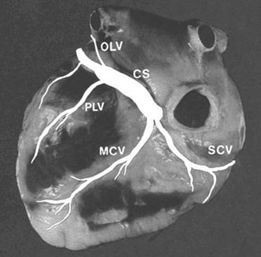
Cardiac veins

Slide 16
Anatomical base of the heart attack

Slide 17
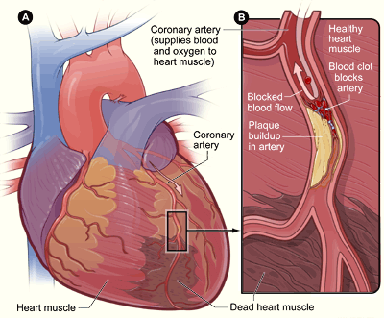
Myocardial infarction (heart) attack
myocardial infarction (heart attack): occlusion of the primary or secondary branches of the coronary arteries, the affected myocardium is damaged (dies)
few anastomoses between the coronary artery branches, no collateral circulation

Slide 18
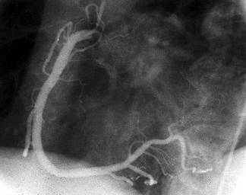
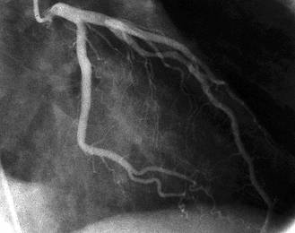
Coronary angiography
long narrow catheter is passed into the ascending aorta via
femoral artery
the opening of a coronary artery

Slide 19
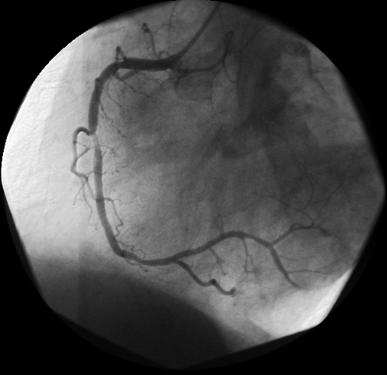
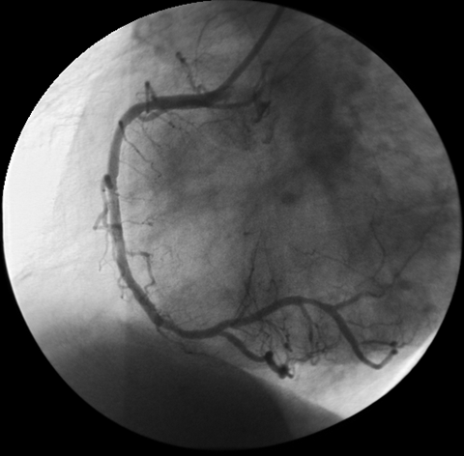
Incomplete stenosis of a. coronaria dextra before and after PCI
(Percutaneous Coronary Intervention)
after
before

Slide 20
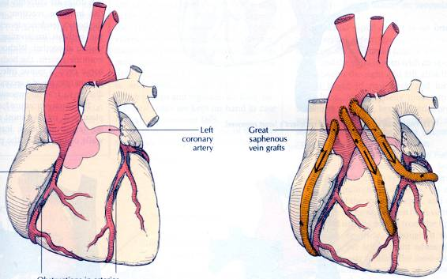
Coronary occlusion: bypass graft
A segment of a vein (internal thoracic, great saphenus v.) is connected to the ascending aorta or the proximal part of a coronary artery and to the coronary artery distal to the stenosis: shunts blood

Slide 21
Conducting system of the heart

Slide 22
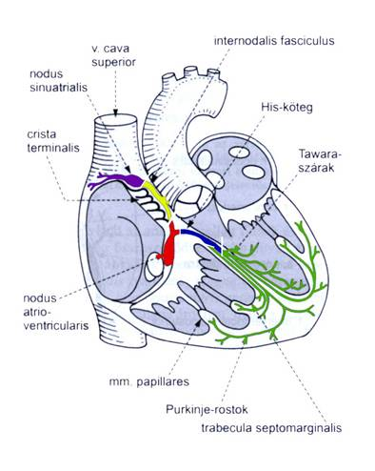
Conducting system of the heart

Slide 23
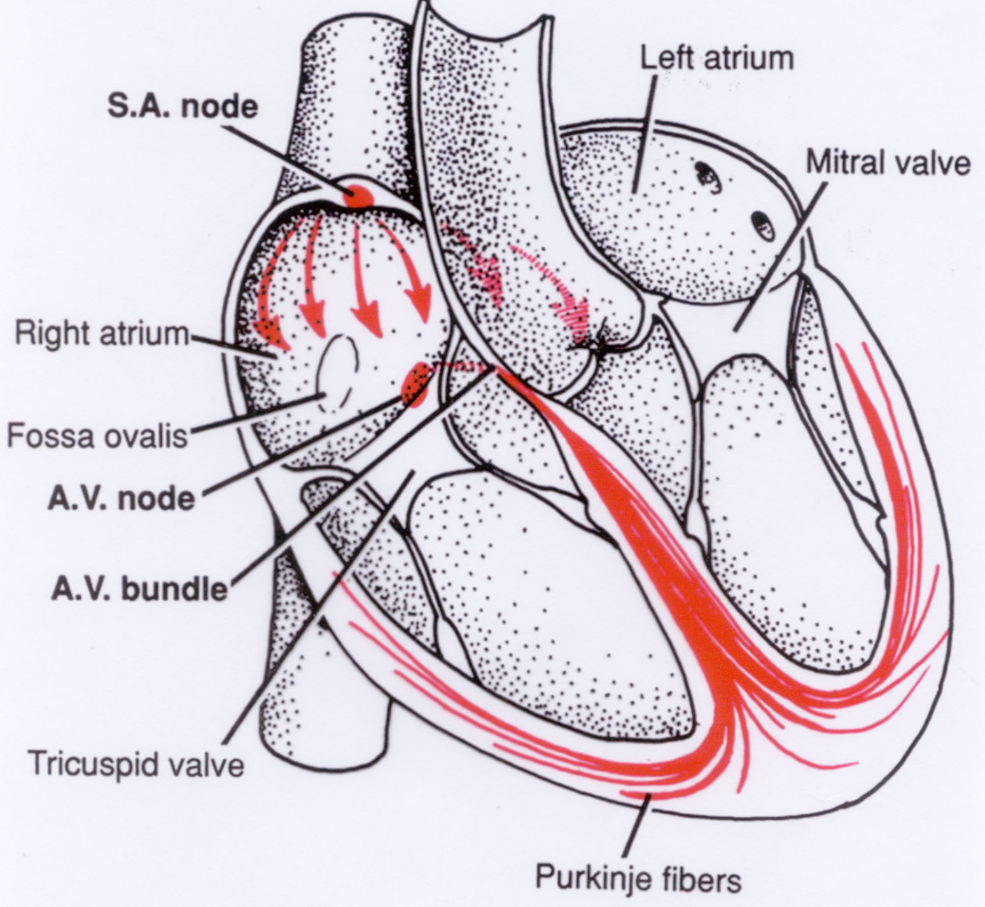
Conducting system of the heart
Specialized for initiating impulses and conducting them rapidly through the heart
coordinate contraction of the four chambers

Slide 24
Conducting system of the heart
Sinoatrial node (SA node): in the wall
of the right atrium (natural pacemaker)
at the superior end of the crista terminalis, at the junction of the sup. v. cava and the right auricle
70 times/ min

Slide 25
Conducting system of the heart
Atrioventricular node: (AV node): in the interatrial septum, on the ventricular side of the orifice of the coronary sinus
40 times/min
Atrioventricular bundles:
a.) His bundle: anulus fibrosus (rigth fibrous trigone)
b.) Tawara fibers: in the muscular interventricular septum
c.) Purkinje fibers (to the papillary muscles)

Slide 26
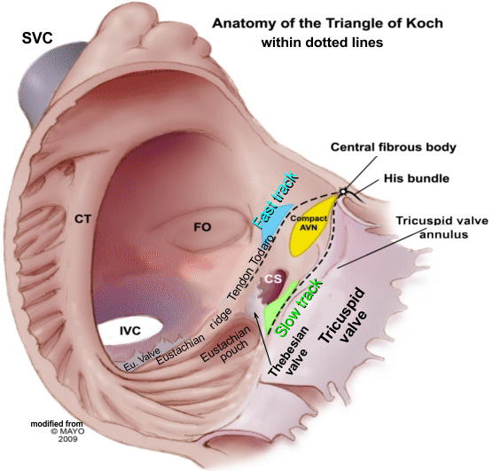

Slide 27
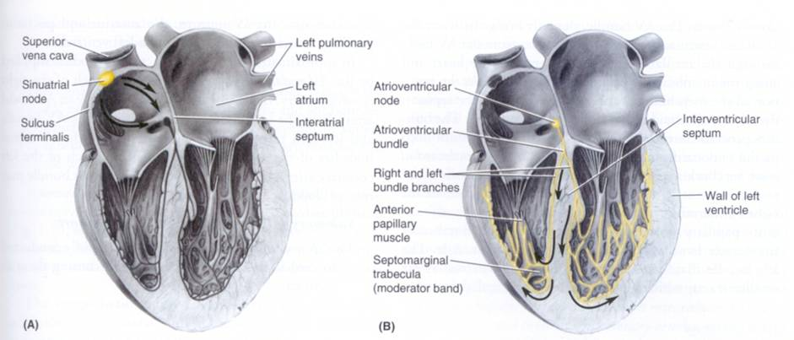
Conducting system of the heart
Sinuatrial node
Atrioventricular node and fascicle

Slide 28
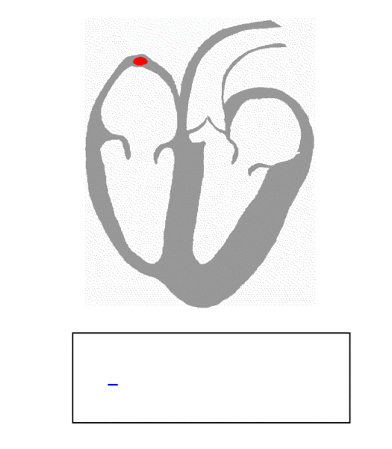
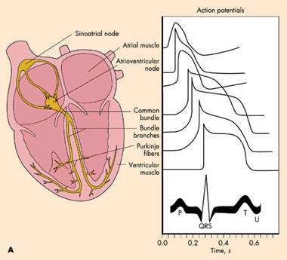
Electrocardiogram

Slide 29
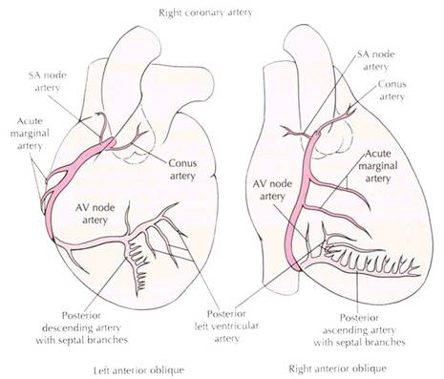
Blood supply of the conducting system

Slide 30
Innervation of the heart
Autonomic nerve fibers:
vagus nerves
Sympathetic trunks
Sympathetic stimulation: increases the heart rate
increases the heart beat causes dilatation of the coronary arteries
Parasympathetic stimulation: decreases the heart rate
reduces the heart beat
constricts the coronary arteries

Slide 31
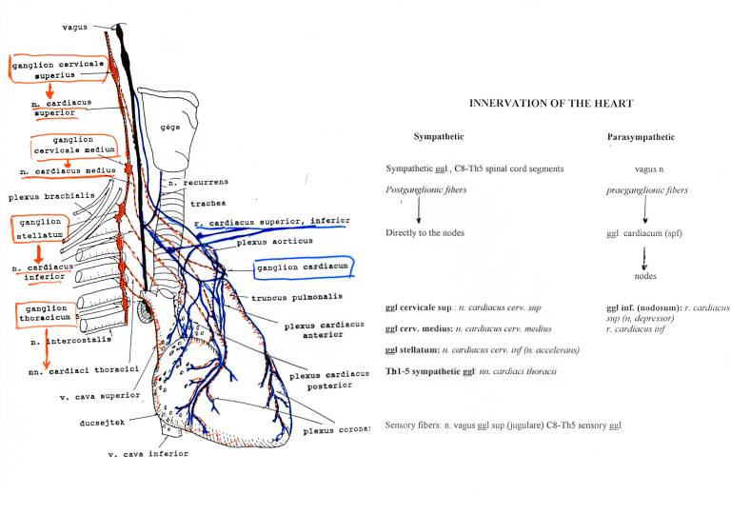
Innervation of the heart

Slide 32
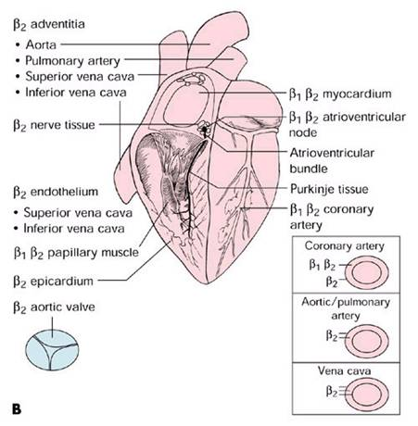
β receptors in the heart

Slide 33
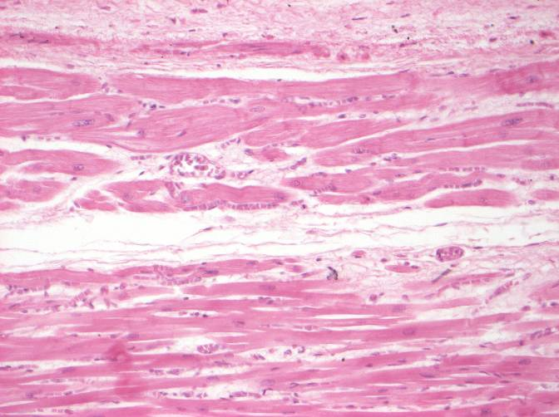
Conducting system of the heart

Slide 34
Position of the heart

Slide 35
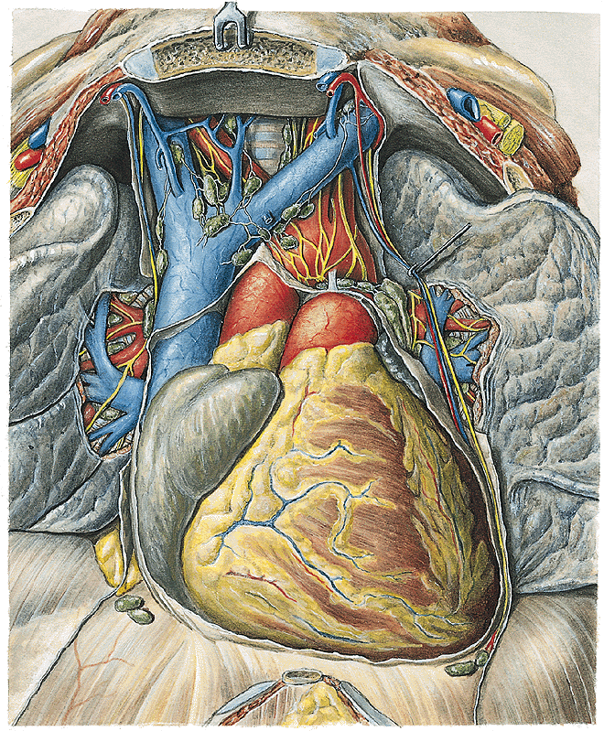
POSITION OF HEART
Aortic arch
Superior v. cava
Pulmonary trunk
Right atrium
Left auricle
Right auricle
Left ventricle
Anterior inter-ventricular sulcus
Right ventricle
Right
Left

Slide 36
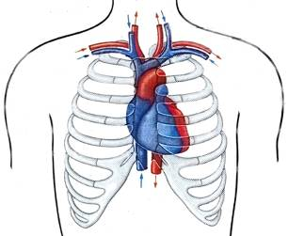
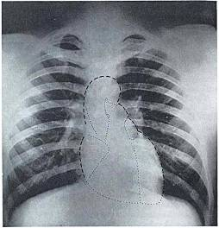
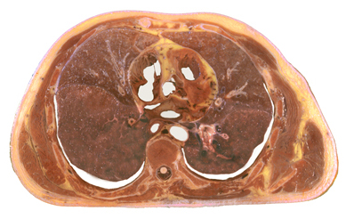
Location of heart
Thoracic cavity
-mediastinum cardiacum
-above the diaphragm
-between mediastinal pleurae
R
L

Slide 37
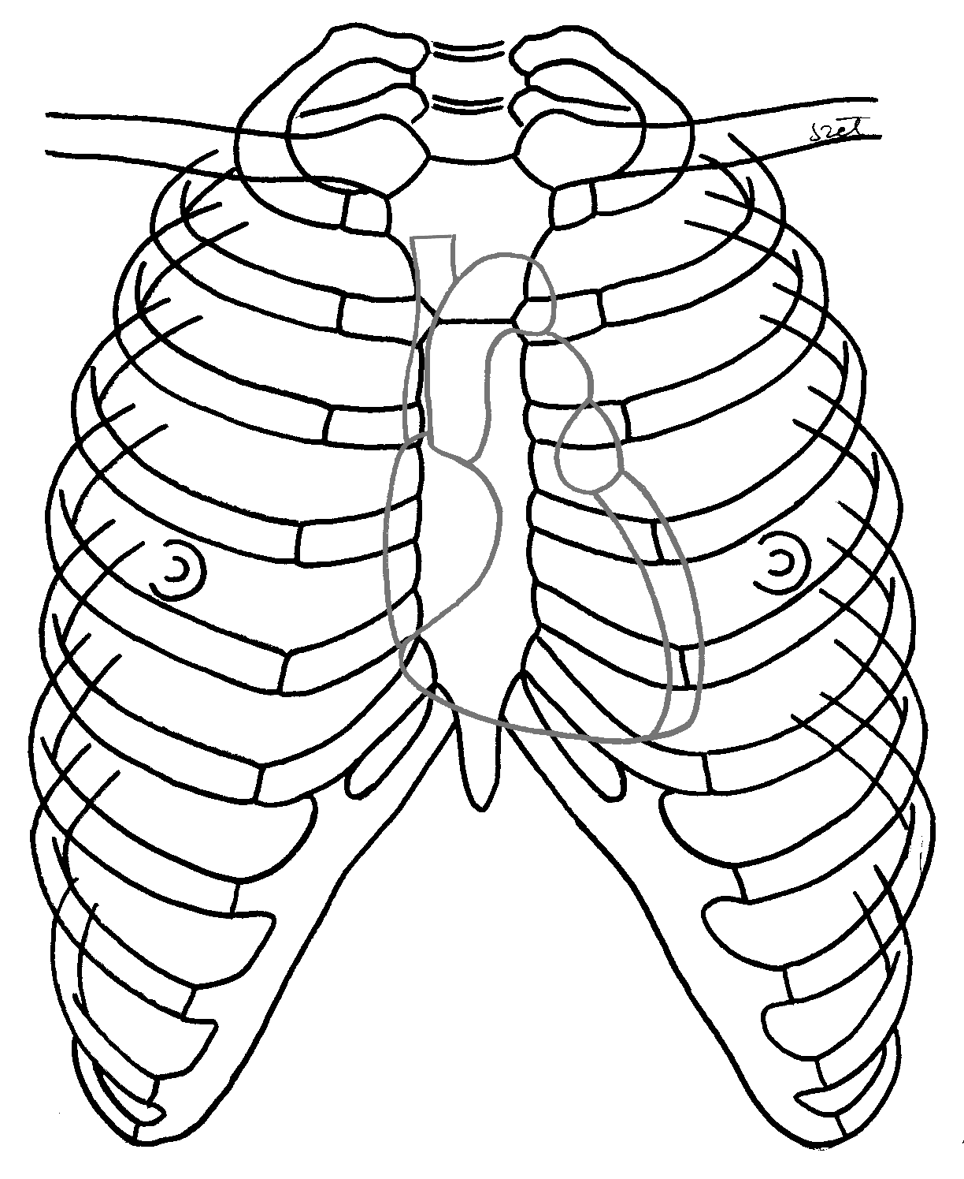
medio-clavicular line
Projection of Heart
mamillary line

Slide 38
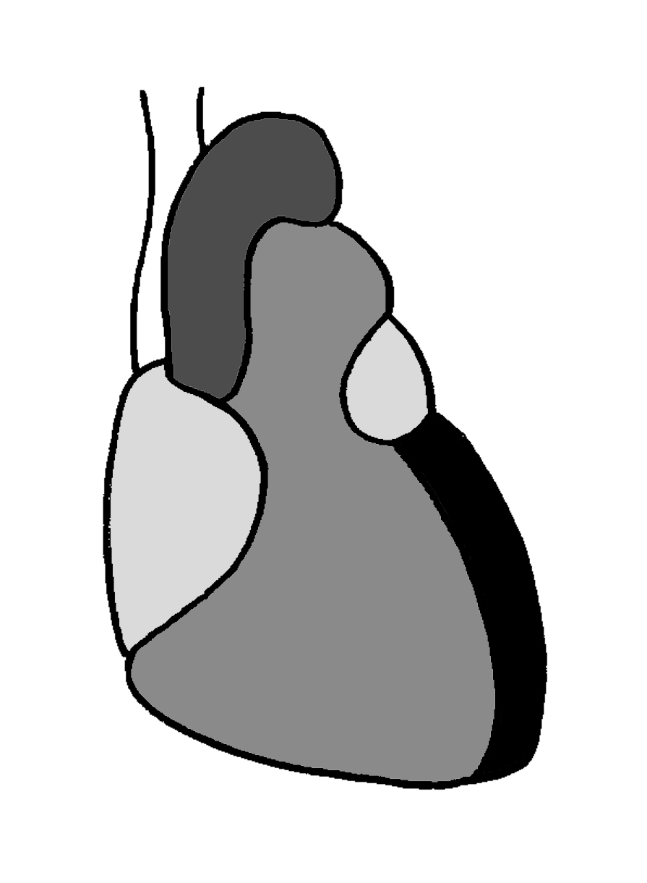
Projection of Heart
left atrium
Site of emptying of superior vena cava into the right atrium
Left projection end of the plane of coronary sulcus
right atrium
left ventricle
right ventricle
Right projection end of the plane of coronary sulcus
Site of apex beat

Slide 39
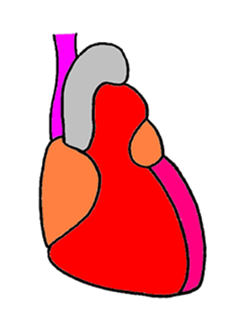
Projection of Heart
left atrium
right side of sternum, level with the 3rd costal cartilage
3 cm to the left from the sternal end of the 3rd costal cartilage
right atrium
left ventricle
right ventricle
2 cm to the right from the sternal end of 6th costal cartilage
9 cm to the left, in the 5th intercostal space

Slide 40
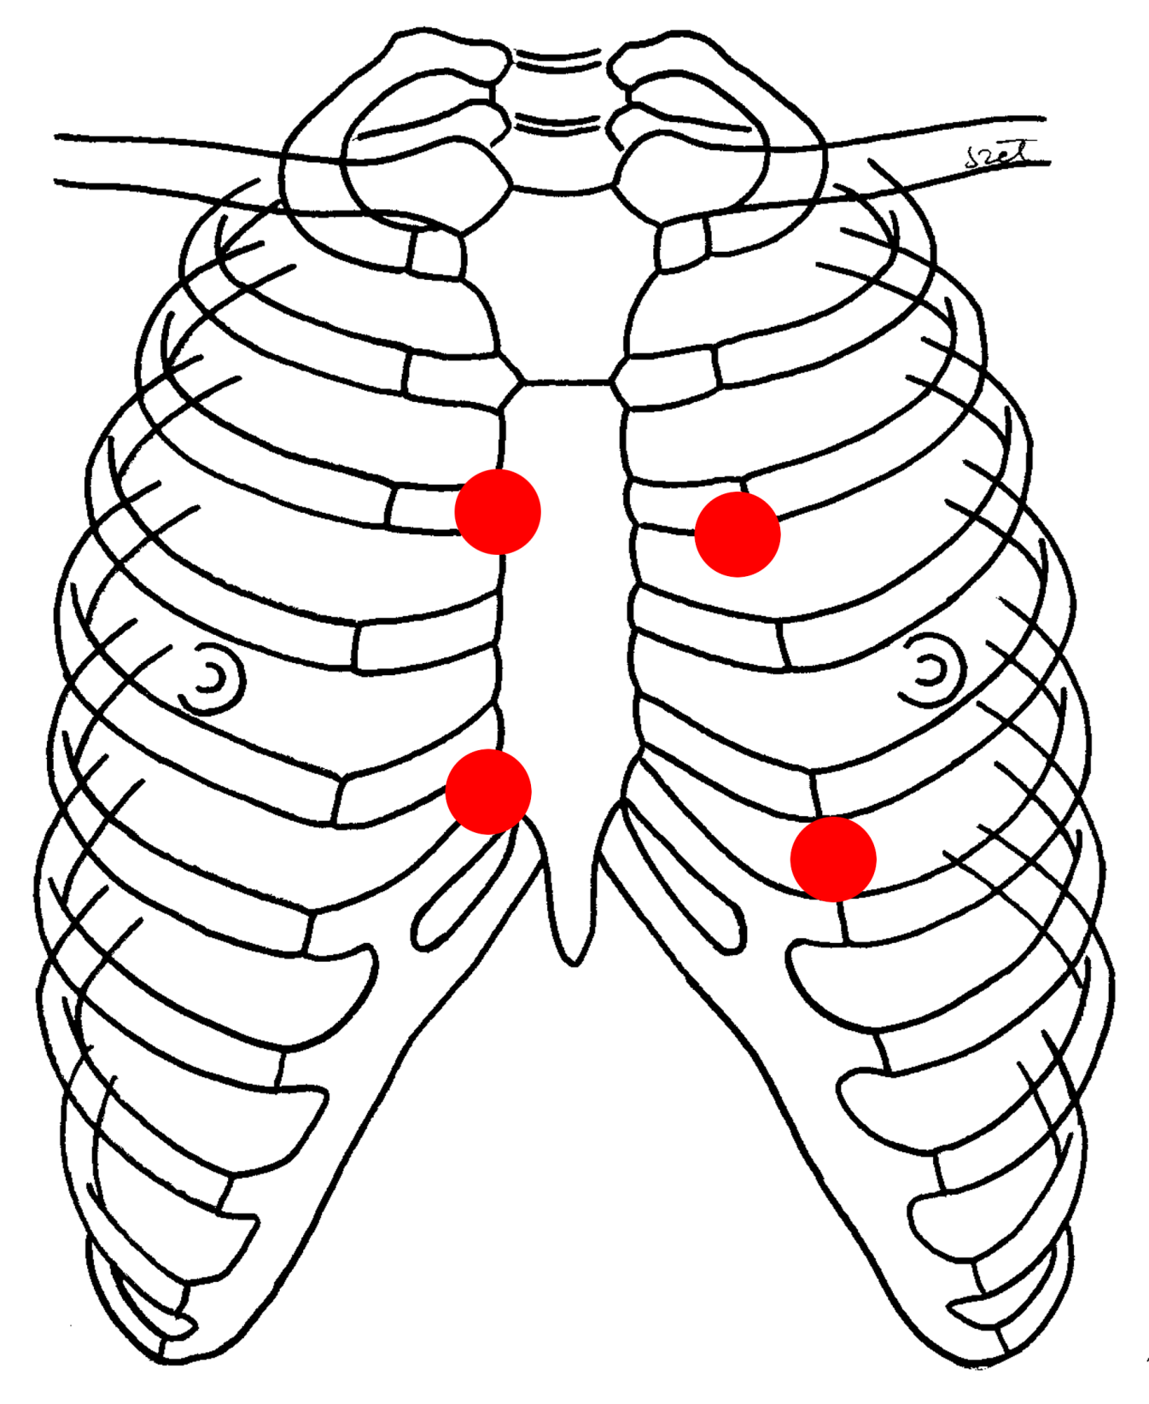
Superior vena cava:
3rd rib,
sternal end
Coronary sulcus:
3rd rib,
3 cm from sternum
Coronary sulcus:
6th rib,
2 cm from sternum
Apex:
5th intercostal space,
9 cm from midline
Notes:
40

Slide 41
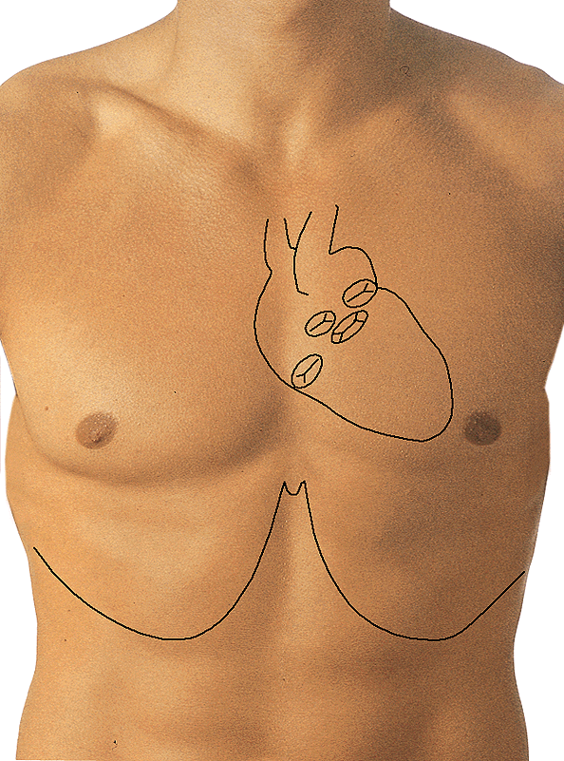
POSITION OF HEART
Superior vena cava:
3rd rib,
sternal end
Coronary sulcus:
3rd rib,
3 cm from sternum
Coronary sulcus:
6th rib,
2 cm from sternum
Apex:
5th intercostal space,
9 cm from midline
Right
Left

Slide 42
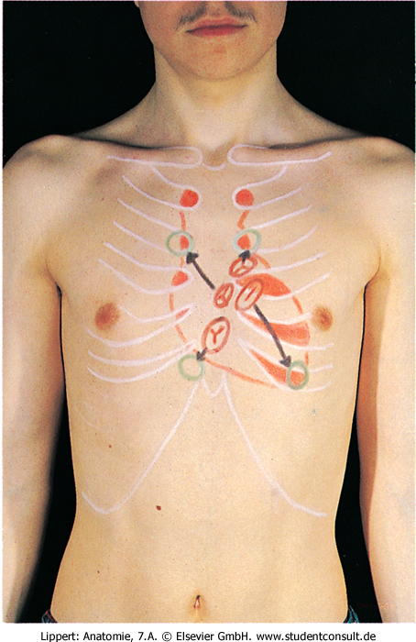
Auscultation points
Aortic valve: 2nd intercostal space right side
  parasternal
Pulmonary valve: 2nd intercostal space left side
parasternal
Mitral valve: 5th intercostal space left side
  9 cm from the midline
Tricuspid valve: 5th intercostal space right side parasternal
Pulmonary valve
Aortic valve
Tricuspid valve
Mitral valve

Slide 43
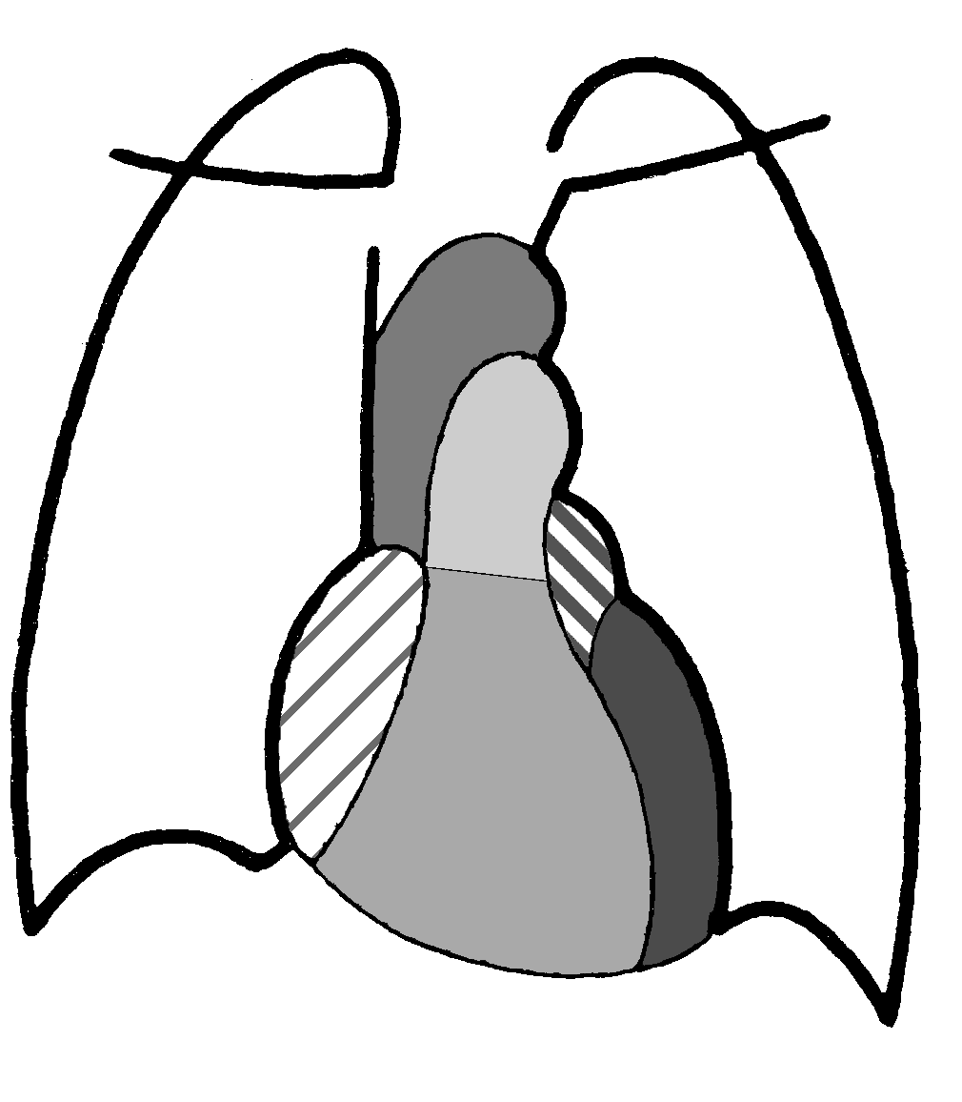
Radiological Anatomy of the Heart
aortic arch
sup. vena cava
pulmonary trunk
left atrium
right atrium
left ventr.
right ventr.

Slide 44
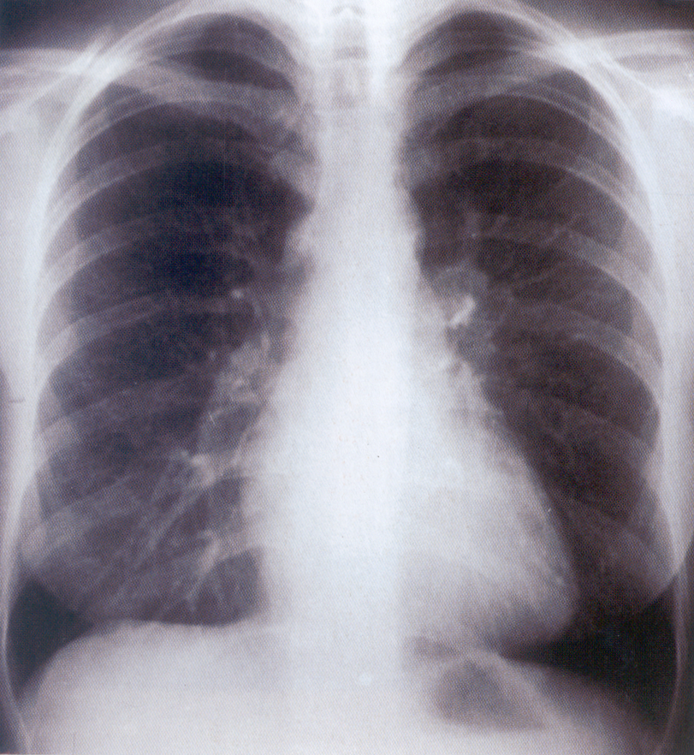
aortic arch
sup. vena cava
pulm. trunk
left atrium
right atrium
left ventr.
right ventr.

Slide 45
Radiological Anatomy of the Heart
right „cardiac sinus”
left „cardiac sinus”
right pericardiaco-phrenic angle
left pericardiaco-phrenic angle

Slide 46
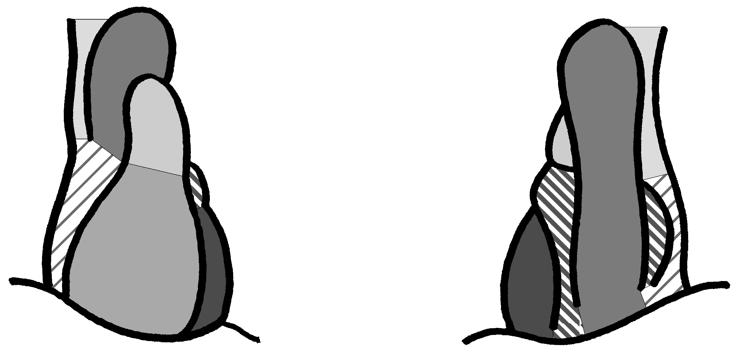
Radiological Anatomy of the Heart
aortic arch
pulmonary trunk
sup. vena cava
right atrium
left atrium
left ventr.
right ventricle
postero-anterior
antero-posterior

Slide 47
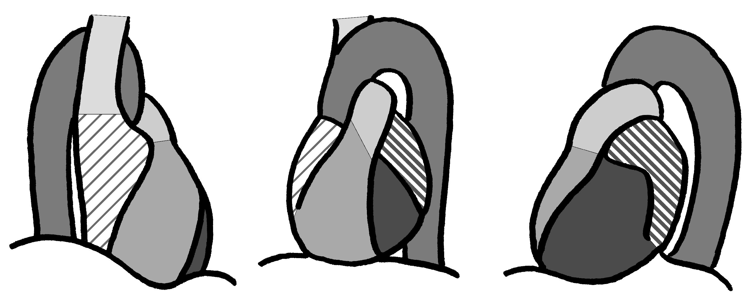
Radiological Anatomy of the Heart
sup. vena cava
aortic arch (aorta-window)
space of Holzknecht
left ventr.
2nd oblique view (boxing-position)
[left side in front]
1st oblique view
(fencing position)
[right side in front]
latero-lateral view
[left side in front]

Slide 48
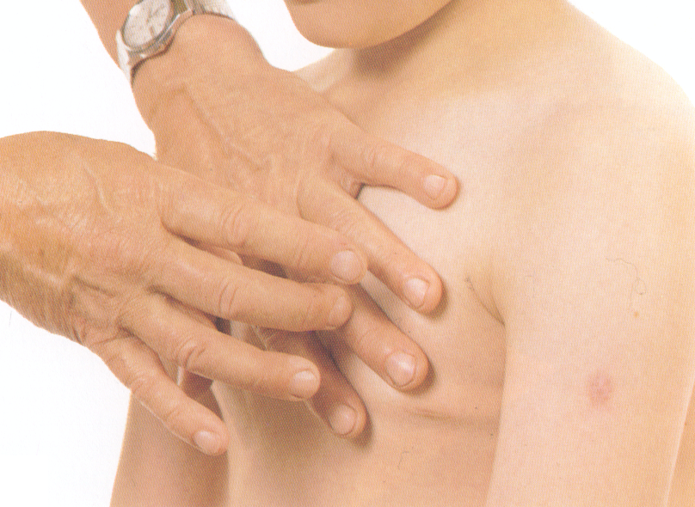
Percussion (Tapping)
sound wave conduction
tapping

Slide 49
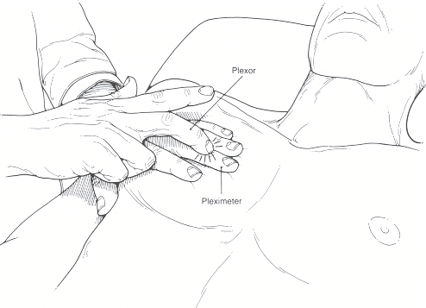
Percussion (Tapping)

Slide 50
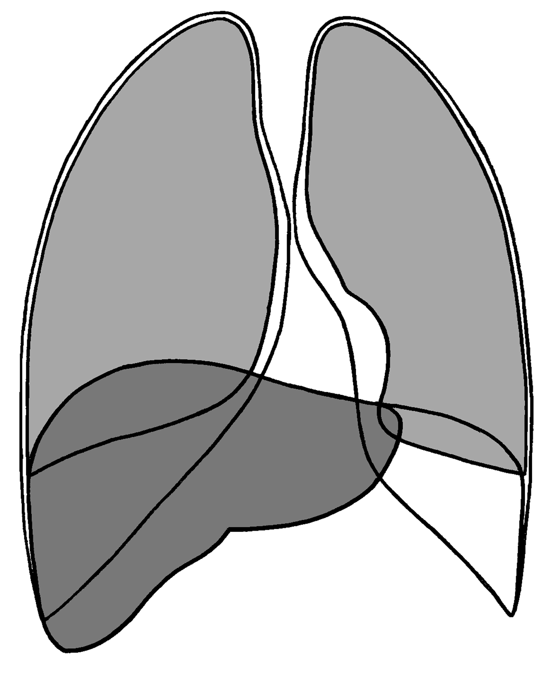
Lung
resonance
Resonance (the sound lasts for long, it is loud and low)
Liver
dullness (the sound is short, high, soft)
Pleura

Slide 51
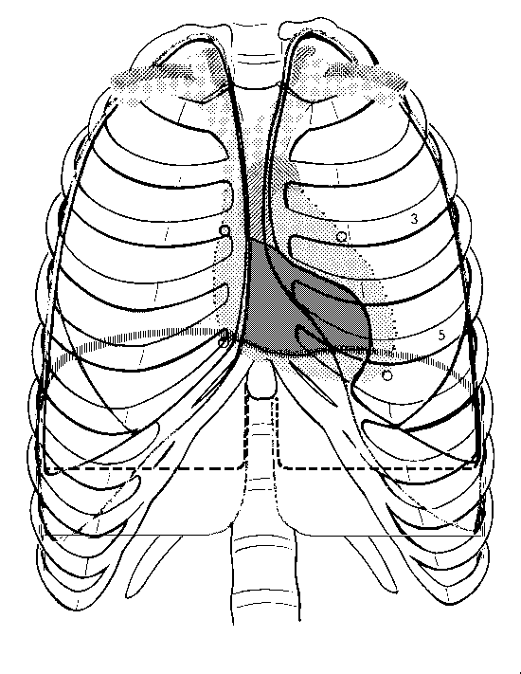
absolute cardiac dullness
relative cardiac dullness

Slide 52
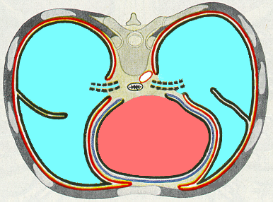
Tapping
Sound Wave Conduction
loud
loud
dullness
sound of the lung (loud)
sound of the lung (loud)
absolute
relative
relative
cardiac dullness

Slide 53
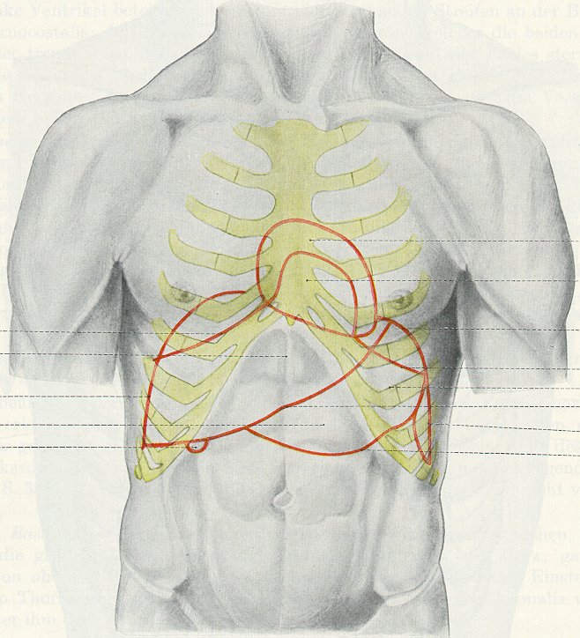
The Cardiac Dullness
relative
cardiac dullness
absolute
liver

Slide 54
Pericardium

Slide 55

Layers of Pericardium I.
fibrous pericardium

Slide 56


Likeness: Tendon and Tendon Sheath
fibrous sheath
synovial sheath (reflection)
synovial sheath
mesotendineum
fibrous sheath
bone + periosteum
mesotendineum (reflection)

Slide 57



Primitive Heart Tube in the Pericardial Sac I.
outflow tract
epicardium (visceral pericardium)
outflow tract
mesocardium
pericardial cavity
transverse sinus of pericardium
fibrous pericardium
parietal pericardium
inflow tract
inflow tract

Slide 58


Primitive Heart Tube in the Pericardial Sac II.
pulmonary artery
aorta
transverse sinus of pericardium
outflow tract
SVC
inflow tract
pulmonary veins
IVC
pericardial cavity
fibrous pericardium
oblique sinus of pericardium

Slide 59

Primitive Heart Tube in the Pericardial Sac III.
outflow tract
transverse sinus of pericardium
serous pericardium (reflection)
fibrous pericardium
inflow tract
serous pericardium (reflection)

Slide 60

Transverse Sinus of Pericardium
aortic arch
superior vena cava
pulmonary artery
transverse sinus of pericardium

Slide 61

Reflection Lines
aorta
pulmonary trunk
SVC
transverse sinus of pericard.
right pulmonary veins
left pulmonary veins
visceral pericardium
IVC

Slide 62

Reflection Lines
aorta + pulmonary artery
transverse sinus of pericardium
oblique sinus of pericardium
caval veins + pulmonary veins

Slide 63

Layers of Pericardium II.
parietal layer of serous pericardium
parietal layer of serous pericardium
visceral layer of serous pericardium

Slide 64

Layers of Pericardium III.
transverse sinus of pericardium
oblique sinus of pericardium

Slide 65
Mediastinum

Slide 66

Subdivisions of mediastinum I.
Angulus sterni
Mediastinum superius
Mediastinum anterius
Pericardium
Mediastinum inferius
Mediastinum medium
Mediastinum posterius

Slide 67

Subdivisions of mediastinum II.
Med.supracardiacum
Mediastinum posterius
Med.cardiacum
Mediastinum anterius

Slide 69

Layers in the mediastinum
supracardiacum
1. Thymus
2. Large veins
3. Phrenic n.
4. Aortic arch branches, vagus n.
5. Trachea
Structures in the posterior mediastinum
Esophagus
Aorta descendens
Azygos-hemiazygos v.
Thoracic duct
Nerves (vagus n., sympathetic trunk, greater and lesser splanchnic nerves)

Slide 73







References

Slide 74
Sources:
Moore, K.L.: Clinically oriented anatomy
Vígh, B.: Szisztémás anatómia
Kahle W, Leonhardt H, Platzer W: Color Atlas/Text of Human Anatomy, 1992, Thieme, Stuttgart
Putz R, Pabst R (editors): Sobotta Atlas of Human Anatomy, 1993, Urban & Schwarzenberg, München
Romanes GJ (editor): Cunningham’s Textbook of Anatomy, 1991, Oxford University Press, Oxford
Szentágothai J, Réthelyi M: Funkcionális anatómia, 2002, Medicina, Budapest

Slide 75


