Slide 1
Introduction, basic tissues, skin
Faculty of Pharmacy
1st Histology practice
Department of Anatomy, Histology and Embryology
2018.

Slide 2
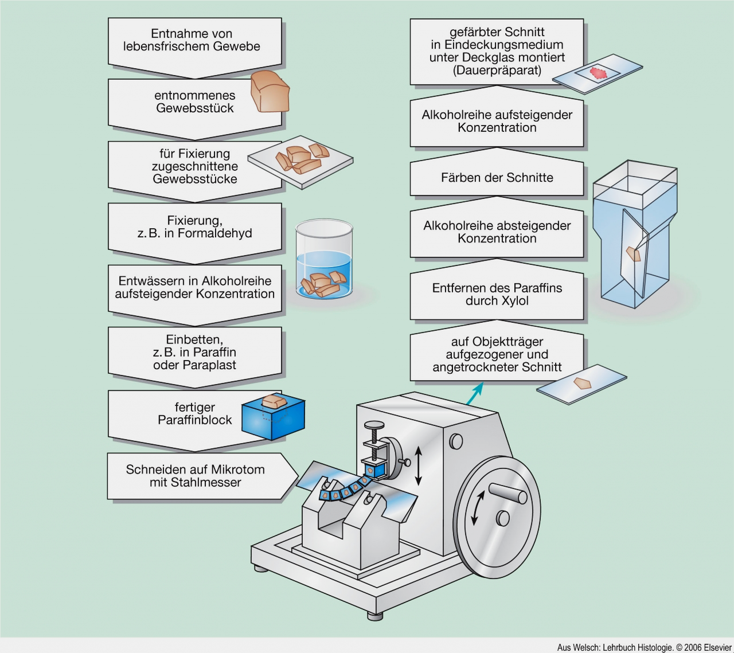
Preparation of histological sections
tissue sample chosen
covering
with
coverslip
tissue piece is taken out
further steps
(alcohol row)
cutting into smaller pieces
staining
fixation e.g. formaldehide
alcohol row,
water
washing,
alcohol row
removal of paraffin with xylene
embedding, e.g. into paraffin
section is put onto glass slide
paraffin embedded block
section cutting with microtome

Slide 3
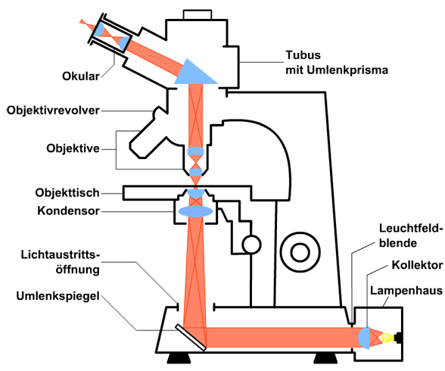
Light microscope

Slide 4
Basic tissues:
Epithelial tissue
Connective and supportive tissues
Muscle tissue
Nervous tissue

Slide 5
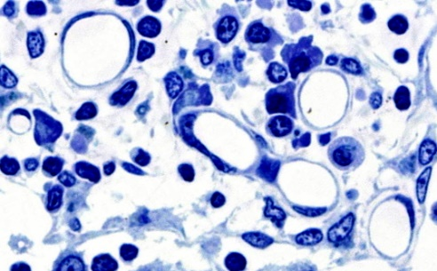
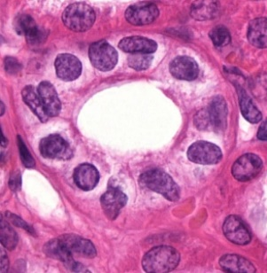
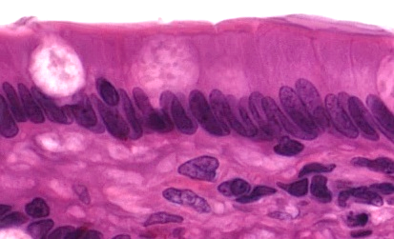
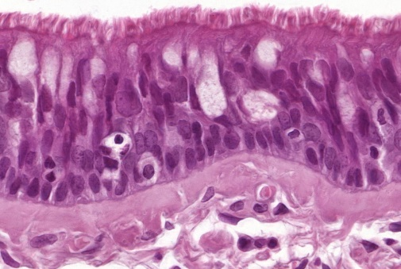
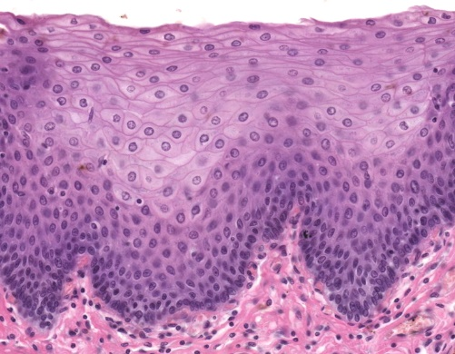
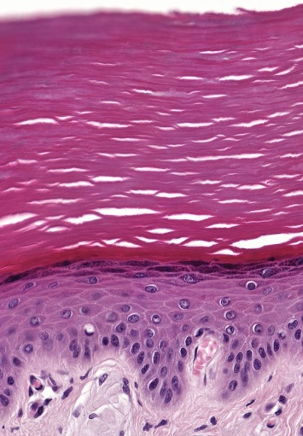
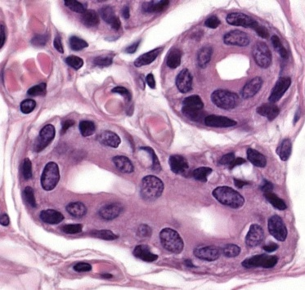
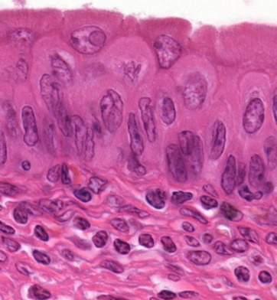
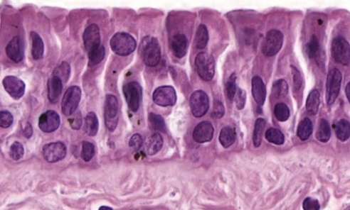
Epithelial tissue:
- Covering epithelia
- simple squamous ep.
- simple cuboidal ep.
- simple columnar ep
-simple, pseudostratified columnar ep.
- stratified squamous non keratinized ep.
- stratified squamous keratinized ep.
- stratified cuboidal ep.
- urothelium
- stratified columnar ep.

Slide 6
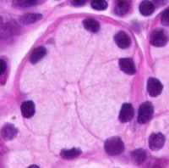
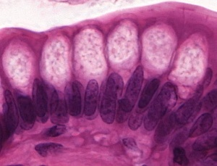
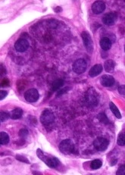
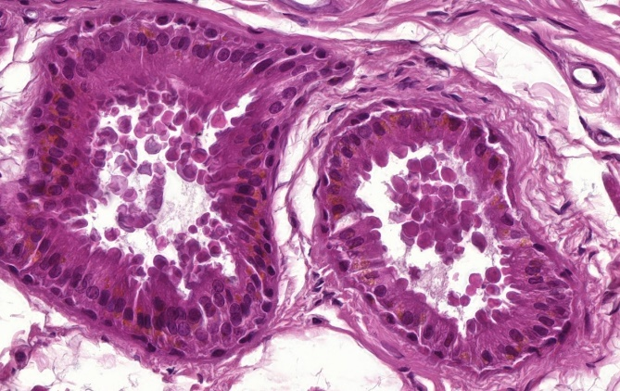
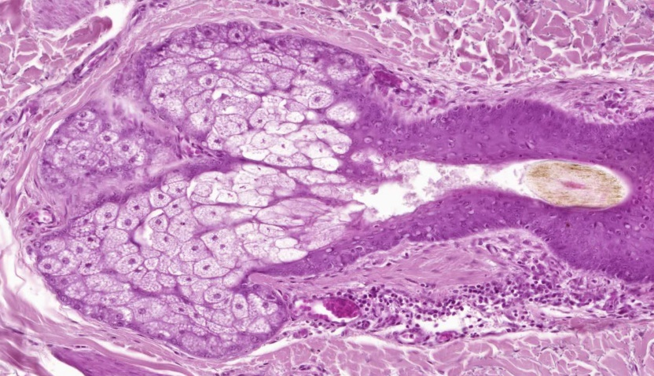
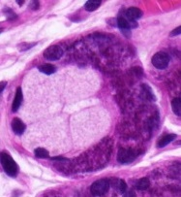
Epithelial tissue:
- Glandular epithelia, classification according to
- discharge of secretion:
- endocrine
- exocrine
- number of cells:
- unicellular (goblet cell)
- multicellular
- secretory unit shape:
- acinar
- tubular
- tubuloacinar
- secretion chemical nature (GI tract glands):
- mucous
- serous
- mixed
- secretion mode:
- merocrine (most)
- apocrine (some)
- holocrine (only sebaceous)

Slide 7
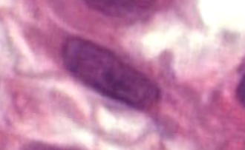
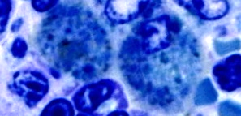
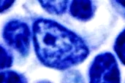
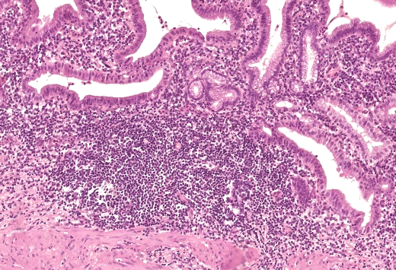
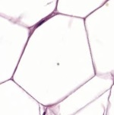
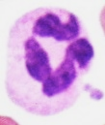
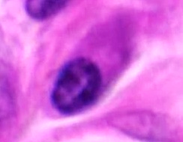
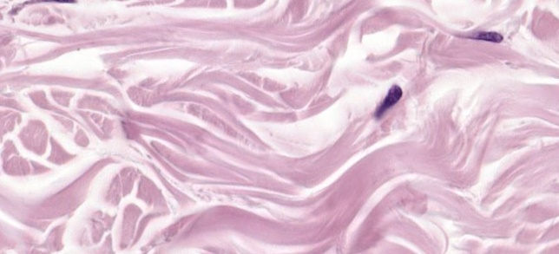
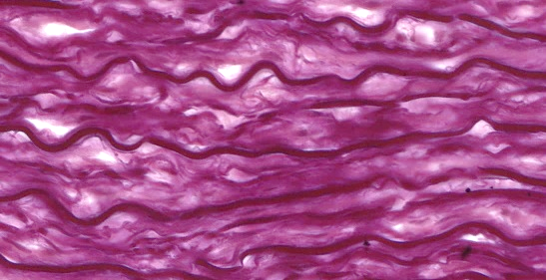
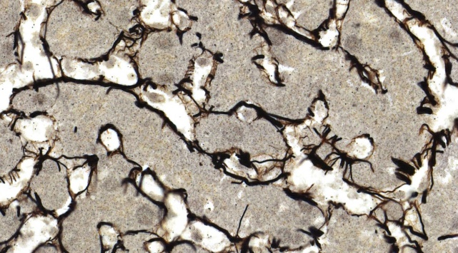
Connective tissue cells:
- immobile, fix cells
- fibroblast
- fibrocyte
- reticulum cell
- adipocyte
- mobile cells
- macrophage
- mast cell
- lymphocyt
- plasma cell
- granulocyte
Connective tissue fibers:
- collagen fiber
- reticular fiber
- elastic fiber

Slide 8
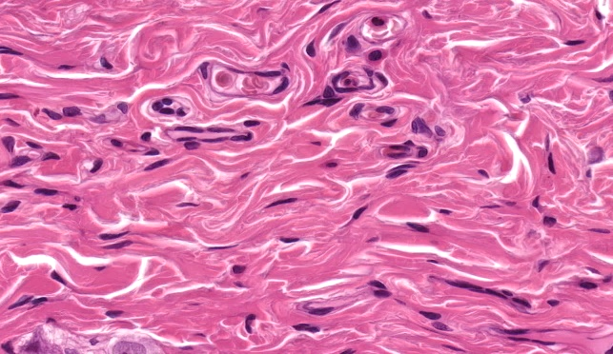
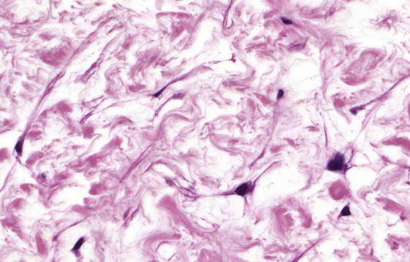
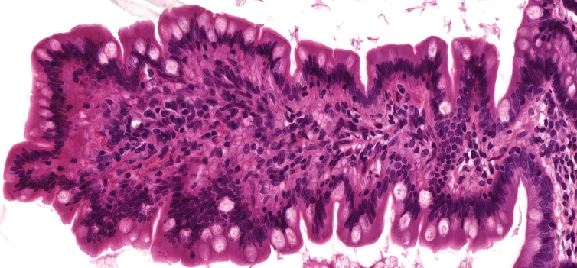
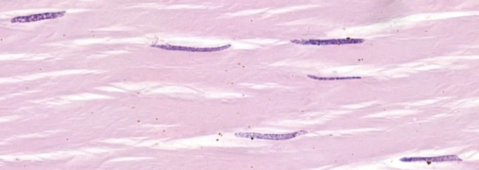
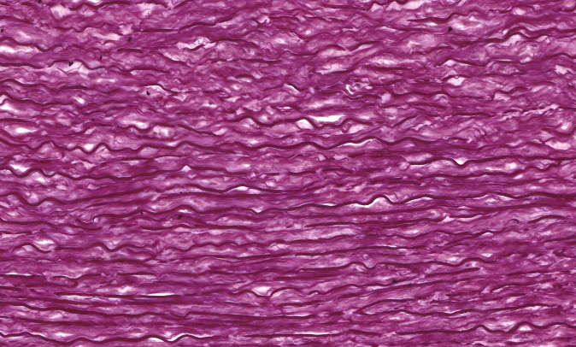
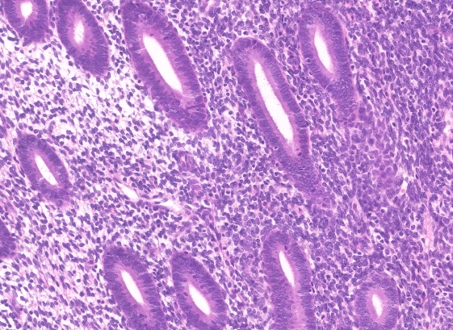
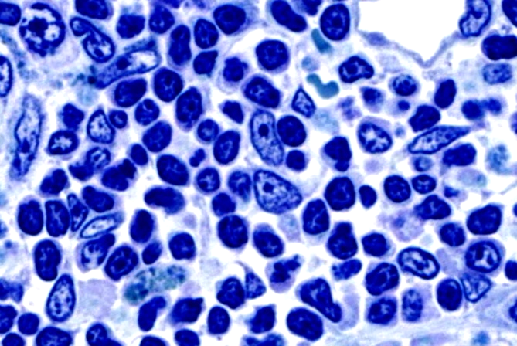
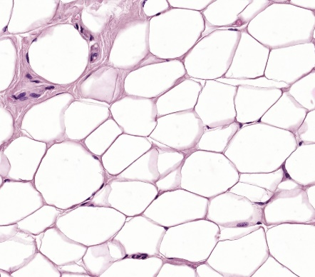
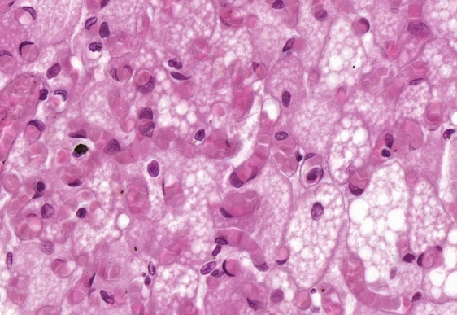
Connective tissue types:
- embryonic conn.t.
- loose conn.t.
- dense conn.t.
- irregular
- regular
- (elasztic conn.t.)
- reticular conn.t.
- cell rich conn.t.
- adipose tissue
- white
- nrown

Slide 9
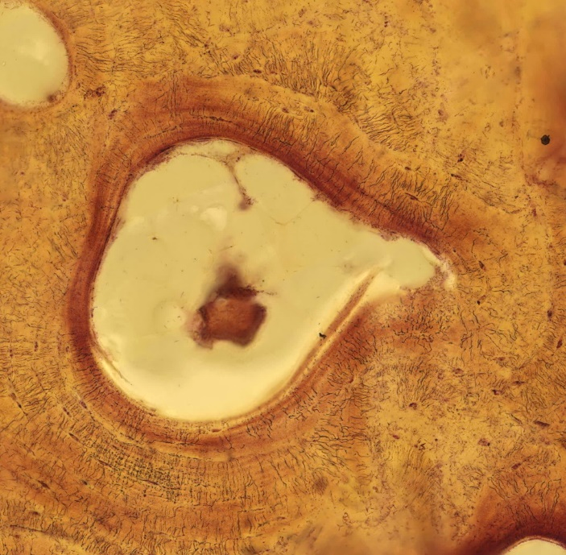
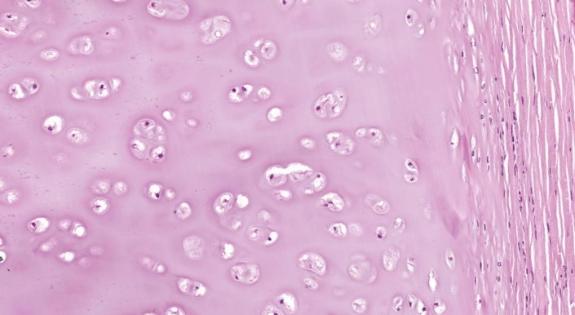
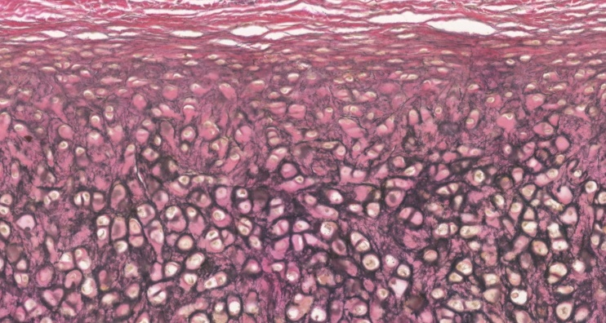
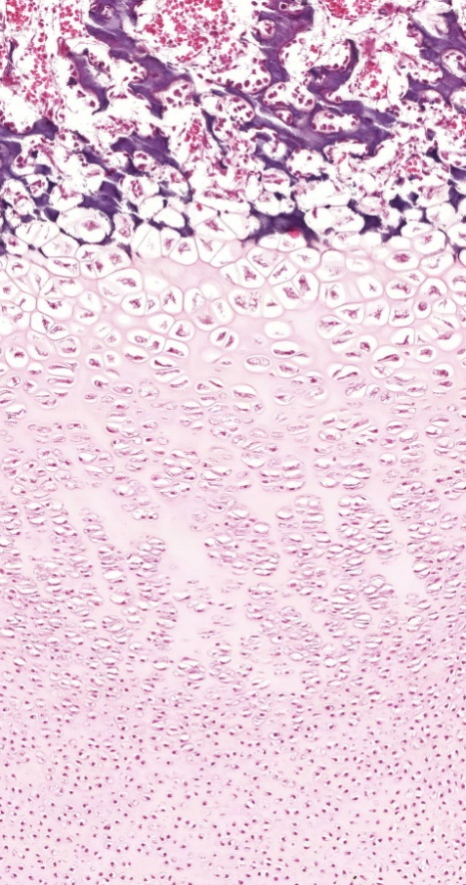
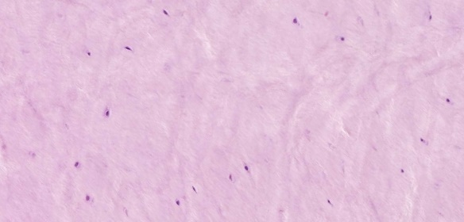
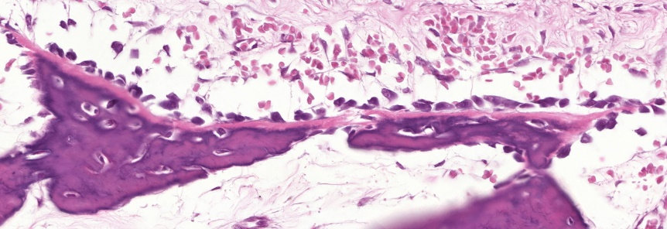
Supporting tissue:
- cartilage:
- hyaline cartilage
- elastic cartilage
- fibrous cartilage
- bone:
- chondral
ossification
- intramembranous
ossification

Slide 10
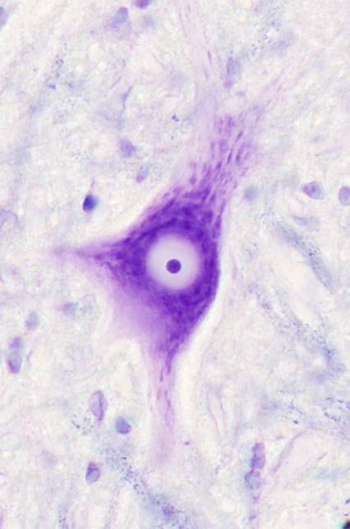
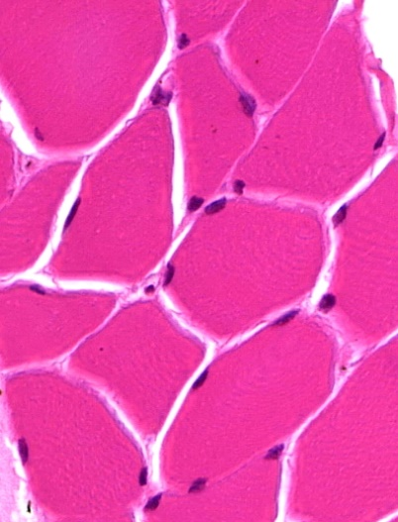
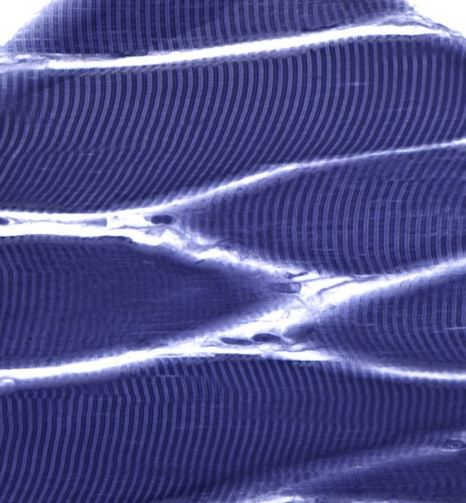
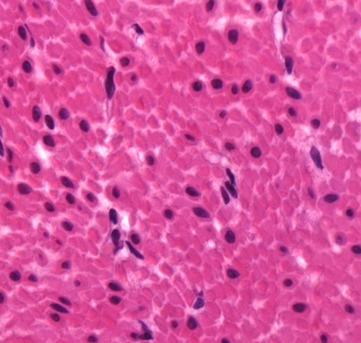
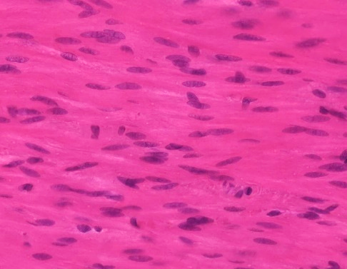
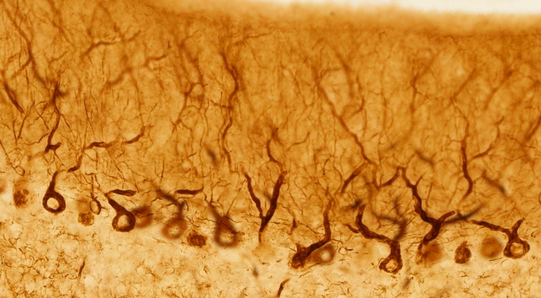
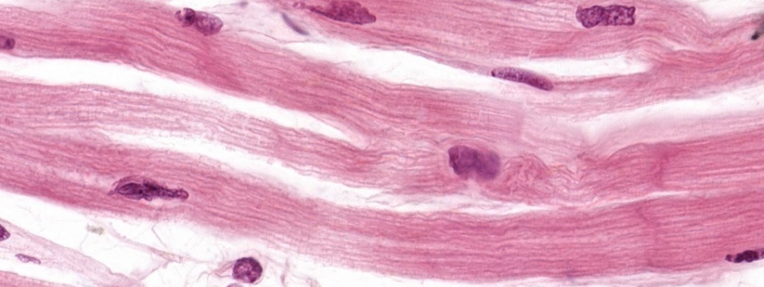
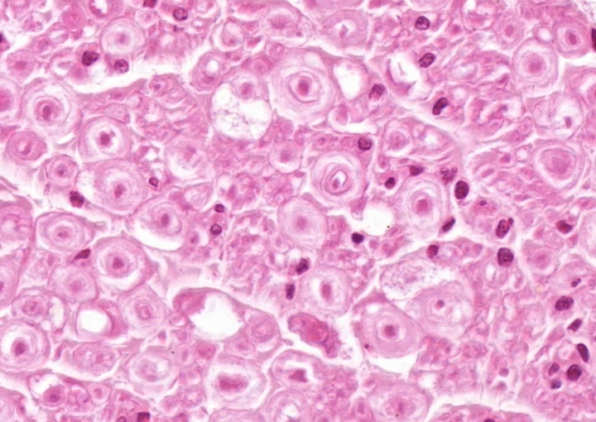
spinal cord
Muscle tissue:
- skelatal, striated muscle
- smooth muscle
- cardiac muscle
Nervous tissue:
- multipolar neurone
- peripheral nerve
- Schwann-cell
cerebellum

Slide 11
Sections and structures to identify

Slide 12
6. Skin (HE)
epidermis
dermis
hypodermis
palm
hairy skin

Slide 13
6. Skin (HE)
Epidermis layers:
stratum corneum
stratum lucidum
stratum granulosum
stratum polygonale
stratum basale
white adipose
tissue
(adipocytes)
kollagen fiber
fibrocyte

Slide 14
25. Bone (Schmorl-staining)
Osteon:
concentric lamella (Haversian lamella)
longitudinal section
Haversian canal
lacuna
+
osteocyte
Volkmann's canal
canaliculus
osseus
cross section

Slide 15
41. Cardiac muscle (HE)
cross section
cardiac muscle cell
cross section
Eberth's line (discus intercalaris )
longitudinal section

Slide 16
101. Spinal cord (luxol-fastblue + cresil violet)
gray matter
multipolar neuron
(alfa-motoneuron)
white matter
Nissl-substance
perykarion
nucleus
(nucleolus)
axon
(axon hillock)
dendrite
myelin sheath

