Slide 1
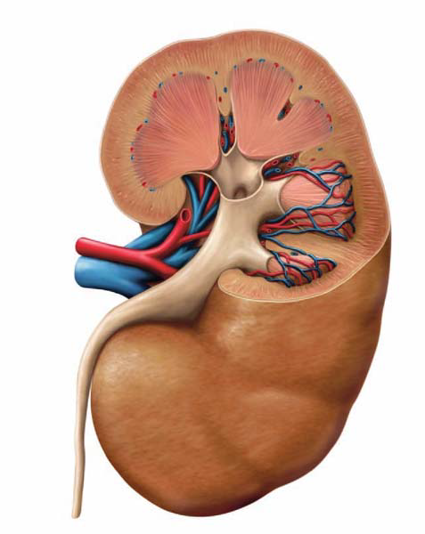
Anatomy of the kidney, ureter and bladder
David Dora
Assistant lecturer
2018. april

Slide 2
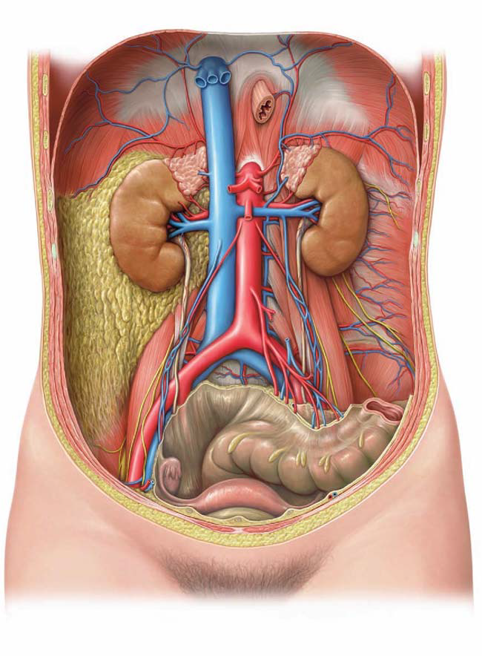
Anatomy of the kidney
Kidneys are paired parenchymal organs with 130-140 grams of mass
Situated in the abdominal cavity retroperitoneally
Left kidney: Th12-L2
Right kidney: L1-L3

Slide 3
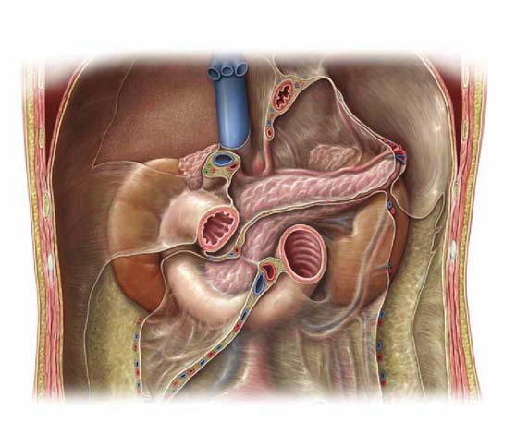
Topography of the kidneys I.
cardia
hepatoduodenal ligament
origin of
mesocolon transversum
superior mesenteric a./v.
cut edge of parietal peritoneum descending colon
cut edge of parietal peritoneum ascending colon
radix mesenterii

Slide 4
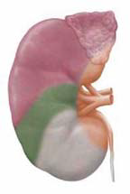
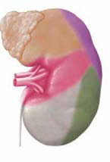
Topography of the kidneys II.
right
left
suprarenal glands
stomach
spleen
liver
renal hilum
pancreas
right colic flexure
duodenum
colon descendens

Slide 5
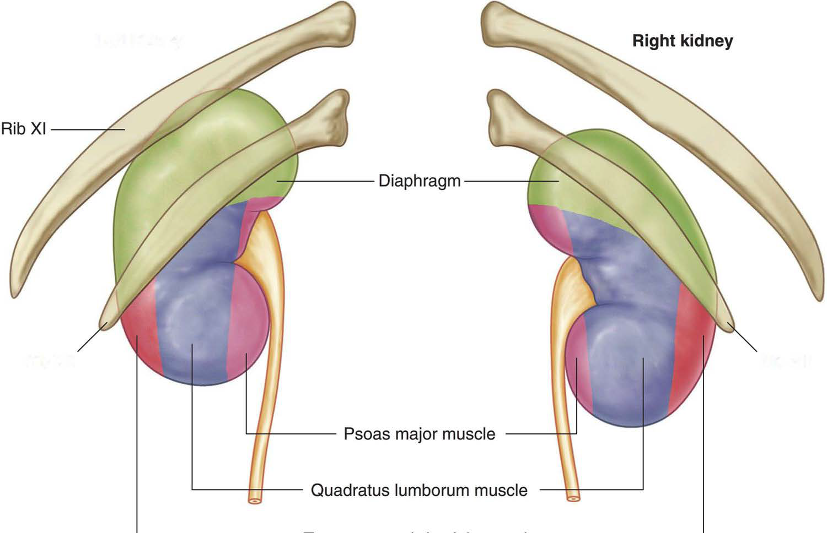
POSTERIOR ASPECT
Right kidney
XI. rib
diaphragm
psoas major
musculus quadratus lumborum
musculus transversus abdominis

Slide 6
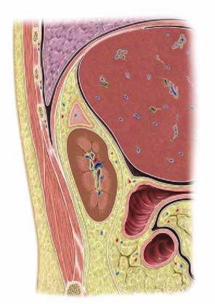
Topography of the kidneys III.
right lung
right suprarenal gland
parietal peritoneum
right kidney
duodenum descending part
renal fascia posterior layer
transverse colon
renal fascia anterior layer

Slide 7
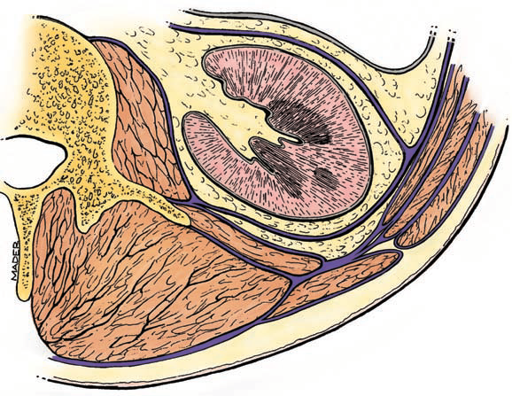
Coverings of the kidney
renal capsule
parietal peritonem
renal hilum
renal fascia ant.
transversalis fascia
sinus
renalis
m. transversus abdominis
psoas major
capsula adiposa
m. obliquus abdominis int.
quadratus lumborum
m. obliquus abdominis ext.
erector spinae
perinephric fat
thoracolumbal Fascia
renal fascia post.
pararenal fat body

Slide 8
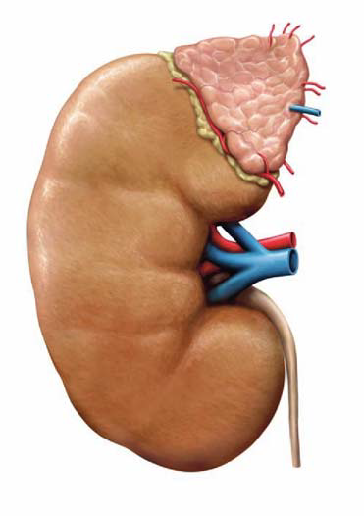
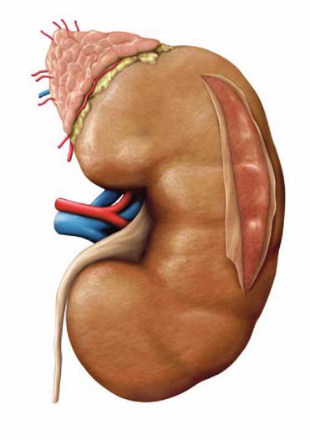
Structure of the kidney I.
ANTERIOR
POSTERIOR
suprarenal gland
Suprarenal arteries sup./med./inf
superior polus
fibrous capsule
renal artery
hilum renalis
hilum renalis
renal vein
renal pelvis
Inferior polus
ureter
Anterior – Posterior order in the hilum: VENA – ARTERIA – URETER → VAU
Superior – Inferior order in the hilum: ARTERIA – VENA – URETER

Slide 9
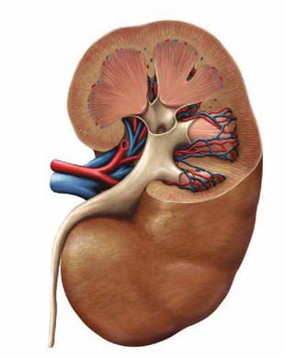
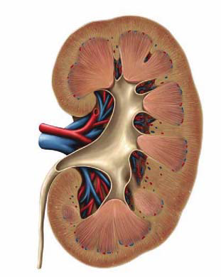
Structure of the kidney II.
cortex
renal pyramid
calyx minor
medullary rays
calyx major
medulla
renal artery and vein
renal papilla
pelvis renalis
ureter
renal columnes „Bertini”

Slide 10
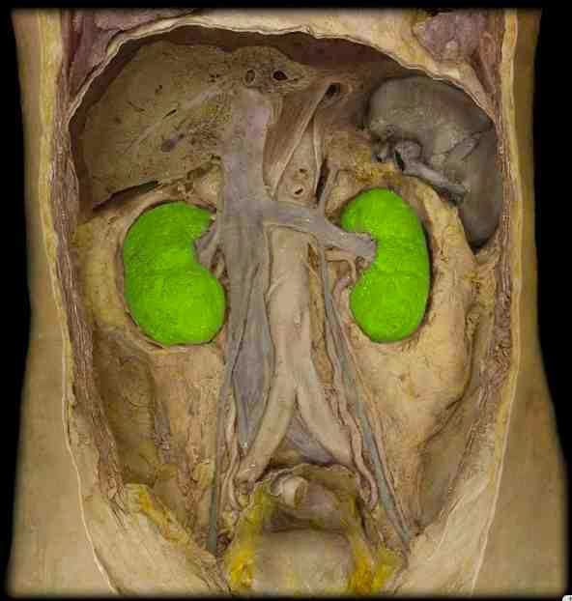
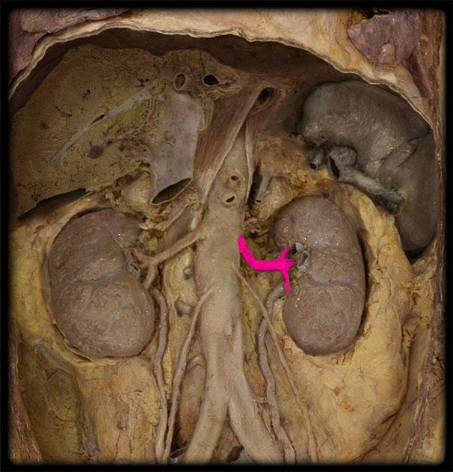
right and left kidney
left renal artery

Slide 11
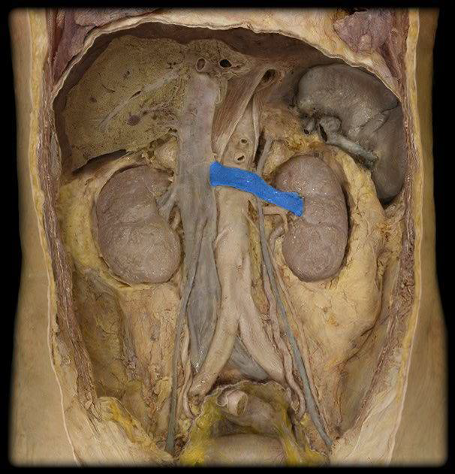
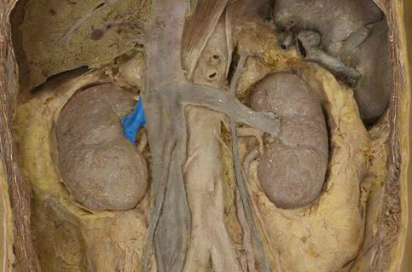
right renal vein
Left renal vein

Slide 12
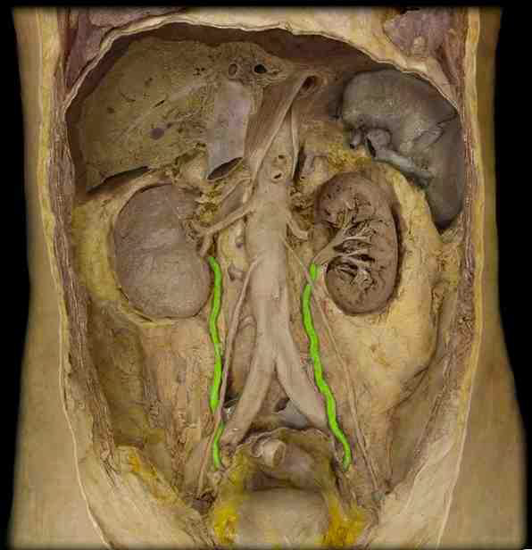
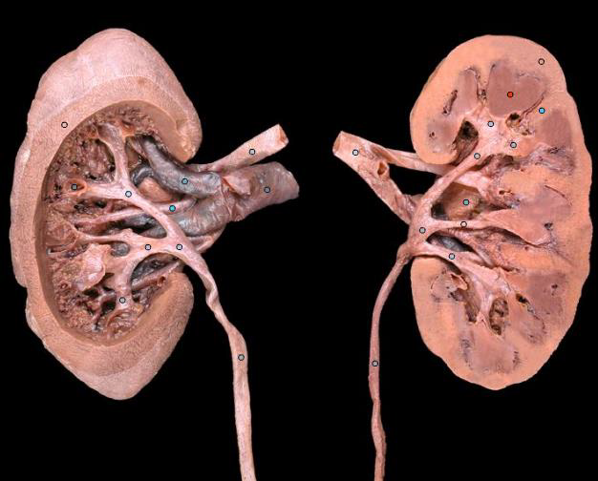
ureters
hilum renalis

Slide 13
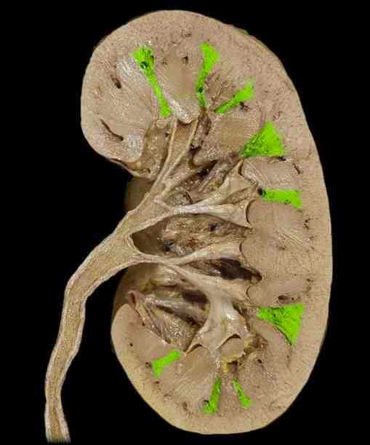
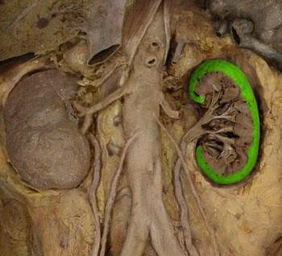
renal cortex
Columns of Bertini

Slide 14
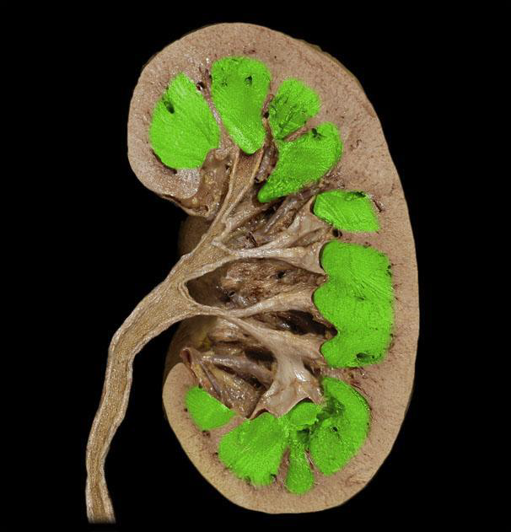
~ 30 renal papillae→ 9 calyces minores → 3 calyces majores → pelvis renalis → ureter

Slide 15
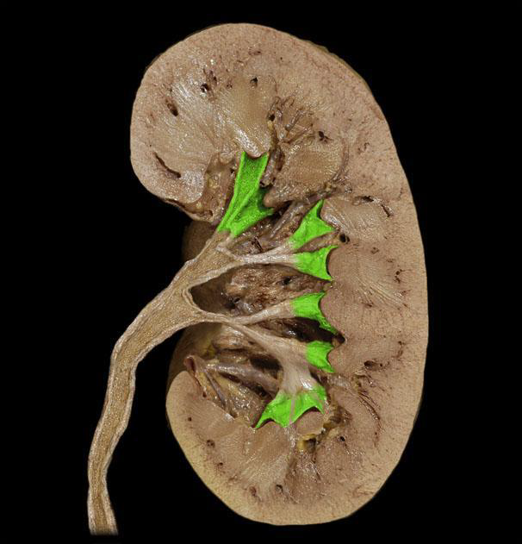
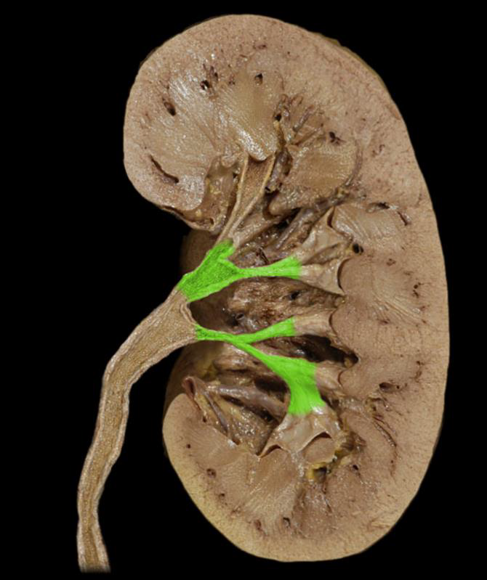
calyces minores
calyces majores

Slide 16
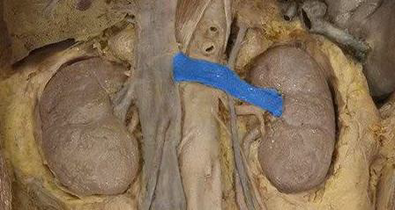
Inferior vena cava
right testicular/ovaric vein
left suprarenal vein
Left renal vein
left testicular/ovaric vein
aorta

Slide 17
Ureter
•retroperitoneal, L2
•lengths: 25-30cm
•parts: abdominal part, pelvic part, intramural part
Crossings:
1. (genitofemoral nerve) – ant.
2. Gonadal a/v - post.
3. Common iliac a., -external and –internal - ant.
4. Uterine a. / vas defferens - post./ inf.
Where’s the ureter from the other?
Physiological constrictions:
1. Renal pelvis – ureter transition
2. (Crossing with gonadal vessels)
3. Crossing with common iliac artery
4. Intramural part

Slide 18
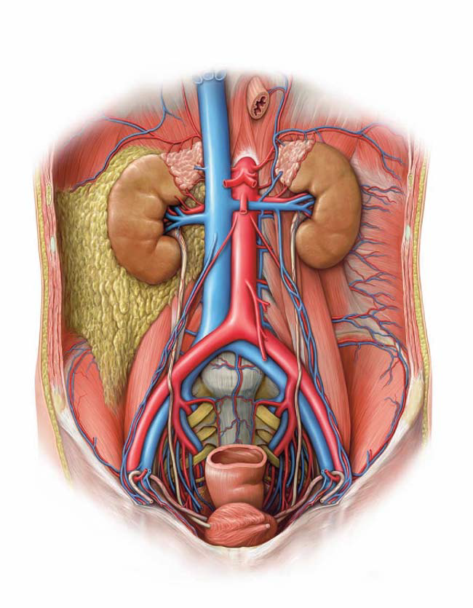
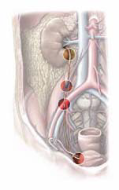

Slide 19
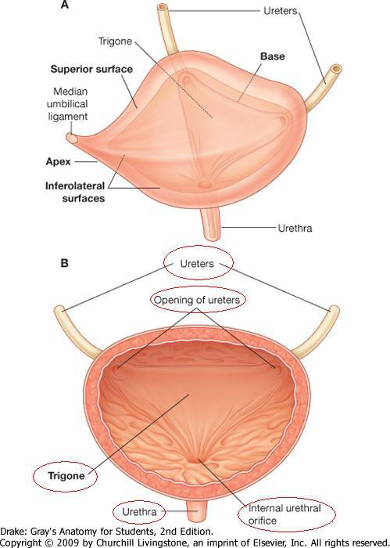
Urinary bladder
- Infraperitoneal
- Parts: fundus-, corpus- and vesical vertex (apex) (lig. umbilicale medianum - urachus)
- Vesical trigone: ureteric ostia, internal urethral orifice
- Volume: 300-350 ml
- Blood supply: superior vesical arteries, inferior vesical artery (branches of internal iliac artery)

Slide 20
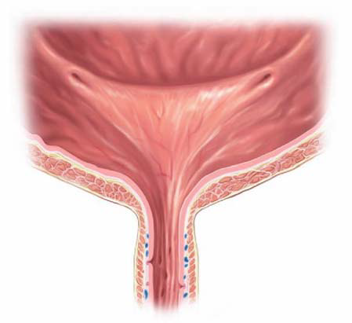
interureteric fold
intramural part of right ureter
intramural part of left ureter
ureteric orifice
vesical trigone
detrusor muscles
neck
internal vesical sphincter
internal urethral orifice

Slide 21
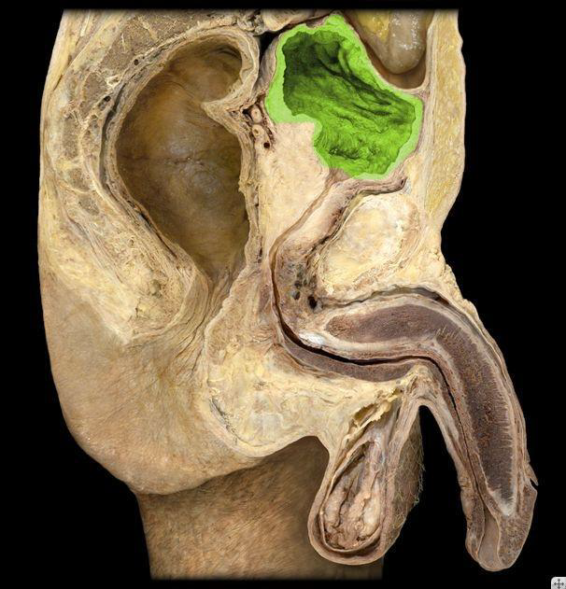
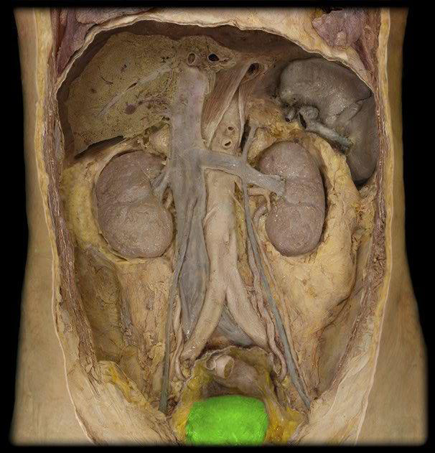
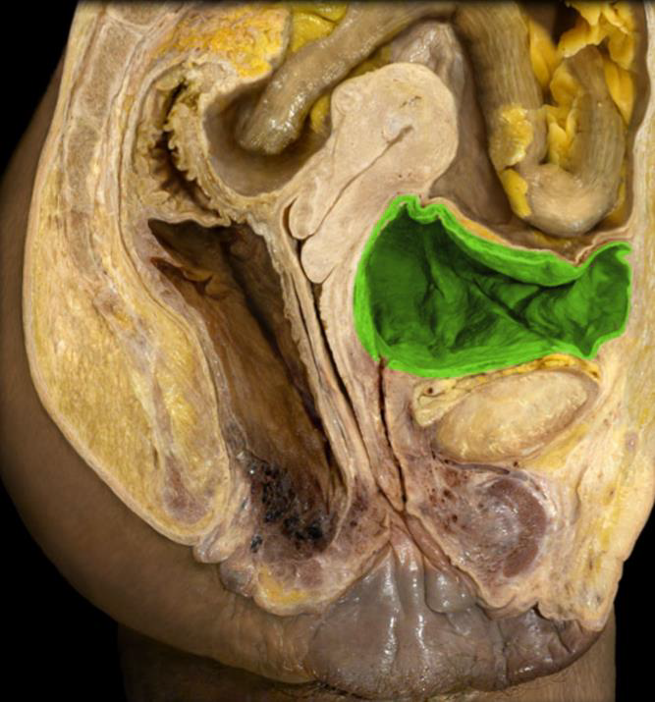
rectum
prostate
urethra
aorta
ureter
uterus
rectum
rectum
bladder
vagina
urethra

Slide 22
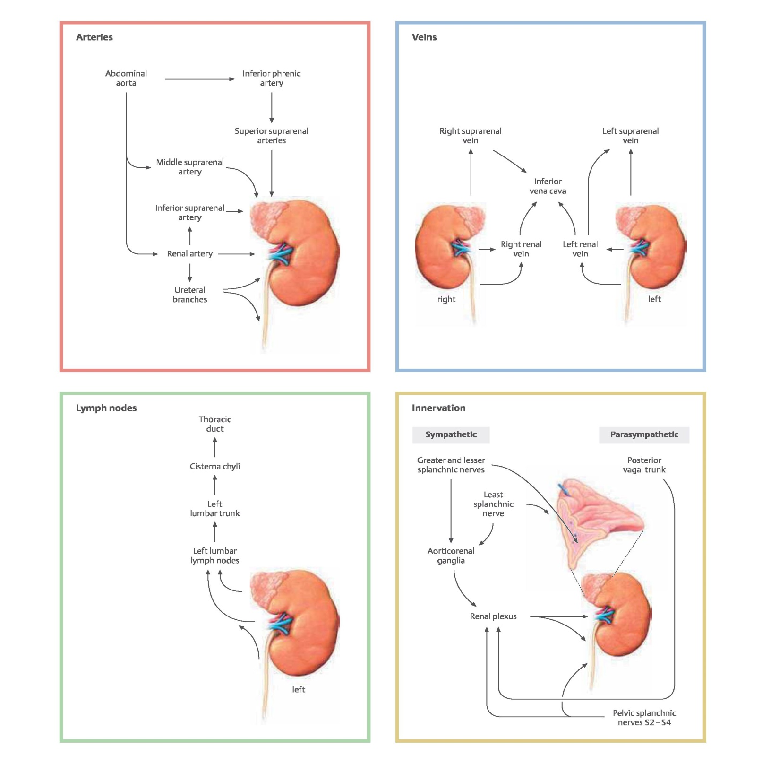

Slide 23
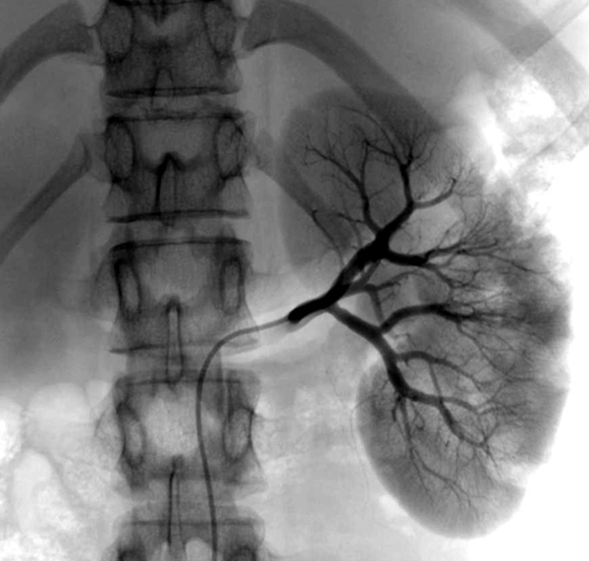
Thank you for your attention!
References:
Gray’s Anatomy for Students
Thieme: Atlas of Anatomy, Neck and Internal Organs
Grant’s Atlas of Anatomy 13th edition
studyblue.com

