Slide 1
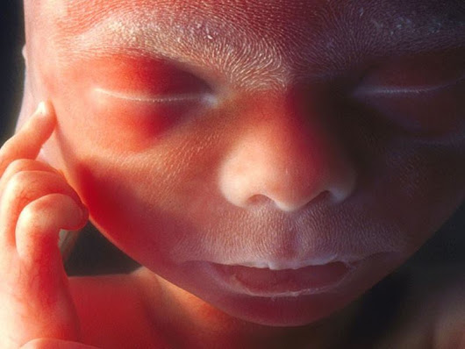
Entwicklung der Haut und
Hautanhangsgebilde
Attila Magyar
13.02.2018

Slide 2
Zellbiologie des adulten Epidermis

Slide 3
Epidermis
Mehrschichtiges, verhorntes Plattenepithel
VERHORNUNG: sehr spezieller zellbiologischer Vorgang
Bedeutung: Mechanische und chemische Unterstützung der unter dem Epidermis liegenden Geweben.
Zeitdauer: von Str. basale bis Str. corneum: 2 Wochen (Maus); Mensch: bisschen länger
täglich abgelöste Hornschuppen: 1,5 g. Wichtiger Teil von Hausstaub!

Slide 4
Verhornung
Spezieller Art der Apoptose (Kornfikation)
Apoptotische Zellen bleiben zeitweise als Hornschuppen erhalten
Sie verlieren alle ihrer Organellen!

Slide 5
Verhornung
Was bleibt erhalten?
- Zytoskelett (aus sehr dicken Keratinfilamenten = Tonofilamenten),
-spezielle intrazelluläre Hülle aus zytoskelettalen
Strukturen (cornified envelop, innere
Hornhülle),
-spezielle, chemisch sehr resistente Lipide, die eine extrazelluläre Hülle (lipid envelop) bilden, worin die Hornschuppen eingebettet sind,
- spezielle Desmosomen (Korneodesmosomen) zwischen Hornschuppen

Slide 6
Spezifische Strukturen in Hornschuppen I.
Programmierter Zelltod, aber nich Apoptose genannt, sondern Cornification
Extrem hohe Menge von IF: Cytokeratine
Spezielle Packungsproteine dafür: Filaggrin.
An der Innenseite der Zellmembran: aus dem Inhalt von Keratohyalin Granulen entsteht die cornified envelop, die 10 nm dick ist und aus Involucrin, Loricrin, cross-linked durch Transglutaminase (diese wird durch Ca aktiviert); auch an Keratin Filamente aufgebaut ist.

Slide 7
Spezifische Strukturen in Hornschuppen II.
Aussenseite der Zellmembran: kovalent-gebundene Lipide (sehr lange ω-Hydroxyceramide): lipid envelop
Zwischen der Hornschuppen: lipid domain aus exozitirte Lamellenkörper (Liposomenartig angeordnet)

Slide 8
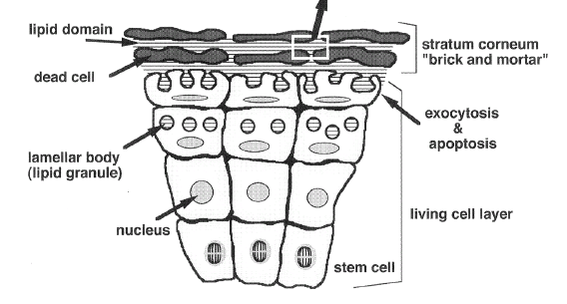
Ziegelstein und Mörtel
Denda, Forma 2000
Notes:
The most important role of the skin for terrestrial animals is to protect the water-rich internal organs from the dry environment. This cutaneous barrier function resides in the upper most thin layer (approximately 10–20 μm in humans) called stratum corneum. The water impermeability of this layer is 1000 times-higher than that of other membranes of living organisms (POTTS and FRANCOEUR, 1991). This is the same level as that of a plastic membrane with the same thickness (TAGAMI, 1998). The stratum corneum is composed of two components, i.e., protein-rich nonviable cells and intercellular lipid domains (ELIAS et al., 1993). The lipid molecules in the intercellular domain form a bilayer structure (Fig. 1). The water impermeability is due to the conformation of the lipid molecules and also the order of the dead cells (DENDA et al., 1994). Because of this specific “brick and mortar” (tégla és habarcs) structure, the stratum corneum shows high water impermeability.

Slide 9
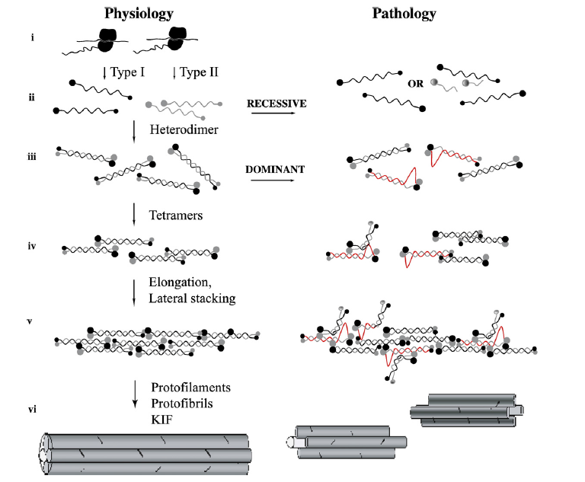
Notes:
Uitto, Exp Cell Res 200
Schematic representation of the physiology of keratin intermediate filament (KIF) assembly (left panel) and mechanisms
of genetic perturbations that can lead to KIF pathology (right panel). Under physiologic conditions, the keratin mRNAs are
translated on the ribosomes of epithelial cells to synthesize type I and II keratins (i). In the cytoplasm, type I and type II keratin
polypeptides heterodimerize (ii) and align in parallel and registry (iii). Pairs of heterodimers align in an anti-parallel,
overlapping fashion to form tetramers (iv), which polymerize to elongated chains (v) and form the KIFs through lateral packing
(vi). The presence of a mutation in a keratin gene can lead to different pathological processes (right panel). As an example, in
autosomal recessive disorders, a mutation that introduces a premature termination codon or affects mRNA splicing can result
in the synthesis of a truncated polypeptide (ii). Concomitant nonsense-mediated mRNA decay or enhanced degradation of the
truncated polypeptides can result in absence of the mutant protein and lack of formation of the corresponding heterodimers
and KIF, resulting in haploinsufficiency. Alternatively, the persistence of truncated altered keratin polypeptides can prevent
heterodimer formation and KIF assembly. In autosomal dominant keratin disorders, most mutations result in non-conservative
amino acid replacement at sites of high sequence conservation (iii). The mutant keratin polypeptides then interfere in a
dominant negative manner with head-to-tail interactions and proper alignment of heterodimers (iv), as well as a elongation
and lateral packing during KIF assembly (v), thus producing a severe phenotype. Mutations with a less severe phenotype often
reside outside the helix boundaries and may have a more subtle effect on KIF assembly or may affect keratin phosphorylation
or interactions with other proteins (Modified from Uitto et al., Epidermolysis Bullosa; in Principles of Molecular Medicine
(Runge, M.S. and Patterson, C., Eds.), Humana Press, Totowa, NJ, Second Edition, pp. 1024–1034, 2006).

Slide 10
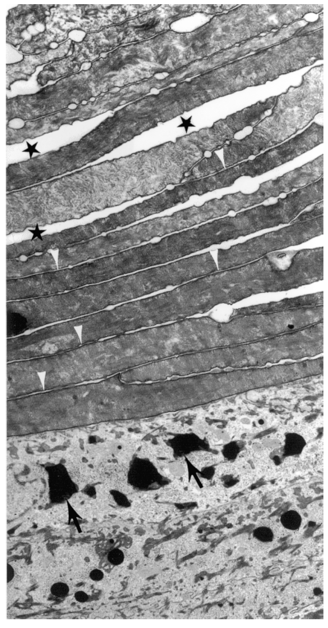
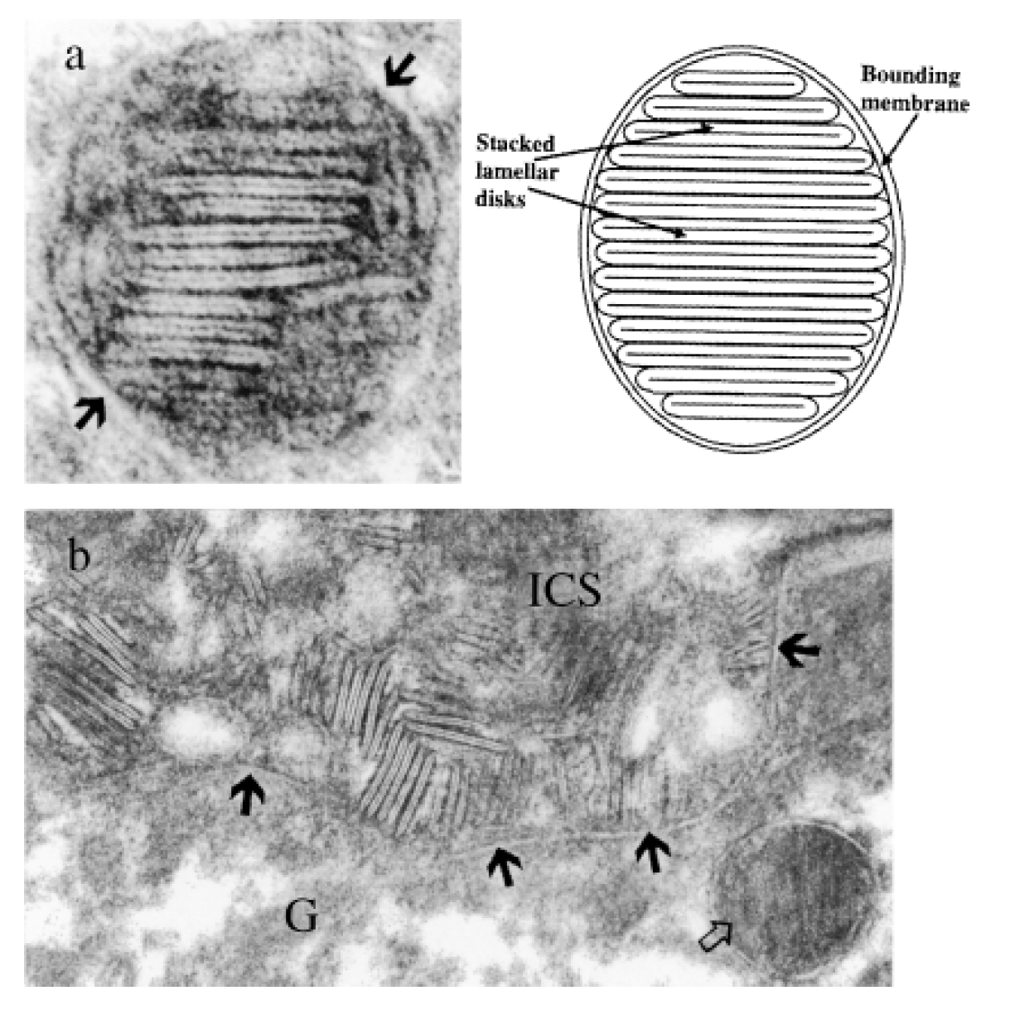
Lamellenkörper (leerer Pfeil); Interzellulärraum (ICS); G: Str. granulosum-Zelle
Madison J Invest Dermatol 2003
Notes:
Bal oldali nagy kép:
Figure 1. Electron micrograph showing the upper stratum granulosum and SC of an organotypic mouse keratinocyte culture. Arrows, keratohyalin granules; arrowheads, intercellular spaces between closely opposed corneocytes; stars, artifactual separation. The intercellular spaces appear empty in this osmium tetroxide postfixed specimen. Original magnification 6000x.
Jobb oldali képek: electron micrograph of a single Lamellar Granules (LG) in mouse epidermis. A lower magnification view of the same LG was used in a previously published figure (Madison et al, 1987). Arrows, bounding membrane. Original magnification x300,000. Right: a schematic diagram of a LG as suggested by Landmann (1986). (b) Electron micrograph of extruded LG contents in the intercellular space at the junction of the granular layer and the SC. G, granular cell; ICS, intercellular space; Arrows, granular cell plasma membrane; open arrow, LG. Original magnification x 125,000.

Slide 11
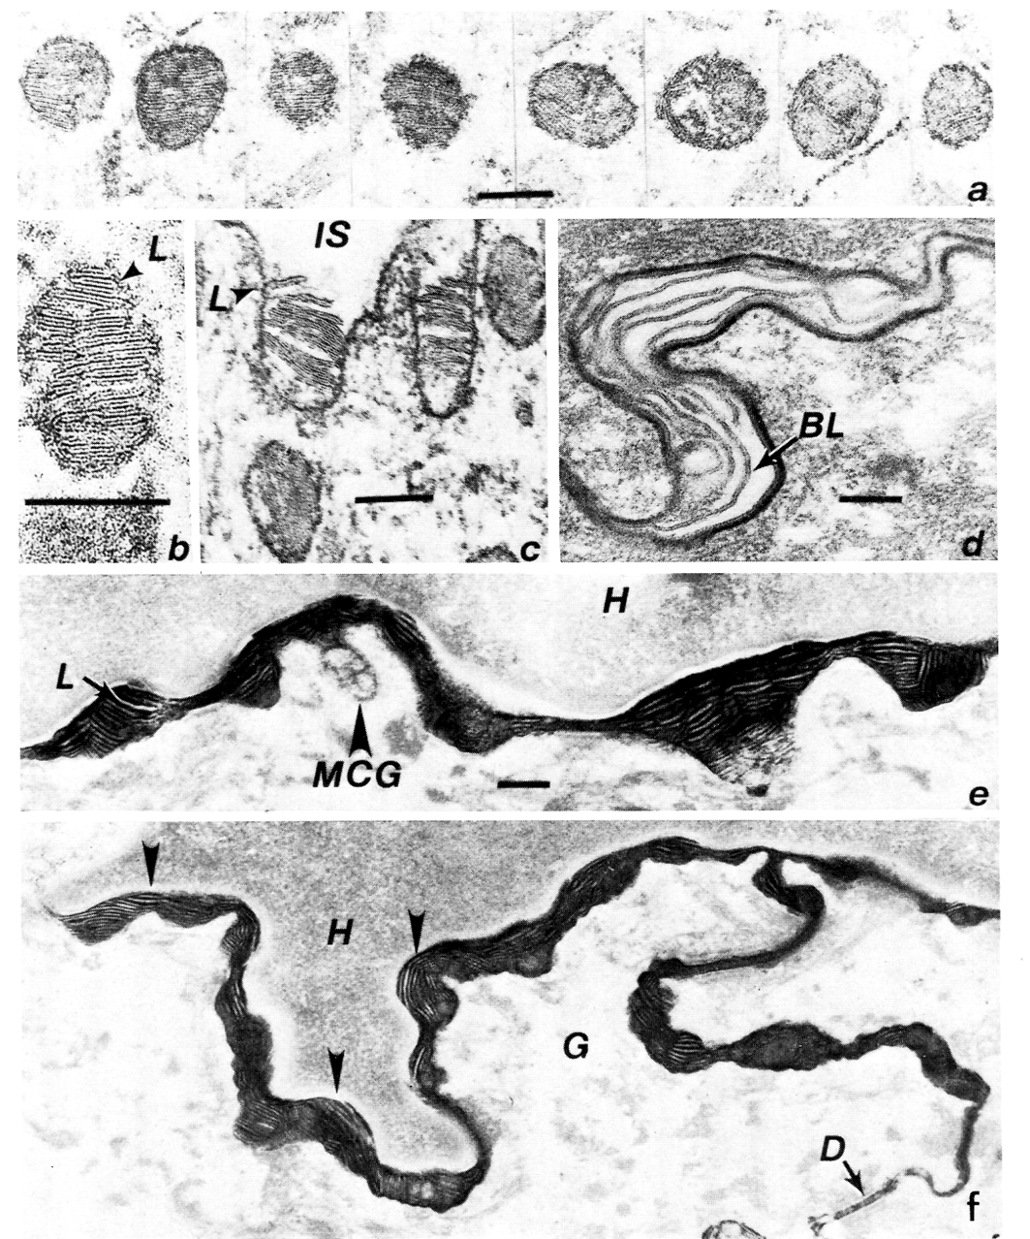
An dieser Abbildung steht MCG für Lamellenkörper
Menschliche Haut
a: verschiedene LK
c: entleerung des LKs in den ICS
d: verlängerte Doppellamellen im ICS (bileaflets, BL)
Matoltsy, Biology of the integuments 2 Vertebrates, Springer, 1986

Slide 12
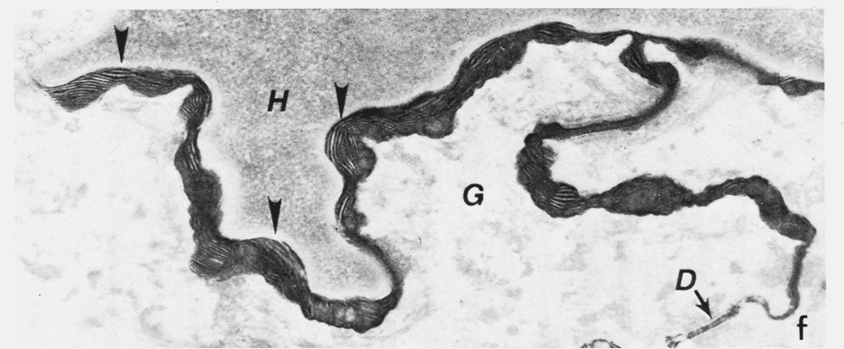
Lipidhülle (lipid envelop), zwischen einer Hornhautschuppe (H) und einer Granulosumzelle (G); Desmosom (D)

Slide 13
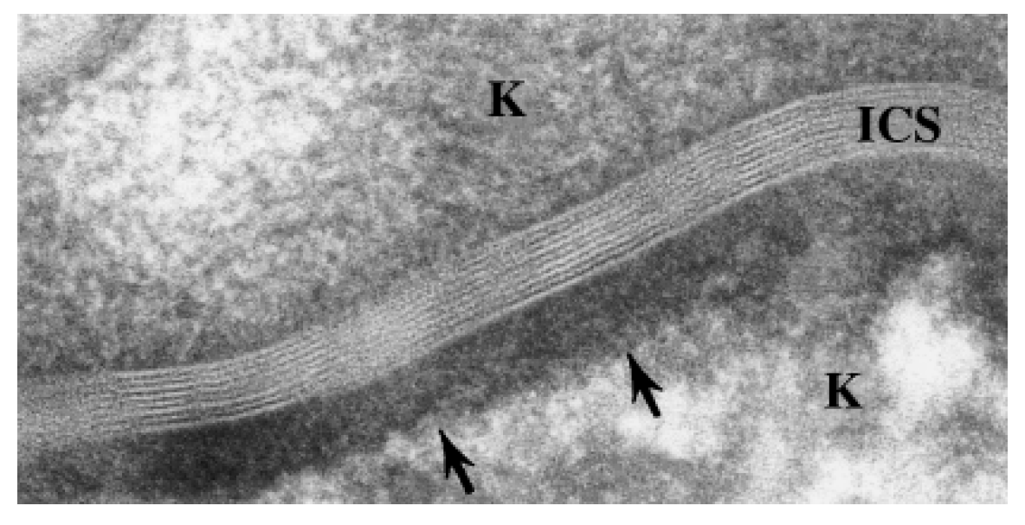
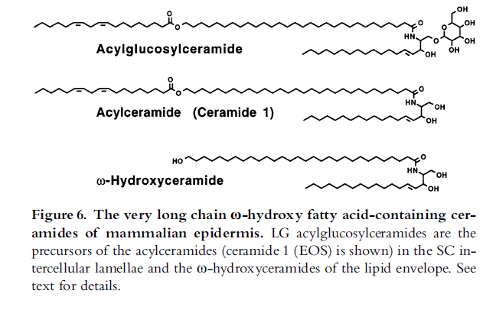
Madison J Invest Dermatol 2003
Lipidhülle (lipid envelop, ICS), zwischen Hornhautschuppen (K)
Biology of the integuments 2 Vertebrates, Springer, 1986
Notes:
Madison kép (felső):
Electron micrograph showing the stacked and patterned lamellar membrane sheets in a single intercellular space in mouse SC postfixed with ruthenium tetroxide. The cornified envelope of the lower corneocyte is clearly visible (arrows); ICS, intercellular space; K, keratin contents of the corneocytes bordering the intercellular space. Original magnification 200,000.

Slide 14
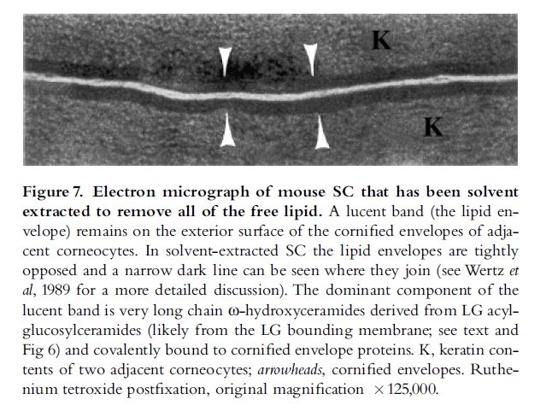
Madison J Invest Dermatol 2003
Verhornte Hülle: cornified envelop der Str. corneum Zelle
zwei Horschuppen

Slide 15
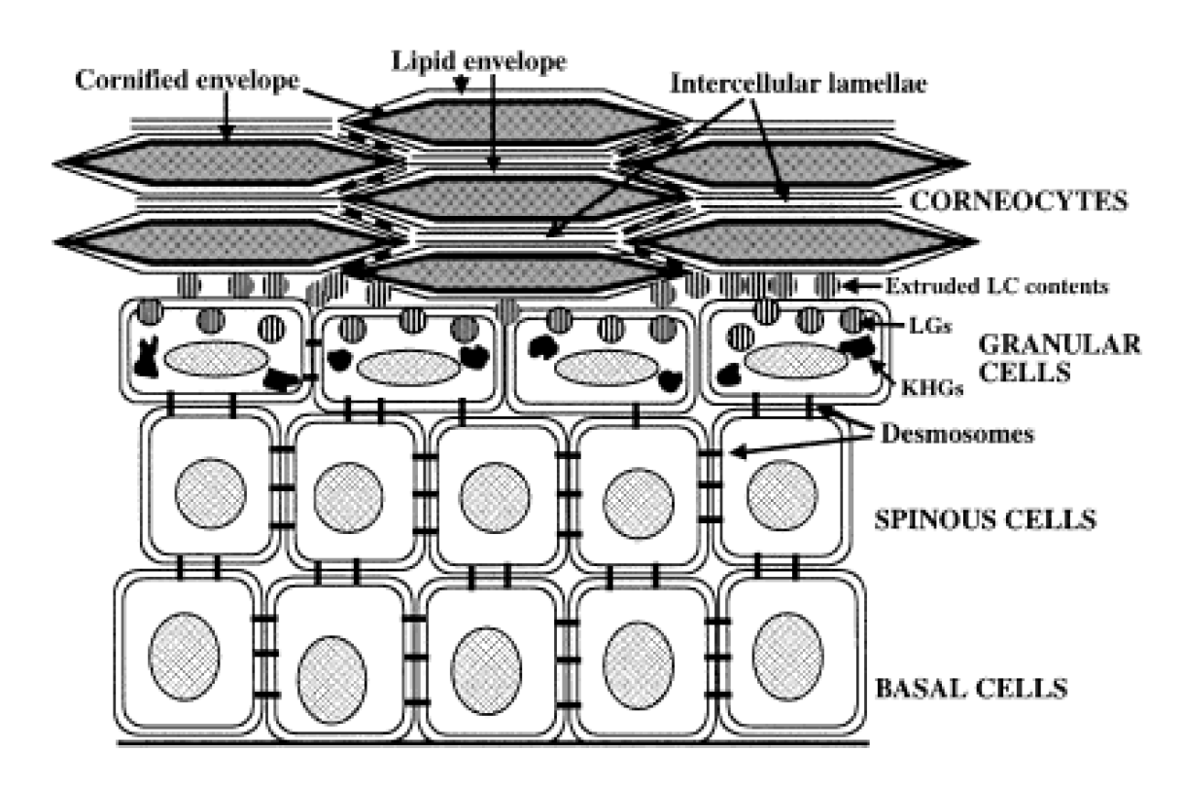
Madison J Invest Dermatol 2003
Notes:
Schematic diagram of the epidermis, including the transformations of lipid structures that accompany epidermal differentiation. Keratin filaments are omitted. Not to scale.

Slide 16
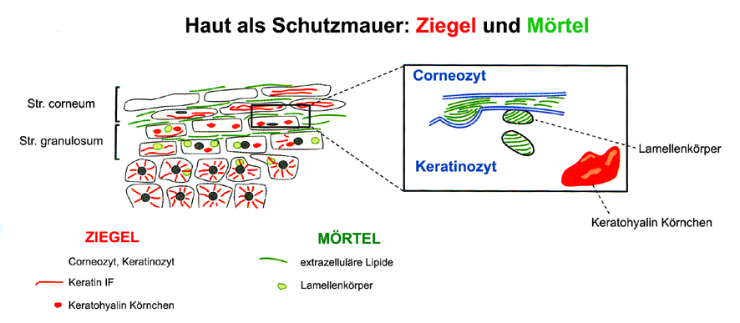
Grenze des Stratum granulosum und corneum
Hornschuppe: Korneozyt
lebende Epithelzelle: Keratinozyt

Slide 17
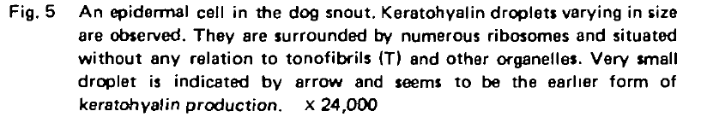
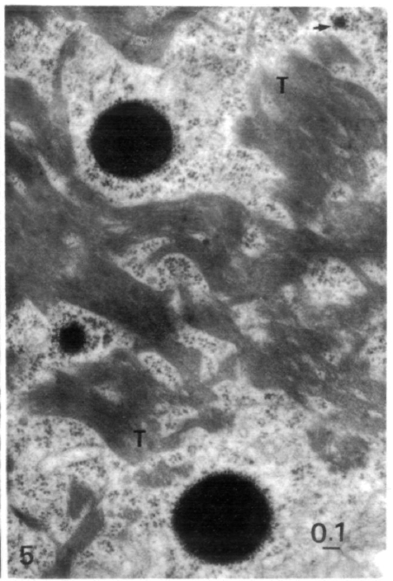
Keratohyalin Körnchen: 10 nm – 1-2 μm

Slide 18
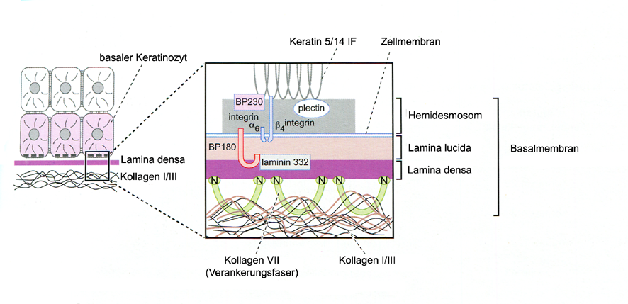
Verankerung der Zellen von Stratum basale
an der Basalmembran

Slide 19
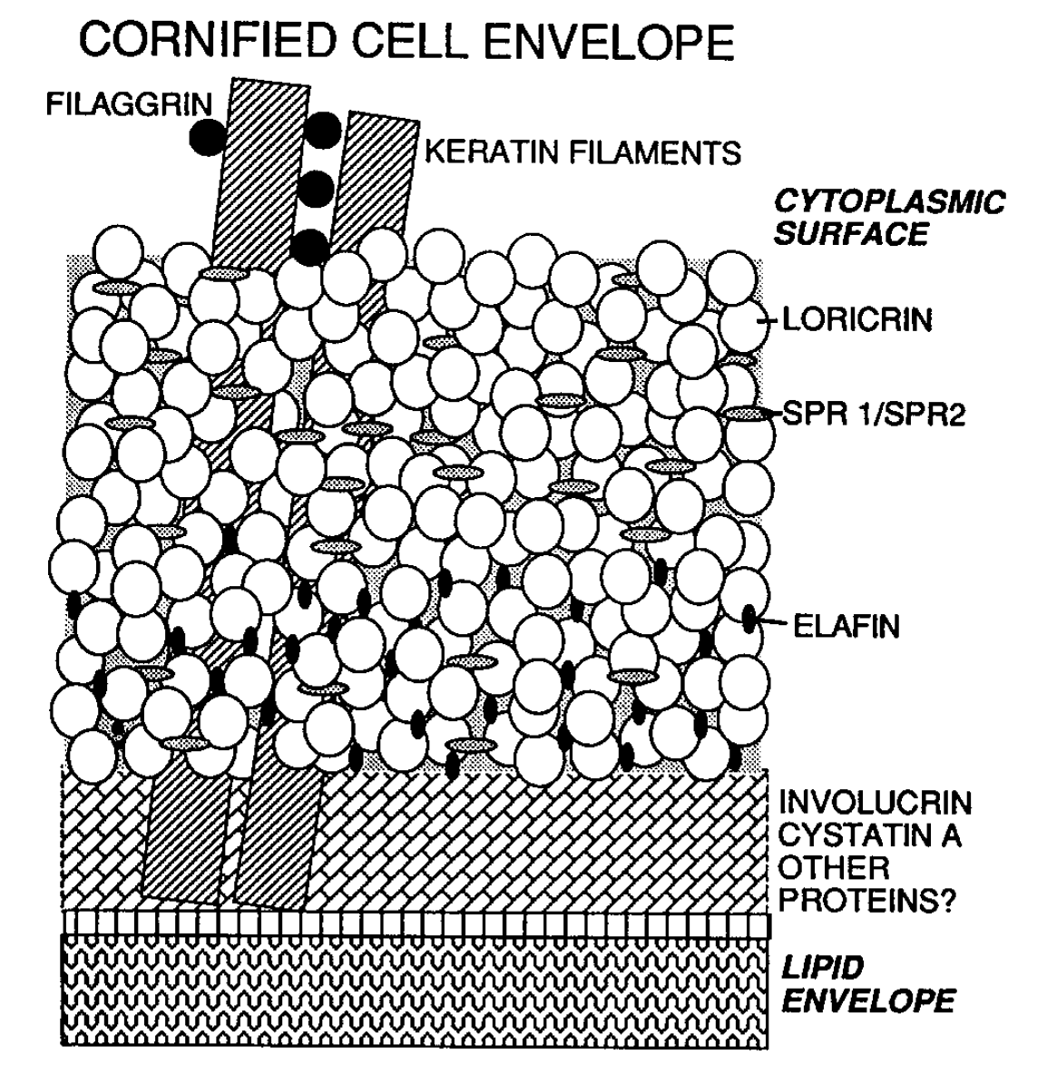
Steinert, JBC, 1995
Menschliche Kera-tohyalin-Granulen (Durchmesser 10 nm-2 μm): sie sind aus mehreren Proteine zusammengesetzt:
Profilaggrin, die bündelt Cytokeratine zusammen
Loricrin ist das Hauptprotein der CE.
Mit der Entstehung der Hornschuppen werden die in den Keratohyalinkörperchen gespeicherte Proteinen frei (in der Zytoplasma der Korneozyt)

Slide 20
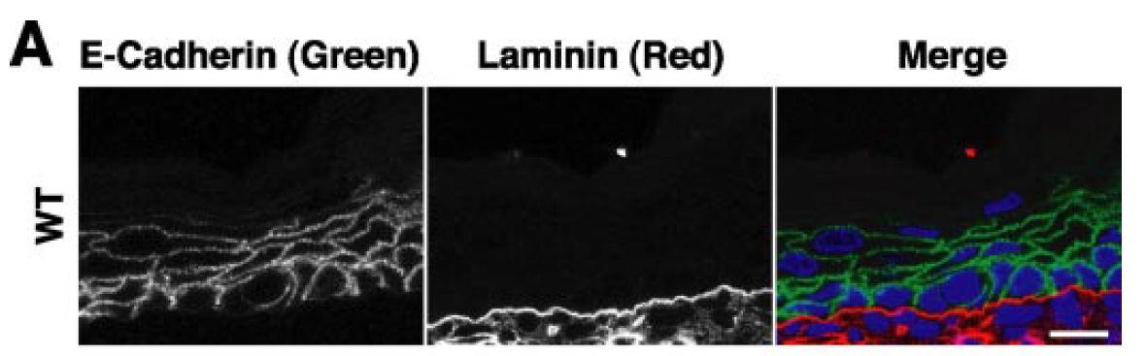
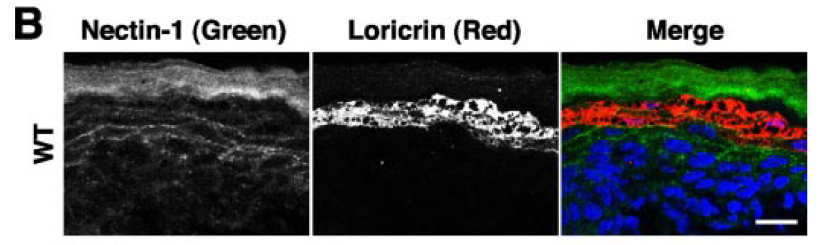
Wakamatsu THE JOURNAL OF BIOLOGICAL CHEMISTRY VOL. 282, NO. 25, pp. 18173–18181, June 22, 2007
E-Cadherin:
Bindung der Langerhans Zellen und
Melanozyten
E-Kadherin: Zelladhäsionsmolekül der Epithelzellen (Str. basale, spinosum und granulosum). Laminin: Protein der Basallamina; Loricrin: Protein der Keratohyalin Granulen

Slide 21
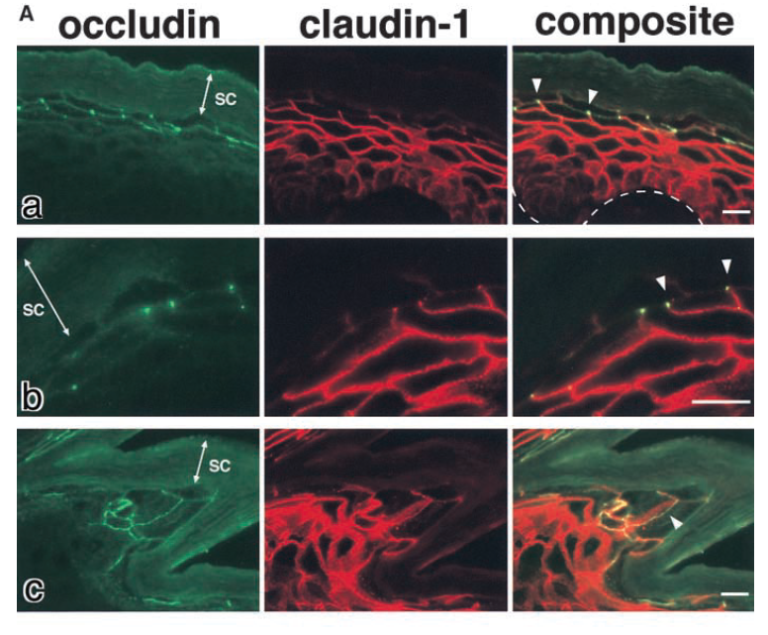
Notes:
Figure 4. Occludin, claudin-1, and claudin-4 in the wild-type epidermis. (A) Double immunofluorescence microscopy of frozen sections of skin from the back of wild-type mice with antioccludin mAb and anti–claudin-1 pAb. In transverse sections (a and b), occludin was concentrated as dots in the most apical region of the lateral membranes of the granular cells in the second layer (arrowheads). This dot-like concentration of occludin was also found in some but not all of the granular
cells in the first (uppermost) and/or third layer. Claudin-1 was distributed diffusely throughout plasma membranes of keratinocytes from stratum basale to granulosum, although the signal from the first layer of stratum granulosum was fairly weak (a). At higher magnification (b), in the lateral membranes of granular
cells in the second layer claudin-1 was coconcentrated as dots together with occludin in the most apical regions (arrowheads). In thicker oblique sections
(c), claudin-1 was coconcentrated precisely at the occludin-positive lines (arrowhead). SC, stratum corneum. The broken line represents the dermis/epidermis border. Bars, 10 m.

Slide 22
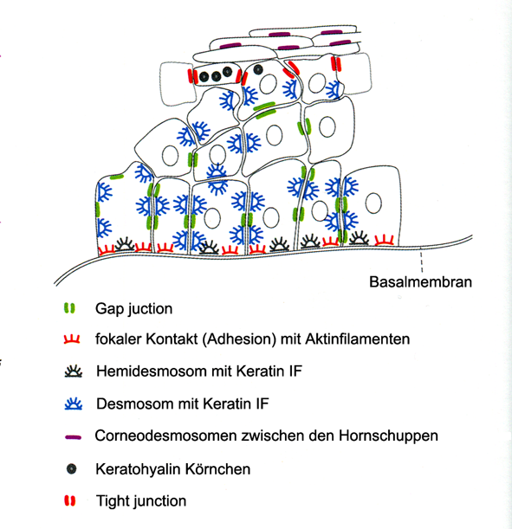
Zellverbindungen zwischen den Epithelzellen des MVPEs
Notes:
Kárpáti, Bőrgyógyászat, Medicina, 2012

Slide 23
Verhornung
als spezielles Form der Apoptose;
benötigt eine für Verhornung spezifische Kaspase: Kaspase-14

Slide 24
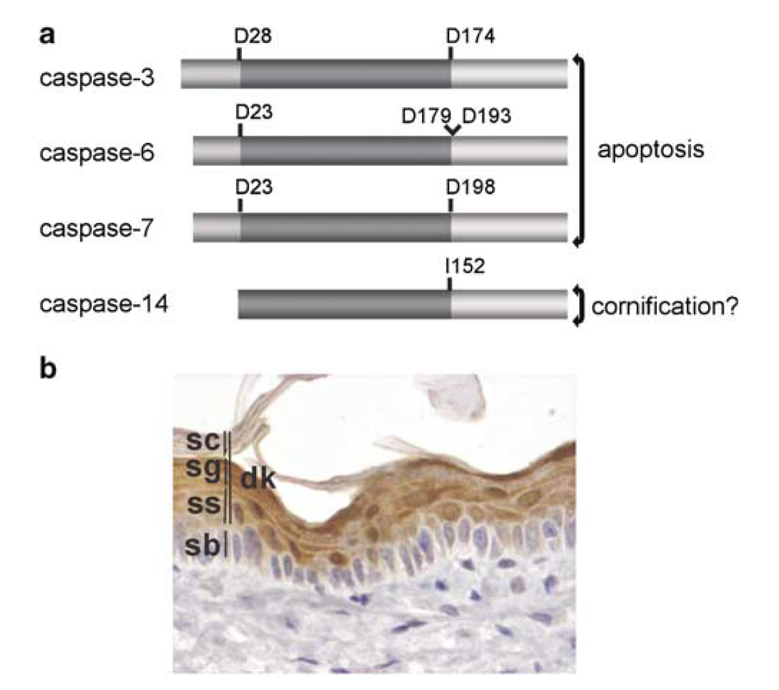
Expression von Caspase-14 in dem Epidermis der Mäus
(braune Reaktion)
Notes:
Structure of caspase-14 and its expression in the epidermis. (a) Schematic structure of procaspase-14 as compared to other short-prodomain caspases (human).125 In general, these caspases have a prodomain ranging from 23 to 28 amino acids. There is currently no evidence that caspase-14 contains a prodomain. Note that human caspase-14 is not processed at a canonical Asp residue due to self-processing or cleavage by upstream caspases, but instead at Ile152.68 (b) Expression of caspase-14 in adult murine epidermis. Caspase-14 is expressed in all suprabasal layers including the stratum spinosum (ss), the stratum granulosum (sg) and the stratum corneum (sc).

Slide 25
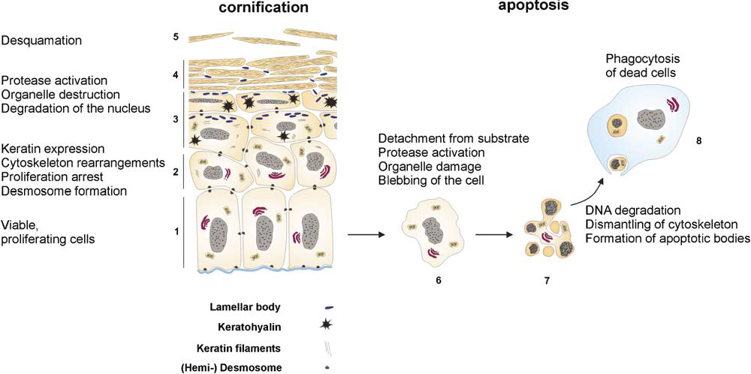
Transglutaminase (Tgase1, 3): Quervernetzung der Zytoplasma-Proteinen in Hornschuppen
Notes:
Morphological and biochemical changes during keratinocyte cornification and apoptosis. (1) The basal layer of the epidermis consists of undifferentiated, mitotic keratinocytes that are attached to the basement membrane. (2) In the spinous layer, the keratinocytes detach from the basal membrane and start to undergo differentiation. The cells flatten and differentiation-specific proteins such as keratins 1 and 10 are expressed. In addition, orchestrated cytoskeleton reorganization occurs through the epithelial sheet. The cell surface extensions or spines end in desmosomes. (3) The granular layer of the epidermis is characterized by the presence of keratohyalin granules. The keratin filament network is crosslinked, DNA is degraded, organelles are destroyed, and the plasma membrane is replaced by the cornified envelope and ceramide deposition from the lamellar bodies. (4) The cornified layer consists of dead cells. (5) The cells are not removed by the phagocytic Langerhans’
cells, but are shed into the environment during desquamation. (6) Upon induction of apoptosis, the caspase cascade becomes activated and apoptotic cells start blebbing. (7) Chromatin and cytoplasm undergo condensation, internucleosomal DNA cleavage occurs, the cytoskeleton is dismantled, the cell membrane ‘invaginates’, and apoptotic bodies are formed. Organelle damage results in release of molecules such as cytochrome c from mitochondria into the cytosol. In contrast, the plasma
membrane remains intact avoiding cytoplasm leakage to the environment. (8) Finally, apoptotic bodies are phagocytozed and degraded inside lysosomes.
Lippens Cell Death Diff 2005

Slide 27
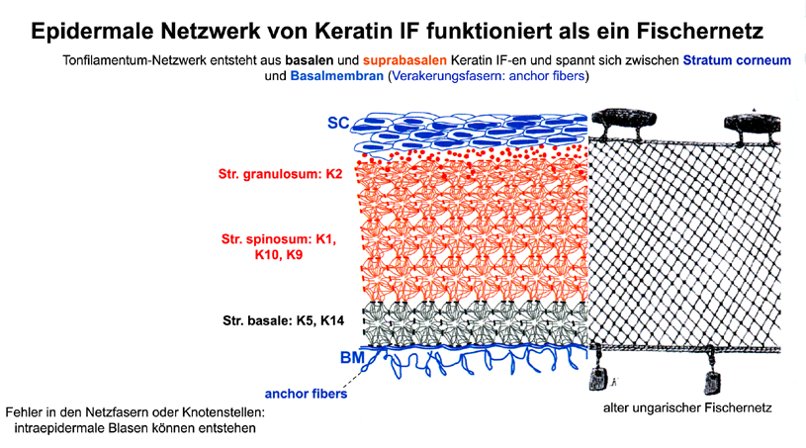

Slide 28
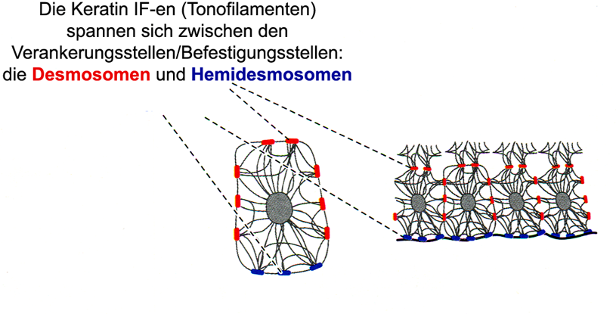

Slide 29
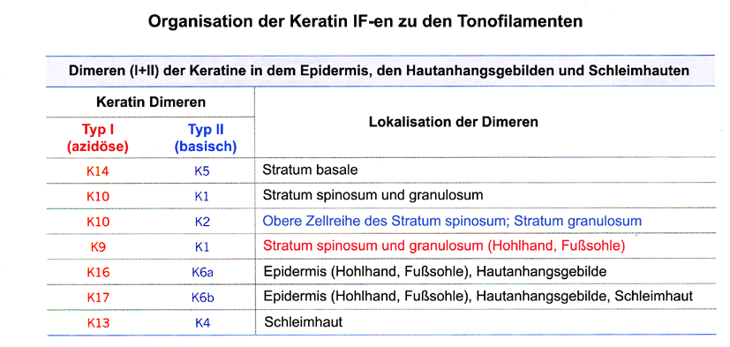

Slide 30
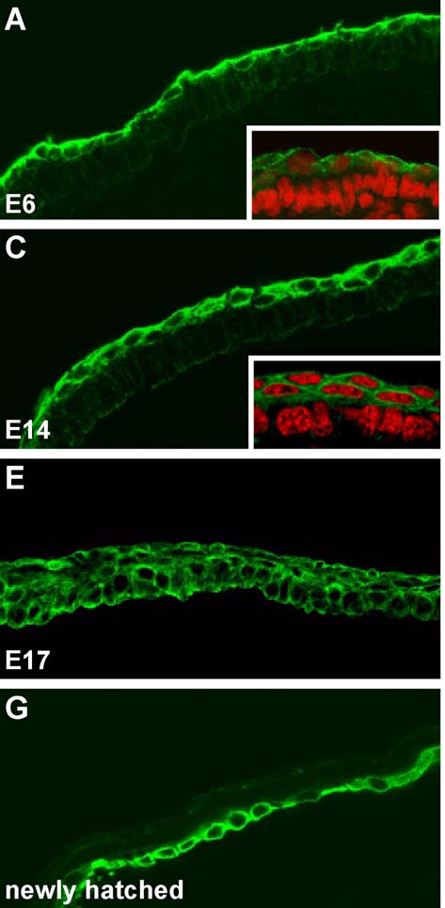
Ontogenese des K5 Expression im Kükenembryo
K5 Immunohistochemie (grüne Fluoreszenz; Insert: rote Fluor.: PI) Nur im Periderm und Subperiderm!
K5: in allen Schichten!
K5: nur in der Basalschicht
Notes:
K5 as a marker for the PSP (periderm and subperiderm) unit.
Immunofluorescence micrographs (A, C, E, and G) and corresponding immunofluorescence/phase contrast overlays (B, D, F, and H) showing the distribution of K5 during chicken embryogenesis.
At E6, expression of K5 was found in the periderm (A and B) but absent from the underlying stratum basale of the emerging epidermis, which became evident by staining the nuclei with propidium iodide (PI) (A, inset).
Beginning with E14, K5 was also found in the subperiderm (C and D) that has been formed between the periderm and the emerging epidermis. Staining of nuclei with PI showed that the periderm and the subperiderm represent epithelial monolayers (C, inset) covering the underlying emerging epidermis that still did not express K5 (C and D).
From E17 to the time of hatching, an intermediate state between the embryonic and the adult epidermis was observed in that K5 was detectable throughout all layers of the stratified epithelium (E and F).
After hatching, K5 was found to be restricted to the basal cell layer (G and H). Scale bar, 20 Am.
Saathoff Exp Cell Res 2004

Slide 31
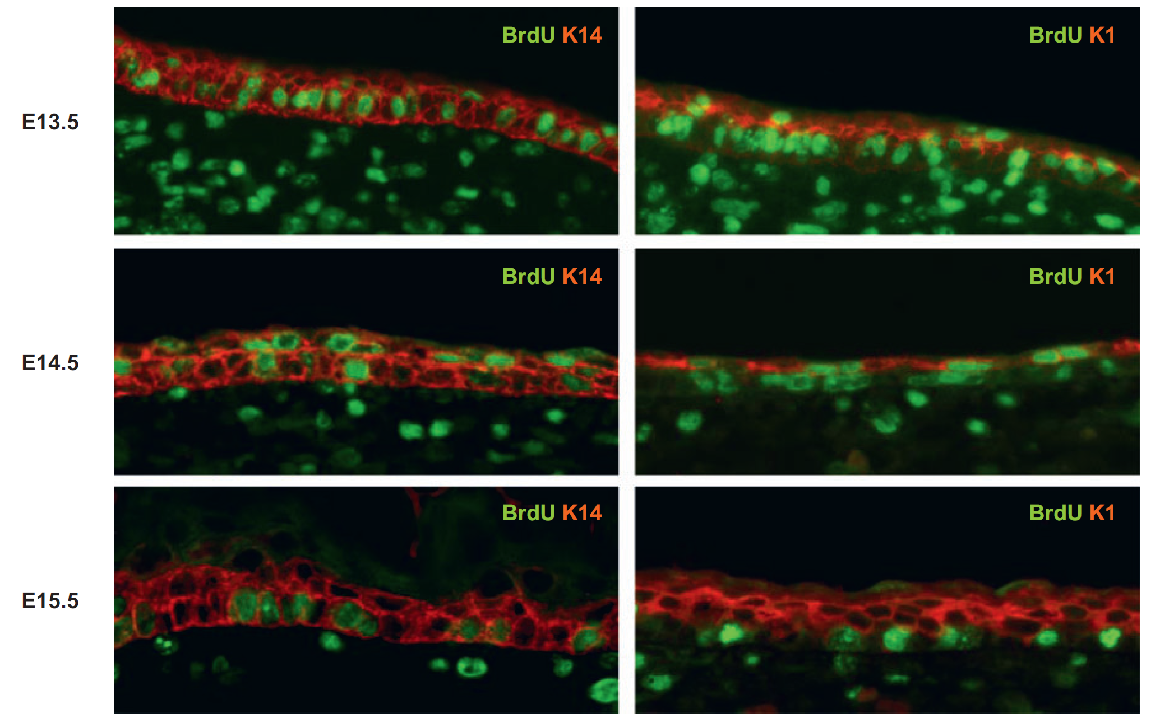
Notes:
Intermediate cells mature into spinous cells in a process that is characterized by cell-cycle withdrawal. The first suprabasal cell layer, the intermediate cell layer, develops at approximately E13.5 and consists of keratinocytes that proliferate and express the terminal differentiation marker K1.
Maturation of these intermediate keratinocytes into spinous keratinocytes occurs at approximately E15.5 and is marked by cell-cycle exit. To identify proliferating keratinocytes, pregnant females were injected with BrdU 1 h prior to the dissection of embryos. Immunofluorescence using an anti-BrdU antibody was used to detect BrdU incorporation (green) at the indicated embryonic stages.
Staining for K14 (red; left panels) highlights the epithelial component of the skin, and staining for K1 (red; right panels) specifically highlights the suprabasal cell layers of the epidermis. At E15.5, proliferating cells are excluded from the suprabasal cell layers, demonstrating that at this developmental stage all intermediate keratinocytes have matured into spinous keratinocytes.
Koster, Annu. Rev. Cell Dev. Biol. 2007. 23:93–113

Slide 32
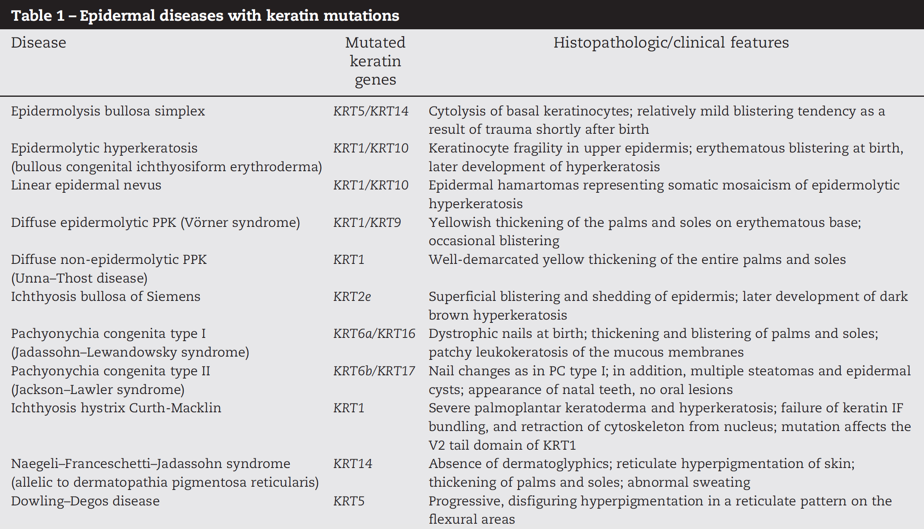
Notes:
Uitto, Exp Cell res 2007

Slide 33
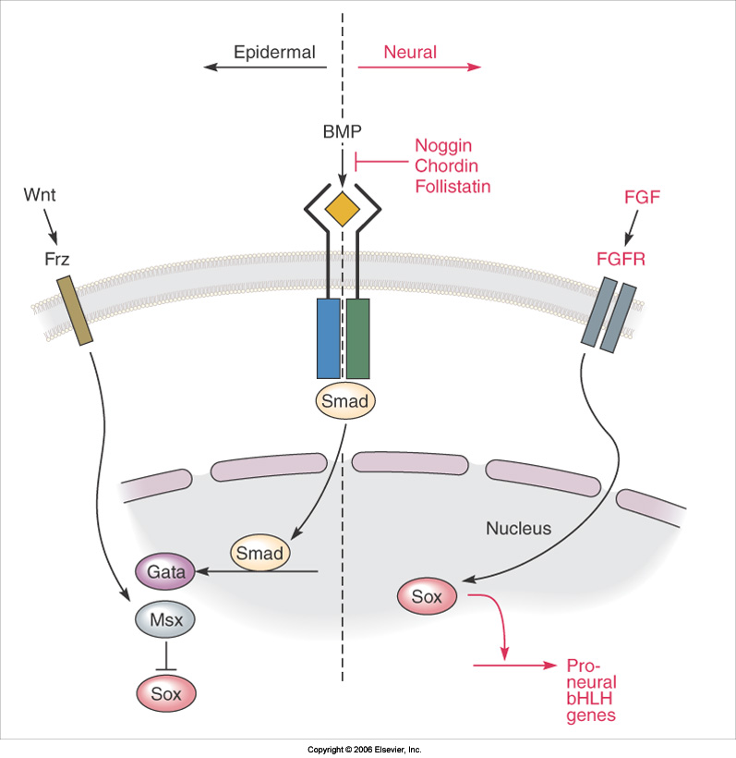
Spezifikation der Haut
Sehr wichtig ist in der neuralen Induktion die Hemmung des BMP-Signalübertragungs-weges.
Wenn die Hemmung ausbleiben würde, würden die Ektodermzellen zu Epidermiszellen (Hautepithel) umwandeln.
Sanes, D Development of the nervous system, Academic Press, 2006

Slide 34
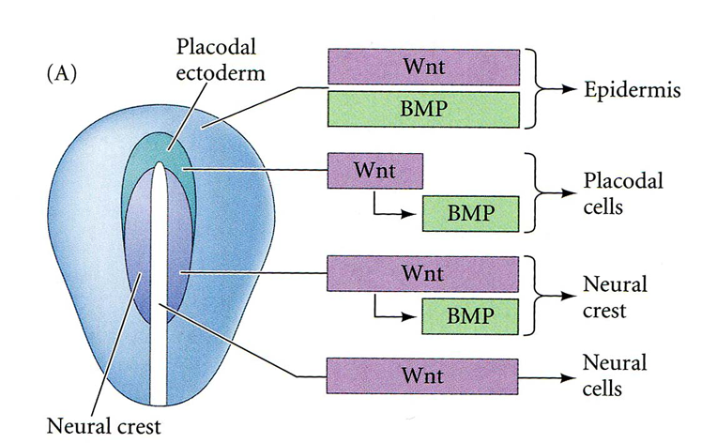
Spezifikation des Ektoderms: Kombination verschiedener Signale entscheidet, ob Epiblast/Ektoderm später Neuralrohr, Neuralleiste, neuralen Plakode oder Epidermis bildet. Diese Signale stammen teilweise aus Ektoderm (autokrine Signale), teilweise aus den unter dem Epiblast liegenden Geweben (Chorda, Hypoblast, parakrine Signale).
Wnt: ein, in der Entwicklungsbiologie sehr wichtiges Signalmechanismus (verschiedene Wnt Liganden binden an ihren Rezeptor (Frizzled). Differenzierung des Neuralrohres nötigt Wnt-Signalisation (Epiblast braucht dafür diese Signalmolekülen), und eine gleichzeitige Hemmung des BMP-SÜTweges. Epidermis entsteht, wenn beide (Wnt und BMP) Signalen da sind.
Notes:
Gilbert Dev Biol Sinauer, 2010
If Wnt induces BMP, and is then downregulated, the cells become placodal border cells. (expressing the placode specifier genes Six1, Six4, Eya2),. If Wnt induces BMP, but remains active, the border cells become neural crest (expressing neural crest specifier genes Pax7, Snail2, Sox9). If they receive Wnt only (because the BMP signal is blocked by Noggin or FGF), the ectodermal cells become neural.

Slide 35
Schritte der Epidermisentwicklung I.
-Nach Neurulation (18-26 ET) zurückbleibendes Epithel: Ektoderm
-Ektoderm ist einschichtig bis 4-5 EW.
-Zwischen 5-8 EW Epidermis wird zweischichtig: erscheint das Periderm. Seitdem nennen wir die untere Schicht als Basalschicht.
-Zwischen 9-11 EW erscheint die intermediäre Schicht über Basalschicht.
-Zwischen 11-20 EW: beginnt die terminale Differenzierung mit der Umwandlung der intermediären Schicht zu Spinosum und Erscheinen von Str. granulosum.
Notes:
Az adatokat egyrészt a Larsenből, meg a Hinrichsenből vettem, plusz: Skin barrier, Ed. by

Slide 36
Schritte der Epidermisentwicklung II.
Str. corneum erscheint zwischen EW20-40 und Periderm geht zugrunde und löst sich ab.
Verhornung beginnt kranial und schreitet nach kaudal fort.
Melanozyten migrieren innerhalb der Dermis, und gelangen in dem Epidermis in der 3 EM.
Langerhans Zellen migrieren in das Epidermis von der 4. EM ein.

Slide 37
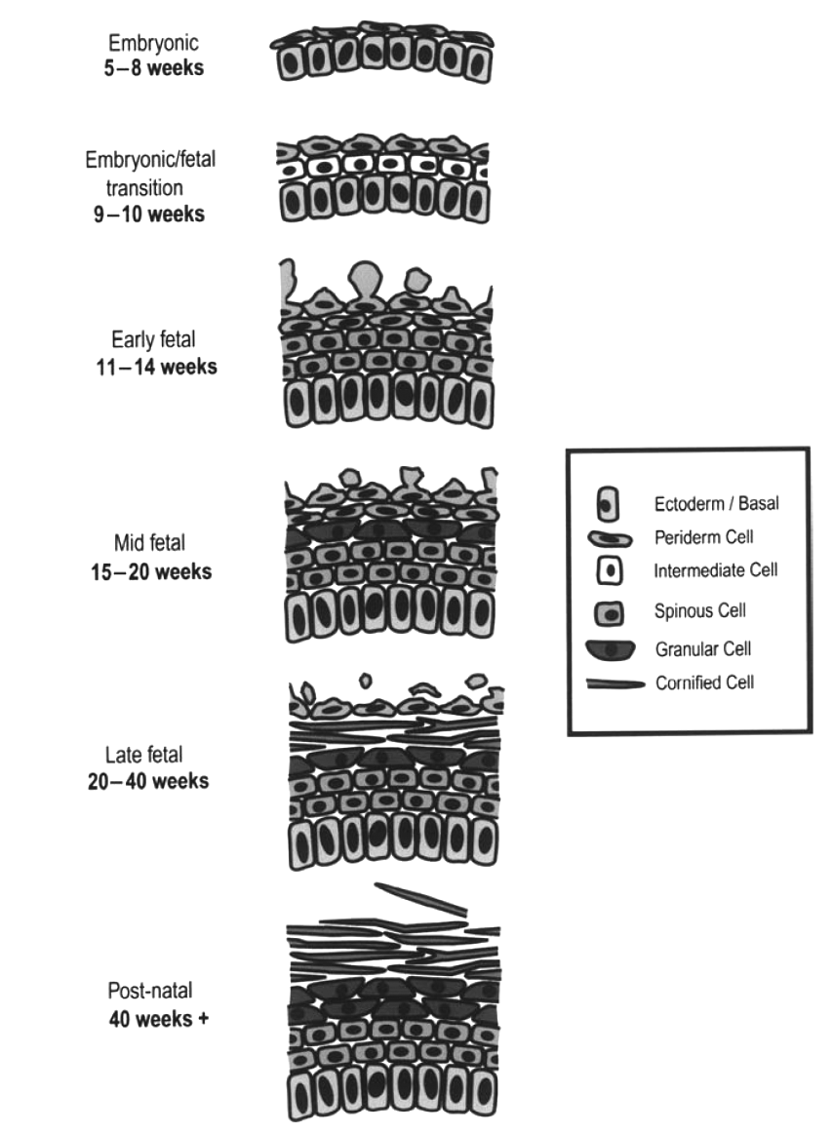
Epidermis des menschlichen Embryo
PE Elias und KR Feingold: Skin barrier, CRC Press 2013

Slide 38
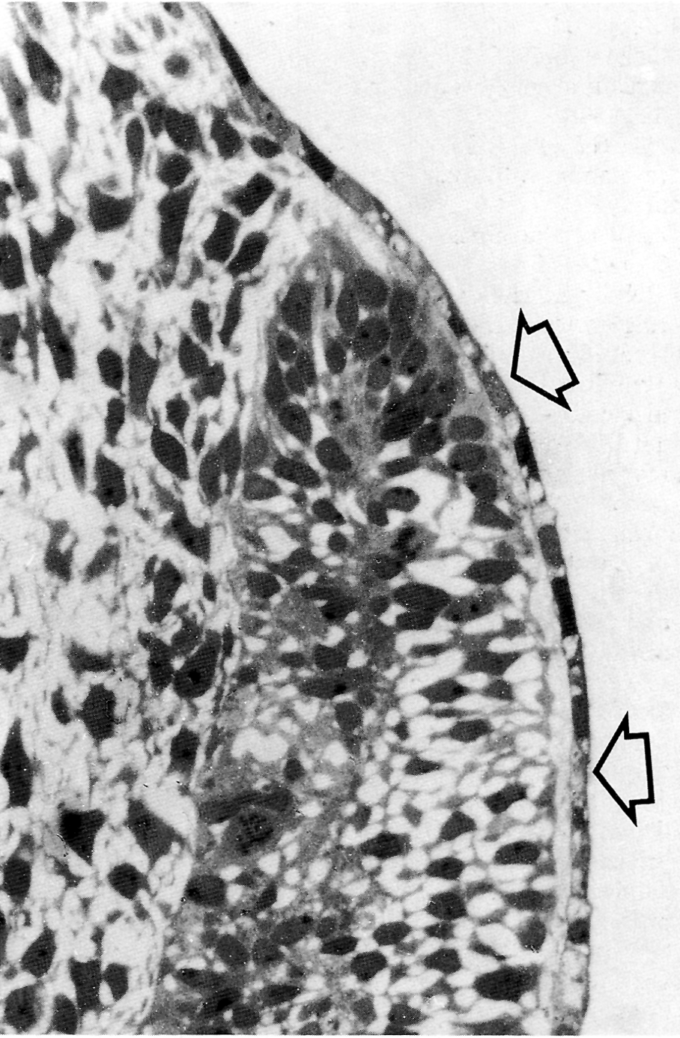
4,5 EW Embryo: unter Ektoderm (einschichtig) sieht man Dermatom
Notes:
Hinrichsen, Humanembryologie, Springer, 1990

Slide 39
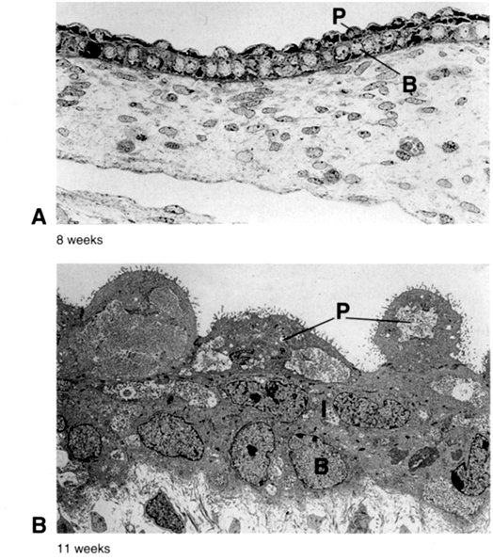
Periderm (P) erscheint
nach der 4-5. Woche,
seitdem nennt man
die untere Schicht als
Basalschicht (B)
Ab EW11
escheint das
Zwischenschicht
(I),
die untere (B) wird dann
als Germinativschicht
genannt.
Notes:
Larsen, Churchill-Livingstone, 2009

Slide 40
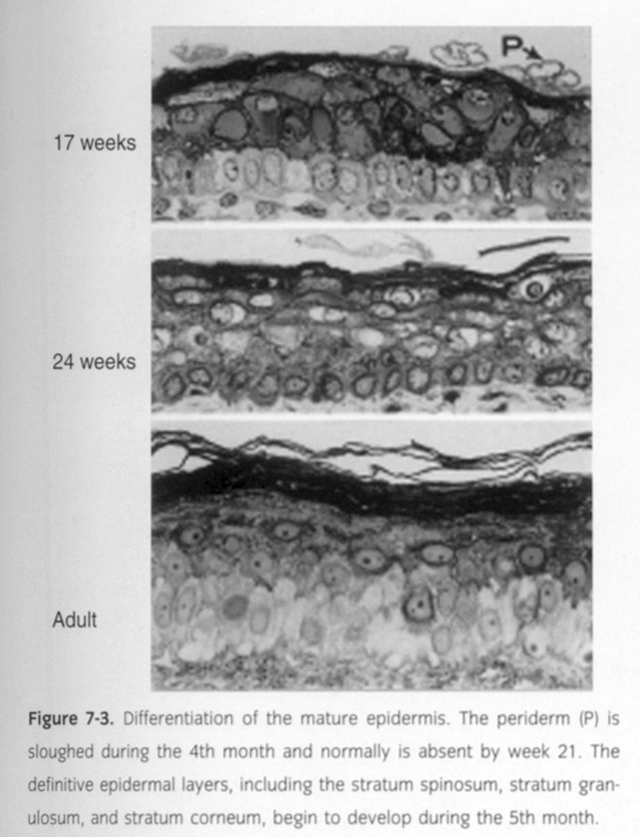
Abstoßen des Periderms in die Amnionflüssiegkeit beginnt an der EW17, beendet normalerweise bis EW21.
Parallel damit (EM5) differenziert die IM Schicht in Spinosum, Granulosum, Corneum.
Notes:
Larsen, Churchill-Livingstone, 2009

Slide 41
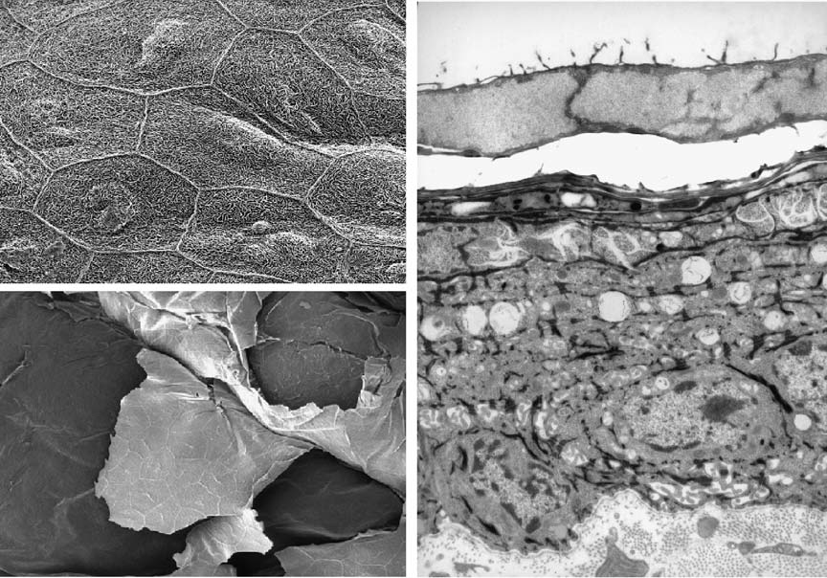
Periderm in SEM Bild (Kükenembryo: Periderm sieht bei den verschiedenen Wirbeltieren sehr ählich aus und verhaltet auch so)
Noch intaktes Periderm
Abstossen des Periderms
Notes:
Csirke embrionális bőrfejlődés. A periderma sejtjei felszínén mikrobolyhok. A hexagonális sejteket tight junctions köti össze: occludin, claudin-1. Korai bőrön csak a peridemra expresszálja a keratin5-öt, E17-től az egész hám, kikelés után már csak a bazális sejtréteg. Gerincesekben a periderma leválik még a születés-kikelés előtt, így csirkében is a E18-19 –n. A leválás apoptózis: kaszpáz-3, -6 és -7 aktivitás megnő a P sejtjeiben.
Saathoff Exp Cell Res 2004

Slide 42
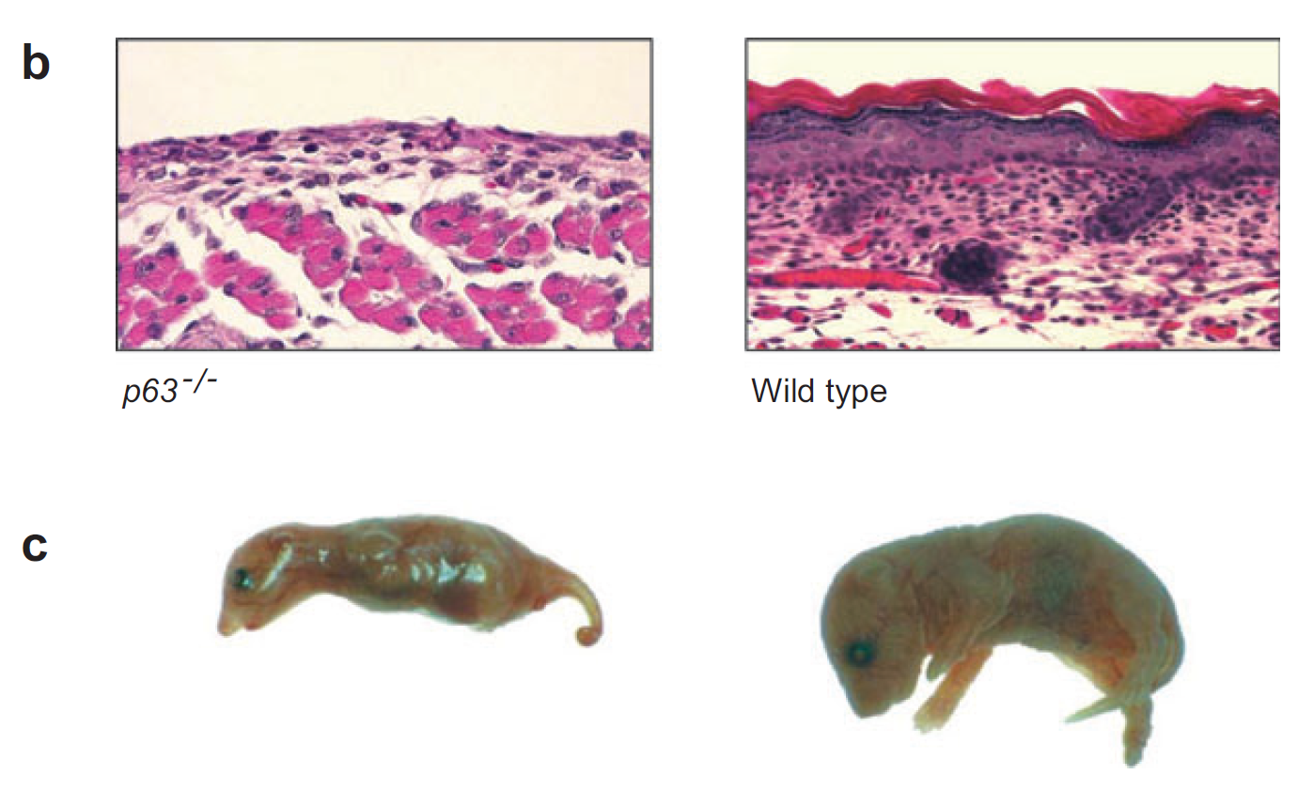
Homozygote Mangel (-/- KO) der TF p63: die Entwicklung von mehrschichtigen verhornten Epihtel ist gehemmt.
Koster, Annu. Rev. Cell Dev. Biol. 2007. 23:93–113
Notes:
(b) In wild-type mice, epidermal stratification and barrier formation are completed by birth (right). The surface ectoderm of mice lacking the transcription factor p63 fails to adopt an epidermal fate, and therefore stratification and barrier formation do not occur (left). As a consequence, mice lacking p63 are born with a single layer of ectodermal cells covering their bodies and die shortly after birth due to dehydration.
(c) Images of p63−/− and wild-type mice.

Slide 43
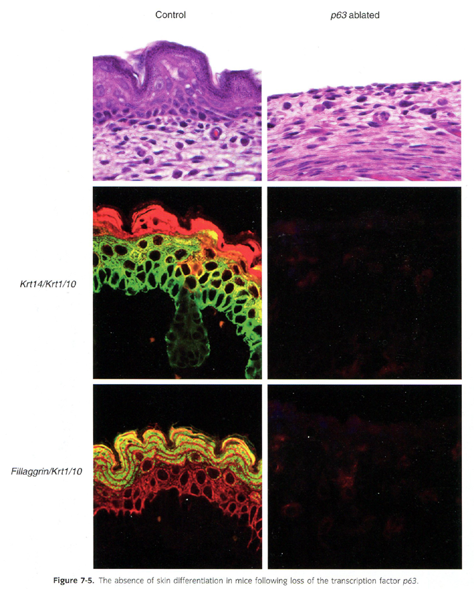
p63 als Master Control Gen für Epidermisdifferenzierung (ählich wie Pax6 für Augenentwicklung): dieses Gen allein kann die ganze EPIDERMALE Differenzierung starten lassen.
Die Expression von p63 Gen in Epidermiszellen (Ektodermzellen) wird durch die darunterliegenden Mesodermzellen induziert.
Notes:
Larsen, Churchill-Livingstone, 2009

Slide 44
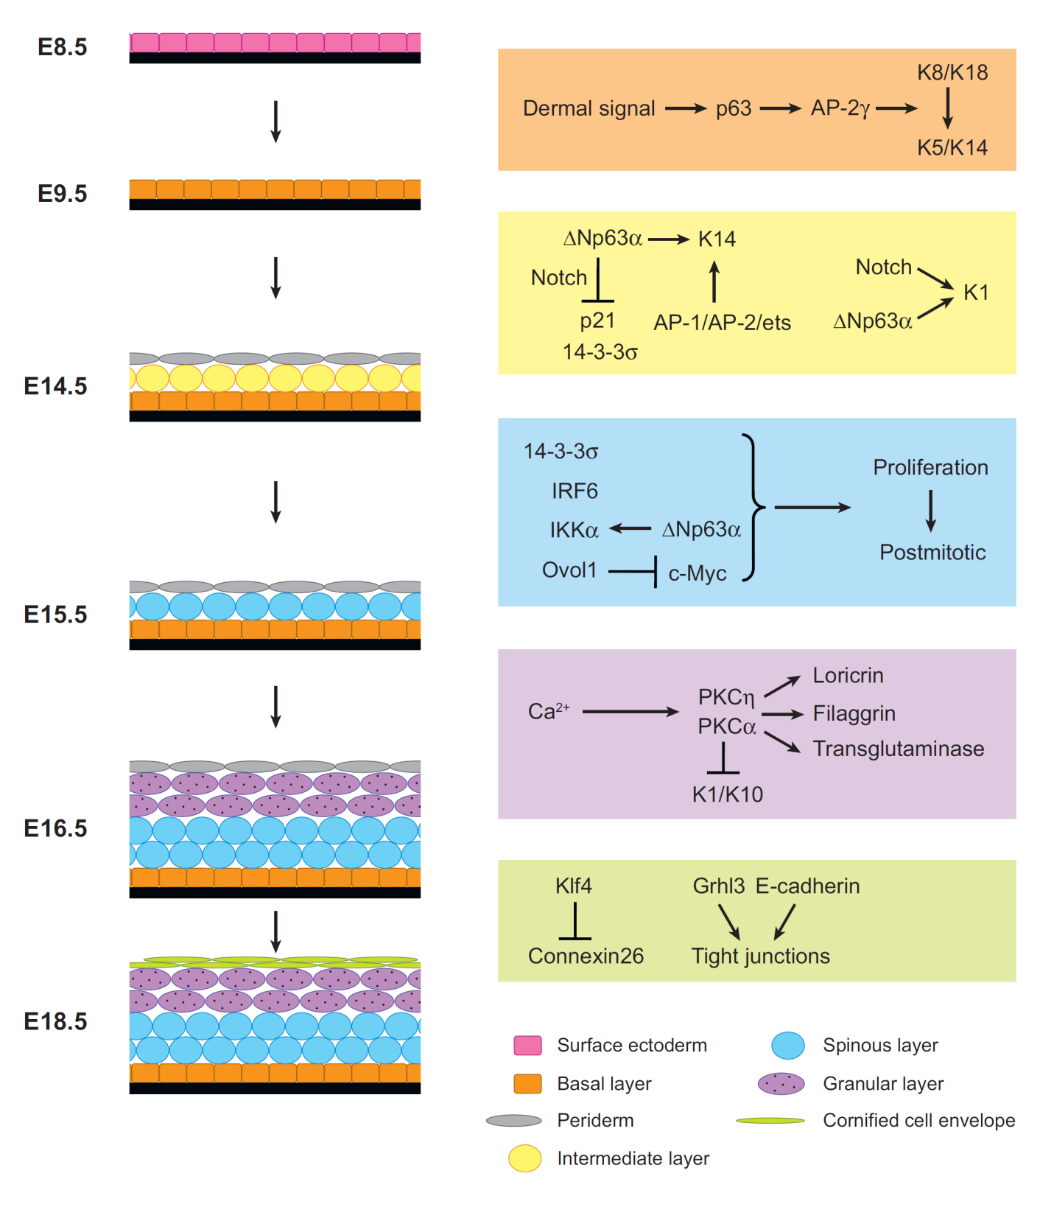
Koster, Annu. Rev. Cell Dev. Biol. 2007. 23:93–113
Notes:
In mice, epidermal stratification is executed in approximately 10 days, from E8.5 to E18.5.
The molecules required for the formation of each layer are highlighted in boxes (right) that are the same color as the layers (left).
The first transition required for epidermal development is epidermal specification, which occurs at approximately E8.5 and results in the induction of p63 expression in the surface ectoderm. p63 in turn induces expression of K14, an intermediate filament protein specifically expressed in embryonic and mature basal keratinocytes.
Maintenance of the basal layer is controlled, in part, by Np63α, which maintains K14 expression and proliferation. In addition, Np63α, in cooperation with Notch, induces K1 expression in suprabasal keratinocytes, thus contributing to the formation of the intermediate cell layer.
Subsequent maturation of intermediate cells into spinous cells is associated with cell-cycle withdrawal and is controlled by IRF6, 14-3-3σ, IKKα, and Ovol1, four transcription factors whose hierarchical relationships remain to be determined.
The postmitotic spinous keratinocytes differentiate into granular keratinocytes in a process controlled, in part, by Ca2+ signaling. Among the currently identified proteins activated by Ca2+ are protein kinase C isoforms, which directly control granular cell formation.
Finally, barrier formation requires cell adhesion as well as the expression of genes involved in lipid synthesis and metabolism. Currently, only a few transcription factors required for these processes, two of which include Klf4 and Grhl3, have been identified.

Slide 45
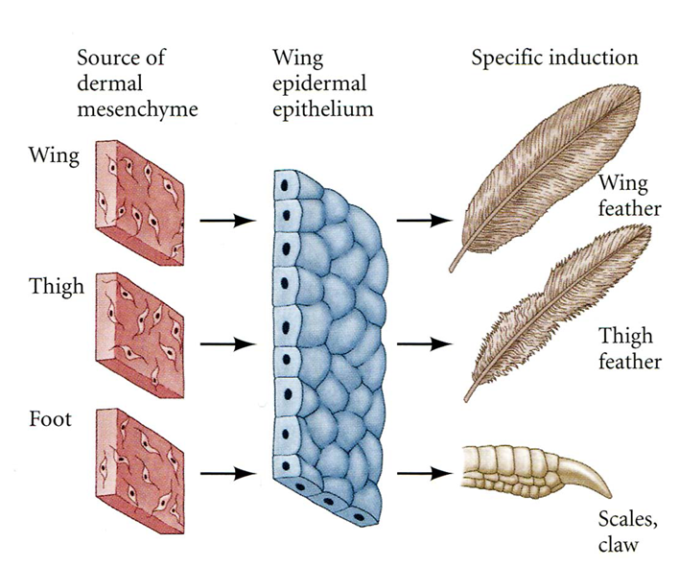
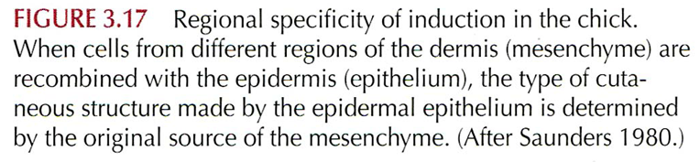
Epithelio-Mesenchymale Wechselwirkungen: das epitheliale Differenzierungsprogram wird durch das Mesoderm eingeschaltet, aber dann geht unabhängig von dem Mesoderm. Mesoderm daneben bestimmt, welches Gestalt, Form wird durch das Epithel aufgenommen (hier, in Beispielen: Feder, Schuppen, Klauen, usw.)

Slide 46
Hautpermeabilitätstest
Assay depends on barrier-dependent access of 5-bromo-4-chloro-3-indolyl-b,D-galactopyranoside (X-gal) to untreated skin. At low pH, skin contains abundant endogenous b-galactosidase activity, which cleaves X-gal to produce a coloured precipitate. Unfixed, untreated, freshly isolated embryos were rinsed in phosphate-buffered saline (PBS) and immersed in standard X-gal reaction mix, except that the pH was adjusted to 4.5. Incubation was at 30°C until colour develops (2 hours to overnight).
Hardman, Development 125, 1541-1552 (1998)

Slide 47
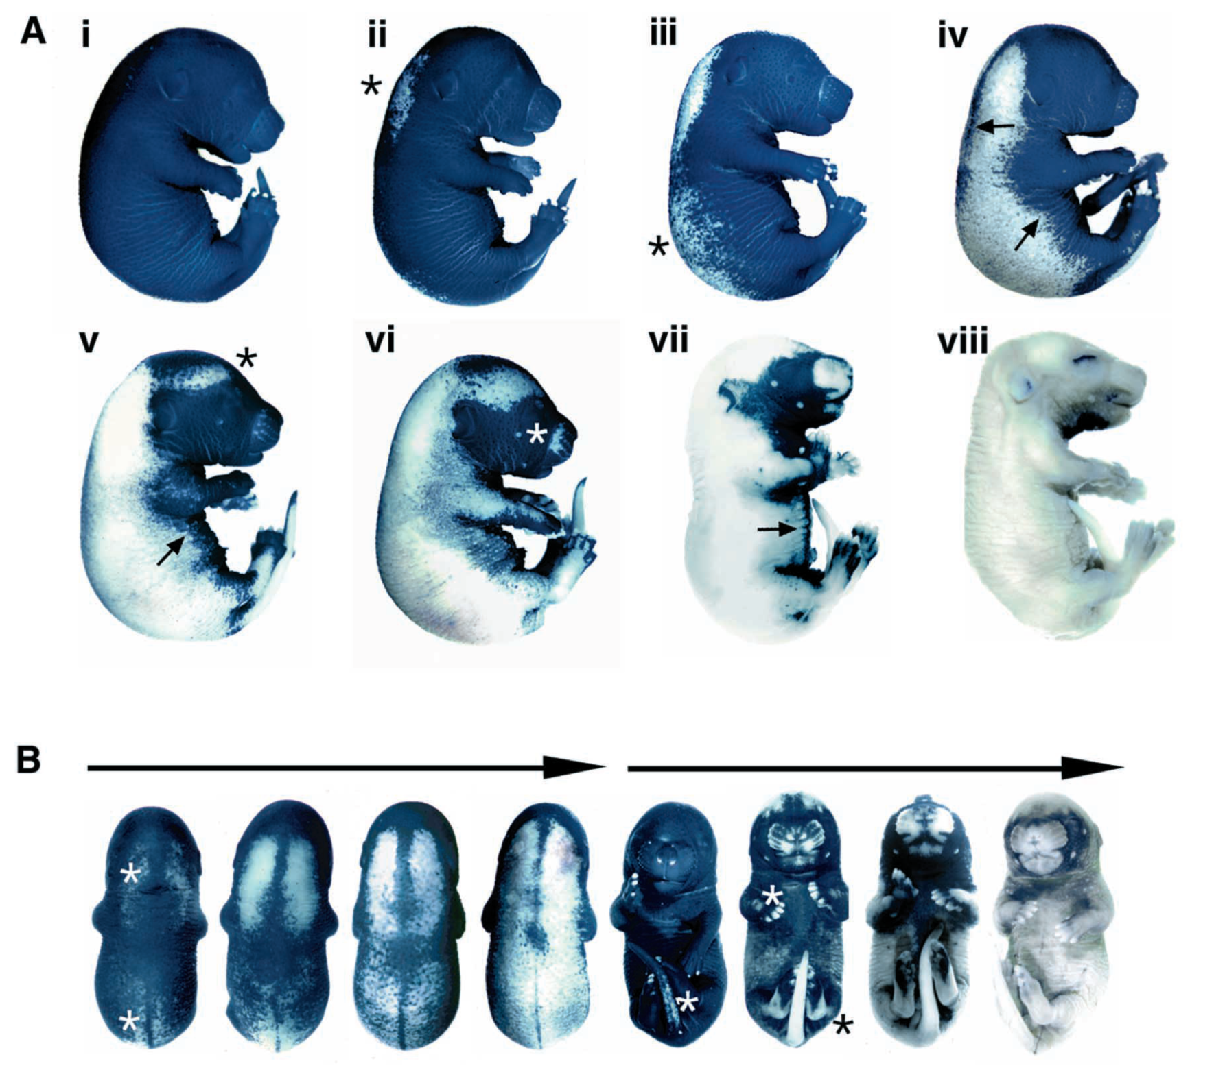
Hardman, Development 125, 1541-1552 (1998)
Ai: jünger als E16,
Av: E16 und 11Stunden alt
Aviii: älter als E17
Technik: β-Galaktosidase Substrat - Diffusionstest in die Haut unter leicht säurem pH.
Notes:
Skin permeability changes in a patterned manner at embryonic day 16; (Ai-viii) increasing embryonic age.
Specific skin sites (initiation sites) acquire impermeable characteristics (asterisk in ii, iii, v and vi), then a moving front of impermeability spreads across the animal’s body (arrows).
(B) Dorsal and ventral views of embryos showing progress of the front (arrows) and evidence of additional late initiation sites on the ventral region (asterisks).
Approximate average gestational ages for each barrier stage in ICR strain mice are: Ai, <E16; Av, E16/11; Aviii, >E17.
Hardman, Development 125, 1541-1552 (1998)

Slide 48
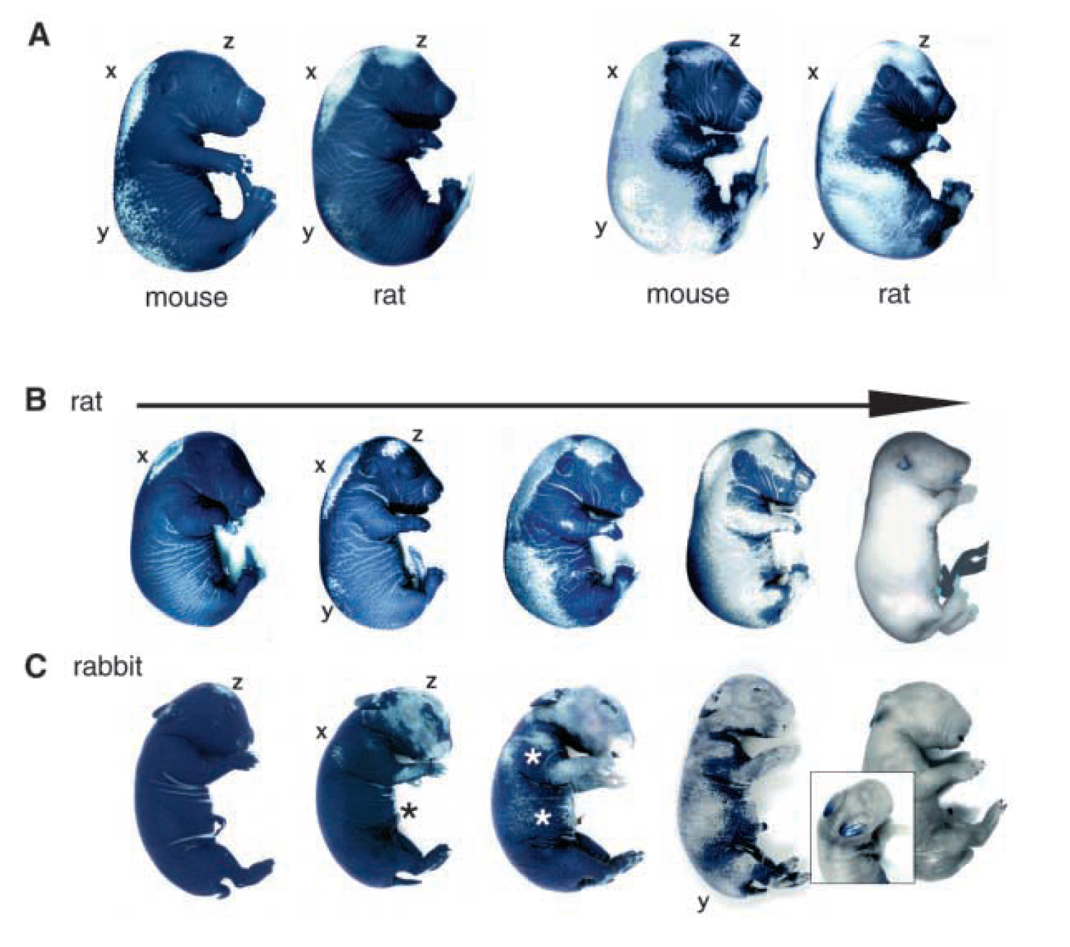
Notes:
Patterned epidermal permeability change in mice (A), rats (A, B), and rabbits (C).
Barrier forms at E16 of mouse gestation, E19 of rat gestation and E25 of rabbit gestation. The initiation sites are activated in a different order.
Mouse embryos activate initiation sites x, y then z. Rat embryos show a different pattern because dorsal initiation sites are activated in the order x, z then y.
(B) Completion of front movement in rat embryos. (C) Rabbit embryos first activate an initiation site on the head (probably analogous to z) then additional initiation sites (limbs, ventral region, a dorsal site similar to x). The different shapes of the embryos impose pattern differences, as illustrated by the retention of permeable epidermis on the lengthened ears of the rabbit embryo long after completion of the permeability change (inset).

Slide 49
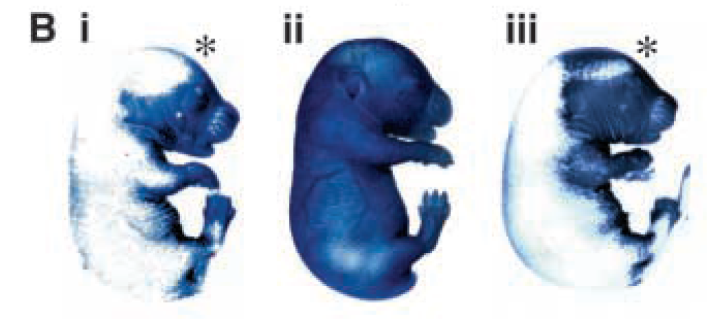
G+, E16/2
G-, E16/2
G-, E16/11
Glükokortikoid-Behandlung der Embryos
Notes:
Glucocorticoid treatment produces accelerated permeability pattern.
(B) Barrier pattern is compared on representative embryos from glucocorticoid-treated (Bi; E16/2) and vehicle-treated groups (Bii; E16/2). An older (E16/11) untreated embryo (Biii) is included to show the pattern distortion in the glucocorticoidtreated embryo (asterisks), also note the wider abdominal front.

Slide 50
Blaschko-Linien
Mehrere Hauterkrankungen entstehen zwischen unsichtbaren Linien (Blaschko-Linien), denen keine anatomischen Strukturen (Blutversorgung, Innervation) entsprechen!
Durch diese Linien begrenzten Hautbezirken können zellulären Abkömmmlingen von gleichen ektodermalen oder ausgewanderten Neurallaisten-Zellen enthalten: klonale Abstammung (zB hinsichtlich der X Chromosomen Inaktivierung).
Kutane Mosaike: aus dem gleichen Zygot entstehen unterschiedliche Genom besithzende Tochterzellen (postzygotische Mutationen).

Slide 51
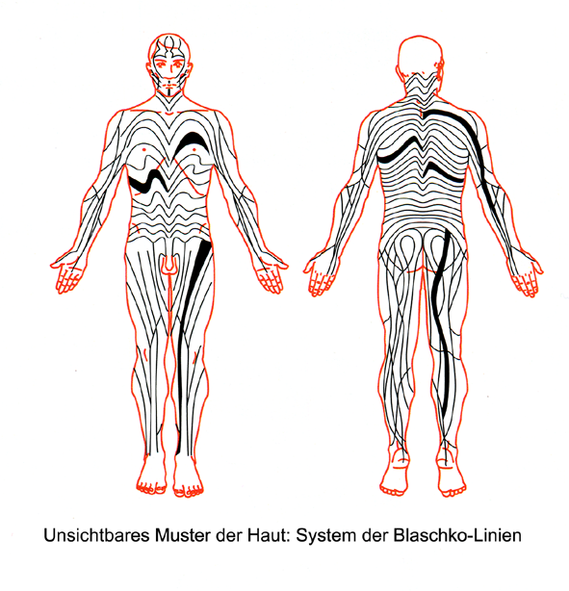

Slide 52
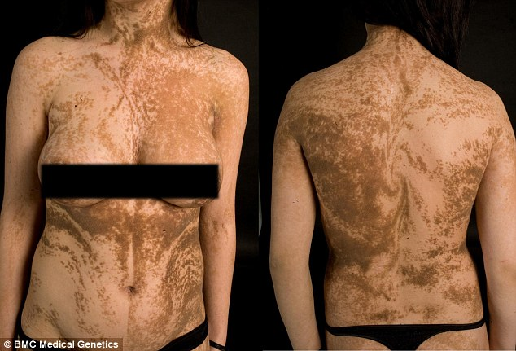
Pigmentverteilung entlang der Blaschko-Linien: kutane Mosaike (Hautmosaike)
Notes:
Blaschko's lines take on the following patterns:
​Scalp - spiral
Face - vertical in the mid-face, laterally from the angles of mouth
Trunk - they differ from dermatomes in being more numerous and wave-like on the lateral trunk, and V-shaped in the middle of the back. Anteriorly they never cross the midline. Posteriorly the midline is often shifted from the anatomical midline
Arms and legs - linear or whorled (spiral), roughly parallel with long axis of the limbs

Slide 53
Fehlentwicklungen

Slide 54
Keratin Mutationen

Slide 55
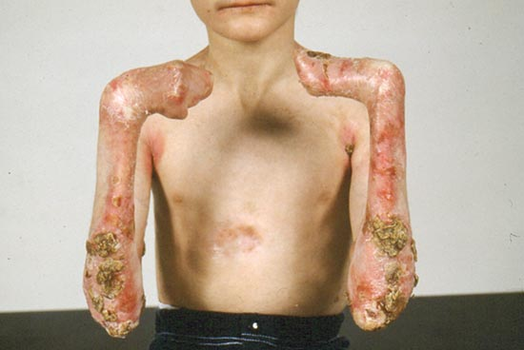
Epidermolysis bullosa: K14 Mutation
Notes:
Figure 10-29. Epidermolysis bullosa (EB). Extensive, trauma-induced bullae are the hallmark of this heterogeneous, inherited condition. Inheritance is either autosomal dominant or autosomal recessive; the latter tends to be more severe. Blisters can be superficial or deep, depending on the level of the defect. In the epidermolytic type (EB simplex), the defect lies in the epidermis; the blisters are superficial and leave no scarring. In junctional EB, the abnormality is in the lamina lucida of the dermal-epidermal junction and consists of defects in the hemidesmosomes. There is mucosal blistering and large nonhealing granulomatous ulcerations. Previously associated with a poor prognosis, good nursing has prolonged the life span of patients affected by this form of the disease. The disease can be associated with severe disabilities. In dystrophic EB, blistering occurs in the superficial dermis, resulting from absent or rudimentary anchoring fibrils. Blistering is present at birth, occurs at sites of trauma, and is followed by severe scarring and joint contractures in recessive dystrophic EB. Scarring of the hands and feet result in webbing of the digits with a mitten-like appearance. There are many extracutaneous manifestations that are difficult to manage and pose challenges for many different specialties. Prevention of infections and monitoring for electrolyte abnormalities is important. The pediatrician has to coordinate services related to feeding and nutrition, eye involvement, dental defects, esophageal/intestinal strictures, contractures, and so on. Parents should be counseled regarding the genetics and the outcome of this condition as soon as pathologic or molecular diagnosis is available.

Slide 56
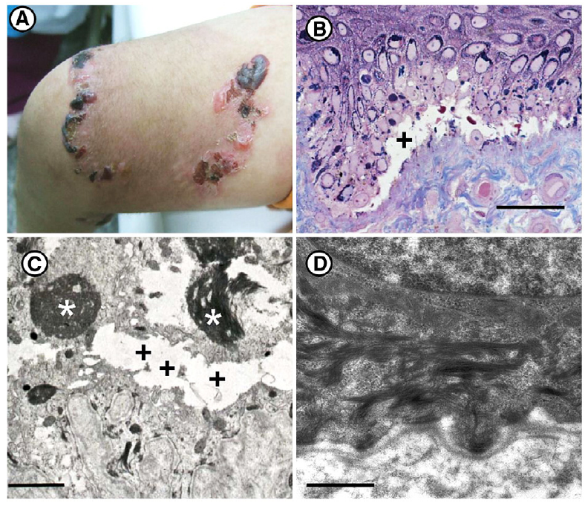

Slide 58
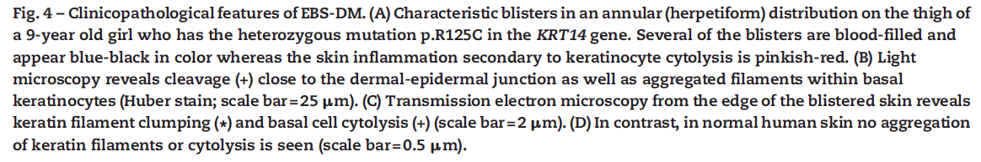
Epidermolysis bullosa simplex: K14

Slide 59
Desmosomale Mutationen

Slide 60
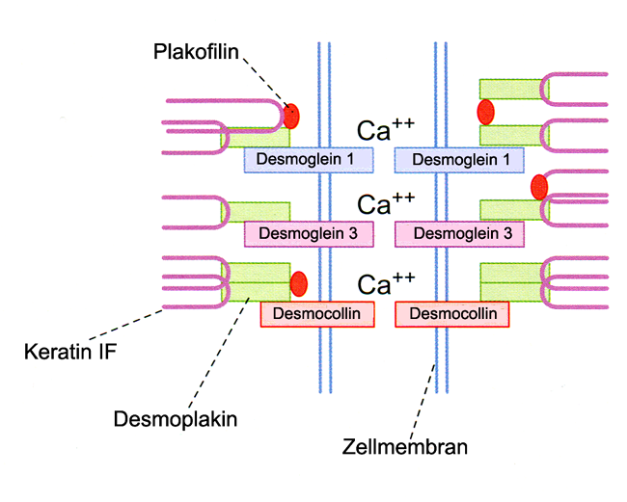

Slide 61
Skin fragility syndrome: PKP1 Mutation (Plakophilin1)

Slide 62
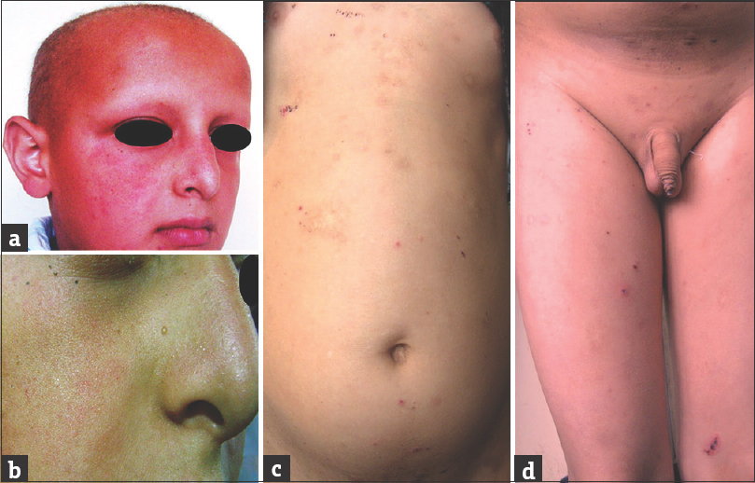
Skin fragility syndrome: PKP1 Mutation
Notes:
Indian J Dermatol, Kashyap, 2015
Figure 1: (a) Clinical image of face and head showing short and sparse hair over scalp, eyebrows, frontal bossing, and retracted ala nasi. (b) Closer view showing granulosis rubra nasi. (c and d) Photograph showing multiple crusted erosions with hyper pigmented macules seen over the trunk, groins and thighs

Slide 63
Desmoplakin Mutation: palmoplantare Keratoderma

Slide 64

Collodion baby

Slide 65



Collodion baby:
10% der Falle heilt sich ohne Konsequenzen (spätere, postnatale Ablösung des Periderms?) , bei den übrigen entwickeln sich verschieden Ichthyosen, wegen Mutationen in den Gene: TGM1, ALOXE3, ABCA12
Nich schmerzhaft für Neugeborene.

Slide 66
Angeborene Ichthyosen

Slide 67
Ichthyosis
Ichthyos (gr): Fisch: Fischschuppenartige Haut
Verhornungsproblemen: deswegen ist eine kompensatorische Hyperkeratose
Angeborene Formen entstehen durch Mutationen in den Genen:
STS (Steroid Sulphatase): Cholesterin desuplhurierung, Str. corneum, Lamellenkörper
FLG (Filaggrin)
TGM1: Transglutaminase-1 Hornschuppen
ABCA12: Lipidtransport; Harlequin-Ichthyosis

Slide 68


recessive X-linked Ichthyosis (RXLI);
STS-Genmutation
Notes:
Steroid Sulphatase Mutation: Anhäufung von Cholesterol Sulphate in nEpidermis, schwacht die Barrier, deswegen kommt eine kompensatorische Hyperkeratosis
Lamellar Ichtyosis: Transglutaminase Mutation

Slide 69

Lamellar ichthyosis:
TGM-1, Cyp4F22, andere Gene
Notes:
69
Figure 10-49. Lamellar ichthyosis. The word ichthyosis means "fish scale." This heterogeneous group of hereditary diseases is characterized by varying degrees of scale accompanied in some types by erythema. Lamellar ichthyosis is recessively inherited and starts at birth with a collodion membrane covering the skin. After shedding of the membrane, the skin may be normal for some weeks before the development of the lamellar scale that is characterized by black platelike scales, particularly noticeable on the forehead and trunk. The cheeks may be spared. The diagnosis is made on clinical grounds. Recent genetic studies have shown a transglutaminase-1 abnormality in 10% to 20% of patients.

Slide 70

Harlequin Neugeborenes:
ABCA12 Mutation

Slide 71



Harlequin Neugeborenes
Sie können einige Tage/Wochen leben (maximal war früher 2,5 Jahre; jetzt mehr als 30 Jahre)
ABCA12 Mutation
Notes:
ABCA12 ATP binding casette transporter A12: Lipidtransport aus den Zellen ist gestört)

Slide 72
In das Epithel eingewanderte Zellen

Slide 73


Ausschwärmung der Neuralleiste Zellen:
dorsolateraler Weg (Melanozyten)
ventraler Weg: verschiedene Ganglien, Nebennierenmark
Kopf Neuralleiste: neben den oben erwähnten noch: Knochen (desmale Knochen der Schädeldecke, Knochen des Gesichtsschädels), Bindegewebe (Dermis, Subkutis, Sehnen), glatte Muskulatur, Dentin.
(Ich habe auch die quergestreifte Muskulatur (zB: Kaumuskeln) erwähnt: es ist ein Fehler! Sorry dafür!)

Slide 74

Melanozyten im menschlichen Epidermis (Immunohistochemie)
Notes:
A hámot az ED40-50 között érik el. A melanintartalmuk révén láthatóváválnak a 10-11EW-től. Tranzit hely: a dermis, itt egy kis időt töltve lépnek át a hámba, még a késői fetális hónapokban is látni melanocitát a dermisben. Melanocita szám 2300/mm2, lemegy 800/mm2.

Slide 75


Slide 76

Melanin Pigentstoffe entstehen aus AS Tyrosin durch Tyrosinase Enzym.

Slide 77

Melanosomen-Reifung: Stadien I-IV
Durchmesser: bis 500 nm
Membrangebundene Organelle

Slide 78

Notes:
Marks, Nat. Rev. Mol Cel. Biol 2001

Slide 79

Langerhans Zellen (der Küken)
ectoATPase-CD45
ectoATPase and vimentin
(d) CD45
Immunohistochemie in epitheliale Schichten
Langerhans Zellen migrieren in das Epidermis von der EW7 ein. Sie stammen aus Knochenmark (CD45-positive Zellen)

Slide 80

Merkel Zellen wandern auch in das Epidermis ein. Sie stammen aus der Neuralleiste.

Slide 81



Slide 82
Dermis
Im Körper: Dermis stammt aus Somatopleura (ventral und lateral) und Somiten (Dermatom; dorsal)
Im Kopf: vorwiegend aus Neuralleiste
Extremitäten: auch Somatopleura

Slide 83


Gewebs-rekombination: Hornhautepithel (aus adulter Auge) mit embryonalem Dermis (aus Rückenregion)
Notes:
Ferraris, Development 127, 5487-5495 (2000)
A jobb oldalon: Formation of hair follicles (pilosebaceous units) induced in adult rabbit (A) corneal epithelium by a mouse embryonic hair-forming dermis, in kidney capsule grafts. (A) After 21 days, adult rabbit corneal epithelium associated with 14.5-day mouse embryo dorsal dermis. Longitudinal section showing a hair follicle (h) with associated sebaceous gland (sg). Note that the pluristratified epithelium now includes a granular layer (gl) and a cornified layer (cl), which
characterizes it as epidermal type.
B jobb oldal: Formation of foot pads associated with sweat glands in adult rabbit corneal epithelium induced by 15.5-day mouse embryonic plantar dermis, 21 days after grafting under the kidney capsule. (B) Longitudinal section of a foot pad, showing an epidermis characterized by an easily recognisable cornified layer (cl), and a well-formed sweat gland (sw).

Slide 84
Entwicklung der Haaren
Erste Haaren erscheinen am Ende des 2. Monats (Augenbraune, Wimpern, Oberlippe), dann eine Pause
Weitere Entwicklung setzt sich im 4. Mo fort, und bis Ende des 5. Mo alle Haare sich entwickeln. Nach Geburt entwicklen sich keine neue Haarfollikeln.
Insgesamt haben wir ungefähr 5 Mio Haarfollikeln.

Slide 85
Entwicklung der Haaren
Erste Haaren sind sehr zarte Haare: Lanugo
Diese werden noch vor dem Geburt (um 7-8. Mo) durch grobere Haaren (Vellus-Haare) ersetzt (aber sind in einigen Fallen bis frühen postnatalen Periode erhalten).
Stadien: Haarplakod-Haarknospe (hair germ), Haarstange (hair peg)- Haarfollikel

Slide 86

Lennart Nilsson

Slide 87

Lanugo mit Vernix caseosa
Vernix: Fruchtschmiere oder Käseschmiere: ist die Produkt der hypertrophierten Talgdrüsen des Fetus plus abgeschilferte Epithelzellen

Slide 88

Vernix caseosa

Slide 89
Entwicklung der Hautanhangsgebilden

Slide 90


Slide 91

Die Entwicklung der Hautanhangsgebilden beginnt sehr ähnlich
Zahn
Haar
Milchdrüse
Epitheliale Plakoden

Slide 92


Slide 93

Haarknospe: (hair germ) ED80; Abb. A
Haarstange (hair peg): (B-F) ertses Trimester
BHP: bulbous haar peg: mit dermaler Papille
Larsen 9e

Slide 94

Wechselwirkungen zwischen Epithel und Mesenchym:
Signale aus Mesenchym induzieren epidermalen Plakoden. Die Plakoden produzieren mehrere Wnt Typen, wie 4,6,7,10a,10b und auch wnt Inhibitoren (schneller diffundierende) Dkk Typen, wie Dkk1,4. Die langsam diffundierende Aktivatoren (Wnts) und schneller diffundierende Inhibitoren (Dkks) werden das Epithel in Haarbildenden Plakoden und interplakodalen Regionen einteilen.

Slide 95


Slide 96

Wildtyp Maus (links) und transgenetische Maus, wo Dkk2 (kurz vor epithelialen Plakodenbildung) überexprimiert wurde: die Densität der Haarfollikeln ist drastisch geringer geworden.

Slide 97

Haarplakoden werden durch Wnt und Eda Signalisierung bestimmt; Bestimmung des Abstandes der einzelnen Haarplakoden durch: FGFs, Follistatin und Tgfb2 fördern (näher), Bmp/Tgfb1 hemmen (weiter); Wachstum der Plakode (und Knospe-Stange): Shh (mitotisch)

Slide 98
Haarfollikel? Schweißdrüse?
Was determiniert, ob welche Strukture aus einem Plakod entwickeln kann? Soll es schon vor die Plakodbildung schon bestimmt werden?
In den Plakoden sind viele Molekülen exprimiert (zB Haarplakod: Wnt 4,6,7,10a,10b, und noch weitere; Wnts daneben Dkk1,4, und auch noch weitere Dkks). Dkk2-Überexpression verursacht eine Reduktion in der Zahl der Haarfollikeln. Dkk4-Überexpression stört nicht die Zahl der Haarfollikeln, aber reduziert die Zahl der Schweißdrüsen. Sollen solche feinere Steuerungen den Schicksaal bestimmter Epithelbezirken determinieren?

