Slide 1






Fehlbildungen des Herzens, der großen Arterien, Gefäßbildung
Medizinische Embryologie
2017/2018
dr. Attila Magyar
20.03.2018

Slide 2
Gefäßbildung
Blutinseln: Dottersack, extraembryonal
Gefäßbläschen: Vaskulogenesis, intraembryonal
Verlängerung und Fusion dieser Bläschen: Bildung eines Netzwerks
Angiogenesis: Ausstülpung neue Gefäße aus den schon existierenden Gefäßen

Slide 3
Blutinseln

Slide 4
Bildung der Blutzellen und Blutgefäßen aus Blutinseln
Notes:
McGeady, Quinn, FitzPatrick, Ryan, VETERINARY EMBRYOLOGY, Blackwell, 2006

Slide 5
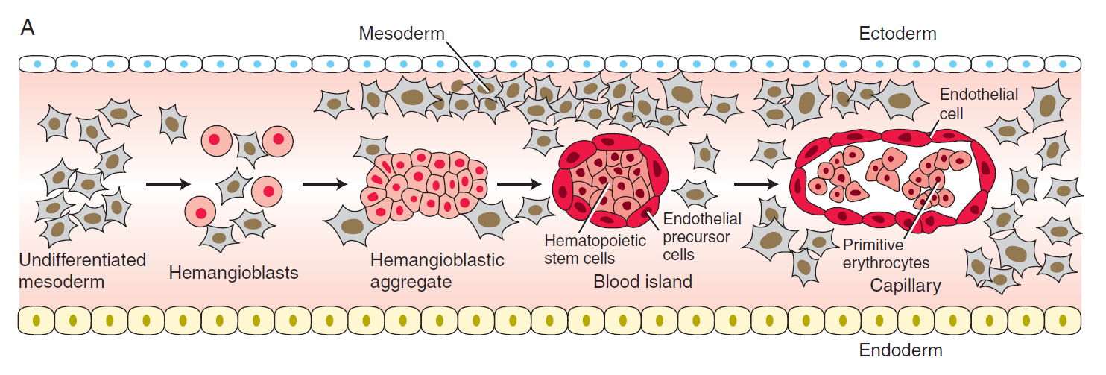
Hämangioblast: mesenchymale Stammzelle für Blutbildung und Endothelbildung
Bildung der Blutinseln im Mensch: von ET17, zuerst extraembryonal (in der Dottersackwand)
Notes:
Larsen’s Human Embriology (4E, Schoenwolf, Bleyl, Brauer, Francis-West, Churchill-Livingstone, 2009)

Slide 6
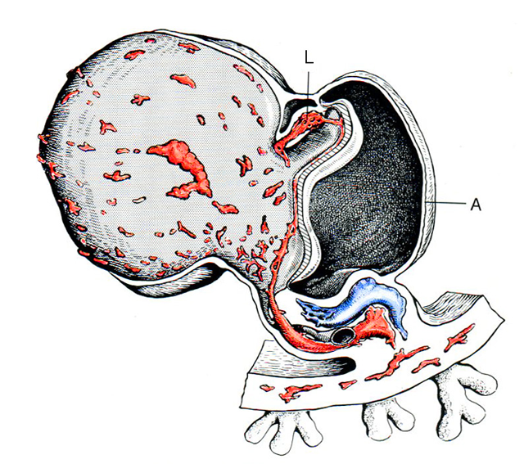
Fusion der Blutinseln zu Netzwerken von Blutgefäßen
Notes:
Hinrichsen, Human Embryologie, Springer, 1990

Slide 7
Vaskulogenesis

Slide 8
Vaskulogenesis
beginnt ab E18 intraembryonal
ohen Blutzellbildung (nur de novo Gefäßbildung), d.h. nur Angioblasten oder Endothel Vorläuferzellen (EPC)
EPC entstehen nur in der Splanchnopleura
Somatopleura: EPCs wandern hinein

Slide 9
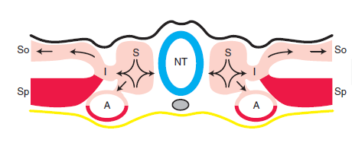
Ursprung der Gefäßbildenden Stammzellen: die meiste Angioblasten (EPC: endothelial precursos cells) stammen aus Splanchnopleura (rot), aber werden solche Stammzelle auch in dem paraxialen Mesoderm entstanden. Diese letztere können in verschiedenen Regionen einmigrieren, so ist es möglich, daß die Aorte ventral aus splanchnopleuralen Endothelzellen, doersal aus paraxialen besteht.
Notes:
Larsen’s Human Embriology (4E, Schoenwolf, Bleyl, Brauer, Francis-West, Churchill-Livingstone, 2009)

Slide 10
Vaskulogenesis:
passiert in der intraembryonalen Splanchnopleura
Notes:
Larsen’s Human Embriology (4E, Schoenwolf, Bleyl, Brauer, Francis-West, Churchill-Livingstone, 2009)

Slide 11
Angiogenesis: neue Gefäe können durch Ausstülpung (sprouting) oder durch Zweiteilung (intussusception) der schon existierenden Gefäßen entstehen.
Notes:
The primitive vascular network established through vasculogenesis is expanded and remodeled by angiogenesis. Expansion by angiogenesis occurs by sprouting from existing vessels or by intussusception, a splitting of existing vessels.
Larsen’s Human Embriology (4E, Schoenwolf, Bleyl, Brauer, Francis-West, Churchill-Livingstone, 2009)

Slide 12
Angiogenesis mit Intussusception (Co: Kollagenfasern, Fb: Fibroblast, grün: Endothelzelle, Pr: Perizyt, BM: Basalmembran)
Notes:
Intussusceptive angiogenesis. A, B, Drawings illustrating the basic steps of intussusceptive angiogenesis. It begins with the protrusion of opposing capillary endothelial cells (EC) into the lumen. At the point of contact, the endothelial layer and basement membrane (BM) is perforated and invaded by pericytes (Pr, capillary supportive cells) and interstitial fibroblasts (Fb) while the epithelial lining of the newly formed capillaries is reconstituted. Co, collagen.
Larsen’s Human Embriology (4E, Schoenwolf, Bleyl, Brauer, Francis-West, Churchill-Livingstone, 2009)

Slide 13
An diesen Bildern sieht man den Vorgang der Intussusception, Abschnürung eines Gefäßes von einem Netztwerk schon existierenden Gefäßchen.
Notes:
Scanning electron micrograph showing branching of chick
chorioallantoic membrane vessels by intussusception. A, Perforations and
pillars penetrate into existing vessels and bridge across the vessel lumen
(arrows). B, C, Pillars then lengthen and merge (arrowheads) and eventually sever and separate the vessel (curved arrows) from the underlying capillary bed.
Larsen’s Human Embriology (4E, Schoenwolf, Bleyl, Brauer, Francis-West, Churchill-Livingstone, 2009)

Slide 14
Notes:
Pardali TICB, 2010

Slide 15
Hypothesized model for establishing arterial and venous identity and for the remodeling leading to the formation of two separate types of vessels.
Notch signaling (by repressing the expression of the venous phenotype) and Tgf!/Alk1 signaling both promote the expression of arterial markers in
endothelial precursor cells, possibly instilling an arterial identity to these cells before they assemble primitive vessels. This leads to the expression of EphrinB2 in arterial cords and
EphB4 in the venous cords, which is ultimately responsible for segregating the two vessel groups.
In this model, Ang/Tie signaling serves to stabilize these vessels and regulate their maturation. Angiogenic growth (mediated by Vegf/Nrp1 signaling in arterial beds and Vegf/Nrp2 signaling in venous beds) and remodeling then sculpts these vascular beds into their final configurations.

Slide 16
Blutzellenbildung: Hämatopoese mit verschiedenen Phasen:
Dottersack Phase (erste, von hier wird die erste Besiedlung der Leber stattfinden)
1. hepatische Phase (um 23 ET)
Aorta-Gonad-Mesonephros (AGM) Region, von hier wird Leber zweitemal besiedelt (um ET30: Adult-Type Hämopoese)
Knochenmark-Phase ab EW10,5, aber Leber bleibt bis Geburt die Hauptstelle der Blutzellbildung.
Notes:
Larsen’s Human Embriology (4E, Schoenwolf, Bleyl, Brauer, Francis-West, Churchill-Livingstone, 2009)

Slide 17
Blutbildung in der AGM-Region: in dem splanchnopleuralen Mesenchym von Aorte, Gonaden, Mesonephros
Notes:
Larsen’s Human Embriology (4E, Schoenwolf, Bleyl, Brauer, Francis-West, Churchill-Livingstone, 2009)

Slide 18
Hämopoetische Stammzellen in der Aortenwand:
A: 3-Tage-altes Kükenembryo, Immunhistoichemie für CD41
B: ET10 Mausembryo mit CD41
C: junges Schweinembryo (Zeichnung)
D: ET35 menschliches Embryo mit anti-CD45
Notes:
Larsen’s Human Embriology (4E, Schoenwolf, Bleyl, Brauer, Francis-West, Churchill-Livingstone, 2009)

Slide 19
Fetaler Blutkreislauf

Slide 20
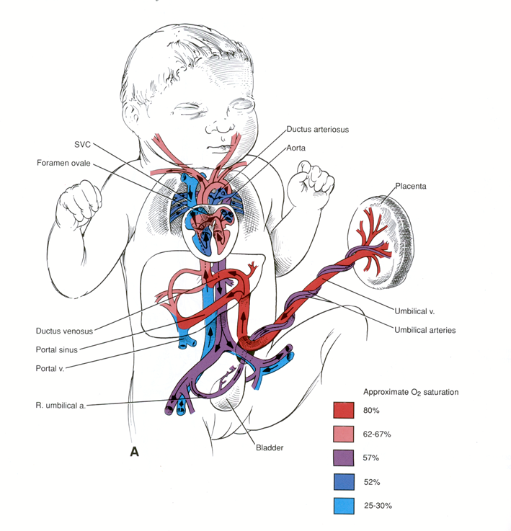

Slide 21
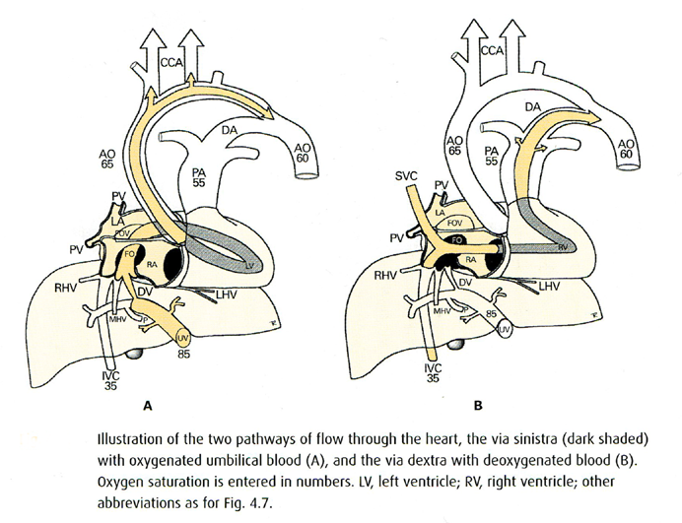
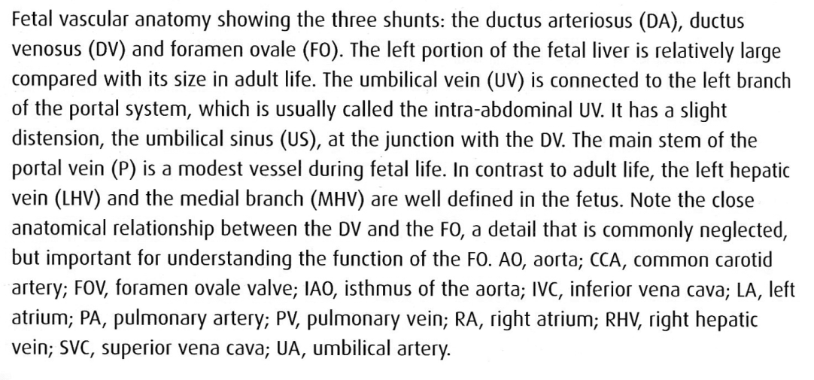
Ductus arteriosus und venosus im menshclichen Embryo. Die Zahlen bedeuten die Sauerstoffsättigung des Blutes.

Slide 22
Genetische Mutationen, die Herzfehler verursachen können

Slide 23
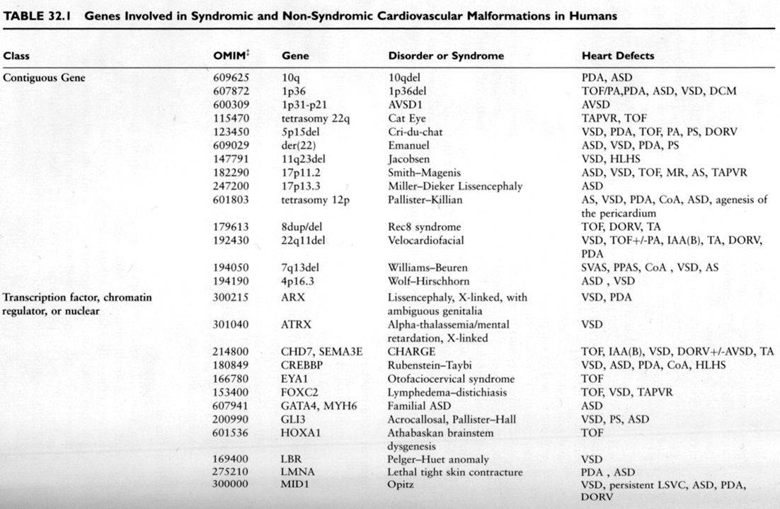
1
Principles of developmental genetics, Sally E. Moody, Academic Press 2007

Slide 24
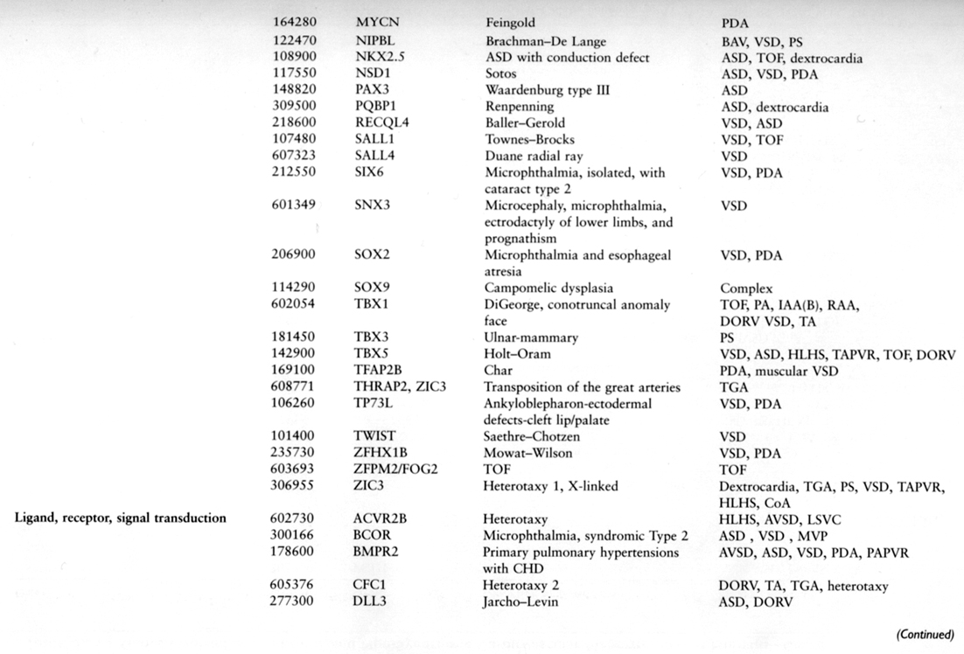
2
Principles of developmental genetics, Sally E. Moody, Academic Press 2007

Slide 25
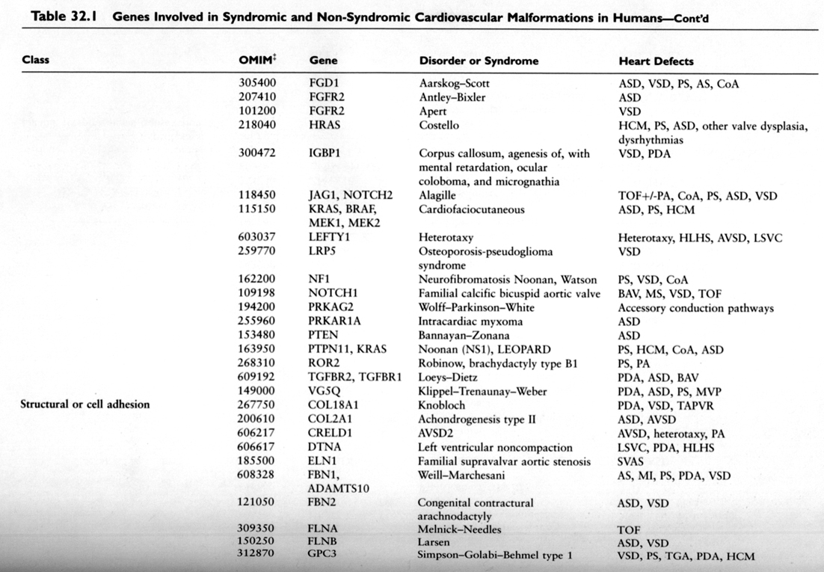
3
Principles of developmental genetics, Sally E. Moody, Academic Press 2007

Slide 26
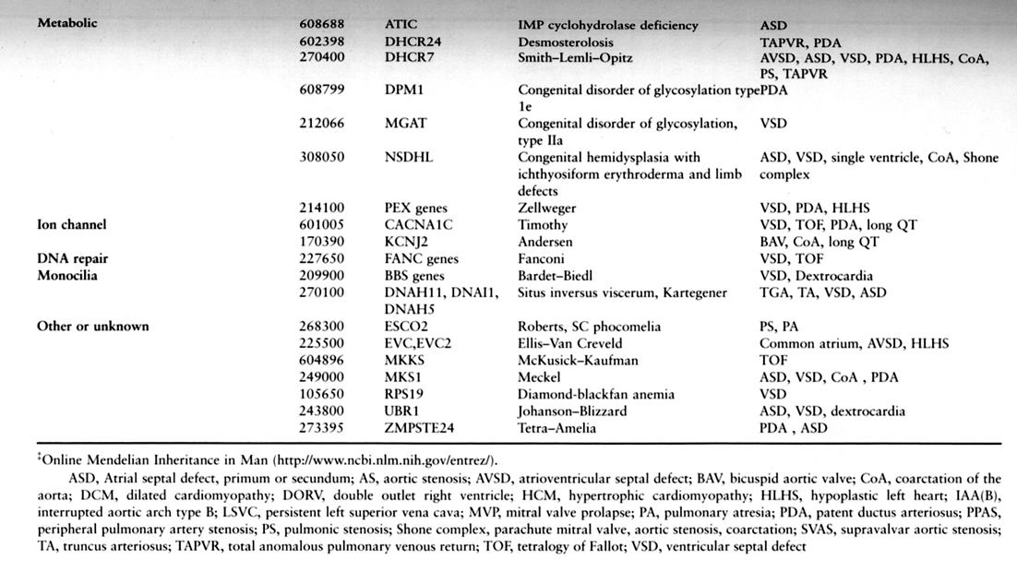
4
Principles of developmental genetics, Sally E. Moody, Academic Press 2007

Slide 27
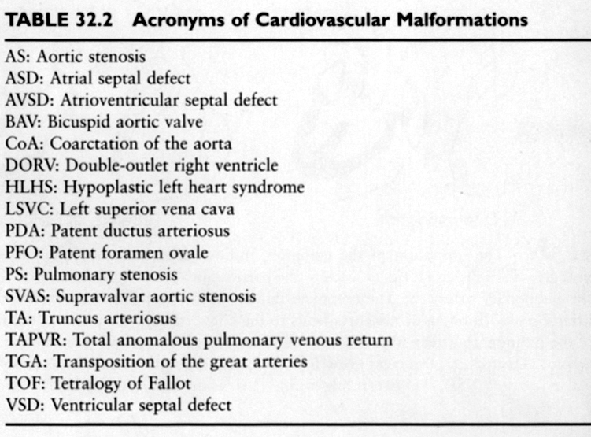
Principles of developmental genetics, Sally E. Moody, Academic Press 2007

Slide 28
Kongenitale Herzfehler
Eingeteilt in drei Gruppen (Bruneau, Nature, 2006):
zyanotische Herzfehler (Herzvitien; Vitium, Vitia: Fehler)
Linksherzobstruktionen
Septierungsdefekte

Slide 29
I. Zyanotische Herzfehler
Blaue Babys: sauerstoffreiches und –armes Blut wird gemischt
Einige Beispiele:
TGA (Transposition der großen Gefäßen)
TOF (Tetralogy of Fallot)
PTA (Persistierender Truncus arteriosus)
DORV (Double outlet right ventricle)
TAPVC (Totale Lungenvenenfehlmőndung)
EA (Ebstein-Anomalie)

Slide 30
II. Linksherzobstruktionen
HLHS (hypoplastisches Linksherz Syndrom)
MS (mitrale Stenose)
AS (Aortenstenose)
CA (Coarctatio aortae)

Slide 31
III. Septierungsdefekten
ASD (Vorhofseptumdefekten)
VSD (Ventrikelseptumdefekten)
AVSD (Vorhof-Ventrikelseptumdefekten)

Slide 32
IV. Andere, nicht eingeteilte Kategorien
BAV (bikuspidale Aortenklappe)
PDA (Patent Ductus Arteriosus)
ccTGA (congenitally corrected transposition of the great arteries)

Slide 33
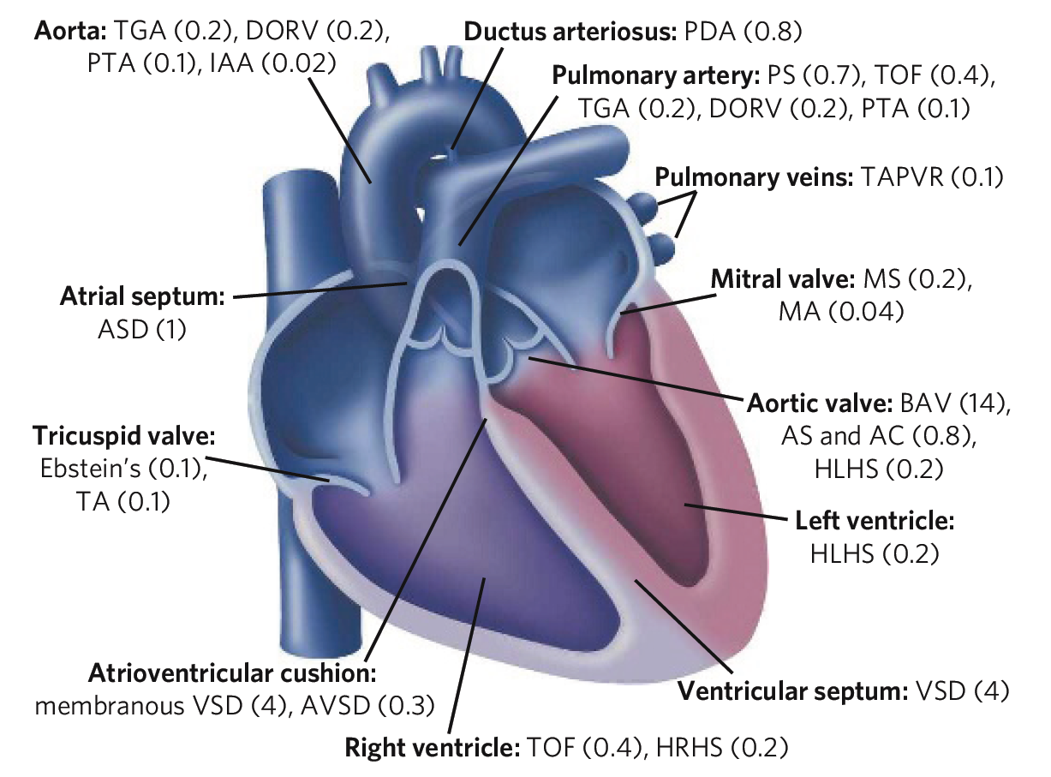
Häufigkeit der Herzfehler
Notes:
Bruneau, Nature 2006

Slide 34
I. Zyanotische Herzfehler

Slide 35
TGA

Slide 36
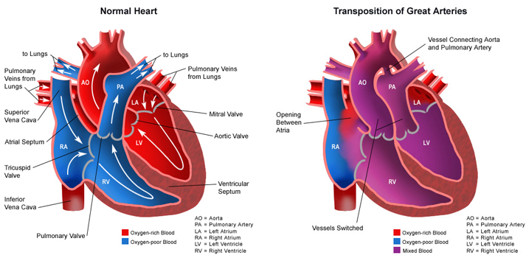
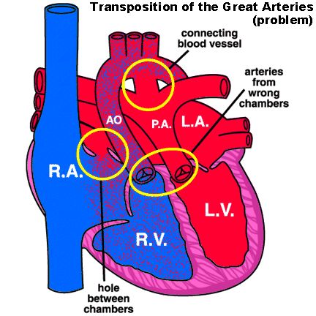

Slide 37
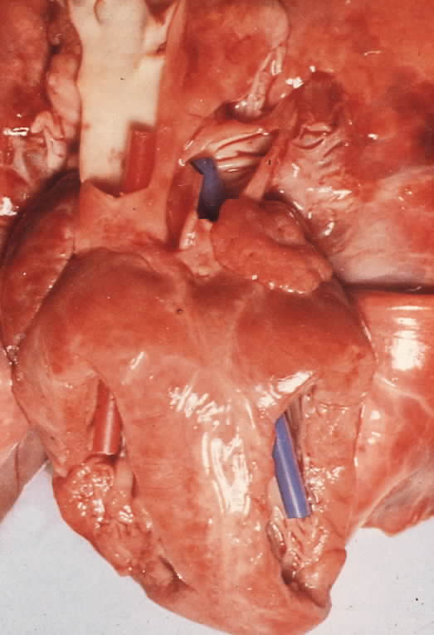
Transposition of great arteries (TGA)
Assoziiert häufig mit Mutationen (Mensch):
NKX2-5
THRAP2

Slide 38
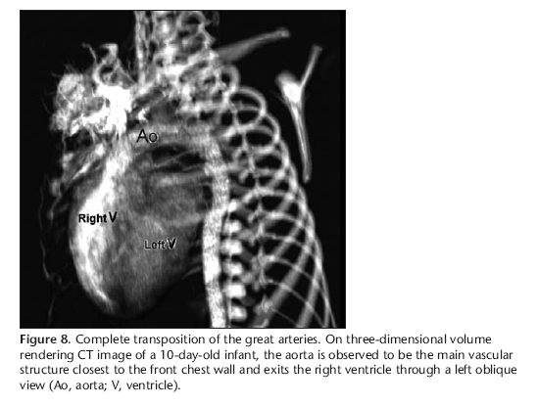
Notes:
Önbas, Diagnostic and Interventional Radiology

Slide 39
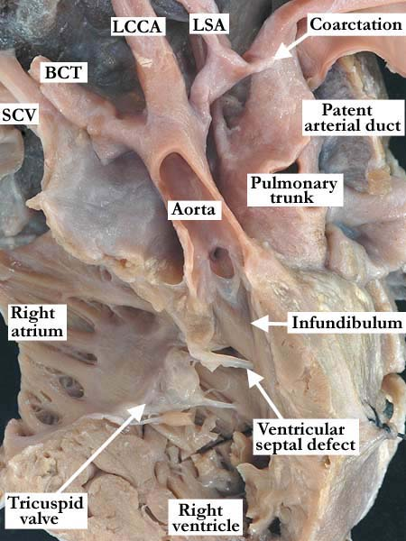
Notes:
The free wall of the right atrium and right ventricle, along with the anterior aspect of the aorta have been removed in this heart with transposition of the great arteries. The pulmonary trunk is posterior and to the left of the aorta. The aorta is stenotic and is supported by a complete muscular infundibulum. Distally, there is a severe aortic coarctation with narrowing of the isthmus between the left common carotid artery (LCCA) and the patent arterial duct. There are concordant atrioventricular connections and a non-committed, muscular ventricular septal defect. (SCV-superior caval vein, BCT-brachiocephalic trunk, LSA-left subclavian artery)
http://www.accd-awg.umn.edu/Transposition/TGA_VSD_COA_01_05_01/ACHA94_19b.html

Slide 40
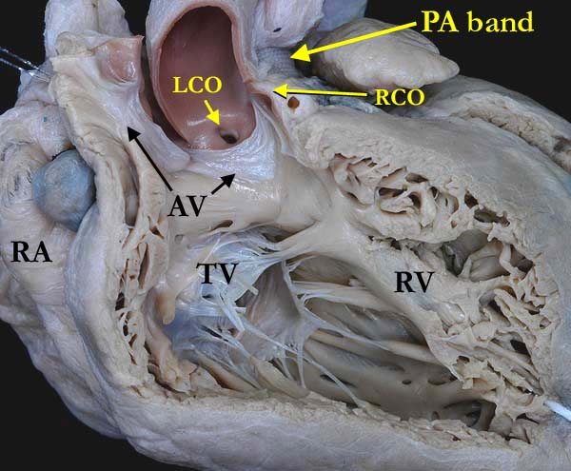
Notes:
A close up view of the heart shown in the left panel with the anterior portion of the aortic valve (AV) opened to demonstrate the discordant atrioventricular connections consistent with transposition of the great arteries. The aorta is anterior to the pulmonary trunk with a pulmonary artery (PA) band in place. The right coronary orifice (RCO) is adjacent to a commissure. Note the muscular infundibulum separating the aortic valve from the tricuspid valve (TV). (RA-right atrium)
http://www.accd-awg.umn.edu/Transposition/TGA_IVS_01_01_02/TGA_IVS_01_01_02.html

Slide 41
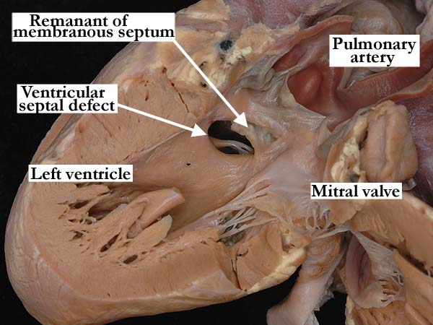
Notes:
The discordant ventriculo-arterial connections are easily seen on the left, with the mitral valve guarding the inlet and the pulmonary trunk forming the outlet component of the morphologically left ventricle. Note the fibrous continuity between the atrioventricular and arterial valves. There is a substantial remnant of the membranous septum at the roof of the perimembranous ventricular septal defect. (Van Mierop Archive – University of Florida,
Gainesville, FL)
http://www.accd-awg.umn.edu/Transposition/TGA_VSD_01_05_01/TGA4d.html

Slide 42
TOF

Slide 43
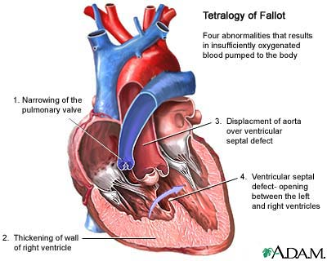
Notes:
http://health.allrefer.com/pictures-images/tetralogy-of-fallot.html

Slide 44
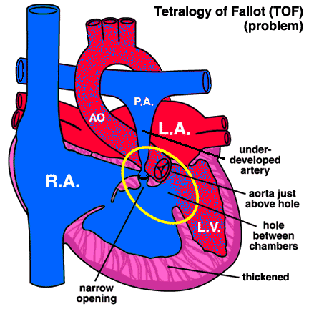
Fallot’sche Tetralogie:
assoziiert mit Mutationen:
NKX2-5
NOTCH1
TBX1
JAG1
NOTCH2
Notes:
http://www.inova.org/healthcare-services/pediatrics/types-of-services/pediatric-cardiovascular-program/procedures/systemic-to-pulmonary-shunt.jsp

Slide 45

Notes:
http://www.doctortipster.com/3146-tetralogy-of-fallot-symptoms-diagnosis-and-treatment.html

Slide 46
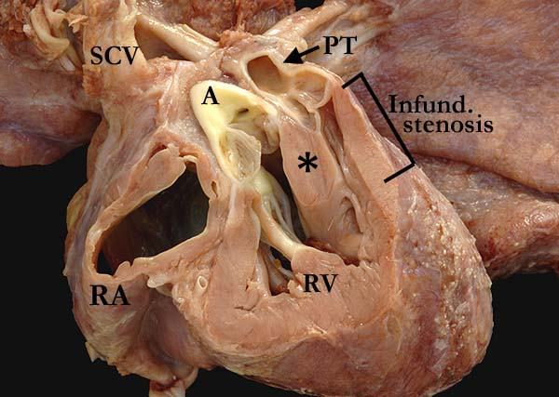
Notes:
This subcostal long axis view of the right ventricle (RV) demonstrates the anterior deviation of the outlet septum (*), causing the infundibular pulmonary stenosis associated with tetralogy of Fallot. There is also supravalvar pulmonary stenosis with dilatation of the pulmonary trunk (PT). The aorta (A) overrides the interventricular septum in this heart with an atrioventricular septal defect (not shown). (SCV-superior caval vein, RA-right atrium)
http://www.accd-awg.umn.edu/TOF/TOF_AVC_01_01_20/TOF_AVC_01_01_20.html

Slide 47
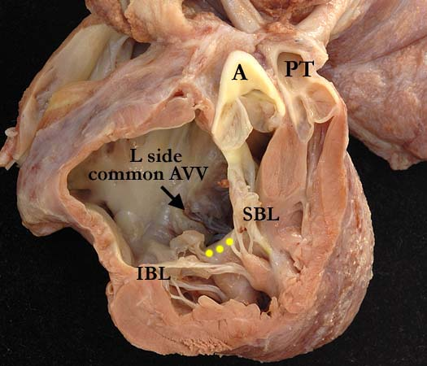
Notes:
A deeper cut into the right ventricle (RV) of the heart shown in TOF1a, shows the common atrioventricular valve (AVV). The left (L) component of the common atrioventricular valve is most posterior, the anterior portion resected and demonstrating the inferior (IBL) and superior (SBL) bridging leaflets as they cross the crest of the interventricular septum (yellow dots). The aorta (A) overrides the interventricular septum and the outlet septum is deviated anteriorly causing the infundibular pulmonary stenosis characteristic of tetralogy of Fallot. Please note the fibrous continuity between the aortic valve and the superior bridging leaflet
http://www.accd-awg.umn.edu/TOF/TOF_AVC_01_01_20/TOF1b.html

Slide 48
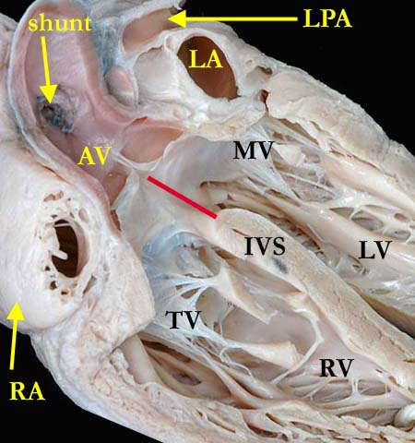
Notes:
http://www.ipccc-awg.net/Pulmonary_Atresia/PA_Atresia_TOF/TOF3b.html

Slide 49
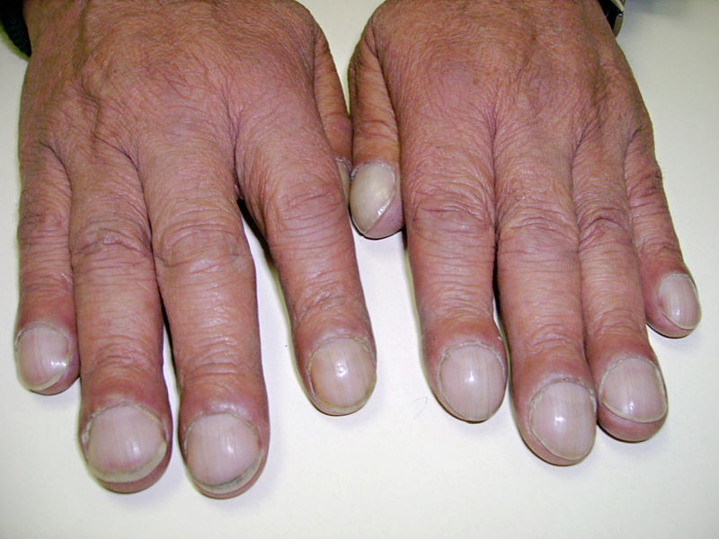
Notes:
Clubbing fingers, a common sign of TOF
Wikipedia

Slide 50
PTA

Slide 51
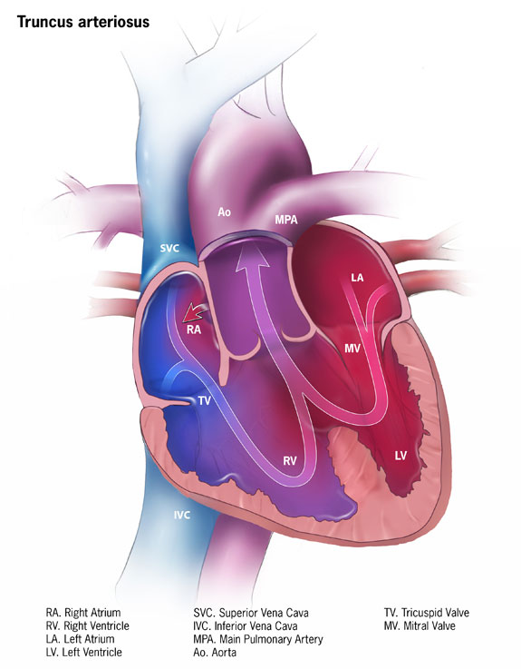
En:
Persistent Truncus Arteriosus (PTA)
De:
Truncus arteriosus communis
assoziiert mit Mutationen in TBX1

Slide 52
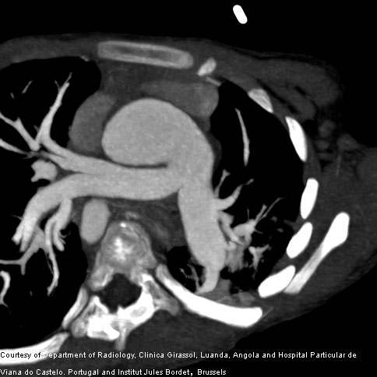
Notes:
Fig.2: MIP (Fig. 2) and VRT (Fig. 3) images demonstrate the arterial trunk which divides into the aorta and main pulmonary artery, and the main pulmonary artery subsequently divides into the left and right branch pulmonary arteries. Volumen rendering technique (VRT), Maximum intensity projection MIP
http://health.siemens.com/ct_applications/somatomsessions/index.php/diagnosis-of-truncus-arteriosus-using-flash-ct-scanning/

Slide 53
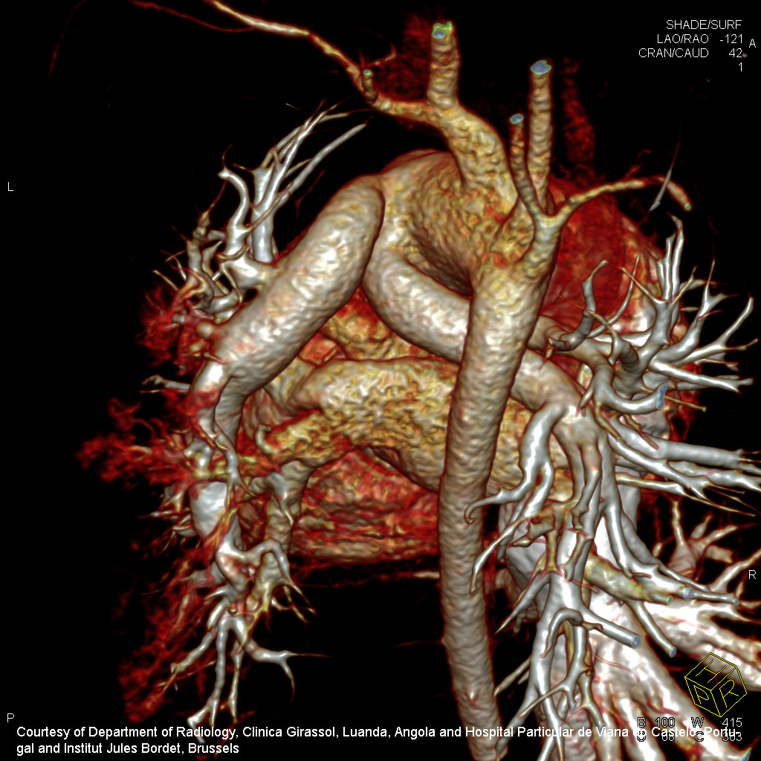
Notes:
Fig.3: MIP (Fig. 2) and VRT (Fig. 3) images demonstrate the arterial trunk which divides into the aorta and main pulmonary artery, and the main pulmonary artery subsequently divides into the left and right branch pulmonary arteries.
http://health.siemens.com/ct_applications/somatomsessions/index.php/diagnosis-of-truncus-arteriosus-using-flash-ct-scanning/

Slide 54
TAPVR

Slide 55
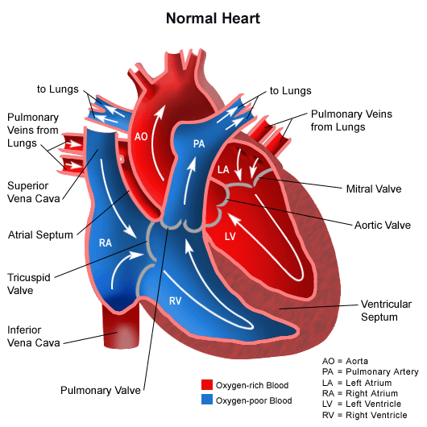
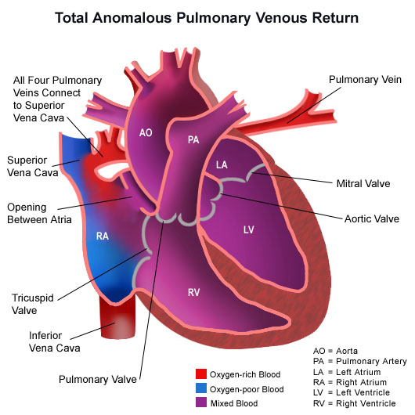
Total anomalous pulmonary venous return (TAPVR)

Slide 56
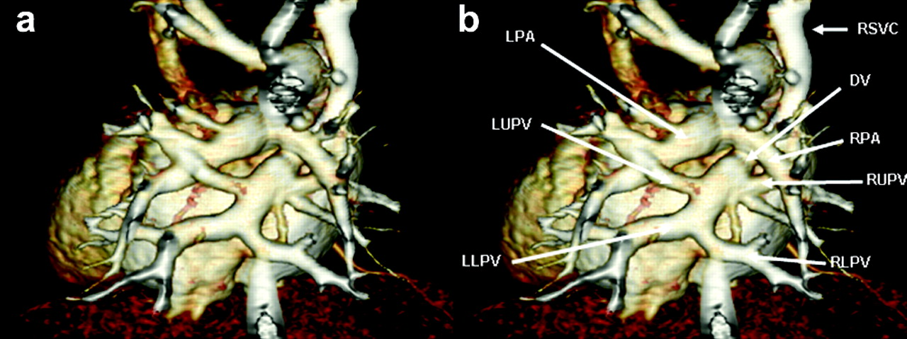
Fig. 1. Preoperative cardiac computerized tomography showing supracardiac total anomalous pulmonary venous drainage which was draining to the junction between the right SVC and the right atrium. LPA, left pulmonary artery; LUPV, left upper pulmonary vein; LLPV, left lower pulmonary vein; RSVC, right superior vena cava; DV, draing vein; RPA, right pulmonary arteryt; RUPV, right upper pulmonary vein; RLPV, right lower pulmonary vein.
Interactive CardioVascular and Thoracic Surgery 2008;7:282-284.

Slide 57
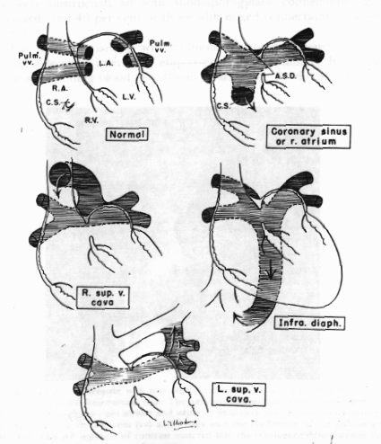
TAPVR:
mögliche Variationen

Slide 58
DORV

Slide 59
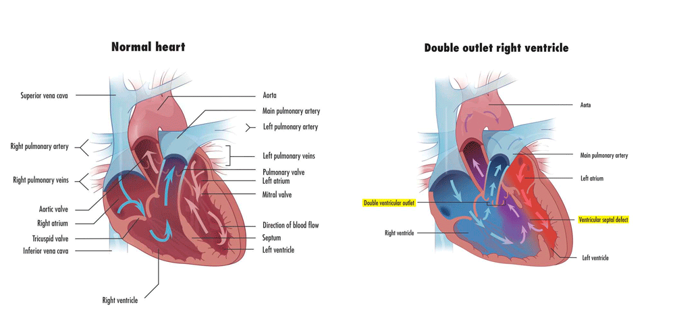
Notes:
http://www.childrenshospital.org/health-topics/conditions/double-outlet-right-ventricle-dorv

Slide 60
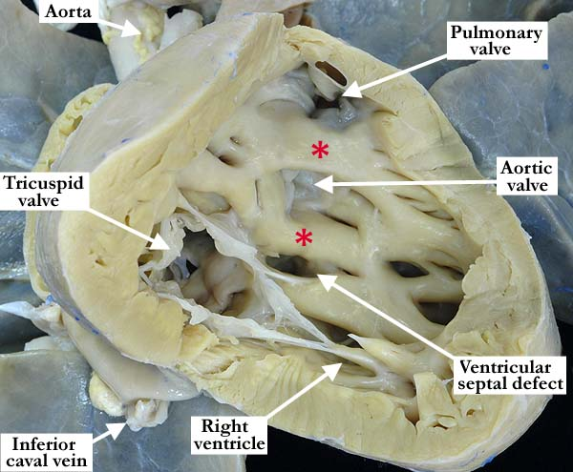
Notes:
The right ventricle has been opened in a clam shell-like fashion, showing the tricuspid valve guarding the inlet and the origin of both arterial trunks from this double outlet right ventricle. There are bilateral, complete, muscular infundibulums (red asterisks) supporting each arterial trunk with absence of continuity between the leaflets of the arterial and atrioventricular valves. There is a non-committed, restrictive, muscular, inlet ventricular septal defect. Note the coarse trabeculations within this morphologically right ventricle.
http://www.accd-awg.umn.edu/DORV/DORV_VSD/DORV_VSD_MA/CMAUN-T80b.html

Slide 61
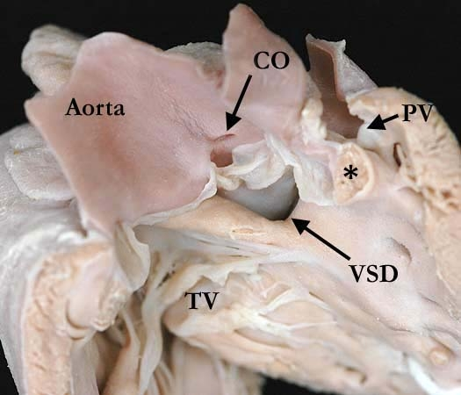
Notes:
This view of the septal surface and the outlet components of this double outlet right ventricle illustrates the aorta anterior and to the right of the pulmonary trunk with anterior deviation of the outlet septum (*). This arrangement is similar to that of tetralogy of Fallot with pulmonary stenosis secondary to the anterior deviation of the outlet septum. There is a subaortic ventricular septal defect with a posterior, inferior muscular rim separating the aortic valve from the tricuspid valve (TV). The single coronary orifice (CO) gives rise to a single coronary artery.
http://www.accd-awg.umn.edu/DORV/DORV_TOF/DORV2a.html

Slide 62
ccTGA

Slide 63
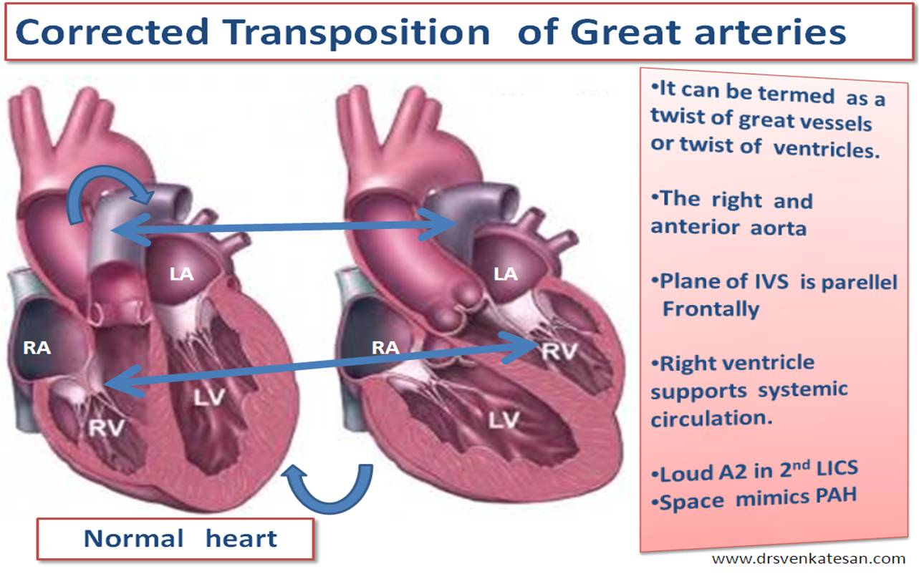

Slide 64
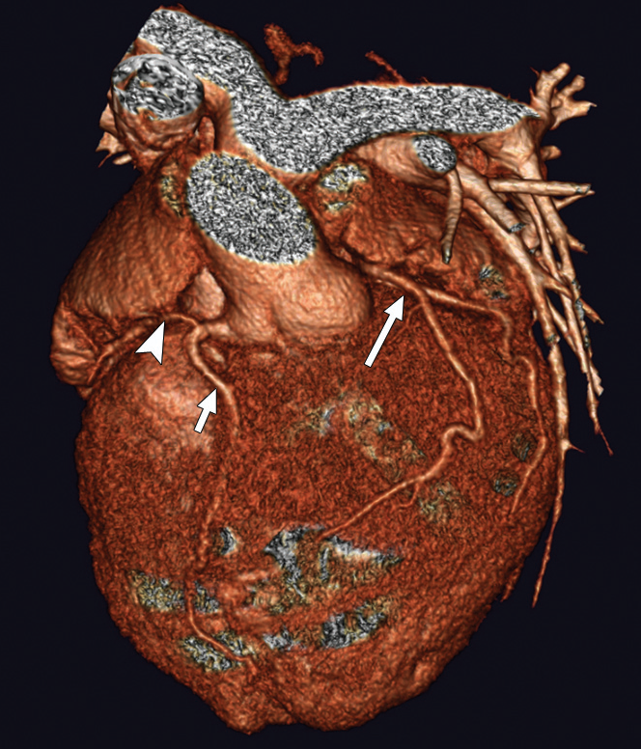
Chang, AJR 2007; 188:W428–W430
Congenitally Corrected
Transposition of the Great Arteries
Notes:
Three-dimensional volume-rendered image shows spatial relationship of great arteries with ascending aorta anterior and to left of main pulmonary artery. Anterior descending artery (short arrow) and circumflex artery (arrowhead) arise from common left ventricular coronary artery off of anterior aortic sinus. Right coronary artery (long arrow) arises from posterior aortic sinus.
Chang, AJR 2007; 188:W428–W430

Slide 65
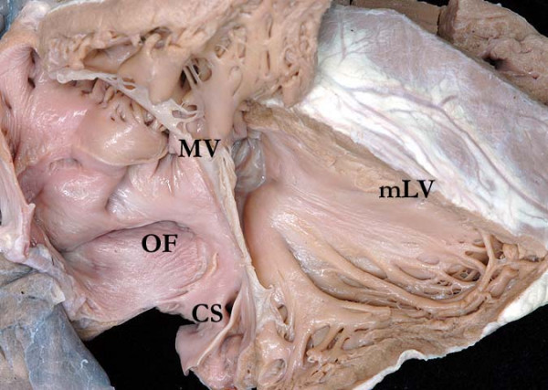
Notes:
This dissection is made to replicate the parasternal long echocardiographic projection. It shows the coronary sinus (CS) opening to the right-sided morphologically right atrium, which connects to the morphologically left ventricle (mLV) through the mitral valve (MV). The oval fossa (OF) is clearly seen in the atrial septum

Slide 66
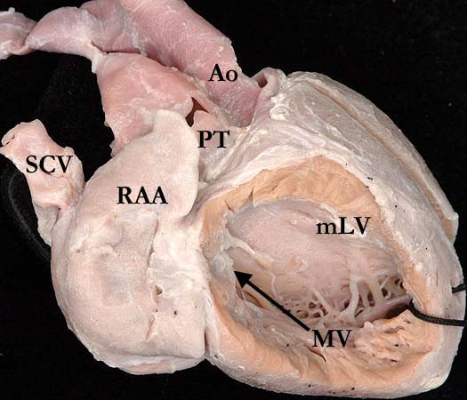
Notes:
This illustration demonstrates how the morphologically right atrium, with its characteristic appendage (RAA), is connected to a morphologically left ventricle (mLV) across the mitral valve (MV), with the ventricle then connected to the pulmonary trunk (PT). Note the smooth septal surface of the ventricle.

Slide 67
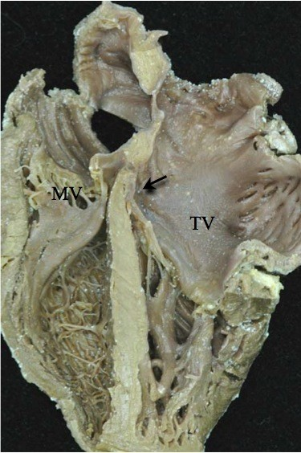
Notes:
Note the reversed off-setting of the attachments of the leaflets of the atrioventricular valves to the septum (Arrow), with the mitral valve (MV) on the right side attached appreciably higher that the tricuspid valve (TV) on the left side.

Slide 68
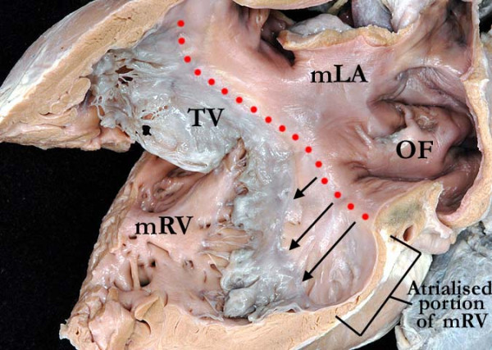
Notes:
This illustration demonstrates the apical displacement (lines) of the septal and mural leaflets of the tricuspid valve (TV). The morphologically left atrium (mLA) is connected to the morphologically right ventricle (mRV) through an Ebstinoid-like tricuspid valve. Note the flap valve of the oval fossa on the atrial septal surface.

Slide 69
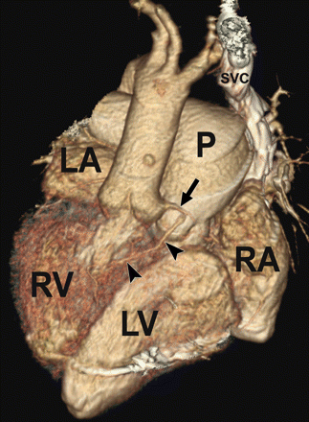
Congenitally corrected transposition oder L-Transposition
(geht zusammen mit AV-Block)
Am. J. Roentgenol. Maldjian and Saric 188 (6) S39
Notes:
Images from ECG-gated CT scan of 52-year-old woman with dextrocardia, situs inversus, and congenitally corrected transposition of great arteries (TGA). Volume-rendered image from anterior view provides 3D perspective of relationships of cardiac chambers and great vessels. Aortic valve is superior and to right of pulmonic valve, as expected with D-TGA. Pulmonary artery (P) is enlarged in this patient due to pulmonary arterial hypertension that is likely secondary to tricuspid valve disorder. Even though patient has situs inversus, anterior descending coronary artery (arrowheads) is supplied by left coronary artery (arrow) because ventricles are in D-loop configuration. LA = morphologic left atrium, LV = morphologic left ventricle, RA = morphologic right atrium, RV = morphologic right ventricle, SVC = superior vena cava.

Slide 70
CA

Slide 71
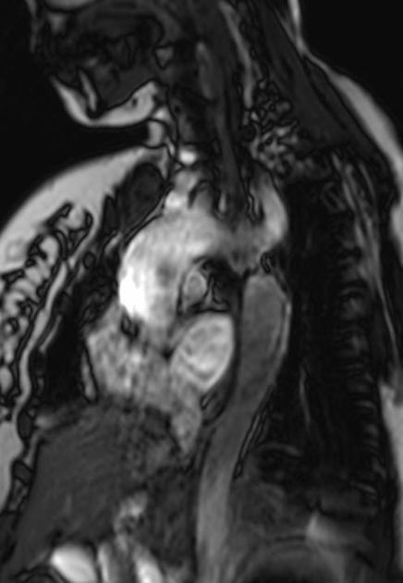
http://radiopaedia.org/cases/coarctation-of-the-aorta-7
Notes:
32 year old pregnant patient with hypertension.
On examination patient had weak lower limb pulses.
Oblique sagittal TRUFI image reveals post subclavian coarctation of aorta.

Slide 72
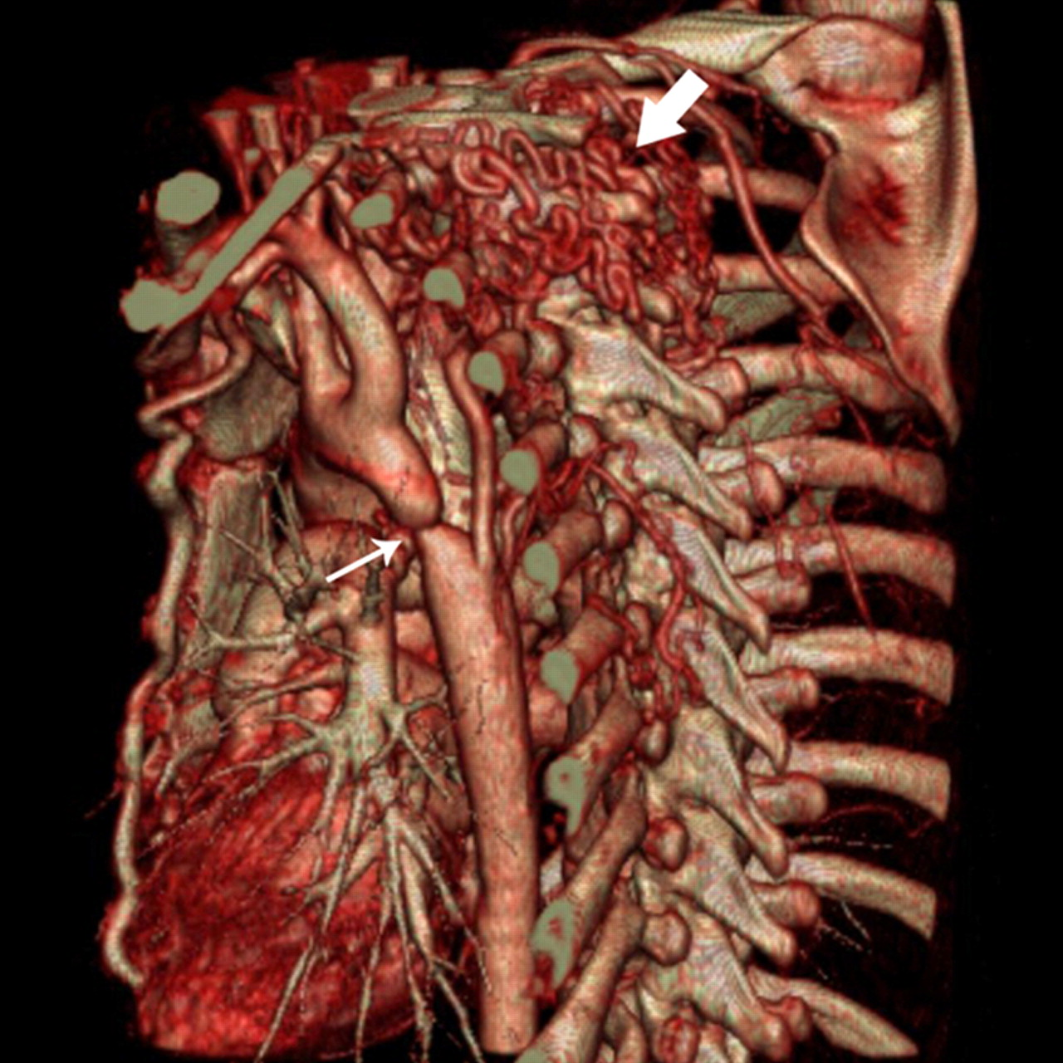
Leschka, RadioGraphics, 2007, 27: 829-846
Notes:
Coarctation of the aorta at nongated CT in a 25-year-old man with atypical chest pain. Thin-section volume-rendered image, obtained with reconstruction in an oblique left-posterior plane by using the cut-plane mode, demonstrates narrowing of the aortic isthmus (small arrow) and extensive collateral intercostal and nuchal arteries (large arrow).

Slide 73
Septumdefekten

Slide 74
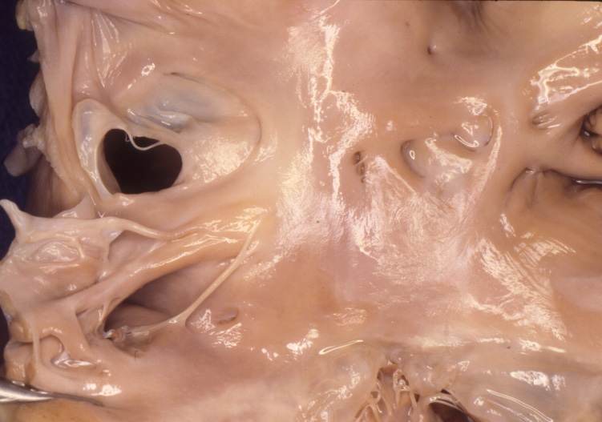
Atrial septal defect (fossa ovalis type)
(Ostium secundum Defekt: zu gross ist das O. Sec)

Slide 75
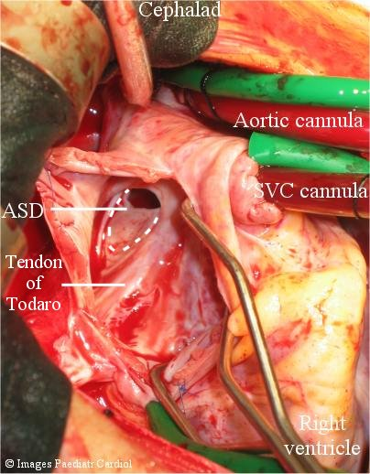

Slide 76
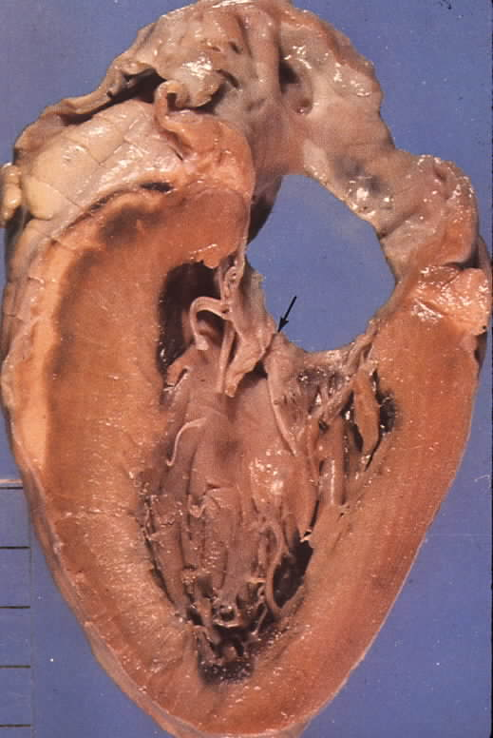
Atrial septal defect (atrioventricular septal)

Slide 77
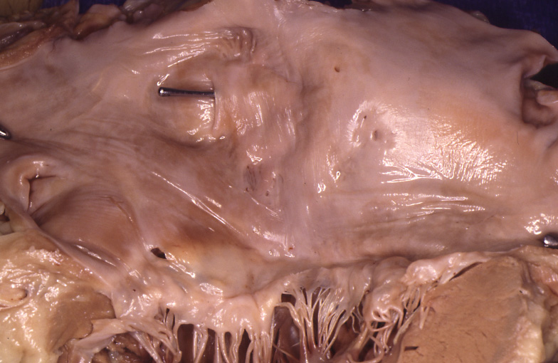
Patent foramen ovale (PFO): bis 30% der gesunden Bevölkerung!
(aber: stroke und migraine)

Slide 78
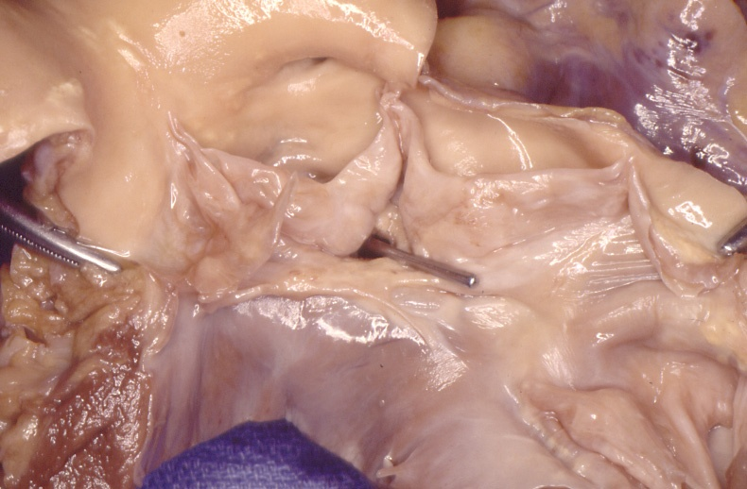
Ventricular septal defect (membranous type)

Slide 79
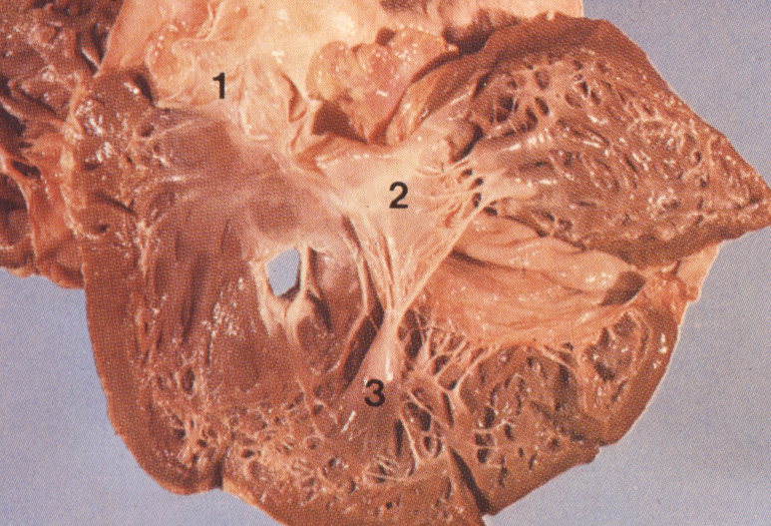
Ventricular septal defect (muscular type)

