Slide 1
Abdomen II
compiled by
András Csillag

Slide 2
Abdomen II
Retroperitoneal organs

Slide 3
Abdomen, axial CT
Rectus sheath/M. rectus abdominis
Costa
Hepar
Gaster
Colon, flexura lienalis
Recessus costodiaphragmaticus
Venae hepaticae
Vena cava inf.
Crus dextrum diaphragmatis
Oesophago-gastricus átmenet (cardia)
Spatium subphrenicum sin.
Mm. intercostales
Lien
Aorta
Vertebra thoracica X
M. erector spinae
M. latissimus dorsi
Csillag, Anatomy of the Living Human, Könemann 1999

Slide 4
Abdomen, axial CT
Rectus sheath/M. rectus abdominis
Costa
Hepar
Gaster
Colon
Lig. teres hepatis /fissura falciformis
Jejunum
Corpus pancreatis
Vena portae, rr. lobares
Lobus caudatus
V. cava inf.
Truncus coeliacus oszlása (a. hepat. comm. et gastr. sin.)
Aorta
Art. lienalis
Lien
Gl. suprarenalis sin.
Ren sinister
Gl. suprarenalis dext. (area nuda mellett)
Vert. thoracica XII
M. erector spinae
Csillag, Anatomy of the Living Human, Könemann 1999

Slide 5
Abdomen, axial CT
Rectus sheath/M. rectus abdominis
Costa
Lobus sin. hepatis, segmentum med. IV.
Lobus sin. hepatis, segmenta latt. II-III.
Duodenum
Gaster (antrum)
Colon
Art. hepatica
V. portae
Pancreas (collum)
Jejunum
V. lienalis
Cauda pancreatis
Gl. suprarenalis sin.
V. cava inf.
Crus diaphragmatis
Art. mesenterica sup.
Aorta
Vertebra thorac. XII.
M. erector spinae
Ren sinister
Lien
Csillag, Anatomy of the Living Human, Könemann 1999

Slide 6
Abdomen, axial CT
Linea alba
Rectus sheath/M. rectus abdominis
Costa
Lobus dext. hepatis
Lobus sin. hepatis
Colon
Duodenum, pars sup.
V. lienalis
Jejunum
Cauda pancreatis
V. cava inf.
Crus dext. diaphragmatis
Art. mesenterica sup.
Aorta
Ren sinister
Lien
Ren dexter
Vertebra lumb. I.
M. quadratus lumborum
M. erector spinae
Csillag, Anatomy of the Living Human, Könemann 1999

Slide 7
Abdomen, axial CT
Linea alba
Rectus sheath/M. rectus abdominis
Hepar
Vesica fellea
Colon transversum
Széles hasizmok
Duodenum, pars descendens
Jejunum
Cauda pancreatis
Caput pancreatis
V. mesenterica sup.
Art. mesenterica sup.
Aorta
V. cava inf.
V. renalis sin.
Ren dexter
Ren sinister
Lien
Vertebra lumb. I.
M. psoas major
M. qudratus lumborum
M. erector spinae
Csillag, Anatomy of the Living Human, Könemann 1999

Slide 8
Abdomen, axial CT
Linea alba
M. rectus abdominis
M. transversus abdominis
M. obliquus internus abd.
M. obliquus externus abd.
Colon
Hepar
Duodenum
Caput pancreatis
V. mesenterica sup.
Art. mesenterica sup.
Jejunum
V. renalis dext.
V. cava inf.
V. renalis sin.
Art. renalis sin.
Ren sinister
Ren dexter
Crus diaphragmatis
Discus intervert. lumbalis I/II.
M. psoas major
M. quadratus lumborum
M. latissimus dorsi
M. serratus post. inf.
M. erector spinae
V. mesenterica inf.
Csillag, Anatomy of the Living Human, Könemann 1999

Slide 9
Abdomen, axial CT
Linea alba
M. rectus abdominis
M. transversus abdominis
M. obliquus internus abd.
M. obliquus externus abd.
Colon
Hepar
Duodenum, pars horizont.
V. mesenterica sup.
Art. mesenterica sup.
Jejunum
Ren dexter
Ureter
V. cava inf.
Aorta
V. mesenterica inf.
Pelvis renalis
Cysta renalis
M. psoas major
Vertebra lumb. II.
M. quadratus lumborum
M. latissimus dorsi
M. erector spinae
Csillag, Anatomy of the Living Human, Könemann 1999

Slide 10
Abdomen, axial CT
Art. iliaca commun. dext.
V. iliaca commun. sin.
Art. iliaca commun. sin.
M. iliacus
Lumbosacralis junctio
M. gluteus medius
Os ilii (ilium)
M. erector spinae
Articulatio sacroiliaca
Linea alba
M. rectus abdominis
M. transversus et obliquus int. abd.
M. obliquus ext. abd.
Ileum
Colon descendens
M. psoas major
V. iliaca commun. dext.
Csillag, Anatomy of the Living Human, Könemann 1999

Slide 11
Pancreas, axial CT
Hepar
Pars pylorica ventriculi
Corpus ventriculi
Flexura coli sin .(lienalis)
Corpus pancreatis
V. lienalis
Art. mesenterica sup.
Lien
V. cava inf.
V. renalis sin.
Aorta
Cauda pancreatis
Gl. suprarenalis
Ren dexter
M. psoas major
Vertebra
Ren sinister
Csillag, Anatomy of the Living Human, Könemann 1999

Slide 12
Kidney
anatomy
examination
Plain abdominal radiograph
iv. urography
US
CT
MRI

Slide 13
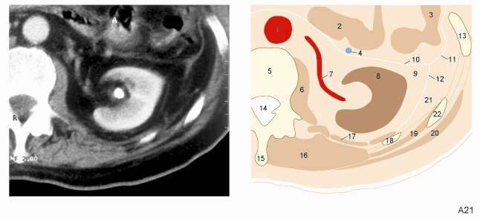
Capsule of kidney, axial CT
Aorta
Jejunum
Colon descendens
V. mesenterica inf.
Vertebra lumb. II.
M. psoas major
Art. renalis
Ren
Capsula adiposa (ventral perirenal fat)
Lamina ant. fasciae renalis (Gerota fascia)
Fascia lateroconalis
Lamina post. fasciae renalis (Zuckerkandl fascia)
Costa X.
Canalis vertebralis
Processus spinosus
M. erector spinae
M. quadratus lumborum
Costa XII.
M. serratus post. inf.
M. latissimus dorsi
Dorsal pararenal fat
Costa XI.
Csillag, Anatomy of the Living Human, Könemann 1999

Slide 14
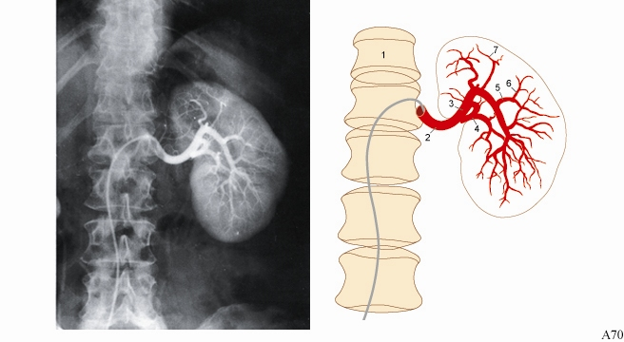
Renal artery, angiography
Columna vertebralis
Art. renalis trunk
Art. renalis, posterior division
Art. renalis, anterior division
Art. lobaris
Art. interlobaris
Art. arcuata
Csillag, Anatomy of the Living Human, Könemann 1999

Slide 15
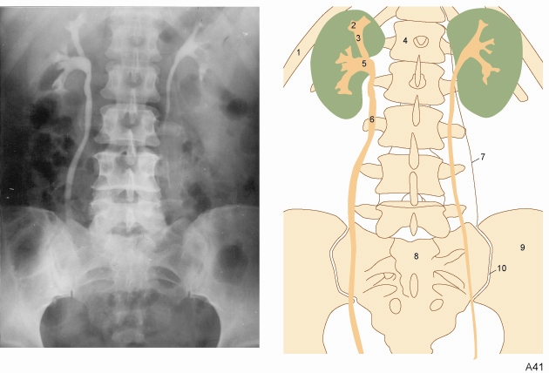
Pelvis renalis and ureter, excretion urography
Costa XI
Calyx minor
Calyx major
Columna vertebralis
Pelvis renalis
Ureter
M. psoas major
Sacrum
Os ilium
Articulatio sacroiliaca
Csillag, Anatomy of the Living Human, Könemann 1999

Slide 16
Liver and kidney, ultrasonography

Slide 17
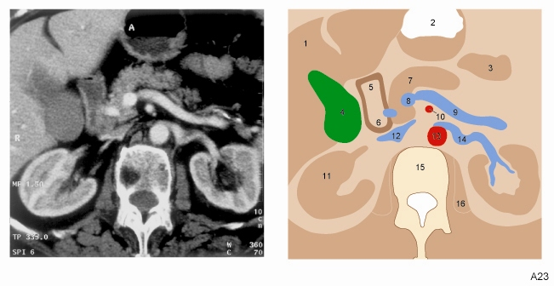
Kidneys, axial CT
Liver
Stomach
Jejunum
Vesica fellea
Duodenum, pars sup.
Duodenum, pars descendens
Pancreas
V. mesenterica sup.
V. lienalis
Art. mesenterica sup.
Ren
V. cava inf.
Aorta
V. renalis
Discus intervertebralis LI/LII
M. psoas major
Csillag, Anatomy of the Living Human, Könemann 1999

Slide 18
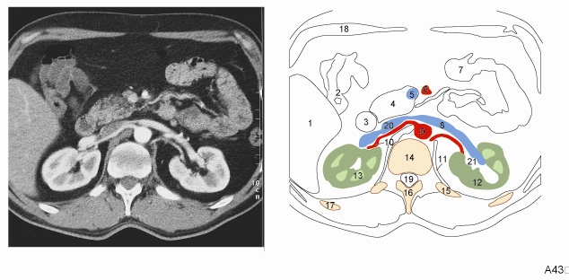
Arteries and veins of kidney, axial CT
Liver
Colon ascendens
Duodenum, pars descendens
Pancreas, proc. uncinatus
V. mesent. sup.
Art. mesent. sup.
Small bowel
V. renalis
Aorta
Art. renalis
Diaphragma, pars lumbalis
Cortex renis
Medulla renis
Corpus vertebrae lumb. I
Costa XII
Proc. spinosus
Costa XI
Arcus costalis
Canalis vertebralis
V. cava inf.
Sinus renalis
Csillag, Anatomy of the Living Human, Könemann 1999

Slide 19
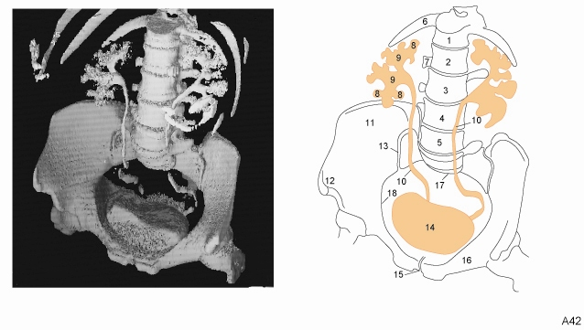
Renal pelvis & ureter, 3D CT reconstruction
Ureter
Crista iliaca
Spina iliaca ant. sup.
Articulatio sacroiliaca
Vesica urinaria
Symphysis
Ramus sup. ossis pubis
Promontorium
Linea terminalis
Vert. thorac. XII
Vert. lumb. I
Vert. lumb. II
Vert. lumb. III
Vert. lumb. IV
Costa XII
Proc. costarius
Calyx minor
Calyx major
Csillag, Anatomy of the Living Human, Könemann 1999

Slide 20
abdominal aorta
coeliac trunk
superior mesenteric artery
abdominal aorta

Slide 21
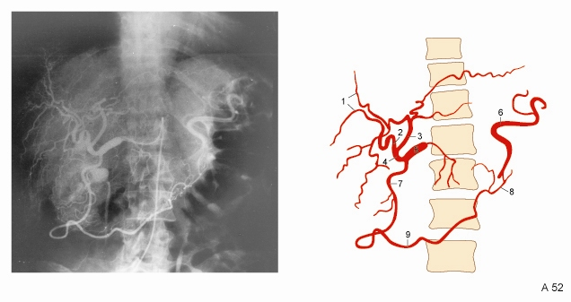
Coeliac trunk, angiography
Rami intrahepatici
Art. hepatica dext.
Art. hepatica sin.
Art. hepatica propria
Art. hepatica communis
Art. lienalis
Art. gastroduodenalis
Art. gastroepiploica sin.
Art. gastroepiploica dext.
Csillag, Anatomy of the Living Human, Könemann 1999

Slide 22
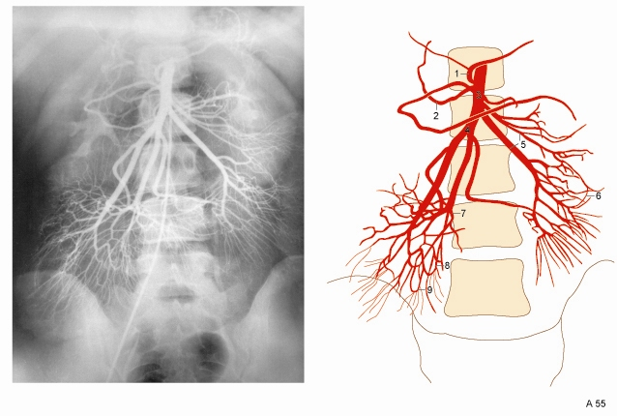
Superior mesenteric artery, angiography
Art. colica med.
Art. pancreaticoduodenalis inf.
Art. mesenterica sup.
Aa. ileales
Aa. jejunales
Aa. jejunales arcades
First arcade of a. ilealis
Second arcade of a. ilealis
Third arcade of a. ilealis
Csillag, Anatomy of the Living Human, Könemann 1999

Slide 23
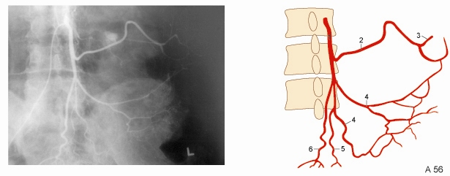
Inferior mesenteric artery, angiography
Art. mesenterica inf.
Art. colica sin.
Art. colica sin., ramus ascendens
Aa. sigmoideae
Art. sigmoidea ima
Art. rectalis sup.
Csillag, Anatomy of the Living Human, Könemann 1999

Slide 24
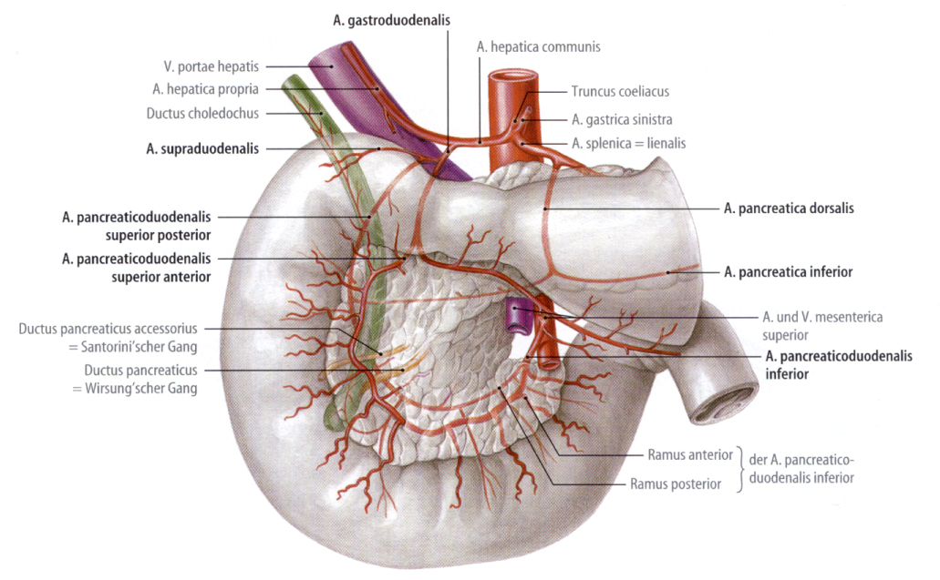
Anastomoses around the duodenum
arcus Riolani minor
Tillmann, Atlas der Anatomie, Springer 2005

Slide 25
Arterial supply of duodenum
Tillmann, Atlas der Anatomie, Springer 2005

Slide 26
Venous supply of duodenum
Tillmann, Atlas der Anatomie, Springer 2005

Slide 27
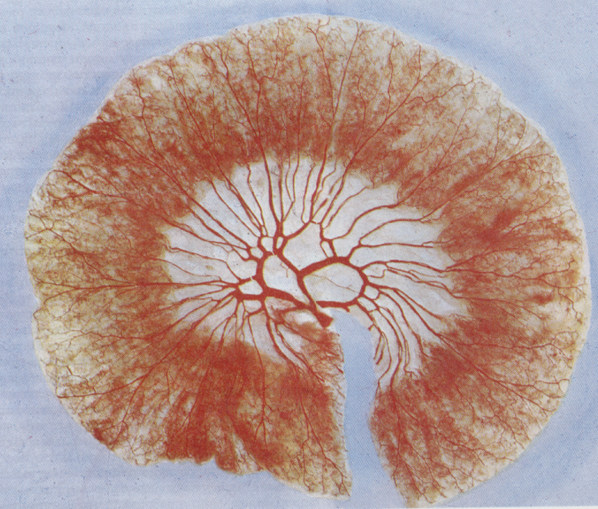
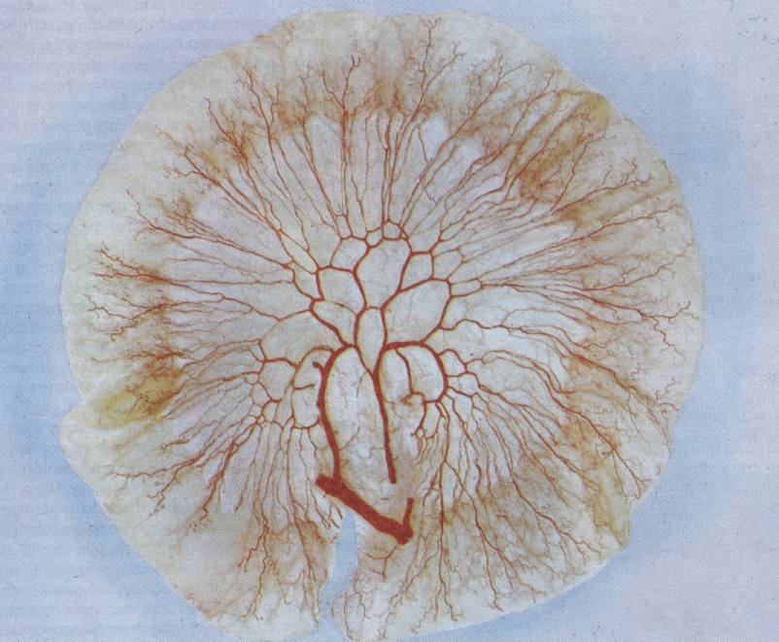
Mesenteric arterial network of jejunum (A) and ileum (B)
A
B
Standring, Gray’s Anatomy, Elsevier, 2005

Slide 28
Abdomen II porto-caval anastomoses
Through cardial veins
superior vena cava
Through rectal veins to the
inferior vena cava
Paraumbilical veins
IVC, SVC anastomoses
(epigastric superficial veins,
thoraco-epigastric veins)
Anastomoses between superficial and deep abdominal wall veins
Connects the portal system from IVC and SVC

