Slide 1
A radiológia anatómiai problémái
Dr. Mester Ádám
Klinikai Anatómiai Előadás
2018/04/10

Slide 2
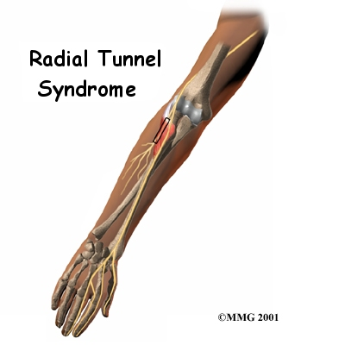
http://www.eorthopod.com/eorthopodV2/index.php?ID=11f7bb694c74b0d58e8142662803c0f6&disp_type=topic_detail&area=8&topic_id=265d5bc27034a24ded64d0226d703e09

Slide 3
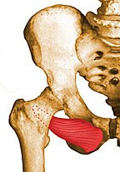
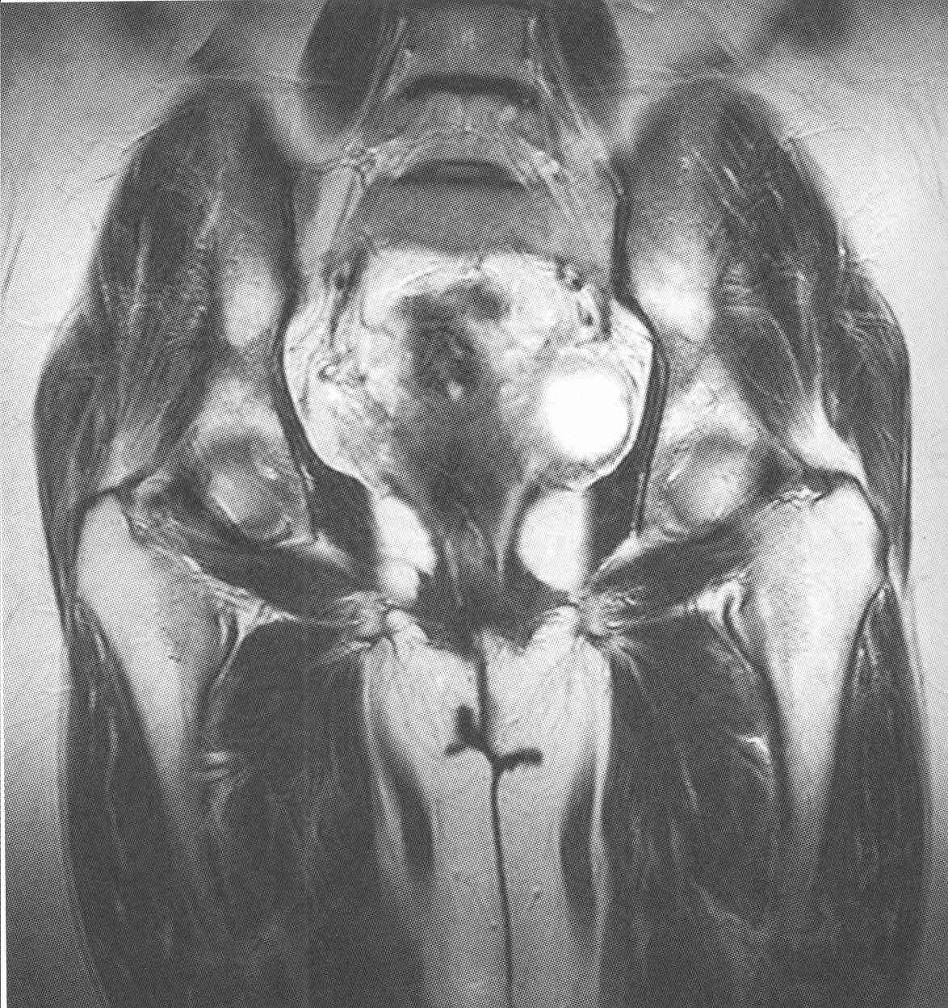
http://www.rad.washington.edu/
oe
Obturator externus

Slide 4
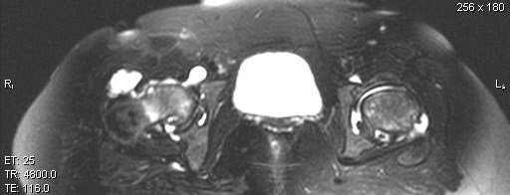
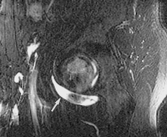
Trochanter major bursa iliopsoas bursa keresztmetszet
hólyag
http://www.eurorad.org/eurorad/case.php?id=6817
nyílirányú

Slide 5
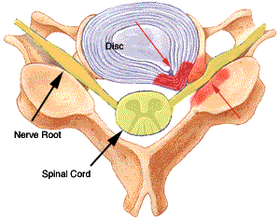
http://www.ispub.com/ostia/index.php?xmlFilePath=journals/ijss/vol3n2/spinal.xml

Slide 6
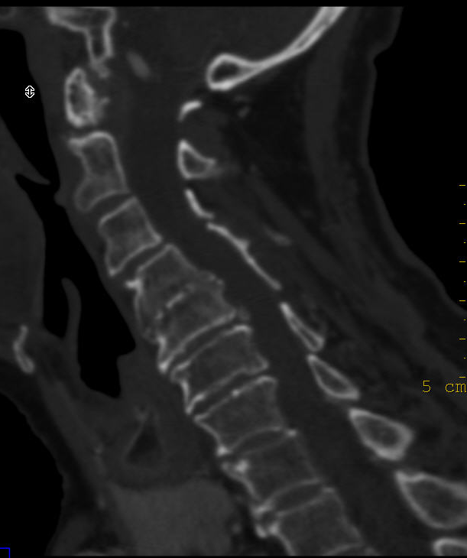
Discus hernia fölött instabilitás: Modic jel
Mester

Slide 7
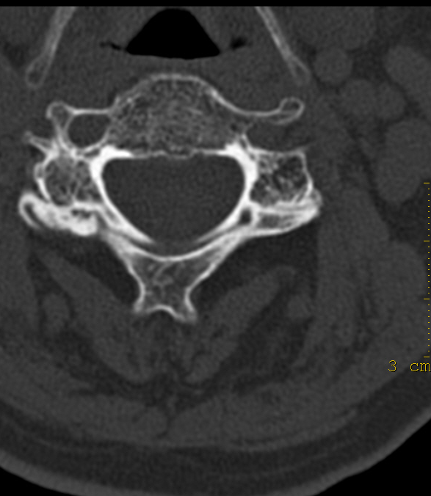
Arthrosis és instabilitás
Mester

Slide 8
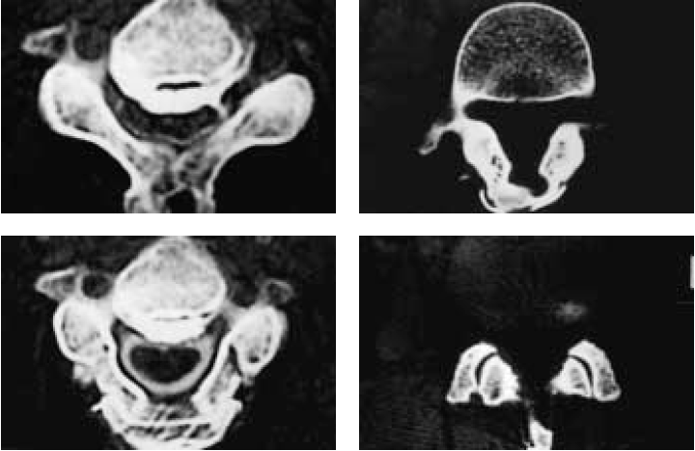
Sagittal Splitting Laminoplasty for Spinal Canal Enlargement for Ossification of the Spinal Ligaments (OPLL and OLF) Tadashi Shimamura, Sadafumi Kato, Tamotsu Toba, Ken Yamazaki, and Shigeru Ehara Seminars In Musculoskeletal Radiology Volume 5, Number 2. 2001.

Slide 9
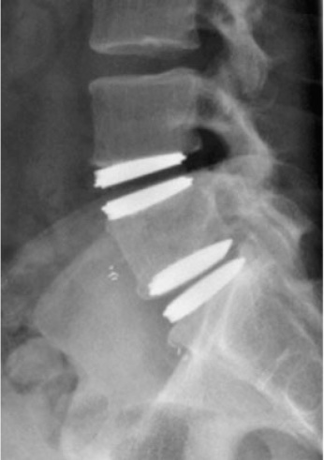
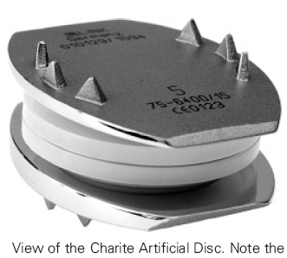
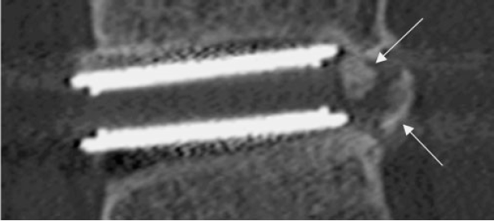
Lumbar Disc Replacement Cheryl A. Petersilge, M.D. Seminars In Musculoskeletal Radiology Volume 10, Number 1. 2006.

Slide 10
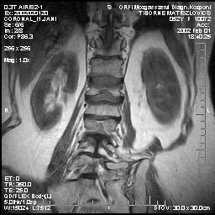
T1
biconcav
ellapult

Slide 11
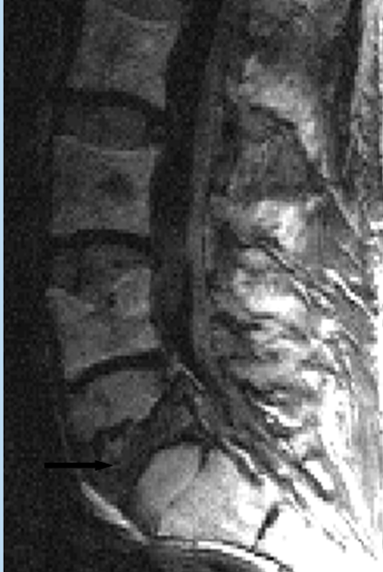
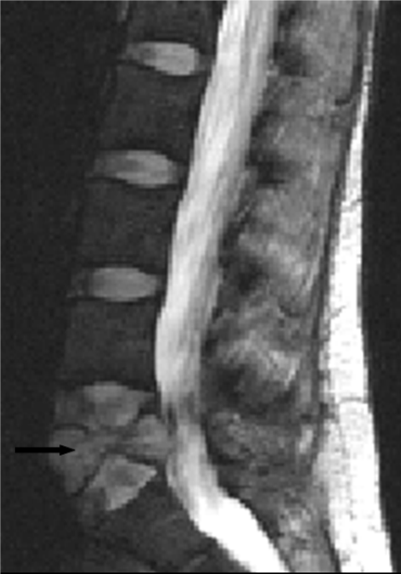
Benign fracture Andrea Baur Malignant fracture
DWI
DWI

Slide 12
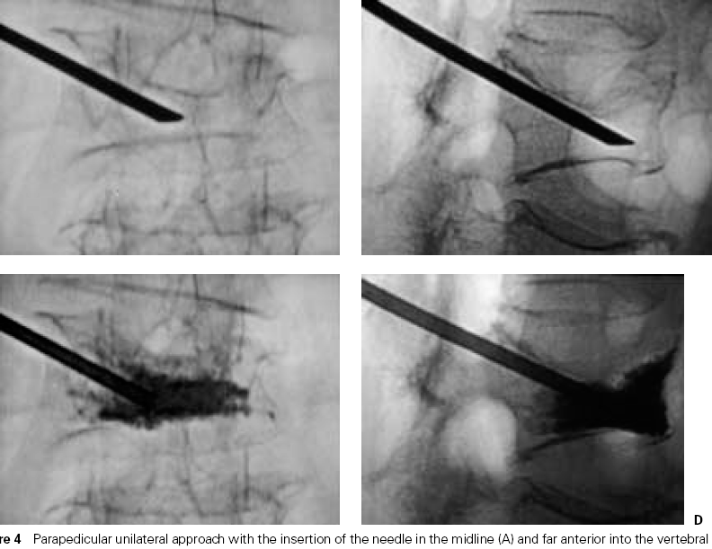
Hervé Deramond, and John M. Mathis, Seminars In Musculoskeletal Radiology, Vol 6, N.3, 2002 VERTEBROPLASTY in Osteoporosis
R
O
P
O
G

Slide 13
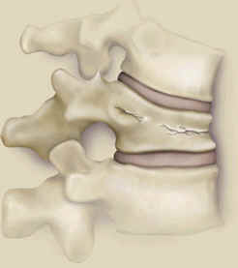
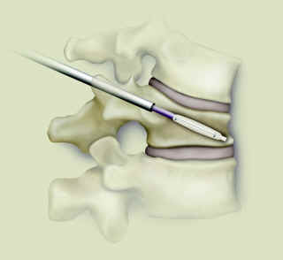
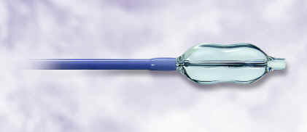
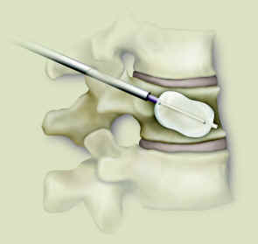
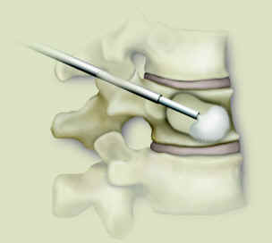
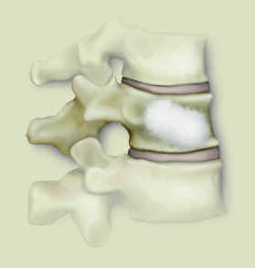
John Regan: Spinal Fractures – From Osteoporosis, Multiple Myeloma or Metastatic Disease KYPHOPLASTY
R
O
P
O
G

