Slide 1
Vasculogenezis, AGM régió, vérképzés
H.-Minkó Krisztina
SE, Humánmorfológiai és Fejlődésbiológiai Int.
2018
Fejlődésbiológia kurzus
Notes:
Vasculogenezis, angiogenezis, vérsziget, vérképzés, aorta-gonad-mesonephros, VEGF, Ephrin, Tie

Slide 2
A fejlődés 17. napján megkezdődik az erek kialakulása a szikhólyag falának splanchnopleurális mezodermájában a hemangioblastikus sejtaggregátumokból. A hemangioblasztikus azt jelenti, hogy ezek a sejtcsoportok egyszerre képesek erek és bennük a vérsejtek létrehozására, vagyis 2 sejtvonal differenciálódik először, primitív hemopoietikus őssejtek és endothel prekurzorok.
A hematopoiesis (vérképzés) tehát a szikhólyag extraembrionális mezodermájában kezdődik. Később megjelenik a májban ahol a vérképző őssejtek találkoznak egy második forrásból származó vérképző őssejt csoporttal amely a fejlődő gonadnak a dorsális aortát körülvevő intraembrionális splanopleura mesoderma részből keletkezett. A végleges vérképző őssejtek a májon belül programozódnak, és később benépesítik a csontvelőt valamint más nyirokszerveket.

Slide 3
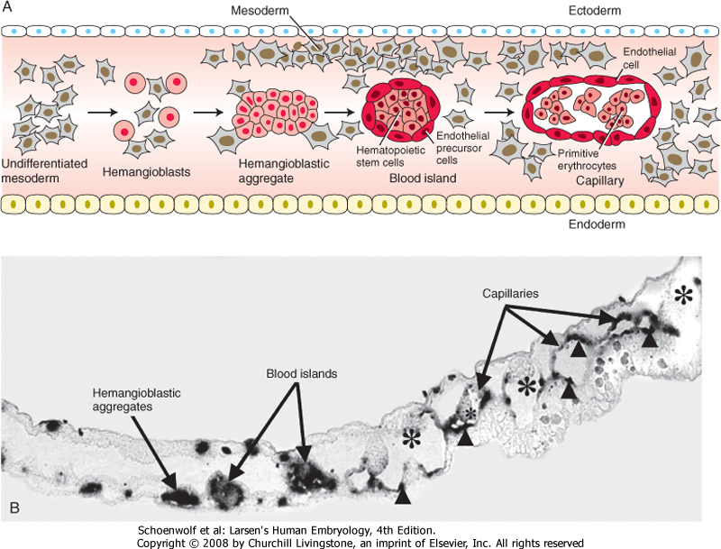
Humán embriókban a legkorábbi bizonyíték vér és vérerek kialakulására a szikhólyag extraembrionális splanopleura mesoderma részénél látható a 17. napon hemangioblasztikus sejtaggregátumok formájában, amely az endodermával határosan fejlődik.
Hemangioblasztikus sejtaggregátumok ezt követően keletkeznek a chorion mesodermájában és a kötőnyelében is.
Figure 13-1 A, Drawing illustrating the formation of hemangioblastic aggregates and their differentiation into hematopoietic stem cells and endothelial precursor cells within blood islands. Blood islands subsequently form both endothelial cells and primitive erythrocytes. B, Expression of Vegfr2 mRNA, an early marker for hemangioblastic aggregates, within the yolk sac wall of a 15-somite avian embryo. As the blood islands develop, endothelial cells retain Vegfr2 expression, whereas hematopoietic stem cells progressively lose it.
Notes:
3
In humans, the earliest evidence for blood and blood
vessel formation is seen in the extraembryonic
splanchnic mesoderm of the yolk sac at about
day 17 in the form of hemangioblastic aggregates
developing adjacent the endoderm.
Hemangioblastic aggregates subsequently form in
the connecting stalk and mesoderm of the chorion.

Slide 4
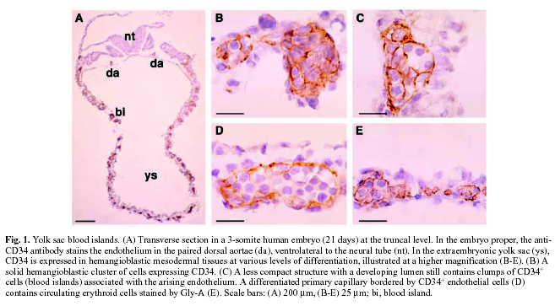
CD34 expressziója a fejlődő humán szikhólyag vérszigeteiben
Notes:
CD34 expression in developing human yolk sac blood islands

Slide 5
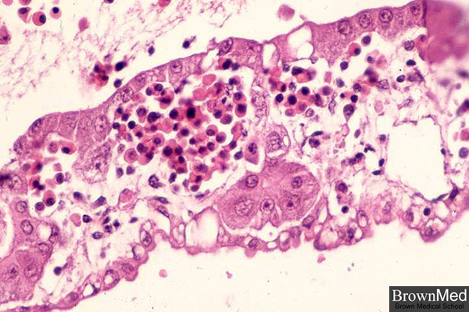
Két sejtvonal alakul ki a hemangioblasztikus sejtaggregátumokból (valószínűleg egyetlen prekurzortól amelyre hemangioblaszként hivatkoznak) a primitív HSC-k és endothel prekurzor sejtek (EPC-k). Együttesen alkotják a vérszigeteknek nevezett struktúrákat.
http://www.brown.edu/Courses/Digital_Path/systemic_path/heme/hemeyolk.html
Notes:
Two cell lineages arise from within the hemangioblastic aggregates (most likely from a single precursor referred to as a hemangioblast), the primitive HSCs and endothelial precursor cells (EPCs).
Together they form what are often referred to as blood islands.

Slide 6
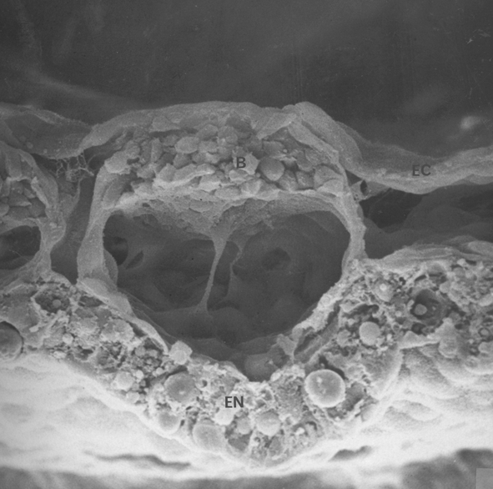
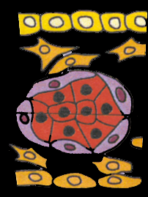
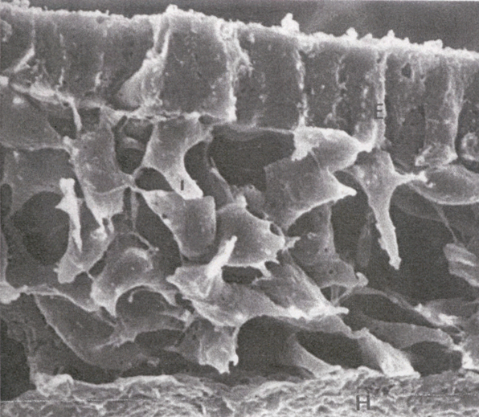
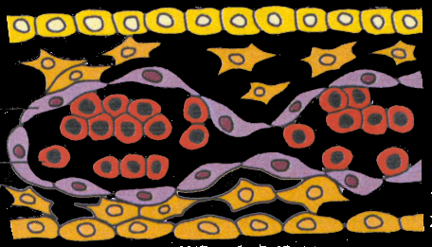
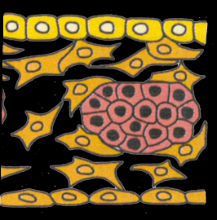
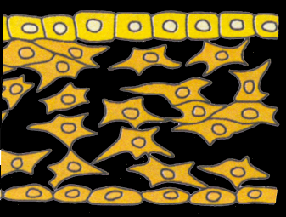
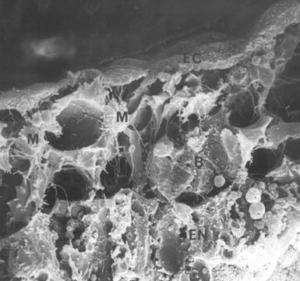
Vérszigetek a csirke embrióban, SEM
Kessel and Fabian, 1985
undifferentiated mesoderm
hemangioblastic aggregate
blood island
vessels and blood cells

Slide 7
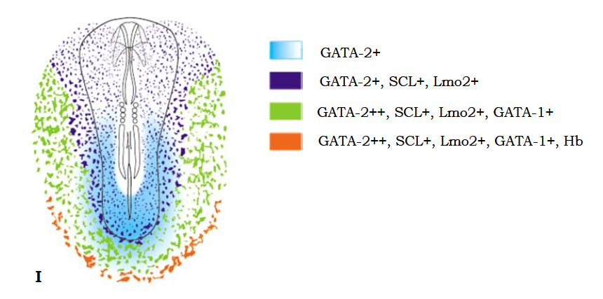
Csirke embrió formálódó vérszigeteinek molekuláris identitása
Notes:
Molecular identity of the forming blood islands
Chicken embryo
H.-Minkó K. doktori

Slide 8
Erythropoietikus transzkripciós faktorok a fejlődő vérszigetekben
(csirke embrió)
Szikhólyagi primitív vérképző őssejtek (HSC-k) szigeteit körülvevő hemangioblasztok endothelikus sejtekké differenciálódnak majd kicsi kapilláris erekbe rendeződnek a vasculogenezis folyamatában.
A szikhólyag primitív vérképző őssejtjei majdnem kizárólagosan erythropoietikus sejteket képeznek (valamint néhány pluripotens progenitor sejtet amelyekből megakaryocyták és primitív makrofágok fejlődnek) a hematopoiesis vagy hemopoiesis (vérsejtképzés) folyamatán keresztül.
Notes:
Transcription factors for erythropoiesis in developing blood islands
(chicken embryo)
Primitive HSCs of the yolk sac form almost exclusively erythropoietic cells (and some pluripotent progenitor cells for megakaryocytes and primitive macrophages) through a process known as hematopoiesis or hemopoiesis (blood cell production). Hemangioblasts surrounding
the islands of primitive HSCs enter into the EPC lineage, then differentiate into endothelial cells and organize into small capillary vessels through a process
called vasculogenesis.

Slide 9
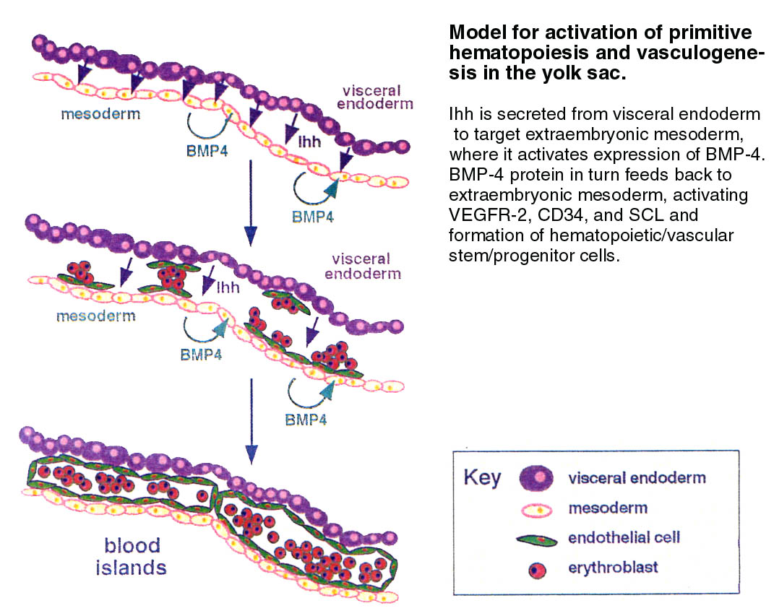
Egérben, a zsigeri endoderma indukciós hatása (e.g., Bmp, Vaszkuláris endothelikus növekedési faktor, és Indian hedgehog) elengedhetetlen a vérsziget specifikus gének kifejeződésének elindításához (in vitro eredmények)
In vivo a hemangioblasztok , és a későbbiekben a hematopoietikus és EPC vonal fejlődésének kiváltó oka máig nem pontosan ismert.
Mind a hematopoietkus prekurzorok, mind az EPC-k sok közös korán kifejeződő markert expresszálnak (CD34, VEGFR-2, Tie, Tie2, SCL, CD31, flt-1, VE-cadherin, GATA-2, EpoR) tehát a 2 sejtvonal igen szoros kapcsolatban áll egymással.
Notes:
In mice, visceral endoderm provides inductive signals (e.g., Bmp, Vascular endothelial growth factor, and Indian hedgehog) that are necessary for inducing the expression of blood island markers in this mesoderm in
tissue culture.
The precise trigger for forming in
vivo hemangioblasts, and eventually the hematopoietic and
EPC lineages, is still unclear.
Both hematopoietic precursors
and EPCs share many of the same early expression markers (CD34, VEGFR-2, Tie, Tie2, SCL, CD31, flt-1, VE-cadherin, GATA-2, EpoR)
so they are closely tied to one another with regard to cell
lineage specification.

Slide 10
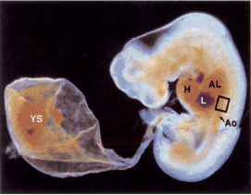
Az extraembryonális primitív hemopoietikus sejtek arra szolgálnak főként, hogy gyorsan létrehozzanak vérsejteket az embrióban amíg a definitív intraembryonalis hemopoietikus sejtek el tudják látni ezt a feladatot.
.
Notes:
The extraembryonic, primitive hematopoietc stem cells (HSCs) serve mainly to provide an early, but necessary, blood supply for the developing embryo until the definitive intraembryonic hematopoietic organs can assume this task

Slide 11
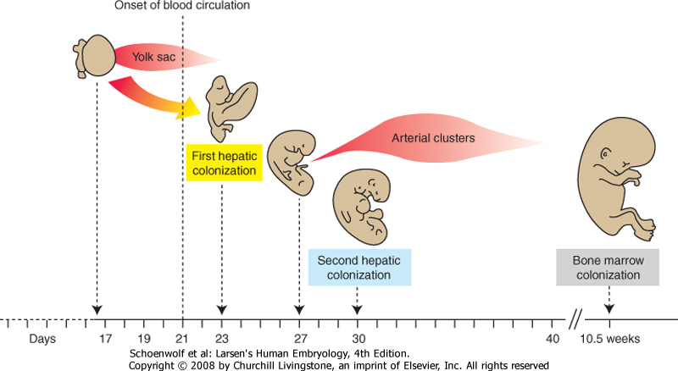
A szikhólyag az első vérsejteket képző hely az embrionális keringés számára. A keletkező sejtek sejtmagvas erythrocyták, amelyek embrionális hemoglobint tartalmaznak (primitive erythrocyták). 60 napos kor után a szikhólyag már nem vérképző hely. Ezután a vérképzés áttevődik intraembryonális területekre/szervekre, a májba, lépbe, thymusba és a csontvelőbe.
Notes:
The yolk sac is the first supplier of blood cells to the embryonic circulation. The cells supplied are predominantly nucleated erythrocytes containing embryonic hemoglobin (primitive erythrocytes). By day 60, the yolk sac no longer serves as a hematopoietic organ. Rather, this task is relayed to intraembryonic organs, including the liver, spleen, thymus, and bone marrow.

Slide 12

Bocsánat innentől angolul van....

Slide 13
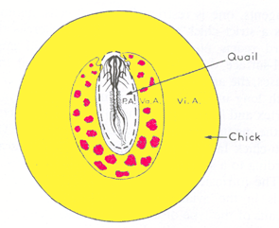
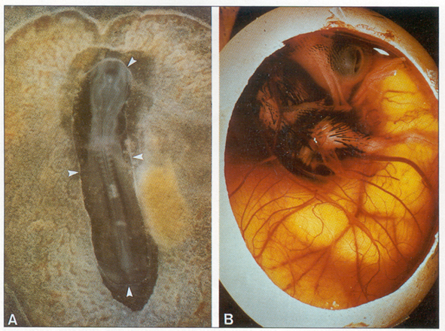
The initial hematopoietic stem cells (HSCs) colonizing the developing liver arise from the yolk sac, a separate
intraembryonic source of HSCs eventually colonizes the liver. Evidence for this second source of HSCs was first garnered using quail-chick transplantation chimeras
Quail embryos were grafted onto chick embryo yolk sacs (after removal of the chick embryo) and allowed to develop. Initially, all blood lineages in the hematopoietic organs including circulating blood were chicken in origin, with quail cells providing the stromal (connective tissue)
cells. However, within 5 days of incubation, a mixture of quail- and chick-derived blood cells were found circulating within the embryo, and eventually the majority of cells became quail derived. Hence, the yolk sac gave rise to shortlived HSCs as opposed to long-term definitive HSCs. Therefore, there had to be a second intraembryonic source of HSCs.
E2
E16
(Dieterlen-Lievre 1994)

Slide 14
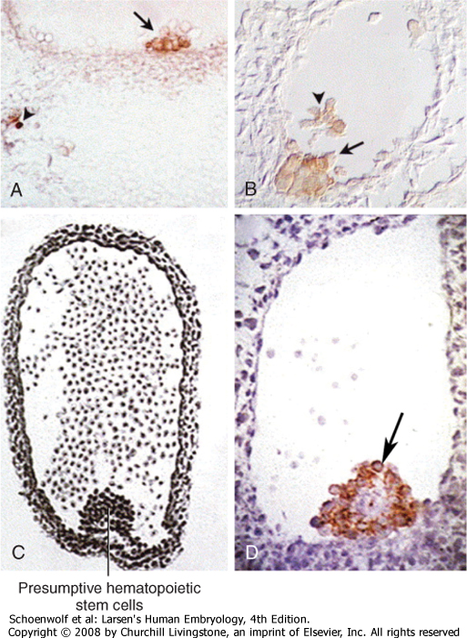
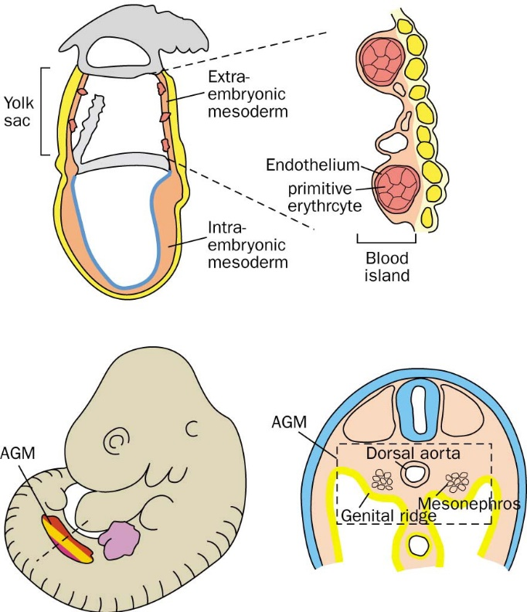
Subsequent studies in birds, amphibians, mice, and
humans identified densely packed clusters of HSCs adhering
to the ventral endothelium of the dorsal aorta in the region of
the genital/mesonephric ridge of the embryo.
This region has been termed the aortic,
gonad, and mesonephros (AGM) region (or the paraortic
splanchnopleure)
http://middleeast.thelancet.com/pdfs/journals/lancet/PIIS0140-6736(01)07044-1.pdf

Slide 15
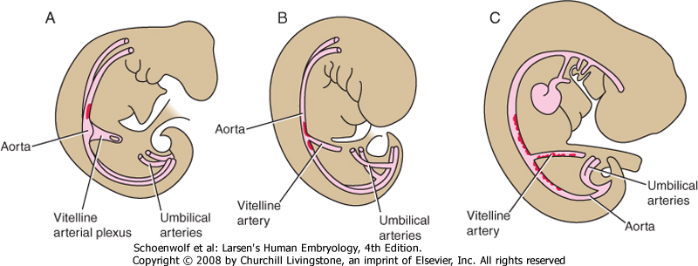
Second source of HSC, the aorta/AGM region
A second source of hematopoietic stem cells arises within the splanchnic mesoderm surrounding the aortic, gonad, and mesonephric region (AGM). These cells temporarily reside in the ventral floor of the dorsal aortic of this region. A, In humans at about day 27, a small number of hematopoietic stem cells (in red) reside and adhere to the dorsal aorta near the origin of the vitelline artery in the umbilical region. B, By day 30, the number of hematopoietic stem cells expands to several thousand. C, By day 36, hematopoietic stem cells expand to reside in the ventral floor of the dorsal aorta along almost the entire length of the AGM, and extending into the vitelline artery. By day 40, hematopoietic stem cells are no longer detected in the dorsal aorta.
Notes:
15

Slide 16
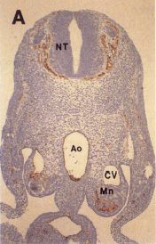
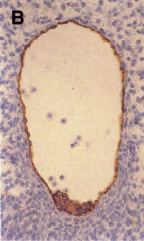
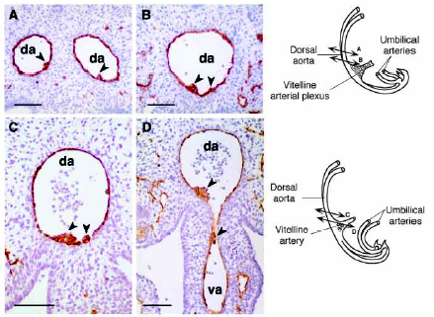
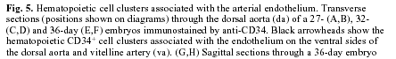
In humans, HSCs are detected within the AGM aorta at 27 days of development as small groups of two or three cells
By day 35, they increase to thousands of cells that extend into vessels adjacent to the umbilical cord region. These cells express transcription factors and cell surface markers associated with early blood progenitors (e.g., Gata2, c-Kit, CD34, CD41, CD45).
These AGM-derived HSCs subsequently colonize the liver,
expand in numbers, and then disappear from the AGM region
by day 40. Although these intraembryonic HSCs could be
derived from colonizing primitive HSCs from the yolk sac,
evidence suggests they are of separate origin.

Slide 17
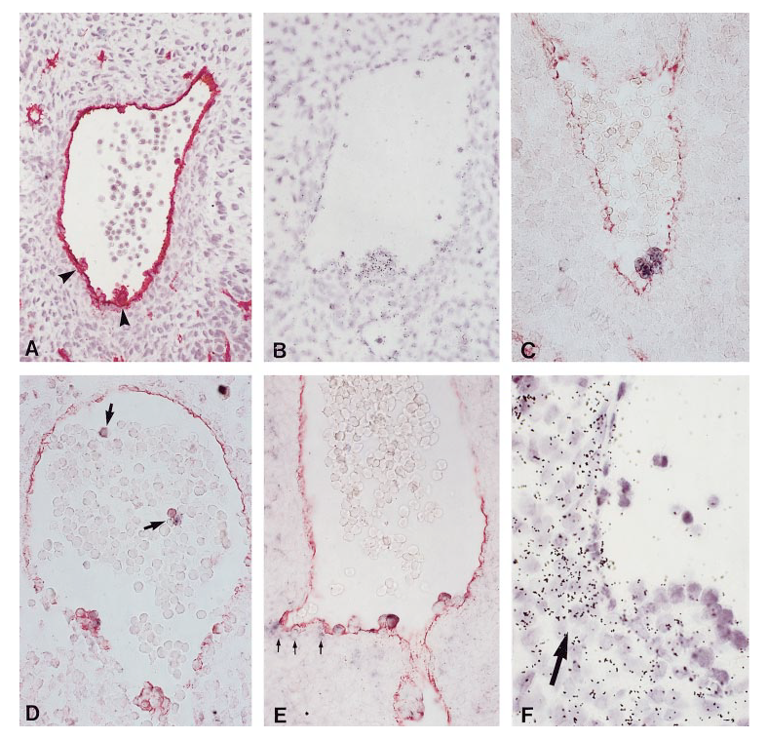
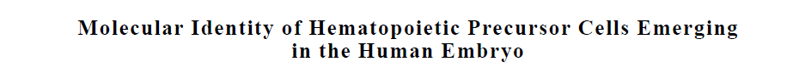
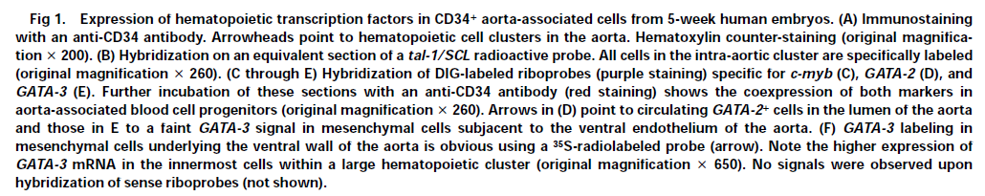

CD34, SCL/tal-1, GATA-2, GATA-3 expression

Slide 18
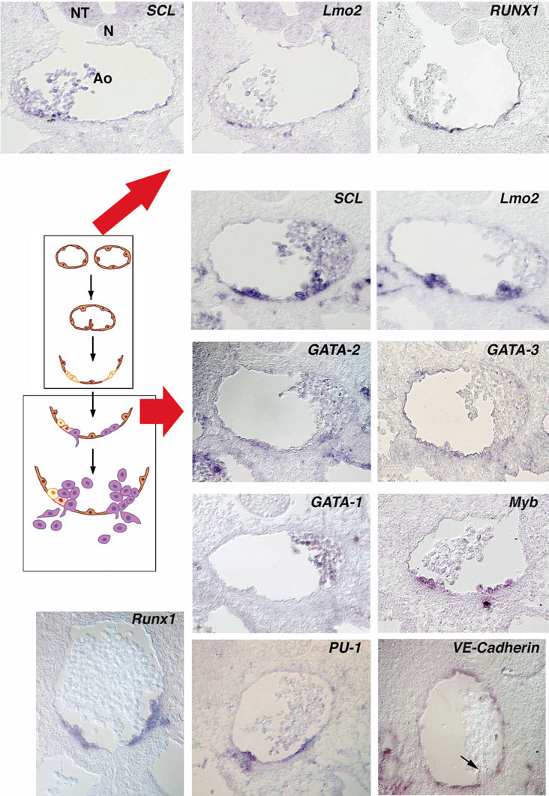
In birds:
Molecules for definitive hematopoietis are expressed in aorta
associated hematopoiesis
Endothelial cells of the ventral wall of the aorta originate from the
splanchnopleural mesoderm

Slide 19
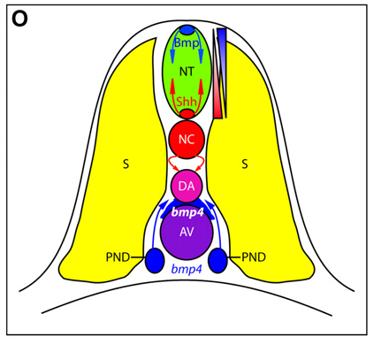
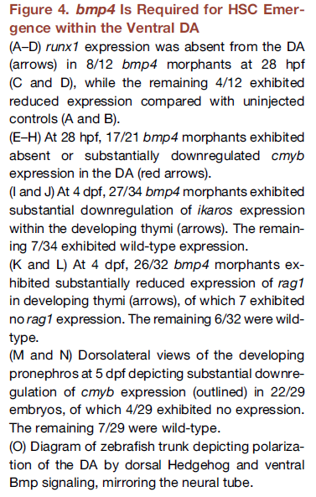
In Zebrafish: BMP-4 and Shh pattern the dorsal aorta

Slide 20
With the onset of a functional circulatory system,
primitive HSCs (i.e., those with limited pluripotential)
from the extraembryonic mesoderm colonize these
organs. The first organ to be colonized is the liver.
This organ remains the main hematopoietic organ of
the embryo and fetus until initiation of bone marrow
hematopoiesis near parturition (birth). Colonization
of the liver primordia by HSCs likely occurs in two
waves, the first beginning at about day 23 and the
other at about day 30, but these HSCs arise from
two different sources.
The shift from generating primitive nucleated erythroblasts to enucleated erythrocytes synthesizing fetal hemoglobin (definitive erythrocytes) occurs by 5 weeks of gestation. The liver is where long-term definitive HSCs arise that have the potential to generate all the hematopoietic cell lineages of the adult, with both primitive and definitive HSC production overlapping for a time. Evidence suggests that definite HSCs come to colonize the bone marrow
and contribute blood cells as early as 10.5 weeks, but the bulk of the hematopoietic burden is still carried by the liver until birth.
Studies in mice show that the yolk sac forms primitive HSCs
capable of generating primitive erythrocytes, macrophages
and megakaryocytes. These primitive erythrocytes likely serve
as a rapidly forming stop gap population of blood cells that
fulfill the oxygen needs of the rapidly developing embryo.
HSCs capable of generating definitive myeloid cells (definitive
erythrocytes, macrophages, and granulocytes) appear within
the yolk sac. However, studies suggest that these cells must
first colonize and interact with the developing liver to acquire
long-term myeloid cell–generating capacity. Coincident with
the second wave of liver colonization by AGM HSCs, HSCs
residing in the liver acquire the capacity to generate the
full spectrum of both myeloid and lymphoid (i.e., B and
T lymphocytes) progenitor cells.

Slide 21
Vasculogenesis/ angiogenesis
Starting on day 17, vessels begin to arise in the splanchnic mesoderm of the yolk sac wall from aggregations of
cells called hemangioblastic aggregates. From these aggregates two cell lineages arise, primitive hematopoietic stem cells and endothelial precursor cells.
On day 18, vasculogenesis (de novo blood vessel formation) commences in the
splanchnic mesoderm of the embryonic disc and later in the paraxial mesoderm. In the embryonic disc, endothelial cell precursors differentiate into endothelial cells and organize into networks of small vessels that coalesce, grow, and invade other tissues to form the primary embryonic vasculature. This primitive vasculature is expanded and remodeled by angiogenesis.

Slide 22
Angiogenesis is the expansion and remodeling of the vascular system using existing endothelial cells and vessels generated by vasculogenesis (Fig. 13-9).
Expansion by angiogenesis occurs by sprouting or vascular intussusception, a splitting or fusion of existing blood vessels (Figs. 13-9, 13-10, 13-11).

Slide 25
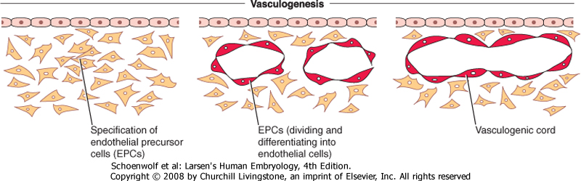
On day 18, blood vessels begin developing in the intraembryonic splanchnic mesoderm. Unlike blood vessel formation in the extraembryonic mesoderm
and AGM region blood vessel formation within intraembryonic splanchnic mesoderm is not coupled with hematopoiesis. Inducing substances secreted by the underlying endoderm cause some cells of the splanchnic mesoderm to differentiate into EPCs (or angioblasts) that develop into flattened endothelial cells and join together to form small vesicular structures. These vesicular structures, in turn, coalesce into long tubes or vessels (Fig. 13-5; see Fig. 12-5A, B).
This process is referred to as vasculogenesis. These cords develop throughout the intraembryonic mesoderm and coalesce to form a pervasive network of vessels that establishes the initial configuration of the circulatory system of the embryo.
This network grows and spreads throughout the embryo by 4 main processes: (1) continued formation, migration, and coalescence of EPCs; (2) angiogenesis, the budding and sprouting of new vessels from existing endothelial cords; (3) vascular intussusception (nonsprouting angiogenesis), in which existing vessels are split to generate additional vessels; and (4) intercalation of new EPCs into the walls of existing vessels.

Slide 26
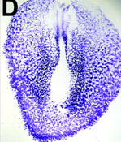
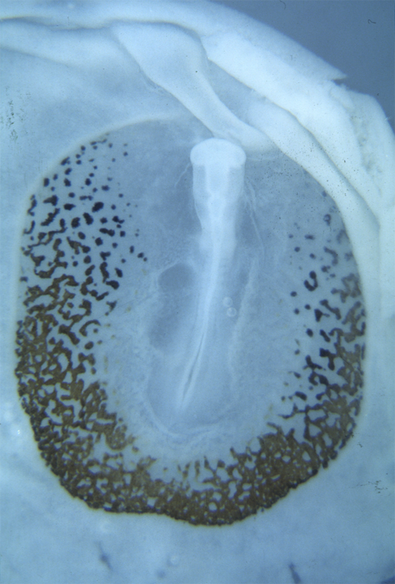
Unlike blood vessel formation in the extraembryonic mesoderm and AGM region blood vessel formation within intraembryonic splanchnic mesoderm is not coupled with hematopoiesis.
Hemoglobin (brown color) is only present in hemopoietic blood islands of the chicken yolk sac
NOT in angioblastic aggregates (blue color/VEGFR-2 expression)
of the area opaca
11-12 pairs of somites

Slide 27
Although the splanchnic
mesoderm has the capacity to generate EPCs and
undergo vasculogenesis, the somatic mesoderm
may not. Studies in avian embryos show that much
of this vasculature develops from migrating EPCs
derived from the paraxial mesoderm that subsequently
form the initial vasculature via vasculogenesis

Slide 28
Because blood vessels form in the yolk sac on
about day 17, but not in the embryonic disc until day
18, it was originally thought that intraembryonic
vessels arose mainly because of centripetal extension
of the yolk sac vasculature into the embryo proper.
However, quail-chick transplantation chimeras provide evidence that almost all
of the intraembryonic splanchnic mesoderm has the
ability to form blood vessels via vasculogenesis.
Furthermore, experiments in which mesoderm is transplanted
from one region in the quail embryo to another
region in the chick embryo, show that the characteristic
branching pattern of the blood vessels in each region is
determined by cues from the underlying endoderm and
its extracellular matrix.

Slide 29
What initiates and controls vasculogenesis?
The inductive effect of endodermally derived Bmps in the absence of Wnt signaling
leads to the cardiogenic cell lineage,
whereas Bmp signaling coupled with Wnt8c signaling enables blood vessel formation in the splanchnic mesoderm.
Likewise, Bmp/Tgfβ signals emanating from extraembryonic endoderm and Wnt signaling in mesoderm prime the extraembryonic mesoderm adjacent to the yolk sac endoderm for blood island formation.

Slide 30
The role of VEGF signaling
Knockout mice for Vegfr2 have a complete absence of HSC and EPC lineages and die in utero.
homozygote knockout mice for Vascular endothelial growth factor-A (VegfA) die due to a lack of blood island formation, whereas mice heterozygotic for VegfA develop fewer blood islands and die at midgestation due to a lack of subsequent vascular remodeling.
Mice lacking Vascular endothelial growth factor receptor-1 (Vegfr1) also die, but the defect seems to be a consequence
of abnormal EPC proliferation that results in a disorganized vasculature.
The coreceptors for Vegfr2—Neuropilin-1 (Nrp1) and Neuropilin-2 (Nrp2), a pair of transmembrane receptors belonging to the class III Semaphorin family that act as axon repellant factors—are also required.
Vegf is a powerful promoter of vasculogenesis:
injecting Vegf into embryos at the outset of vasculogenesis can vascularize normally avascular areas (e.g., cartilage forming areas and cornea).

Slide 31
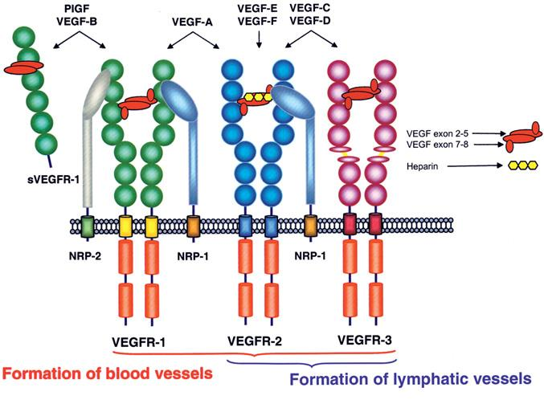
Figure 5.
Schematic presentation of the VEGF ligands and their interaction with membrane-bound and soluble (secreted) VEGF receptors. Notably, inhibitory effects are exerted by sVEGFR-1 (anti-hemangiogenesis) and sVEGFR-2 (anti-lymphangiogenesis). Neuropilin-2 (NRP-2) also interacts with VEGFR-3 on lymphatic endothelial cells, which is not shown in this
scheme . NRP-1: Neuropilin-1.
Modified from:
http://www.rosenthallab.com/gallery/images/VEGF_VEGFR.jpeg
Pavlakovic et al. Page 14
Ann N

Slide 32
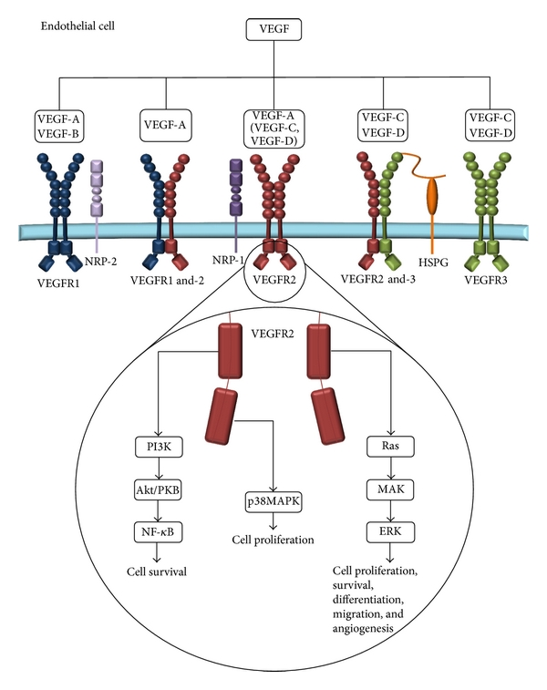
Figure 1: VEGF receptor binding. The five mammalian vascular endothelial growth factors (VEGF-A-D) bind to the receptor tyrosine kinases, VEGF receptor (VEGFR1-3 and co-receptors HSPG, NRP-1 and NRP-2). VEGFR-binding leads to the formation of homodimers and/or heterodimers. Proteolytic cleavage enables VEGF-C and -D to bind VEGFR-2 forming a homodimer. The binding and activation of VEGFR-2 lead to downstream signaling of the PI3 K, MAPK, and Ras pathways which promote cell survival, proliferation, differentiation, migration, and angiogenesis.

Slide 33
Organization of endothelial cells into recognizable blood vessels usually occurs at the site of EPC specification during vasculogenesis. However, evidence suggests that EPCs can also migrate into and proliferate at distant secondary sites before organizing into blood vessels, in a process distinct from angiogenesis (see Fig. 13-6).
Vessels that form through this modified form of vasculogenesis include (in the avian embryo) the posterior cardinal vein and perineural vascular plexus and (in the Xenopus embryo), the bulk of the dorsal aorta and intersegmental vessels.

Slide 34
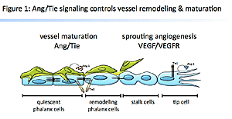
ANGIOGENESIS EXPANDS AND REMODELS INITIAL
VASCULAR COMPLEX
Tie/Ang signaling along with Vegf signaling is essential for expansion and remodeling of blood vessels after the initial primitive vasculature is established by vasculogenesis.
Vegfs and their receptors play major roles in angiogenesis.
Another group of Tyrosine kinase receptors and ligands act in parallel to promote proper angiogenesis, namely, the Tie (Tyrosine kinase with immunoglobulin-like and EGF-like domains) receptor/Angiopoietin group.
Angiopoietin-1 (Ang1) and Tyrosine kinase with immunoglobulin-like and EGF-like domains-2 (Tie2) are clearly involved in regulating intussusception of the vasculature, whereas
Ang2, in cooperation with the stimulatory effects of Vegf, stimulates sprouting.

Slide 37
Circulating endothelial cells
It was once thought that EPCs were present only in the embryo and fetus. However, evidence suggests that EPCs exist in adult bone marrow and peripheral blood. Vegf, Granulocyte-monocyte colony-stimulating factor, Fgf2, and Igf1 all stimulate EPC mobilization and differentiation. The decision of circulating endothelial cells to integrate into blood vessel walls may involve the Ephrin/EphB family. Ephrins are transmembrane ligands for a family of EphB receptor-tyrosine kinases that modulate EPC and endothelial migration and proliferation. In addition, they play important roles in artery/vein specification.

Slide 38
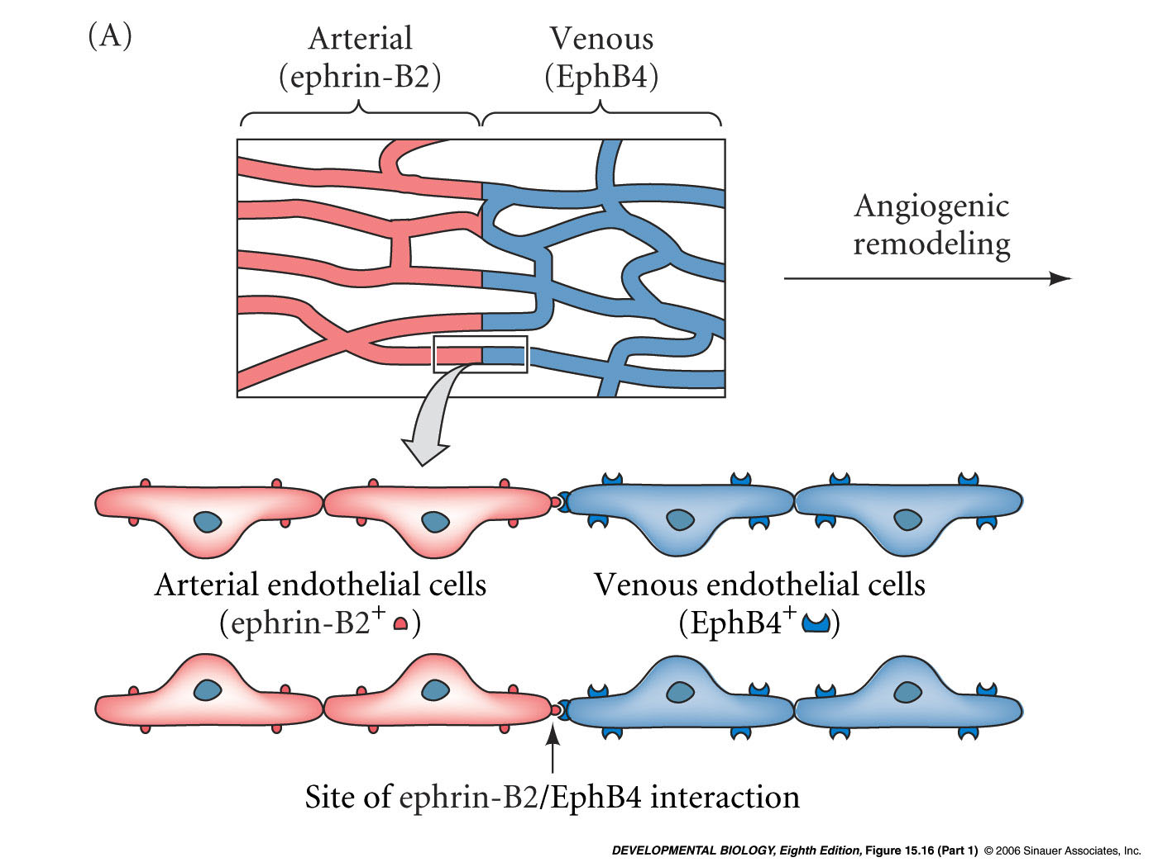
Model of the roles of ephrin and Eph receptors during angiogenesis
Notes:
devbio8e-fig-15-16-1.jpg

Slide 40
One of the main driving forces for vascularization by
angiogenesis is the need to counteract hypoxia
Low oxygen saturation leads to stabilization of the transcription factor, Hypoxia- inducible factor-1" (Hif1"). Hif1" upregulates VegfA expression and Nitric oxide synthase expression. Nitric oxide production dilates existing blood vessels, thereby increasing the permeability and extravasation of plasma proteins leading to an increase in the expression and activation of the proteases, Matrix metalloproteinases and Plasmin.
Matrix metalloproteinases and Plasmin play major roles in promoting proliferation and migration of endothelial cells by activating growth factors and receptors and increasing extracellular matrix turnover, which is necessary for sprouting.

Slide 41
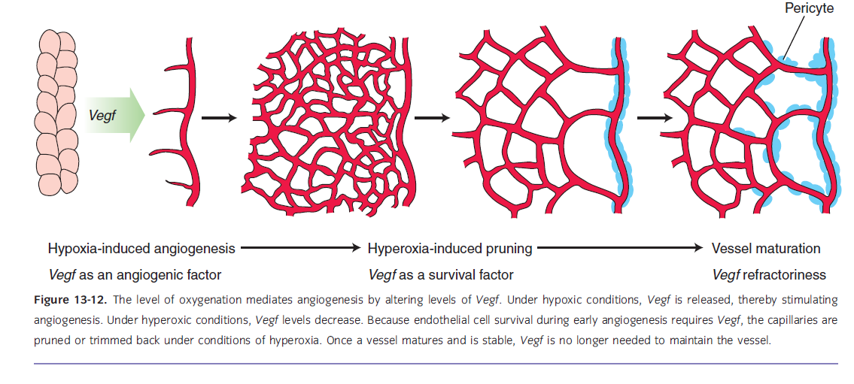

Slide 42
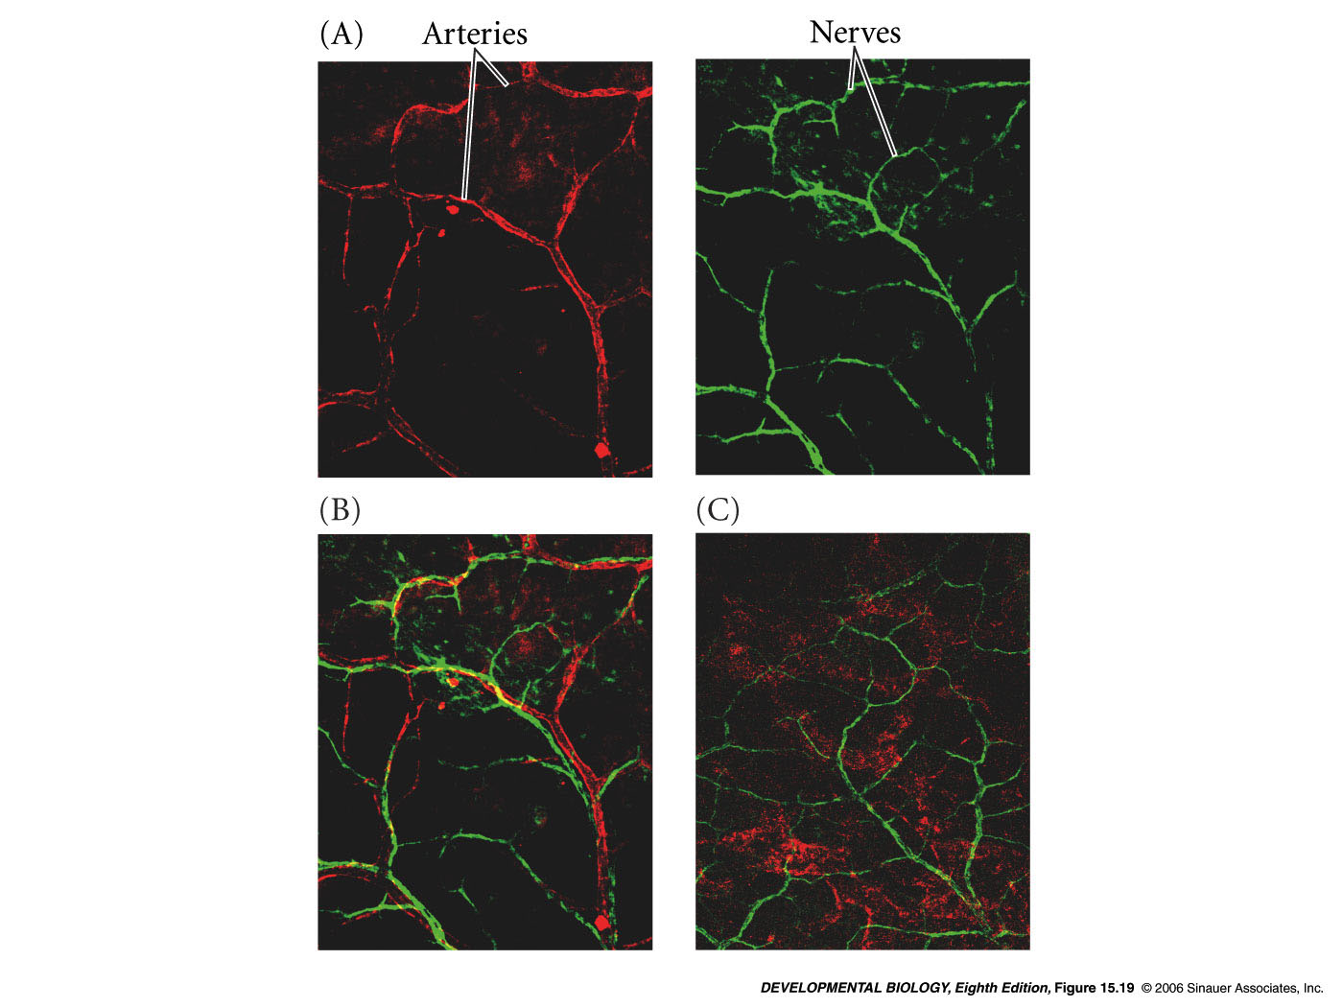
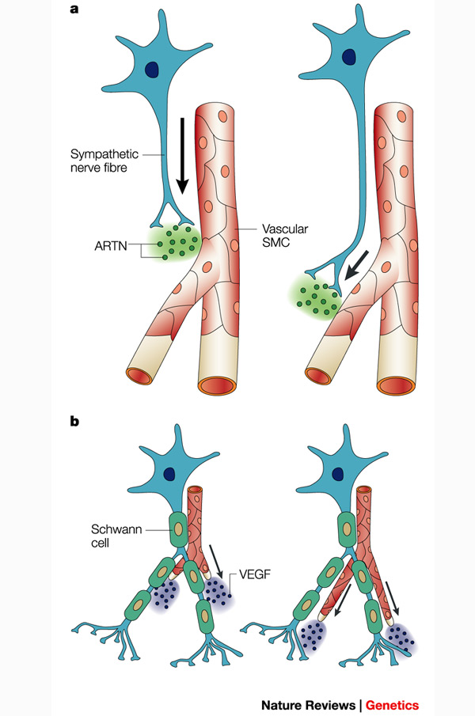
Arteries are specifically aligned with peripheral nerves in mouse limb skin
Notes:
devbio8e-fig-15-19-0.jpg

Slide 43
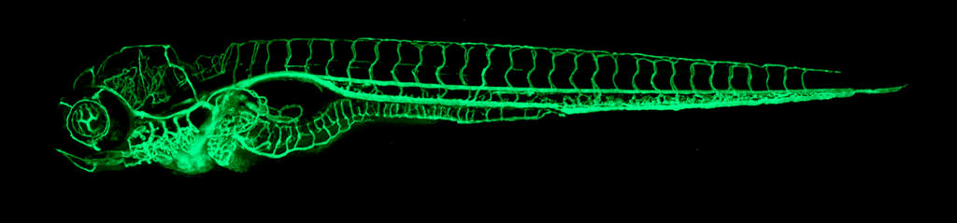
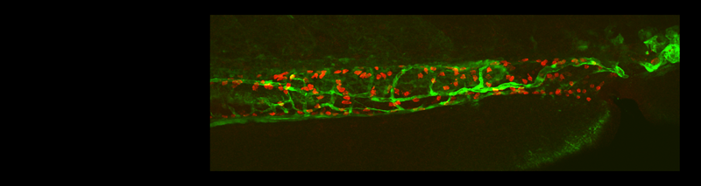
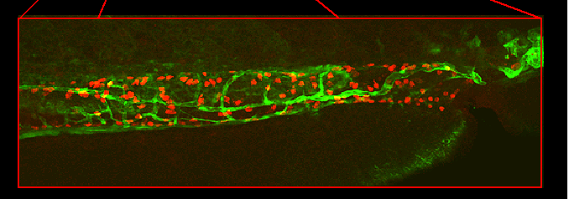
Intestinal vessels and enteric neurons develop in close association in zebrafish
5 dpf Tg(fli-EGFP)
RED: HuC antibody (enteric neurons)
GREEN: Fli-EGFP + anti-GFP antibody (blood vessels)
Nagy N et al. 2009 Developmental Biology
Notes:
We were interested in knowing whether a similar relationship between EC and ENCCs exists in other species.

Slide 44
Thank you for attention!
11-12 pairs of somites

Slide 45
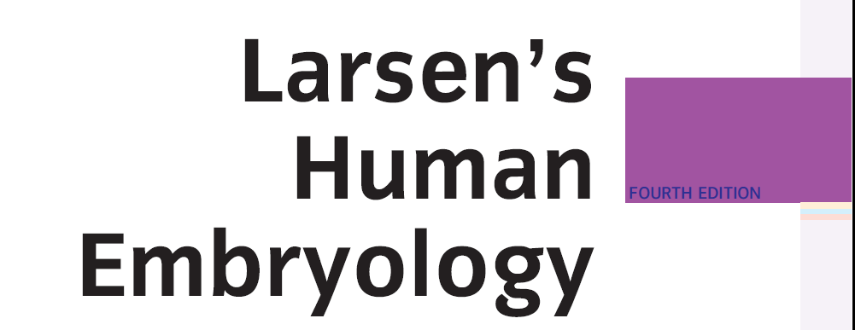
Main reference:

