Slide 1
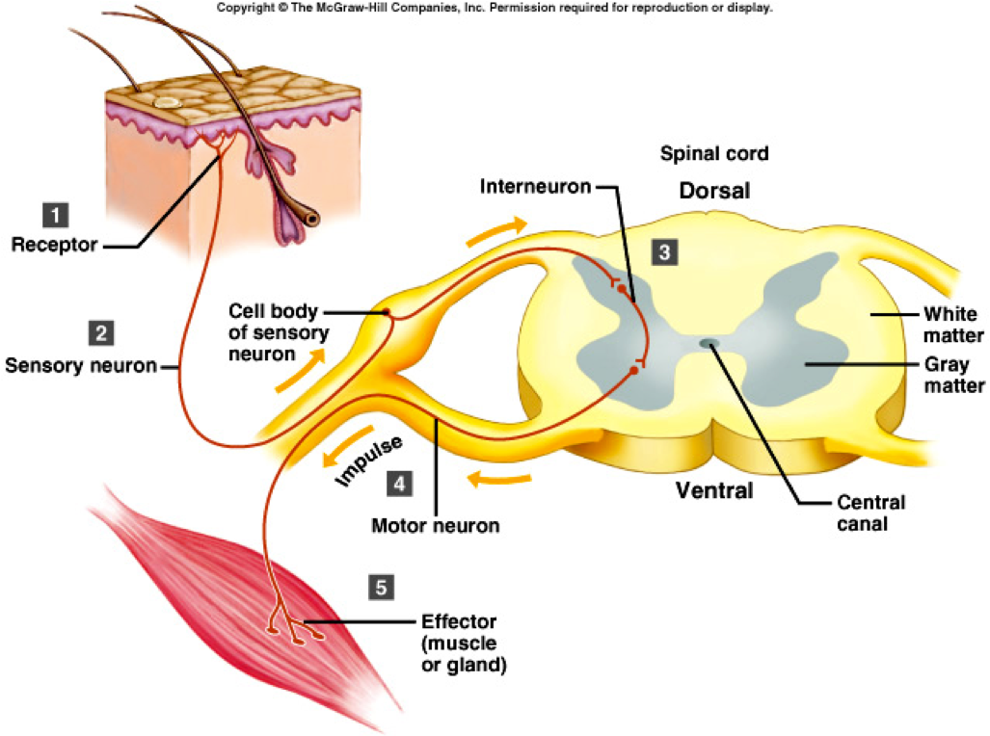
Nociceptive and autonomic reflex arcs. Spinal pathways, injuries, symptoms
Márk Kozsurek, M.D., Ph.D.
mark@kozsurek.hu
EM II., 28/09/2017

Slide 2
II. Spinal reflex arcs

Slide 3
Reflex: involuntary and automatic response to a stimulus
A (1) receptor is responsible for detecting a stimulus and converting it into a neuronal signal. Evoked action potentials reach the central nervous system through the (2) afferent limb. Decission is made and response is generated by the (3) central processing neuronal networks. (4) Efferent limb exits the central nervous system and terminates on the (5) effector, which might be a muscle or a gland. (1) to (5) components altogether constitute the reflex arc!
viscerosensory
visceromotor
central nervous system
somatosensory
somatomotor
SENSORY GGL.
AUTONOMIC GGL.
v
skin, muscles, joints, tendons
skeletal muscles
internal organs
smooth muscles , glands
receptors effectors

Slide 4
Spinal reflex: In the case of spinal reflex arcs the stimulus is received and processed by the spinal cord and the response is organized and performed by the spinal neuronal circuits.
Under normal circumstances stimuli evoking spinal reflexes also reach the brain and descending fibres from higher centres may modulate spinal reflexes but experimentally spinal reflexes can be evoked even after the removal of the brain!
Proprioceptive reflex
Nociceptive reflex
Autonomic reflexes

Slide 5
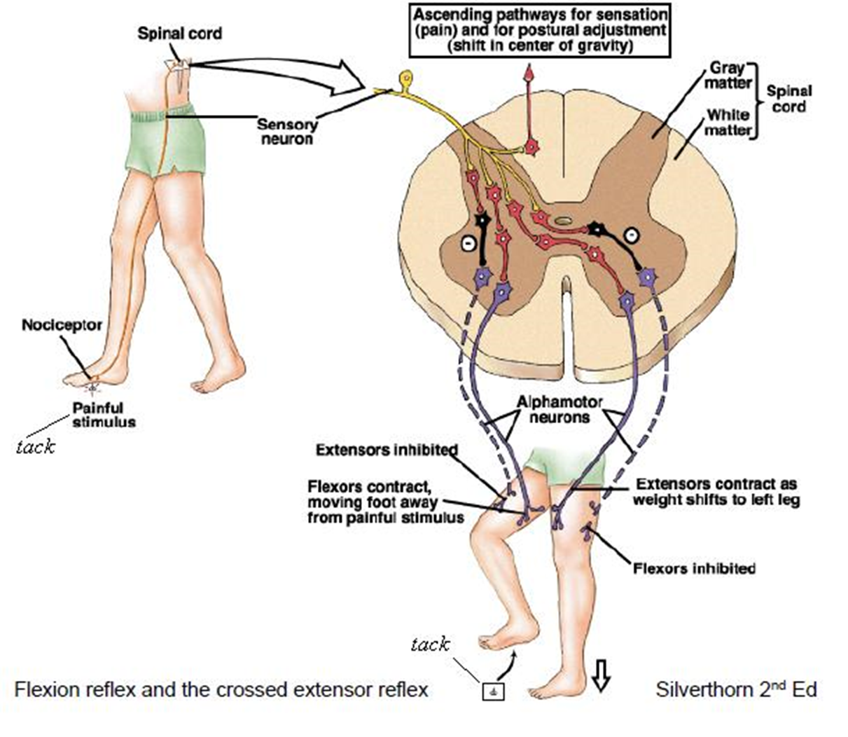
1. Nociceptive reflex arc
Synonyms: flexor reflex, withdrawal reflex, polysynaptic spinal reflex
Ancient reflex that protects the body from potentially damaging, noxious stimuli.

Slide 6
Nociceptors of the skin and mucous membranes → Adelta and/or C fibres → spinal ganglion → spinal dorsal horn → numerous collaterals: excitacion of flexors and inhibition of extensor on the side of stimulus and stimulation of extensors together with inhibition of flexors on the contralateral side (flexor reflex with crossed extensor response).

Slide 7
2. Autonomic spinal reflex arcs
Both proprioceptiv and nociceptive spinal reflexes were „somatic”: a somatosensory input evoked a somatomotor response.
viscerosensory
visceromotor
central nervous system
somatosensory
somatomotor
SENSORY GGL.
AUTONOMIC GGL.
v
skin, muscles, joints, tendons
skeletal muscles
internal organs
smooth muscles , glands
receptors effectors
In case of autonomic spinal reflexes either the afferent or the efferent limb of the reflex arc or both of them are „visceral”!

Slide 8
viscerosensory
visceromotor
central nervous system
SENSORY GGL.
AUTONOMIC GGL.
v
internal organs
smooth muscles , glands
receptors effectors
Urinary or micturition reflex: after reaching the threshold of the stretch receptors within the wall of the urinary bladder, sphincters relax, the muscles of the bladder contract and the bladder discharges. (It is clearly seen in babies and after spinal cord trauma, as the supraspinal control is missing in both of these cases.
Viscerocutaneous reflex: diseases of internal organs are frequently associated with local hyperemia (increased blood supply) of the skin due to the vasodilator innervation of the smooth muscles of vessels.

Slide 9
viscerosensory
central nervous system
somatomotor
SENSORY GGL.
AUTONOMIC GGL.
skeletal muscles
internal organs
receptors effectors
„Défense musculaire”: inflammation of abdominal organs will result in maximal contraction of abdominal muscles. This is protecting involved abdominal organs and immobilizes the patient.

Slide 10
visceromotor
central nervous system
somatosensory
SENSORY GGL.
AUTONOMIC GGL.
v
skin, muscles, joints, tendons
smooth muscles , glands
receptors effectors
Cuti-visceral reflex: applying local heat may relax bowels and can reduce pain (but not in the case of inflammation!) or stimulation of the skin of the glans penis results in erection and ejaculation.

Slide 11
viscerosensory
visceromotor
central nervous system
somatosensory
SENSORY GGL.
AUTONOMIC GGL.
v
skin, muscles, joints, tendons
smooth muscles, glands
internal organs
receptors effectors
Depending on the target, the neurotransmitter used and the physiological effect, different types of efferent limbs of the autonomic spinal reflex can be noted!

Slide 12
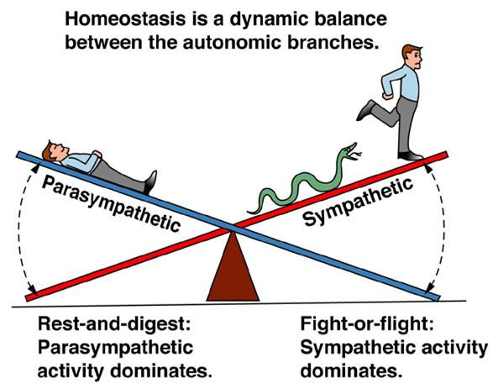
Two types of the visceromotor fibres can be distinguished: they can be parasympathetic or sympathetic.
Sympathetic ones can be further classified as parietal (innervating the skin of limbs and the trunk with sudomotor, pilomotor and vasomotor fibres) and visceral (innervating internal organs).

Slide 13
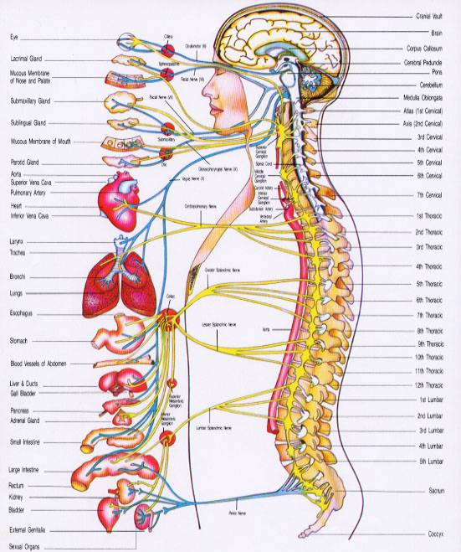
All the internal organs have a double – sympathetic and parasympathetic – innervation. (Limbs and the skin of the trunk exclusively have sympathetic innervation!)
Sympathetic and parasympathetic fibres arise from completly different regions of the CNS.
Visceromotor efferents of spinal autonomic reflexes have to synapse once on the periphery in an autonomic ganglion.
Parasympathetic (craniosacral):
- Autonomic ganglia of cranial nerves
- Plexuses within the walls of internal organs (thoracic, abdominal and pelvic viscera)
Sympathetic (thoracolumbar):
- parevertebral ganglia
(sudo-, pilo- and vasomotor innervation of the trunk and limbs)
- prevertebral ganglia (viscera)

Slide 14
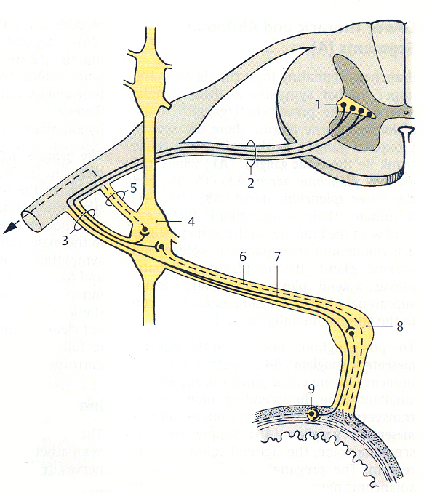
S
IML
3. white ramus communicans
5. gray ramus communicans
parasympathetic
– synapse in intramural plexus
(or in the ganglia of the cranial nerves, but these are not related to the spinal reflexes)

Slide 15
Th-L
IML
3. white ramus communicans
5. gray ramus communicans
parietal sympathetic
– synapse in the paravertebral ganglia of the sympathetic trunk

Slide 16
Th-L
IML
3. white ramus communicans
5. gray ramus communicans
visceral sympathetic
– synapse in prevertebral ganglia
(celiac, superior and inferior mesenteric ganglion)

Slide 17
II. Tracts of the spinal cord Ascending (sensory) pathways
1. PROTOPATIC SENSIBILITY
pain and heat, potential harmful stimuli
2. EPICRITIC AND ÉS PROPRIOCEPTIVE SENSIBILITY
fine touch, vibration, two-point-discrimination
position and movement of joints and muscles

Slide 18
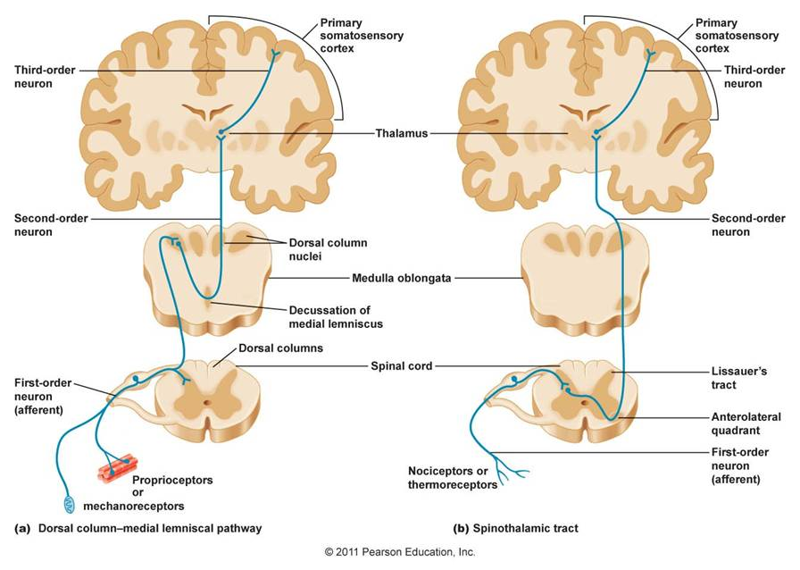

Slide 19
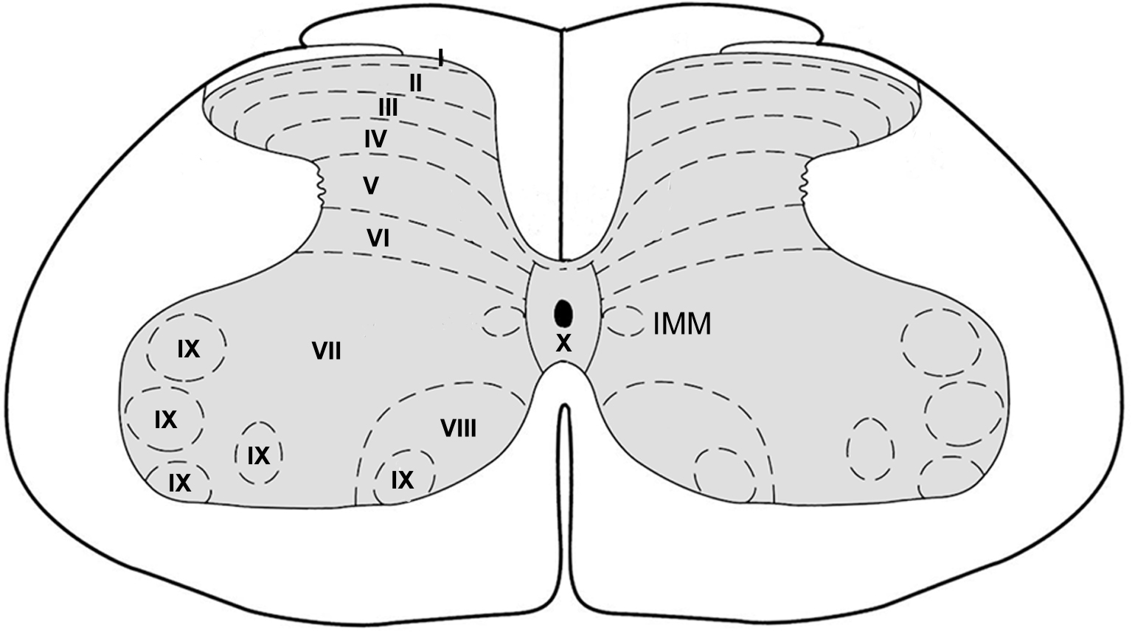
uncrossed
spinobulbar tract
crossed
Flechsig
Gowers
spinothalamic tract
Spinothalamic tract situated in the anterior and lateral funiculi conveys protopathic (pain, heat) signals toward higher areas of the CNS.
Spinobulbar tract carries epicritic and proprioceptiv information into the brainstem, while dorsal and ventral spinocerebellar tract (tract of Flechsig and Gowers, respectively) share epicritic and proprioceptiv signals with the cerebellum.

Slide 20
II. Tracts of the spinal cord Descending (motor) pathways
1. EXTRAPYRAMIDAL TRACTS
Periodic and automatic movements
Posture and body balance
Tone of muscles
2. PYRAMIDAL TRACT
Voluntary, individual movements

Slide 21
PYR
e
a
a
pyr
d
c
b
a: reticulospinal tract
b: olivospinal tract
c: vestibulospinal tract
d: tectospinal tract
e: rubrospinal tract
extrapyramidal

Slide 22
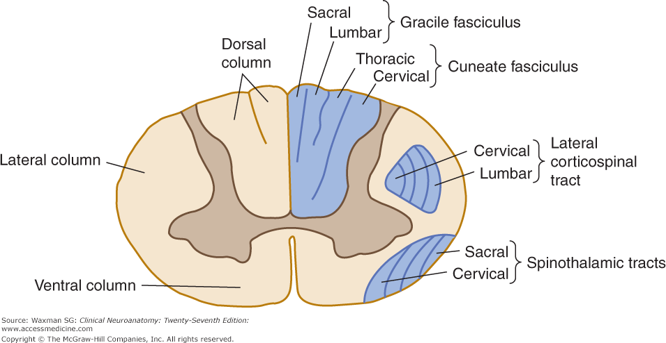
Somatotopic arrangement of major sensory and motor pathways

Slide 23
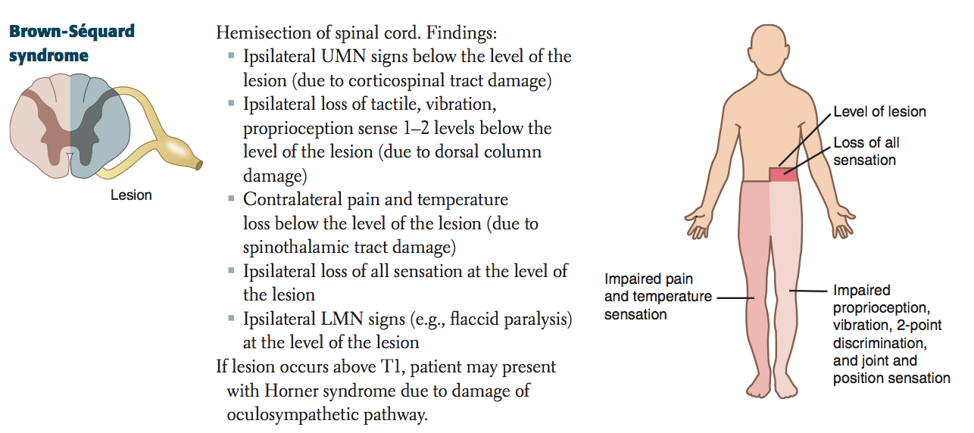

Slide 24
Thank you for your attention!

