Slide 1
Fény- és elektronmikroszkópos kvantitatív vizsgálatok, morfometria
Négyessy László
MTA, Wigner FK
negyessy@gmail.com

Slide 2
Morfometria
testek morfológiai jellemzőinek és azok térbeli és/vagy időbeni változásának mennyiségi adatokkal való (kvantitatív) jellemzése
Geometriai morfológia (topológia, topográfia)
Sztereológia: háromdimenziós szerkezetek térbeli viszonyainak kétdimenziós minták (képek) alapján történő értelmezése (disszektor módszerek)
Forrás: http://elte.prompt.hu/sites/default/files/tananyagok/SzovettaniEsSejttaniVizsgaloModszerek/index.html

Slide 3
Mérés előtt
Lencsék leképezési hibái (kromatikus-, szférikus aberráció)
Digitalizálás
folytonos fényességfüggvényből (tárgy) mintavételezés és kvantálás (diszkrét értékek létrehozása)
Információtartalom
Elemi képpontokat hány tulajdonság írja le (dimenziószám)
Mintavételi sűrűség határozza meg a képpont méretét, vagyis a térbeli felbontást
A képponthoz társított színinformációk minősége és részletessége pedig a színfelbontást (pl: 1 bit (b&w), 8 bit (grayscale), 24 bit (RGB), stb.)
jel/zaj arány (S/N, SNR)

Slide 4
Kvantitatív (digitális) mikroszkópia eszközei ImageJ, FIJI
Ingyenes Java alapú képfeldolgozó szoftver
Letölthető: http://imagej.nih.gov/ij/, http://fiji.sc/ImageJ2
Áttekinthető menüszerkezet
Számos orvosi/biológiai funkció
Bővíthető (plugin)
Jól dokumentált (Help, Tutorial, videók)

Slide 5
ImageJ
Tulajdonságok (frissített leírás a kézikönyvben)
http://rsbweb.nih.gov/ij/docs/guide/
Fejlesztés

Slide 6
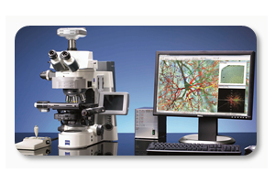
Térinformatikai eszközök Neurolucida
Rekonstrukció
Térképezés
Analízis
pl. http://www.mbfbioscience.com/neurolucida360
http://www.mbfbioscience.com/neurolucida

Slide 7
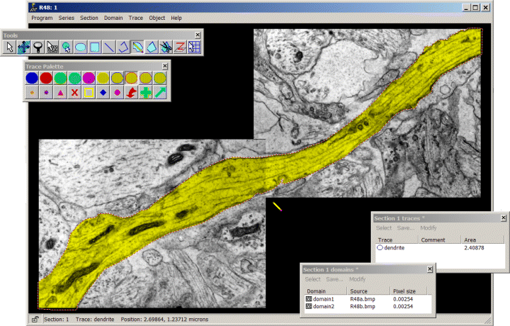
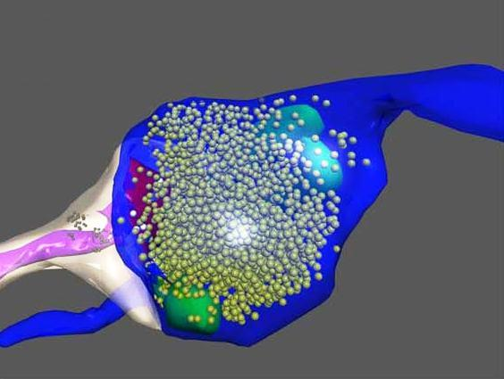
Kvantitatív elekrtonmikroszkópia Reconstruct
3D rekonstrukciók készítése sorozatmetszetekből
http://synapses.clm.utexas.edu/tools/reconstruct/reconstruct.stm

Slide 8
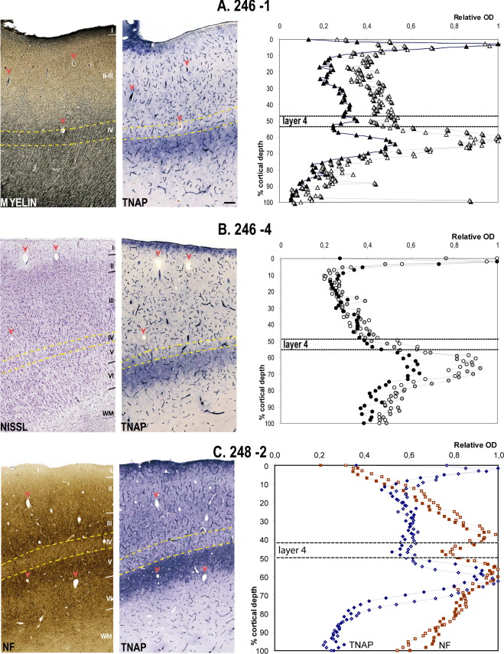
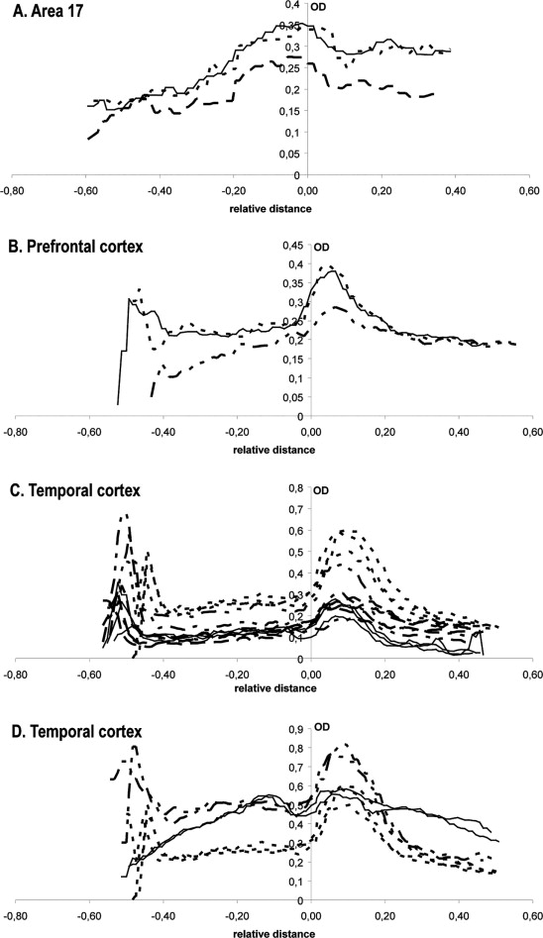
Réteganalízis optikai denzitás méréssel az agykéregben
Notes:
doi:10.1016/j.neuroscience.2010.10.049
Bal: Fig. 5. Quantitative localization of TNAP-positive layer in human temporal cortex. Rectangular regions indicated in Fig. 4 are displayed at a higher magnification for the different samples (case 246 in A, B and case 248 in C). Arrowheads point to common landmarks between serial sections. Layer 4 was identified by a high content in myelin (A), a high density of granular cells (B), or a low intensity of SMI-32 staining (NF) as opposed to layer 3 and 5 which are neurofilament-rich layers (C). In all cases, the TNAP-positive band was observed below layer 4 (yellow dashed lines). Moreover it was found to correspond to layer 5, as demonstrated with the SMI-32 staining. Optical density measurements done on three different sections in sample 246–1 (white, gray, black triangles) and 246–4 (white, gray, black circles) confirmed these results: layer 4 position measured on cresyl violet stained sections was found between 48% and 56% of the cortical depth, while the TNAP band occupied a band ranging between 52% and 77% of the cortical depth in the different samples. Optical density measurements carried out in case 248–2 on TNAP- and SMI-32 stained sections revealed that the TNAP-positive band (two measurements, plain and bordered diamonds) was found at a similar location than the lower SMI-32 positive band (NF, two measurements, plain and bordered squares) corresponding to layer 5 (between 50% and 70% of the cortical depth). In this sample layer 4 was positioned between 42% and 49.5% of the cortical depth. Bar: 200 μm. For interpretation of the references to color in this figure legend, the reader is referred to the Web version of this article.
Jobb: Fig. 6. Quantitative analysis of TNAP pattern in human cortical areas. Optical density values (OD) of TNAP stained sections of the primary visual cortex (A), prefrontal cortex (B) and temporal cortex of case 246 (C) and case 248 (D) are shown in common coordinate systems. OD values are plotted relative to the bottom of layer 4 (zero on the abscissa) identified on the cresyl violet-series, in the case of TNAP labeling. On the abscissa, large negative values represent proportionally more superficial layers, while more positive values show gradually deeper layers relative to the bottom of layer 4. Different line types indicate different measurements on one section in (A) on different sections in (B) or on different blocks of the temporal cortex in (C; several sections/block). In (D) sections stained for SMI32 and TNAP are shown by continuous lines and dashed lines, respectively. Long-dashed lines correspond to two measurements on a same TNAP-labeled section, short-dashed lines to three other neighbouring TNAP-labeled sections. Lines were fitted to the data points by way of moving average with window size 3.

Slide 9
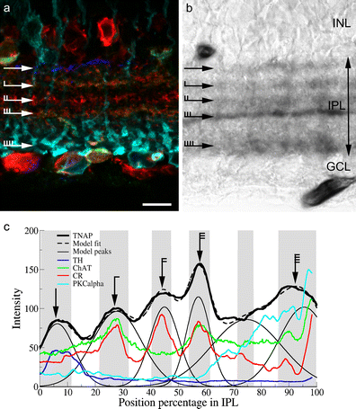
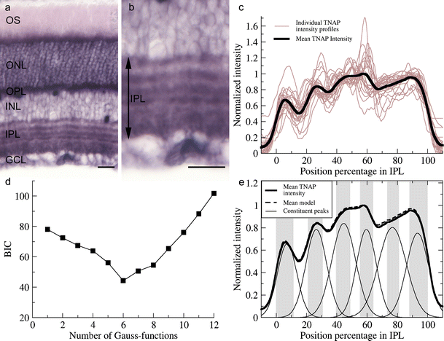
a retinában
Notes:
DOI.10.1007/s00441-014-2047-x
Fig. 2. Determination of the number and position of TNAP-labeled IPL strata. In addition to retinal vessels, photoreceptors, and the outer plexiform layer, TNAP histochemistry revealed several strata of the rat IPL. Five darkly labeled strata and one pale stripe were visualized with five more lightly stained strata between them (a, b at higher magnification). Individual intensity plots of TNAP histochemistry from the IPL (light linesin c) were combined to create a mean TNAP intensity profile (bold line in c), exhibiting five clearly visible peaks corresponding to the five easily identifiable, darkly labeled TNAP strata. Next, we constructed the model best describing the mean TNAP staining. Bayesian information criterion analysis (d) resulted in a minimum value of six; thus, the mean TNAP staining can be best modeled with the sum of six Gaussian curves (e). Indeed, an almost exact match was found between the mean TNAP intensity profile (bold line ine) and the best fitting model (dashed line in e). Inflection points of the individually fitted Gaussians delineated the borders of the IPL strata seen after TNAP histochemistry (alternating white and shaded areasin e). According to the model, 11 strata were revealed by TNAP (OS photoreceptor outer segments, ONLouter nuclear layer, OPL outer plexiform layer, INL inner nuclear layer, IPL inner plexiform layer, GCLganglion cell layer). Bars 20 μm (a, b)

Slide 10
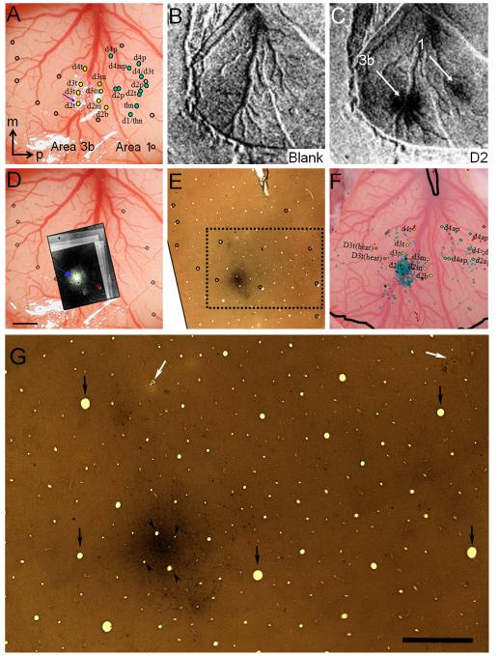
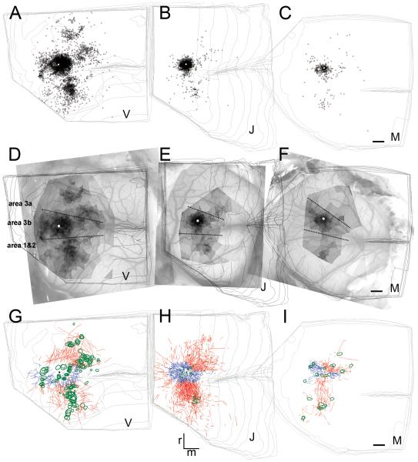
Konnektivitás vizsgálat Neurolucidával
Notes:
http://www.ncbi.nlm.nih.gov/pmc/articles/PMC4157923/
Bal: Fig.2. Alignment of functional maps and BDA label (case M). (A) Vessel map. Color dots: some of electrophysiological recording sites (see Fig. 1for full map). Open circles: surface vessel endings used for alignment. Blue arrow: injection site. m: medial, p: posterior. (B) Optical map: blank condition. (C) Optical map in response to D2 tip stimulation reveals one activation in area 3b and another in area 1 (white arrows). (D) Dark field photomicrographs of the resulting label near the BDA injection site aligned and superimposed on the surface vessel map. The figure was made by the superposition of the reconstructed series of this case (6 inverse photomicrographs on each other) with the image of the cortical surface. Green and red circles outline several vessel lumens used for the alignment. (E) Histological section revealing darkly stained injection site and other patches. Open circles: same as those shown in A and D and used to align with vessel lumen across sections. Note the almost perfect match of these blood vessels on the serial sections. Break at top of section: end of the central sulcus. (F) Map of BDA-labeled cells projected on cortical surface and some of electrophysiological map. (G) Enlarged view of the area outlined by the dotted rectangle in (E). Retrogradely labeled neurons appear as small black dots. Patches of darkly stained regions also include the fine net of BDA labeled neuronal processes composed both of dendrites and axons. Arrows show blood vessel cross sections encircled on (E). Arrowheads indicate blood vessels, which are encircled by green near the injection site in (D). White arrows point onto electrode penetrations shown in (F) near d4t and d4ap, respectively. Axis: m = medial, p = posterior. Scale bars represent 1 mm.
Jobb: Fig.6. Horizontal distribution of the retrograde and anterograde BDA labeling in the three different cases (V, J, M). (A-C) Distribution of the retrograde labeling on the merged representations of the serial reconstructions. Small black triangles represent retrogradely labeled neuronal perikarya. Injections site is shown by the white dot. (D-F) Voronoi tessellation as a measure of the density of cell body labeling overlaid on the cortical surface. Voronoi areas are greyscaled providing darker tones for smaller areas using log values. White region directly around the injection site, representing about 300 μm, shows the area omitted from the analyses. (G-I) Anterograde labeling is represented by connections intrinsic (blue lines) and extrinsic (red lines) to the hand representation region of area 3b; intrinsic connections mostly course medially and laterally (blue lines) and inter-areal axonal fibers course anteriorly and posteriorly (red lines). Green outlines represent patches of terminal axon arborizations. Fibers crossing the estimated borders of the hand representation of area 3b were defined as long distance, inter-areal; otherwise fibers localized within the hand representation were considered intrinsic. The large lateral vein crossing area 3b in (E) is a characteristic landmark identifying the hand-face border within area 3b. Dashed lines: estimated areal borders. Scale bars on C, F and I represent 1 mm and apply also to A,B,D,E,G,.H.

Slide 11
Sűrűség eloszlás Voronoj cellák, kernel denzitás
Notes:
https://hu.wikipedia.org/wiki/Voronoj-cella
https://en.wikipedia.org/wiki/Kernel_density_estimation

Slide 12
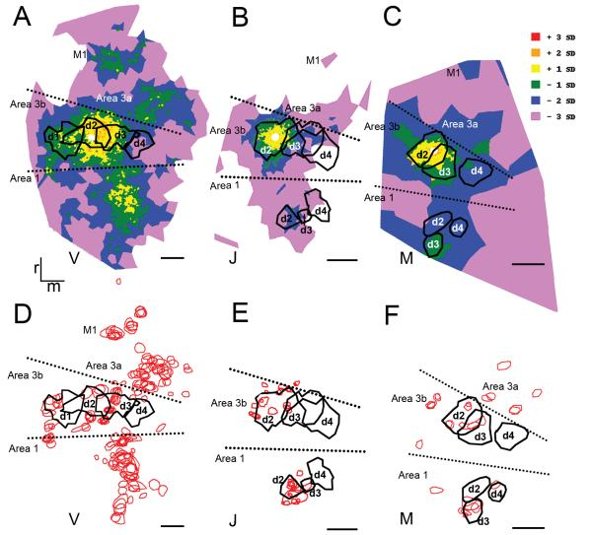
Agykérgi összeköttetések elemzése
Notes:
http://www.ncbi.nlm.nih.gov/pmc/articles/PMC4157923/
Figure 9. Input and target preference of the connections revealed by the BDA injection into D2 overlaid on the representation of the distal finger pads. (A-C) input preference is shown by the correspondence of peak labeling densities with the optical imaging maps (black outlines). Color code is given in units of standard deviation (SD) above and below average. (D-F) Target preference is defined by the localization of terminal patches (red outlines) on the optical imaging maps (black outlines). Conventions are the same as in Figure 7. Scale bars represent 1 mm.

Slide 13
Agykérgi összeköttetések elemzése
Area 3b
log scale
+ 3 SD
Area 1
+ 2 SD
+ 1 SD
0 SD
- 1 SD
- 2 SD
- 3 SD

Slide 14
Agykérgi összeköttetések elemzése
Area 3b
log scale
+ 3 SD
Area 1
+ 2 SD
+ 1 SD
0 SD
- 1 SD
- 2 SD
- 3 SD
500 µm

Slide 15
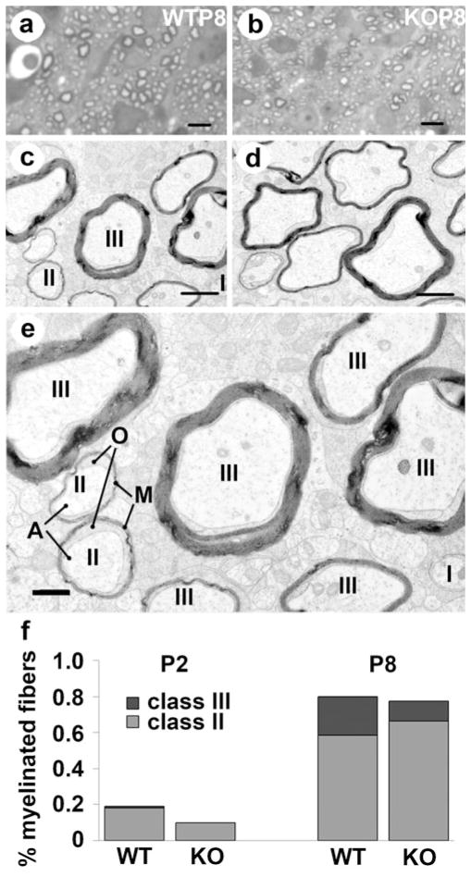
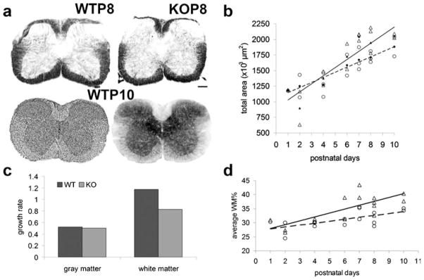
Profilok mérete és abundanciája
Notes:
http://www.ncbi.nlm.nih.gov/pmc/articles/PMC3415568/
Fig.1. a Cross-sections of the spinal cord cervical segment in wild-type (WT) and TNAP knockout (KO) animals at postnatal days 8 and 10 (P8,P10). Upper two sections are stained for myelin and lower left and right sections are stained by cresyl violet and TNAP histochemistry, respectively. Note the high activity of TNAP in the gray matter and along fibers in the white matter. Ventral is down. Scale bar 200 μm. b Size of total cross-sectional area measured on the myelin-stained sections of the spinal cord is illustrated as the function of age. Individual cases are shown as open triangles in case of the WT as well as opern circles in case of the KO animals. Linear fit is represented by the straight line in the case of WT and dashed line in the case of KO animals. Filled symbols represent averages of the KO (circle) and WT (triangle) data. C Growth rates of grey and white matter between P1 and P10 in the WT and KO animals. d Relative white matter content (WM%) in the two groups as the function of age. Conventions are the same as in (b)
Fig.2. Myelinated fibers in the spinal cord of normal (WT) and Akp2 gene-ablated (KO) animals. Light (a, b) and electron microscopic (c, d) images taken from the ventral funiculus of WT and KO mice at postnatal day 8 (P8). Images of semithin (a, b) and ultrathin (c, d) sections taken from the same resin-embedded blocks of WTP8 (a, c) and KOP8 (b, d) are shown in columns. a, b Note strongly labeled circular structures corresponding to myelinated axons in the toluidin blue azure II-stained semithin sections. c, d Note irregular shape of the cross-section of myelinated fibers in the KO. I, II, and III mark the three classes of fibers (see definition in the text). e Higher resolution of (c). M myelin, Oprocesses of oligodendrocytes, A axon. f Effect of TNAP gene deletion on the proportional distribution of the myelinated (Class II and Class III) fibers 2 days (P2) or 8 days (P8) after birth. Scale bars 10 μm on the light micrographs (a, b) and 500 nm on the electron micrographs (c–e)

Slide 16
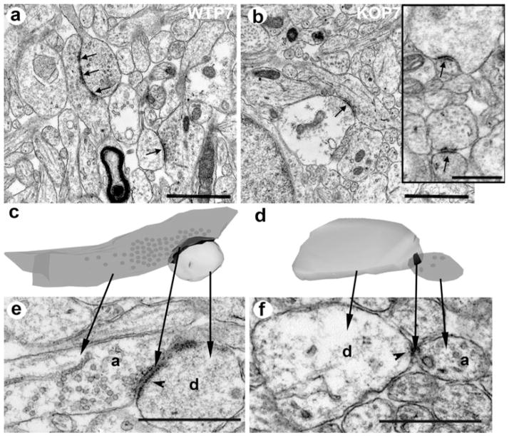
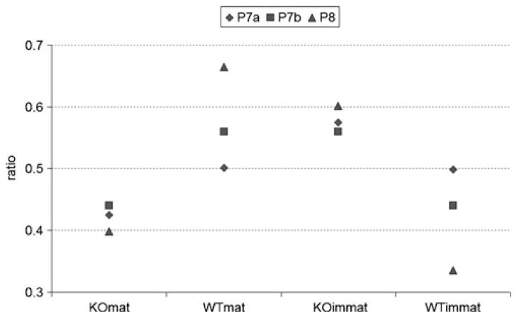
Szinapszisok: morfometria, rekonstrukció
Notes:
Bal: Fig.6. Synaptic organization of the cerebral cortex in the WT (a, c, e) and TNAP KO (b, d, f) mice at P7. a, b Arrows indicate synaptic contacts exhibiting all the ultrastructural characteristics of matured synapses. Inset shows non-matured synapses lacking synaptic vesicles with recognizable synaptic membrane specializations (arrows) and synaptic cleft in the KO mice. c, d Three-dimensional reconstructions showing the ultrastructural differences between developed and non-developed synaptic contacts. Axon terminal is shown darker and postsynaptic dendrite is in lighter shading. Dots represent synaptic vesicles in the axon terminals. Synaptic membrane specialization is shown in black. Note small synaptic membrane specialization and the paucity of synaptic vesicles in the KO. e, f Electron micrographs from the series used for the reconstructions shown in (c, d), where the synapses exhibited the most elaborated structural specialization. Arrows connect corresponding structures of the reconstructions and the electron micrographs. Arrowhead synaptic membrane specialization. a axon terminal, d postsynaptic dendrite. Scale bars (a, b) 1 μm, (insett and e, f) 500 nm
Jobb: Fig.7. The ratio of mature (mat) and immature (immat) synaptic contacts are shown in two animals at postnatal day 7 (P7a, P7b) (diamonds andsquares) and in one animal at postnatal day 8 (P8) (triangles) in both WT and TNAP KO mice

Slide 17
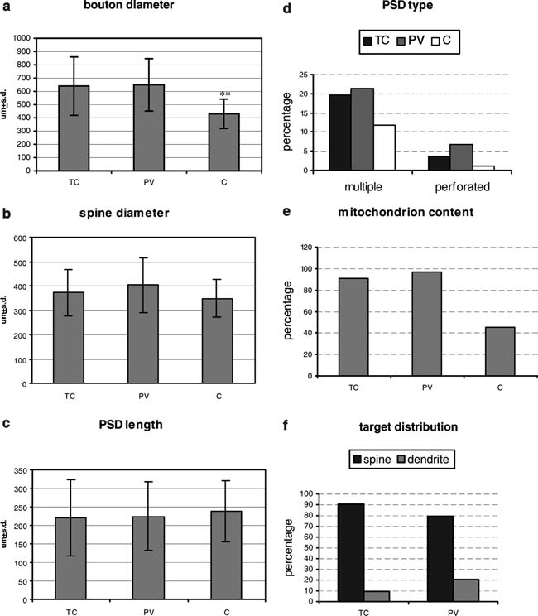
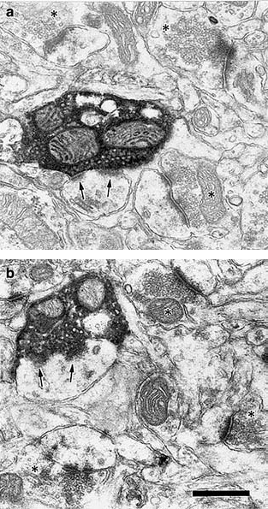
2D méret
Notes:
DOI.10.1007/s00221-005-2237-6
Fig. 2a–b. Electron micrographs illustrate BDA-labeled (a) and parvalbumin-immunopositive (b) axon terminals in the middle layers of the prefrontal cortex (PFC). Arrows show postsynaptic membrane specializations.Asterisks mark non-labeled endings forming asymmetric axospinous contacts. Scale bar: 500 nm
Fig. 4.a Mean values (±SD) of bouton-size measurements in the different groups. b Mean values (±SD) of spine-size measurements in the different groups. c Average lengths (±SD) of postsynaptic densities in the different groups. d–f The percentage of each population of nerve endings that: d exhibit either multiple or perforated synapses; e exhibit one or more mitochondria; f synapse on either spines or dendrites. TC BDA-labeled mediodorsal thalamocortical afferents, PV parvalbumin-immunoreactive axon terminals, C non-labeled axonal endings

Slide 18
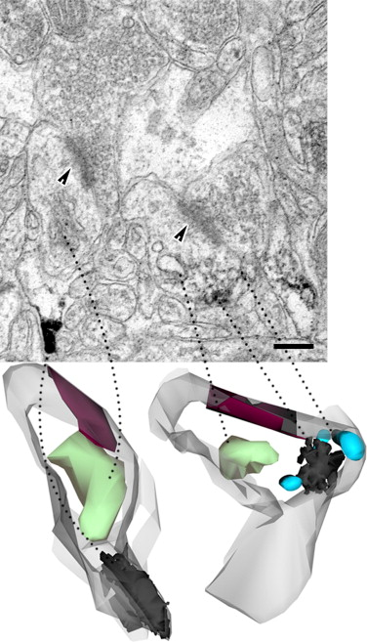
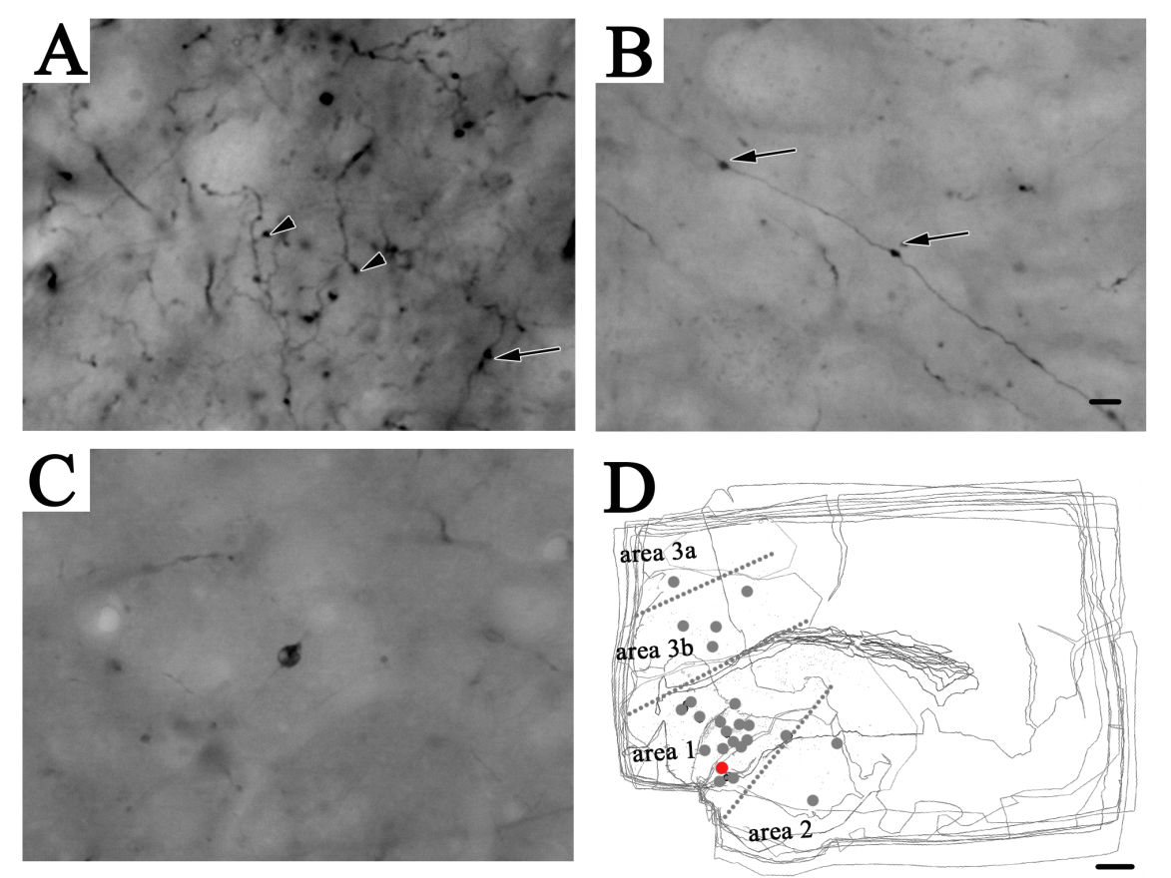
3D rekonstrukció
Notes:
https://www.ncbi.nlm.nih.gov/pubmed/18539394

Slide 19
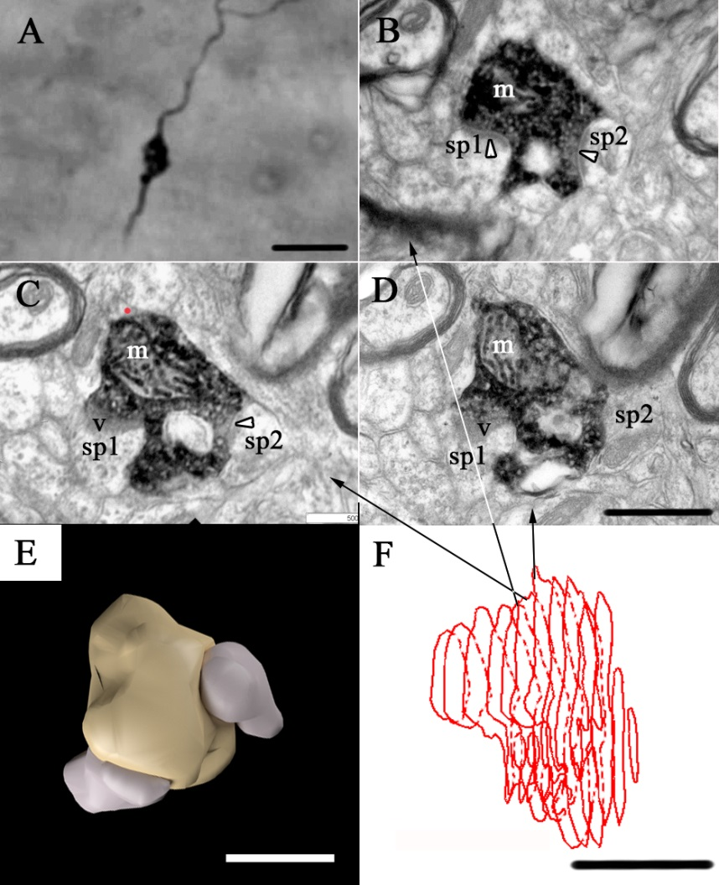
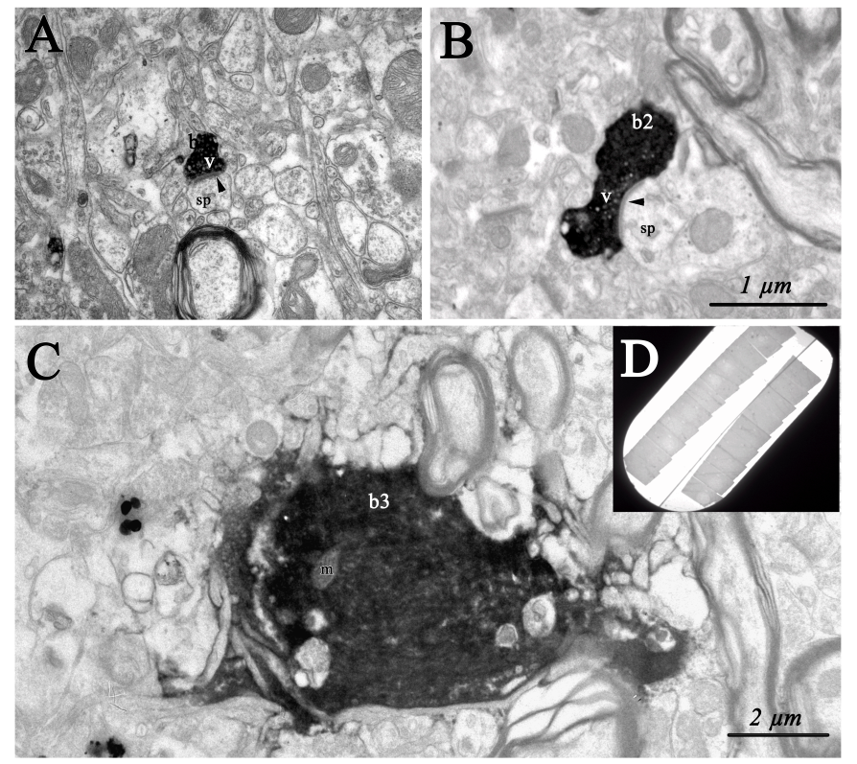

Slide 20
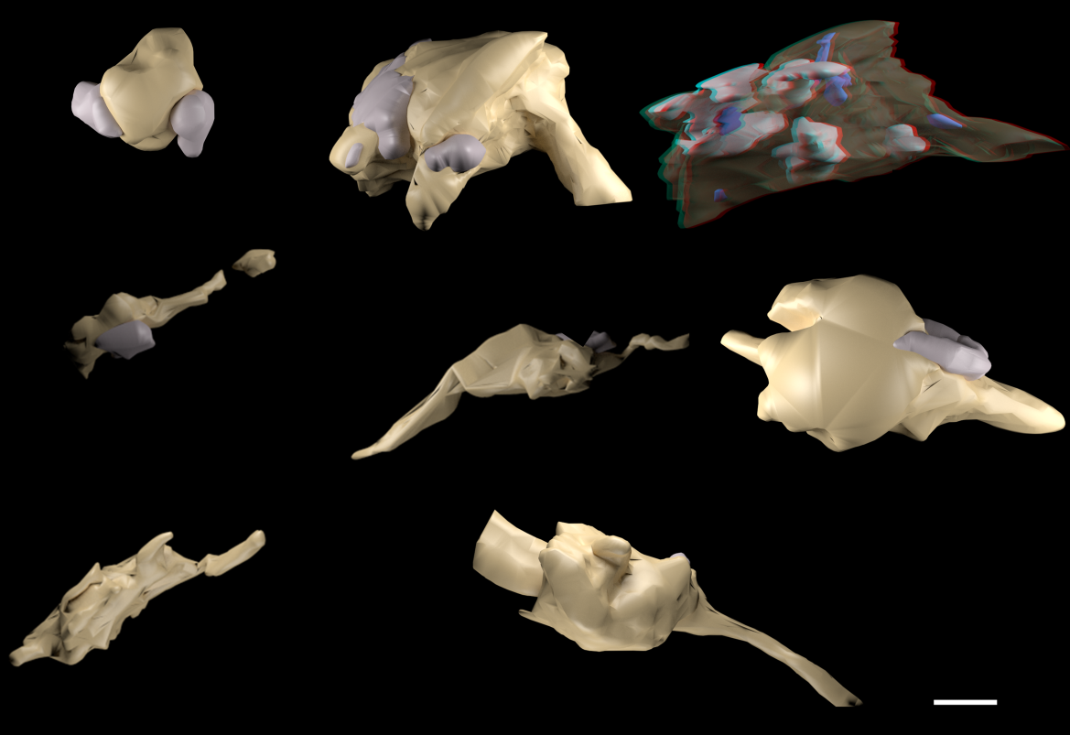

Slide 21
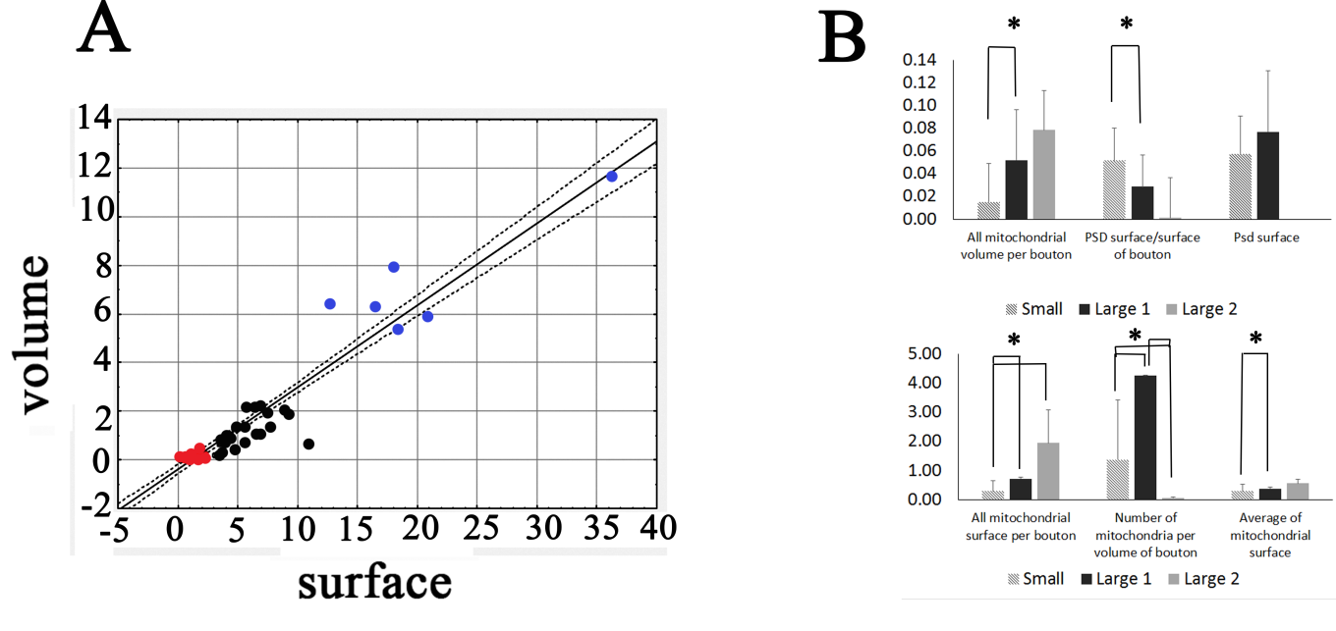
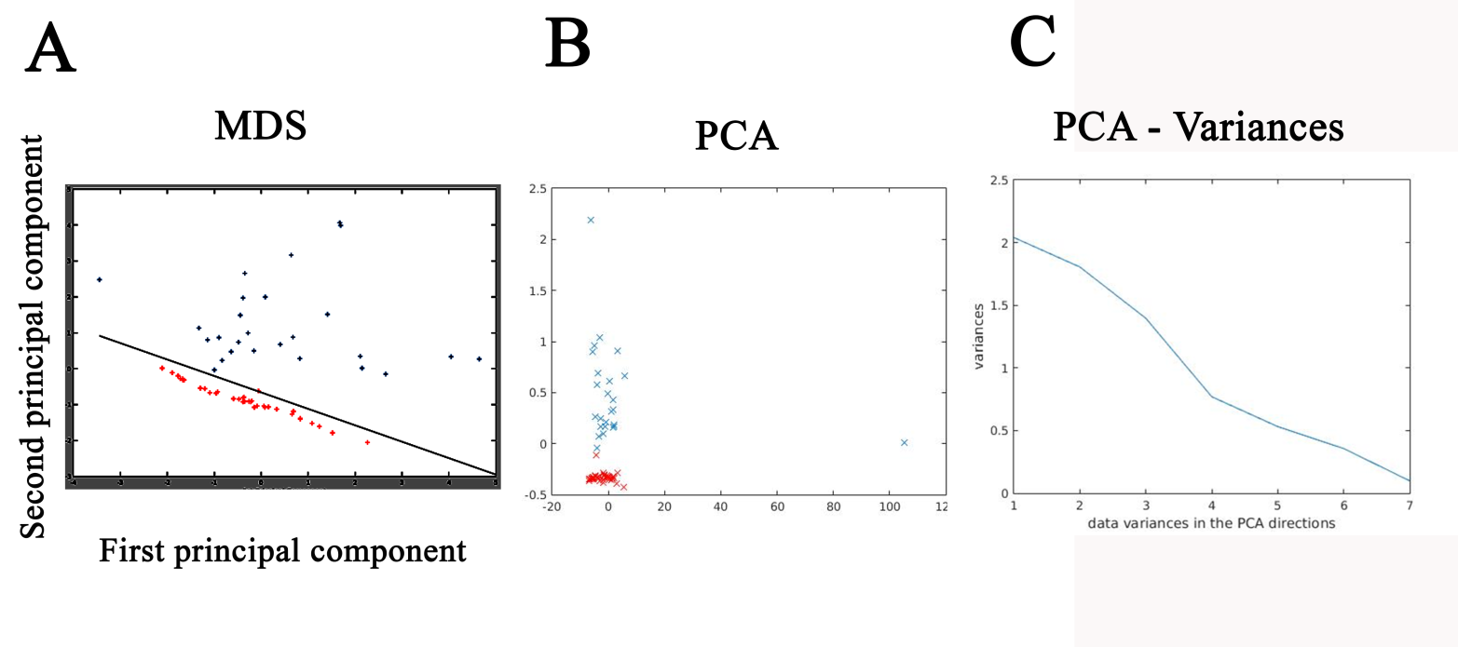

Slide 22
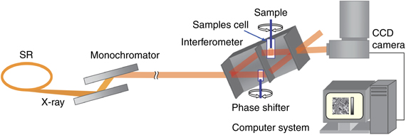
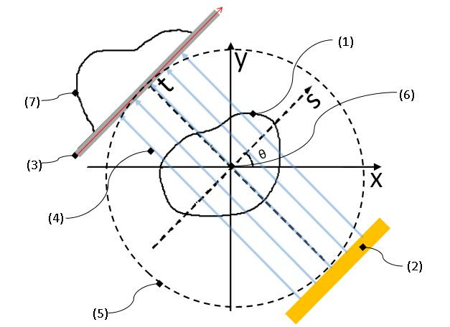
Röntgensugár mikrotomográfia
Notes:
https://en.wikipedia.org/wiki/Tomography
Alul: Fig. 3: Considering a parallel beam irradiation optical system where the angle between the object and all transmission lights equals θ. Here, the numbers in the figure (see the numbers within the parentheses) respectively indicate: (1) = an object; (2) = the parallel beam light source; (3) = the screen; (4) = transmission beam; (5) = the datum circle; (6) = the origin; and (7) = a fluoroscopic image (a one-dimensional image; pθ(s)). Two datum coordinate systems xy and ts are also imagined in order to explain the positional relations and movements of features (0)–(7) in the figure. In addition, a virtual circle centered at the above-mentioned origin (6) is set on the datum plane (it will be called “the datum circle” henceforth). This datum circle (6) will be represents the orbit of the parallel beam irradiation optical system. In the figure above, X-Y plane rotates around the point of origin in the plane in such a way “to keep mutual positional relationship between the light source (2) and screen (7) passing through the trajectory (5).” Rotation angle of this case is defined as θ. In the figure set out above, absorption coefficient at a cross-sectional coordinate (x, y) of the subject is modeled as μ(x, y).

Slide 23
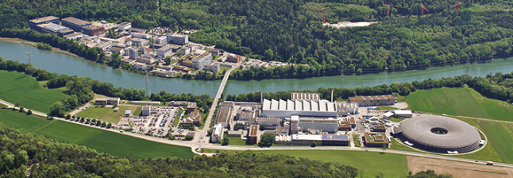
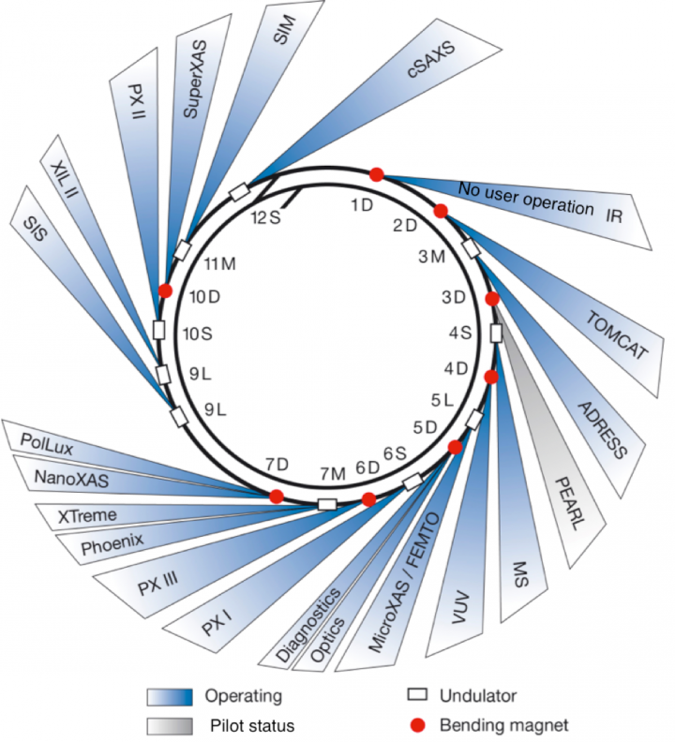

Slide 24
Mintaelőkészítés

Slide 25
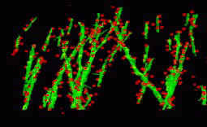
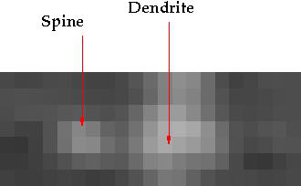
Dendrtittüske azonosítás
Notes:
https://hal.inria.fr/hal-00793573/file/Spine.pdf

Slide 26
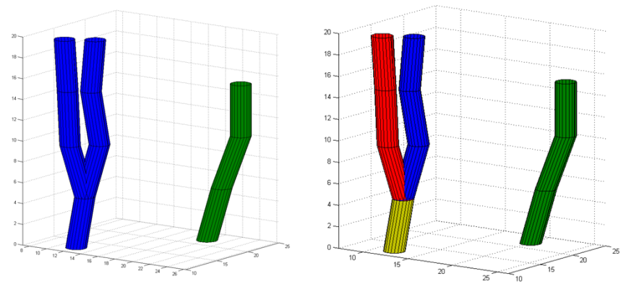
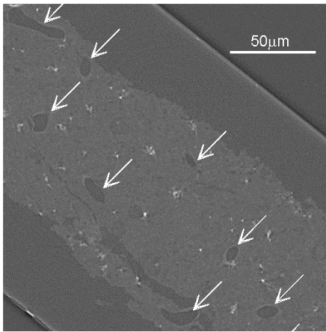
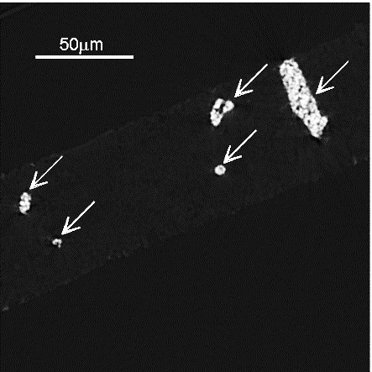
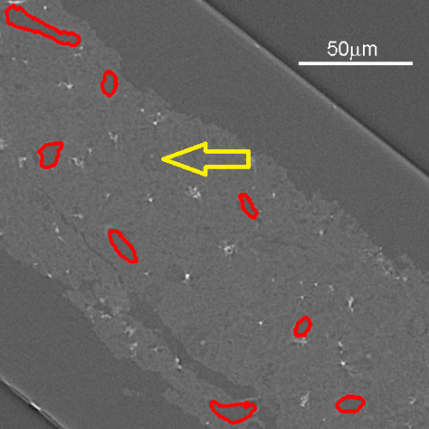
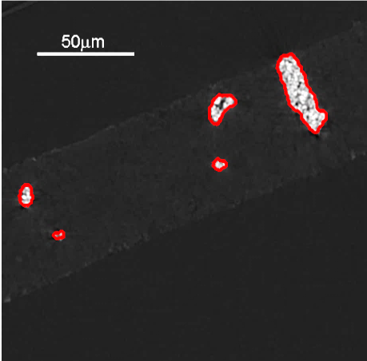
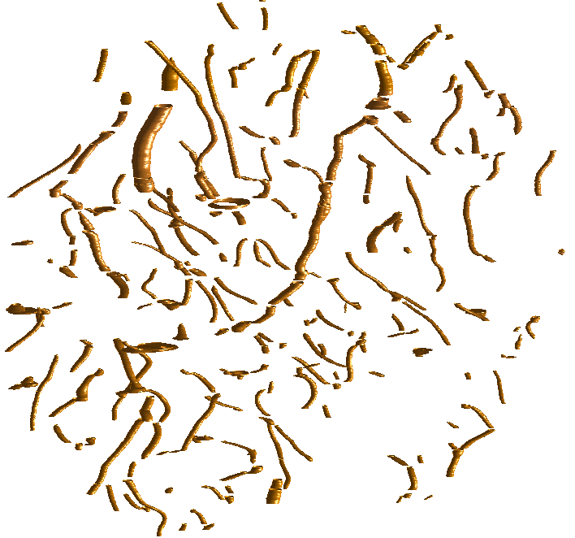
Mikro-érhálózat rekonstrukciója
Notes:
http://mycite.omikk.bme.hu/doc/146255.pdf

Slide 27
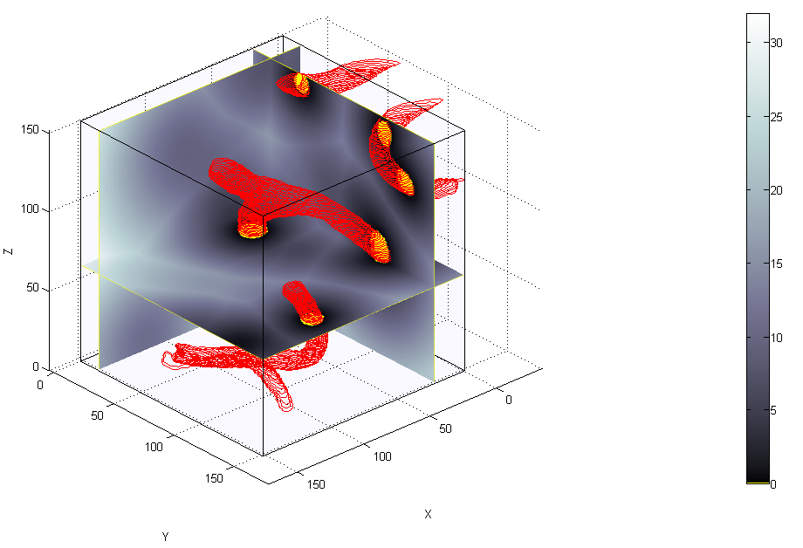
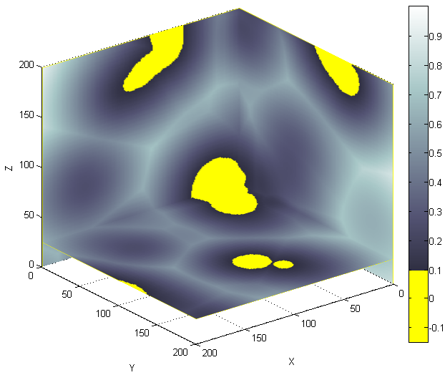
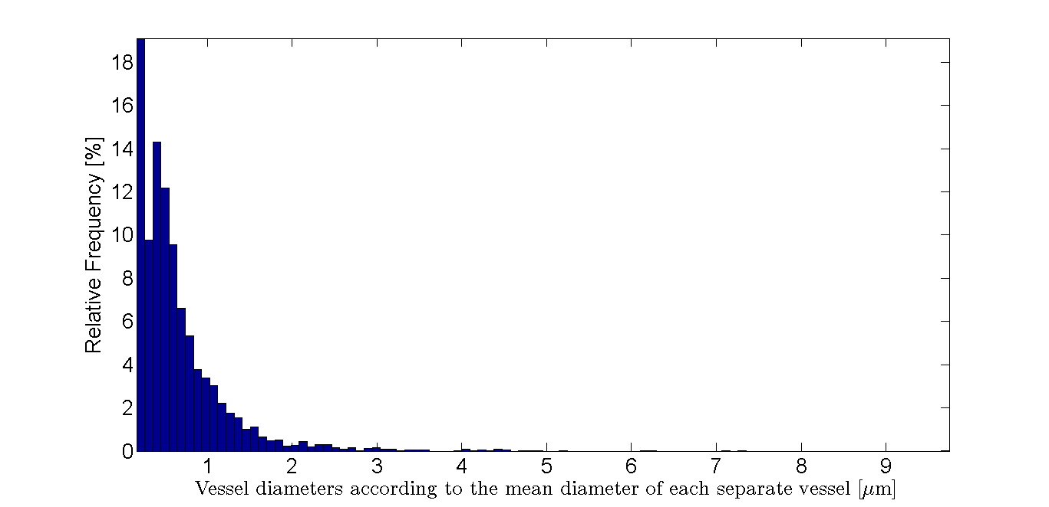
Kvantitatív tulajdonságai

