Slide 1
Ossification, bone remodelling
Semmelweis University, Faculty of Medicine
1st year, 1st semester
Department of Anatomy, Histology and Embryology
Katalin Kocsis
09/10/2017

Slide 2
Bone formation (ossification)
(Primary angiogenic ossification of Krompecher: bone is synthesized de novo by osteoblasts differentiated from mesenchymal cells found in the adventitia of small vessels – in human it is not common.)
Secondary ossifications
Bone replaces a former tissue type, the former tissue forms a shape producing, load-bearing tissue:
Intramembranous ossification: osteoblasts differentiate from mesenchymal cells and replace the preexisting connective tissue. Typical in flat bones, e.g. the skull cap, clavicle, mandible, (periosteal ossification is this type as well)
Endochondral ossification: load-bearing cartilage replaced and rebuild by bone while the whole structure is a functional bone. Characteristic for long bones.

Slide 3
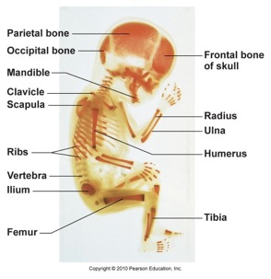

Slide 4
Intramembranous (desmal) ossification

Slide 5
Intramembranous ossification
Increased vascularity of tissue
Active proliferation of mesenchymal cells
Differentiation of osteoblasts
Osteoid production
Differentiation of osteocytes
Osteiod calcifies
Spicules form trabeculea
Bone remodeling

Slide 6
Steps of intramembranous ossification
Ossification center appears in the fibrous connective tissue membrane – cluster of osteoblasts
Bone matrix (osteoid) is secreted within the fibrous membrane and calcifies
osteoprogenitor cells - osteoblasts – osteoid – osteocyte
Woven bone and periosteum is formed
osteoid around the blood vessels forming trabeculae
Lamellar bone replaces woven bone under the periosteum
compact plates
spongy bone forming trabeculae
vascular tissue becomes bone marrow

Slide 7
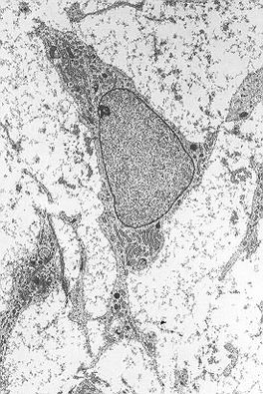
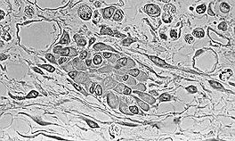
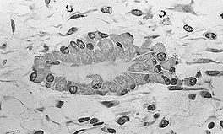
osteoprogenitor cells
mesenchymal cell
osteoblasts

Slide 8
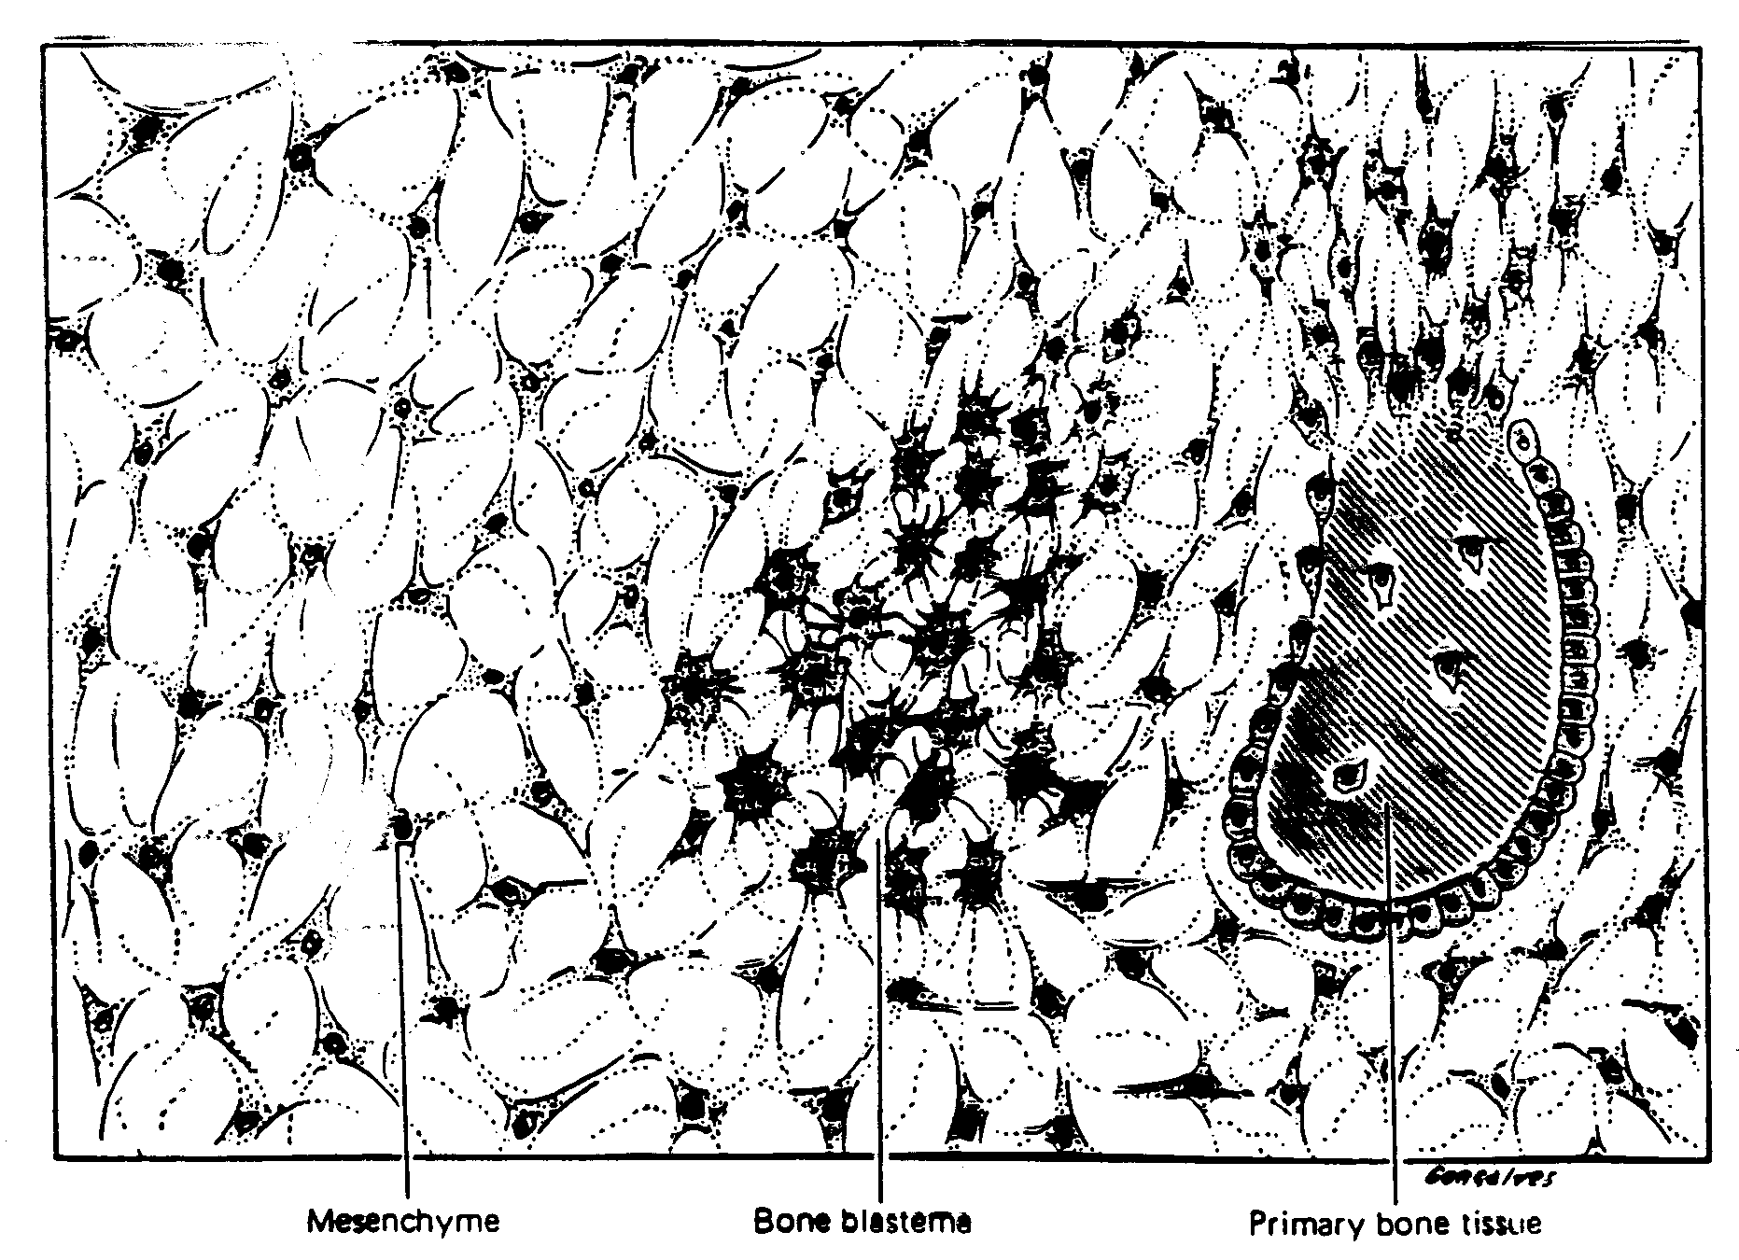

Slide 9
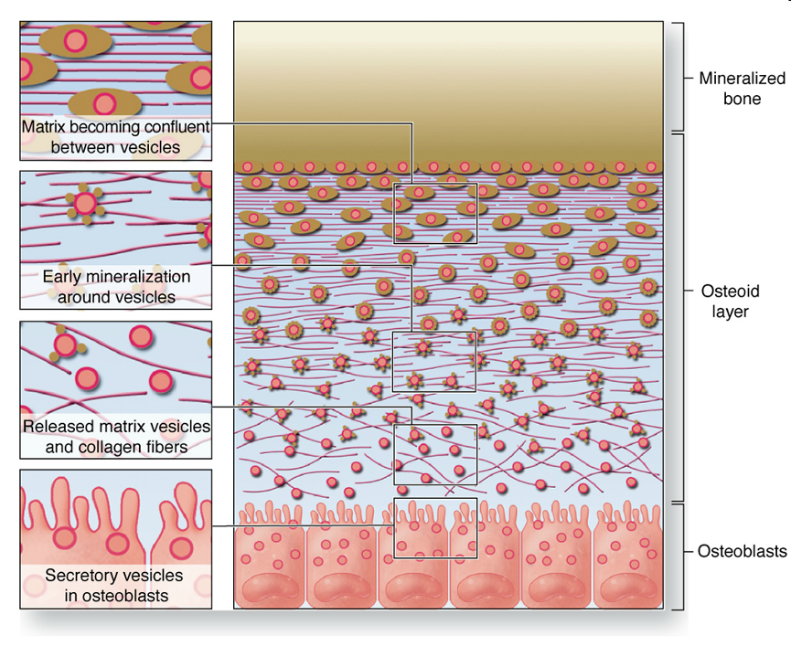

Slide 10
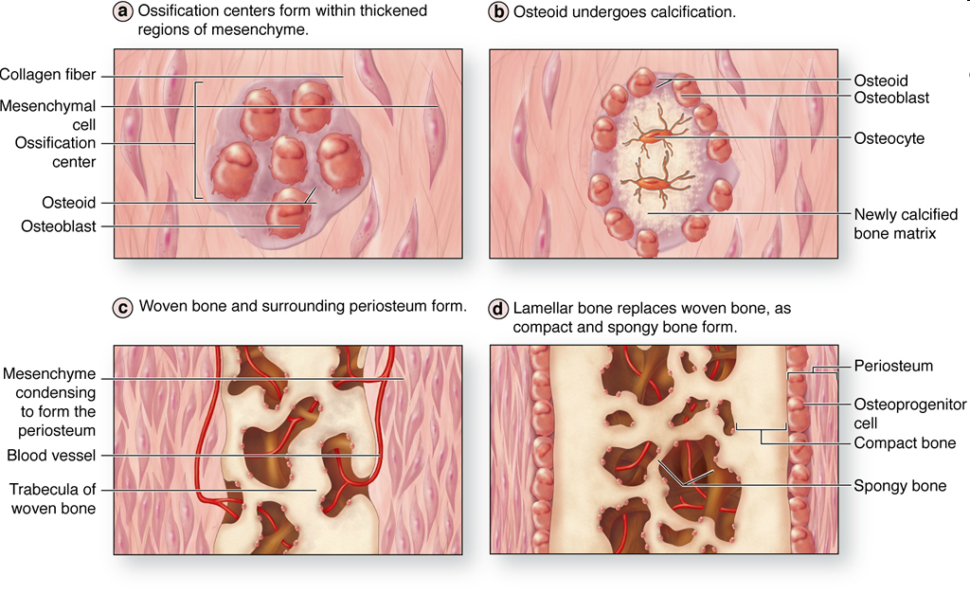

Slide 11
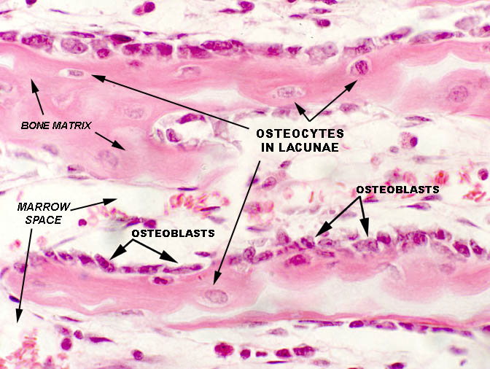

Slide 12
osteocytes
bone marrow cavity
osteoid
osteoblasts

Slide 13
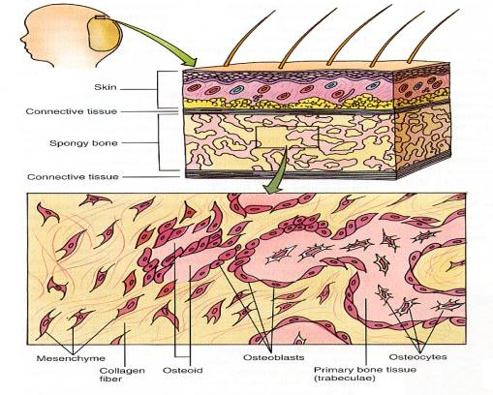

Slide 14
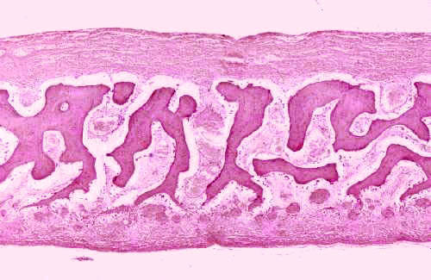

Slide 15
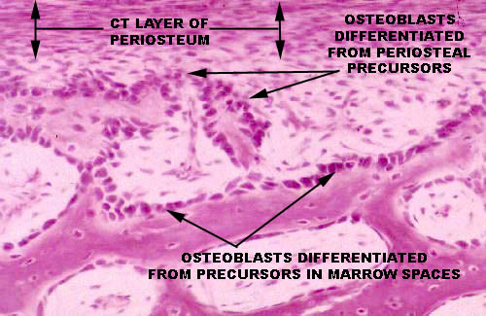

Slide 16
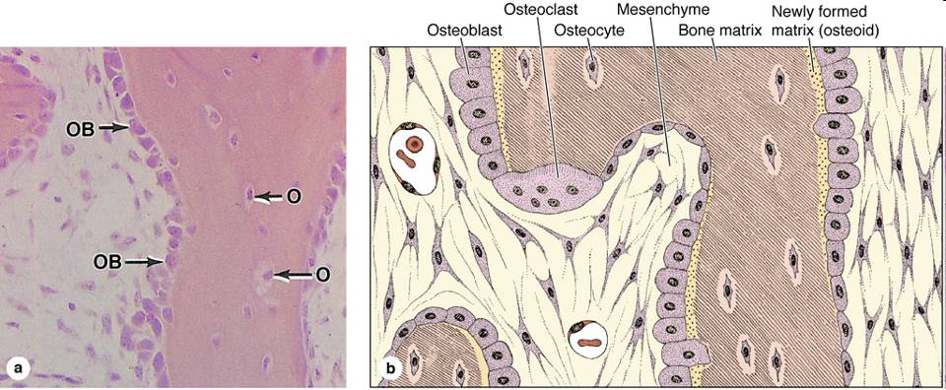

Slide 17
Endochondral (enchondral, intrachondral) ossification

Slide 18
Steps of endochondral ossification
Hyaline cartilage models are formed
Bone collar forms around the hyaline cartilage model
Cartilage in the center of diaphysis calcifies and then cavities develop
Periosteal bud invades the internal cavities, spongy bone begin to form
Diaphysis elongates, medullary cavity forms as ossification continues. Secondary ossification centers appear at the epiphyses
Epiphyses ossify. When completed hyaline cartilage remains only in the epiphyseal plates and articulating surfaces

Slide 19
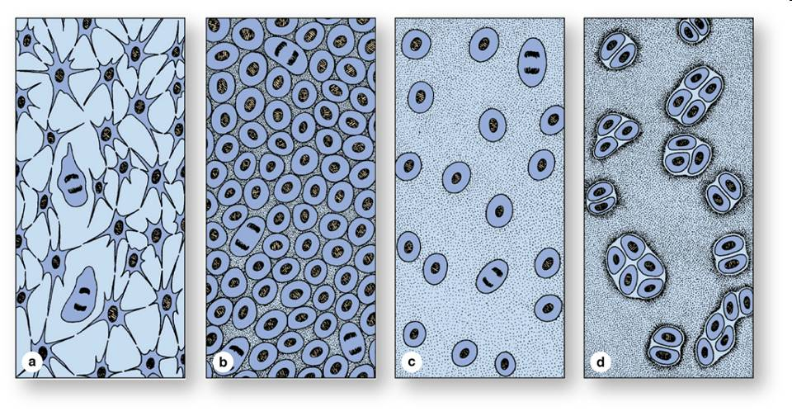
cartilage differentiation

Slide 20
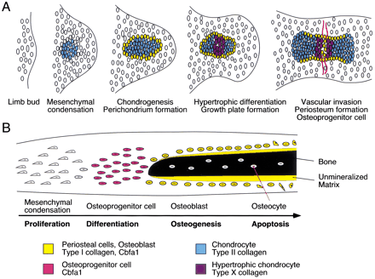

Slide 21
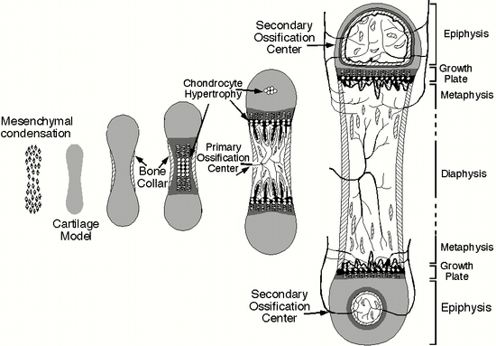

Slide 22
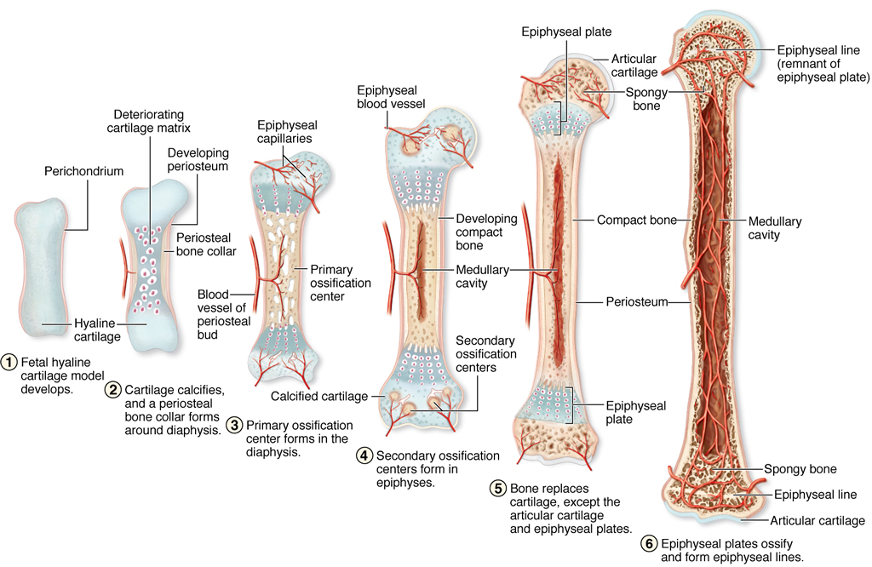
Endochondral ossification

Slide 23
Zones of enchondral ossification
1. Zone of reserve cartilage (resting)
2. Zone of proliferation
3. (a,b,c) Zone of chondrocyte maturation, hypertrophy, and degeneration, parallel process: cartilage matrix calcification
4. Zone of osteogenesis (mesenchymal invasion)
Mixed cartilage - bone matrix spicules, primitive bone marrow cavities
Bone tissue rebuilds the mixed matrix (osteoclasts, remodelling), spongy bone/compact bone, bone marrow cavities
Thickening via periosteal ossification

Slide 24
Cartilage-bone border zones (enchondral ossification)
1. Zone of reserve cartilage (resting)
2. Zone of proliferation
3. (a,b,c) Zone of chondrocyte maturation, hypertrophy, and degeneration, parallel process: cartilage matrix calcification
4. Zone of osteogenesis (mesenchymal invasion)
*
*: primitive bone marrow cavity
osteclast (chondroclast)
(calcified) cartilage matrix trabecule
osteoid (new bone matrix)
osteblast

Slide 25
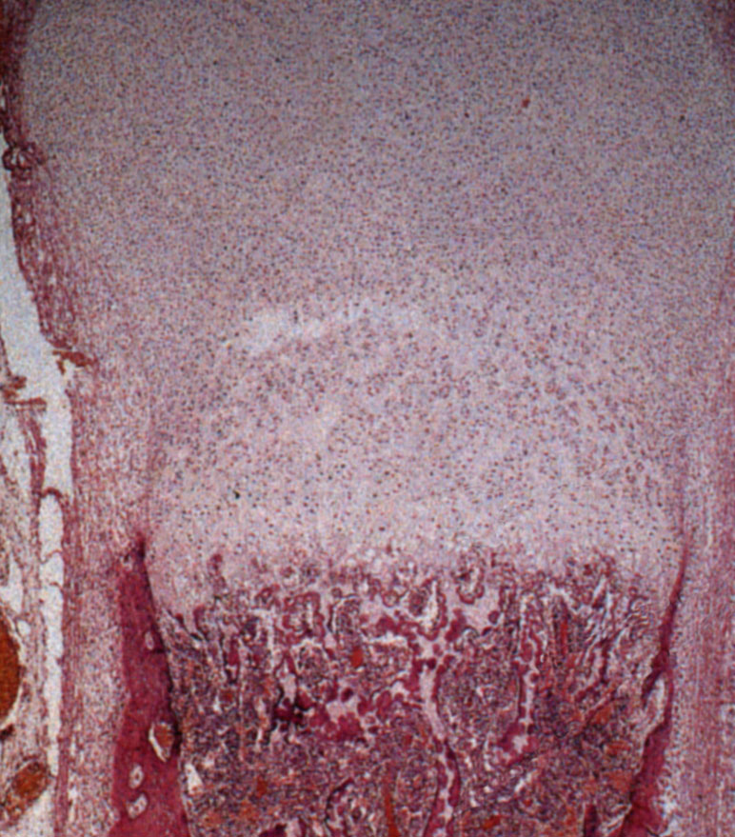
Developing tarsus bone
1. Zone of reserve cartilage (resting)
2. Zone of proliferation
3. (a,b,c) Zone of chondrocyte maturation, hypertrophy, and degeneration
4. Zone of osteogenesis (mesenchymal invasion)
periosteal (appozitional, intramembr.) ossification

Slide 26
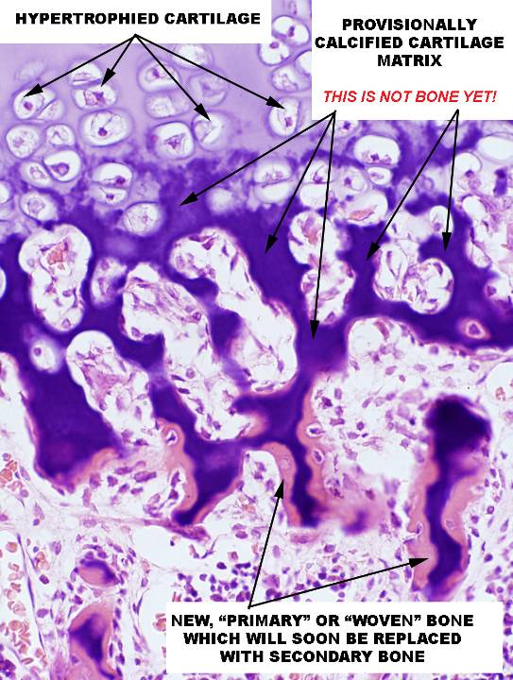

Slide 27
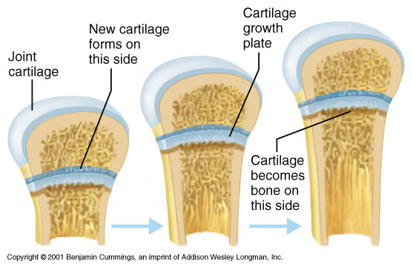
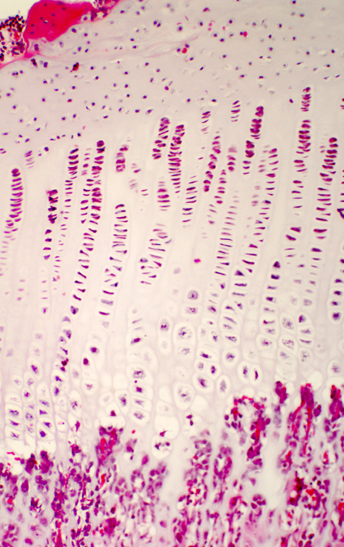
1.
2.
EPIPHYSEAL (GROWTH) PLATES:
zone of resting cartilage
zone of proliferation
zone of degenaration and matrix calcification
zone of mesenchymal invasion
3.
4.

Slide 28
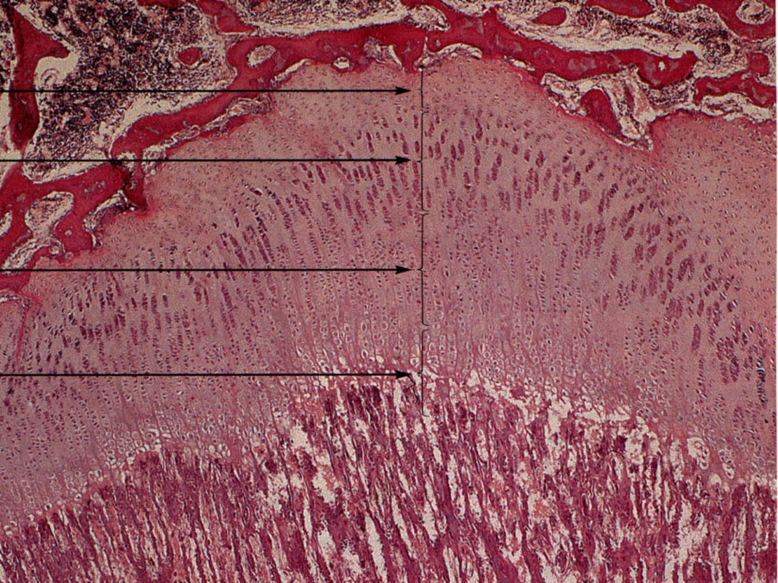
zone of resting cartilage
proliferative zone
degeneration zone
zone of osteogenesis

Slide 29
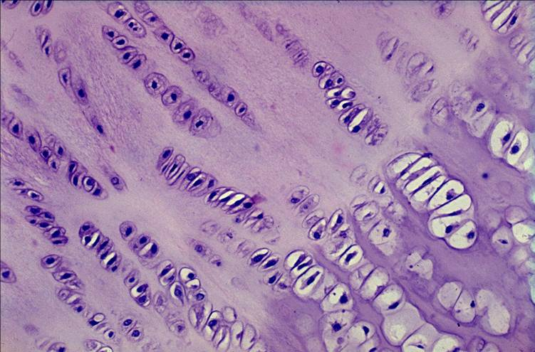

Slide 30
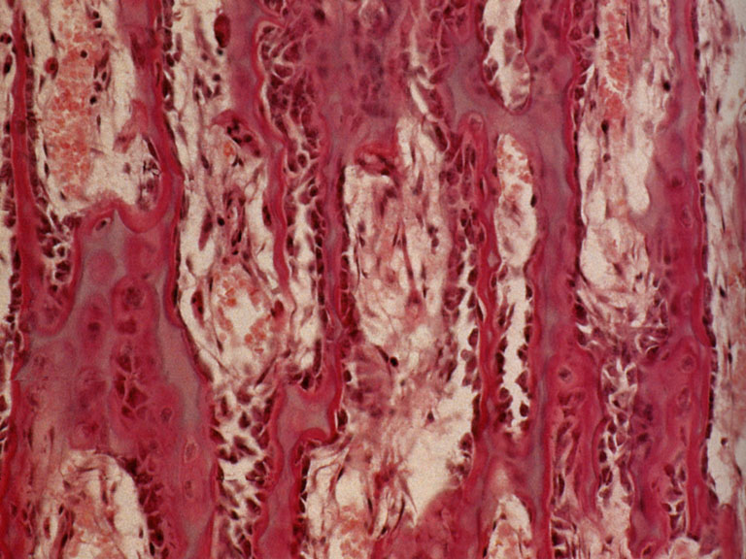
*
primitive bone marrow cavity
osteclast
(calcified) cartilage matrix
osteoid
osteblast
ostecyte
MESENCHYMAL INVASION

Slide 31
BONE ELONGATION PROVIDED BY ENCHONDRAL OSSIFICATION: CARTILAGE TISSUE FORMS A "LEADING" ("RUNNING") EDGE (! CARTILAGE DOES NOT BECOME BONE !)

Slide 32
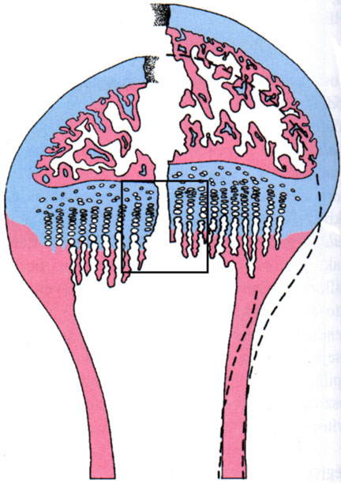
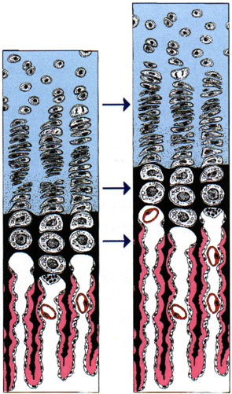
BONE ELONGATION PROVIDED BY ENCHONDRAL OSSIFICATION: CARTILAGE TISSUE FORMS A "LEADING" ("RUNNING") EDGE (! CARTILAGE DOES NOT BECOME BONE !)

Slide 33
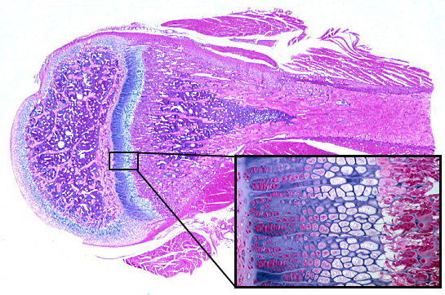

Slide 34
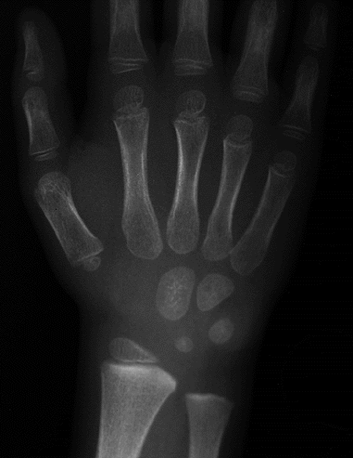
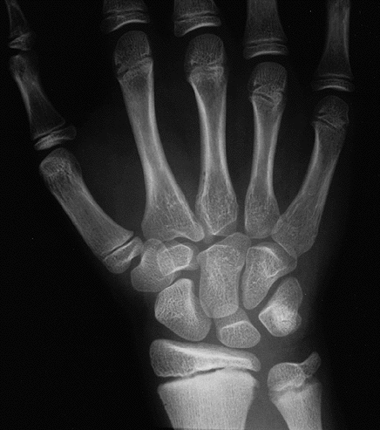
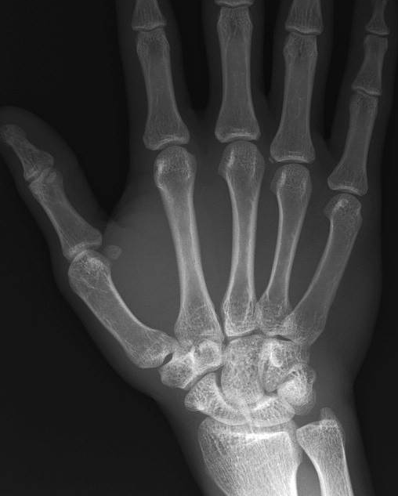
Secondary ossification centers,
epiphyseal plates
4 ½ years 11 years adult

Slide 35
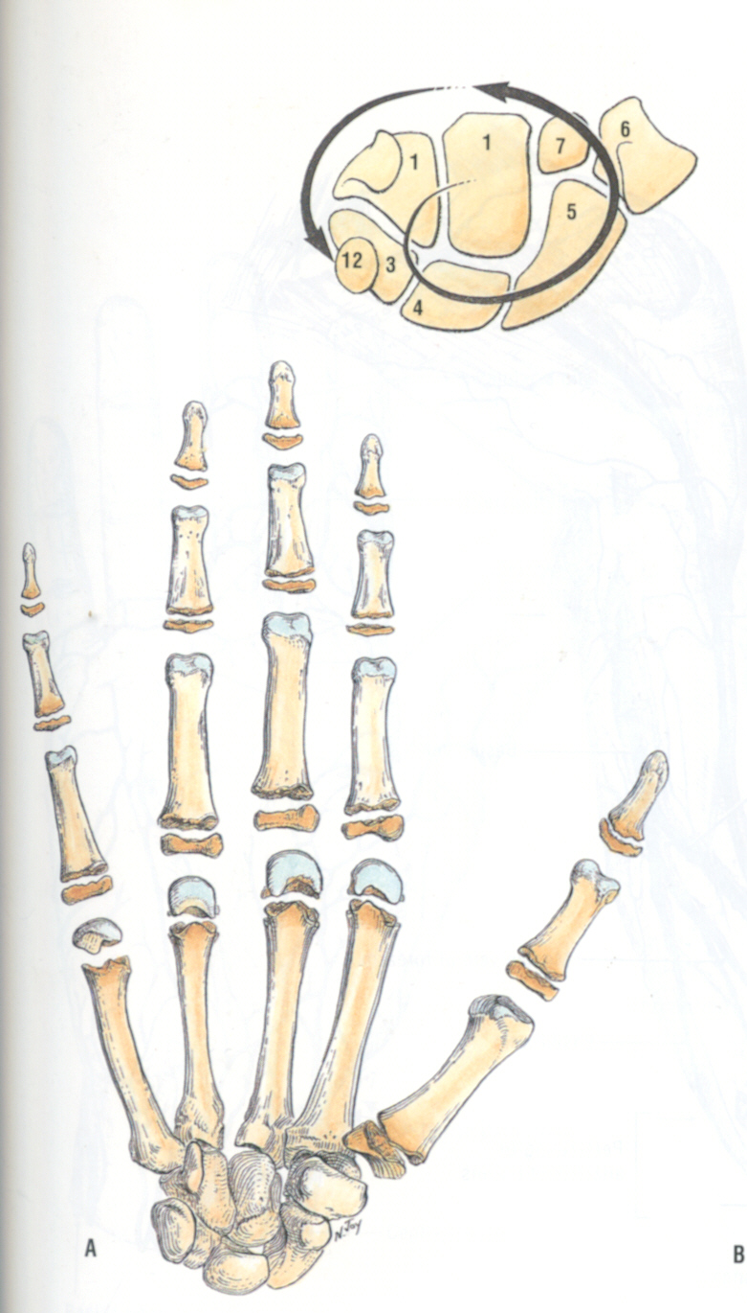
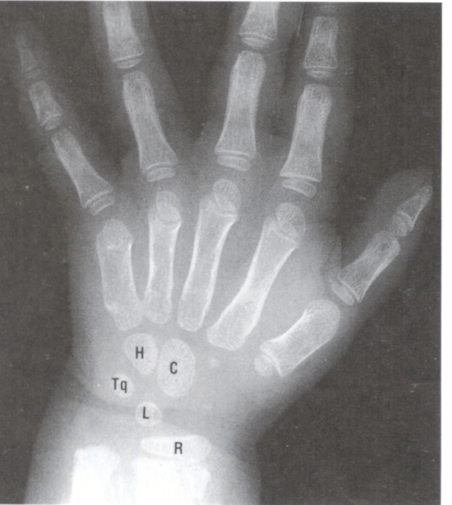
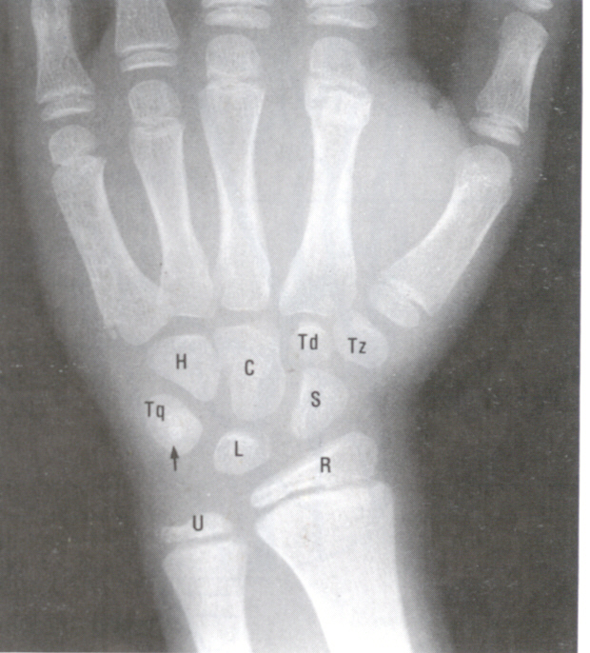
age is shown
2 year old
11 year old

Slide 36
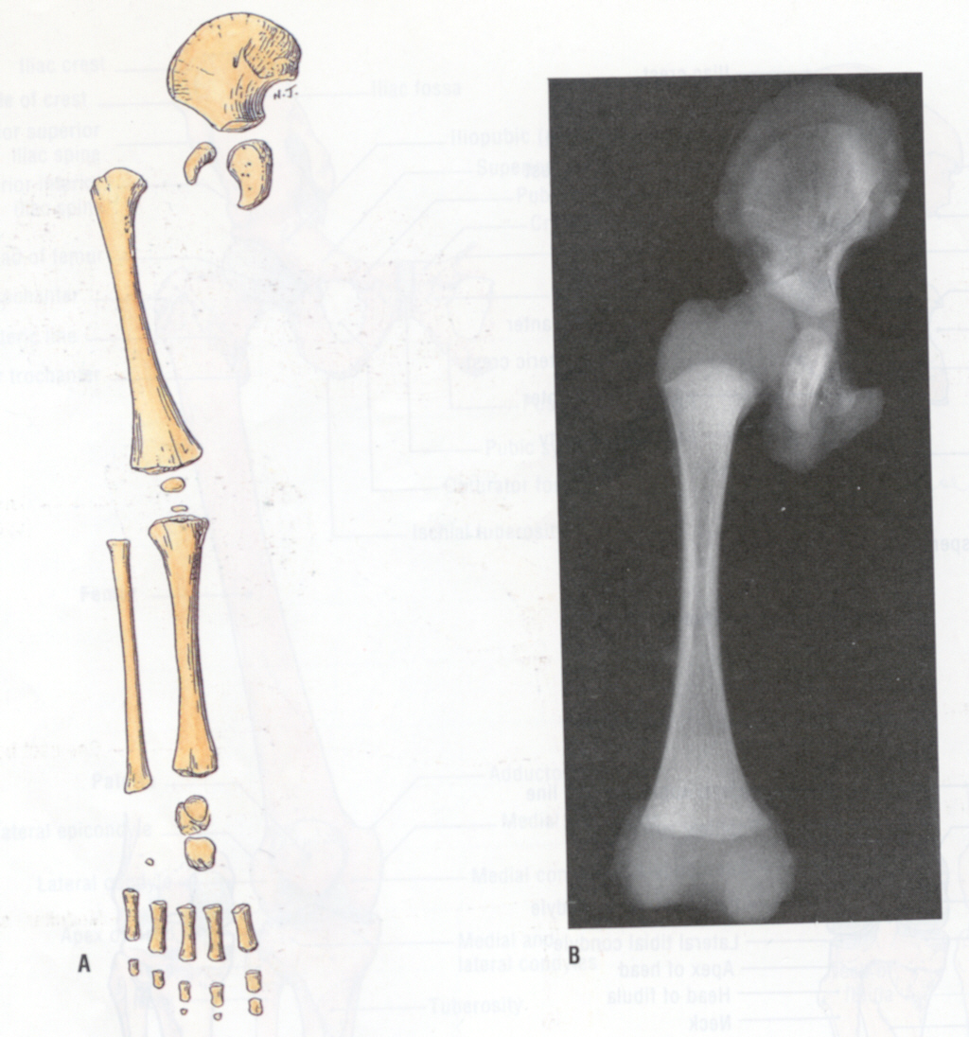
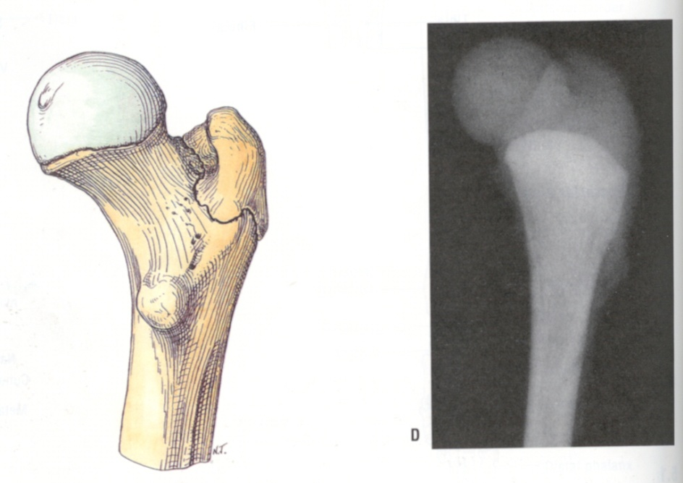
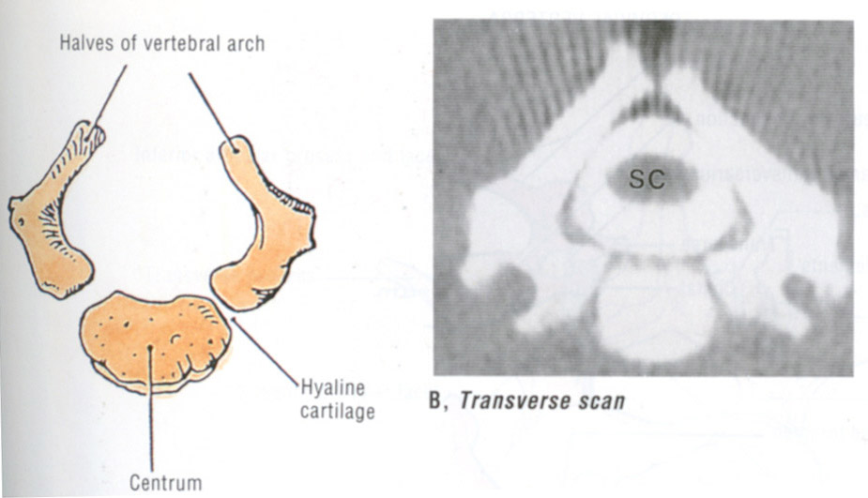
epiphysis 1st year
trochanter major 5th year
trochanter minor 14th year
18th-20th year full
at birth
at birth

Slide 37
Bone remodelling

Slide 38
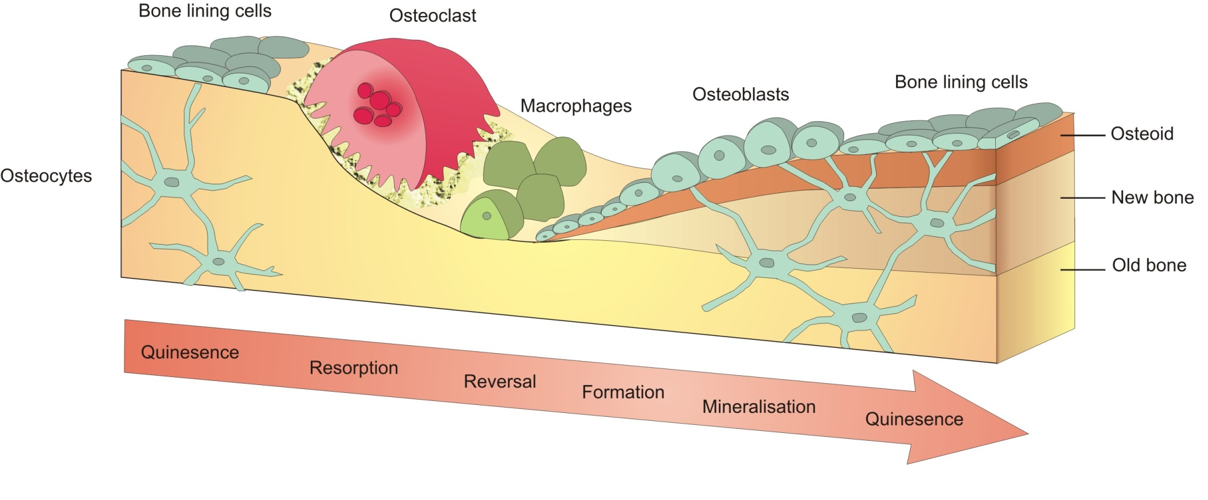
Bone remodelling
A lifelong process where mature bone is resorbed and a new bone is synthesized. Remodelling might also be considered as an adaptation to changing demands of mechanical loadings. In the first year of life, almost 100% of the skeleton is replaced. In adults, remodeling proceeds at about 10% per year.

Slide 39
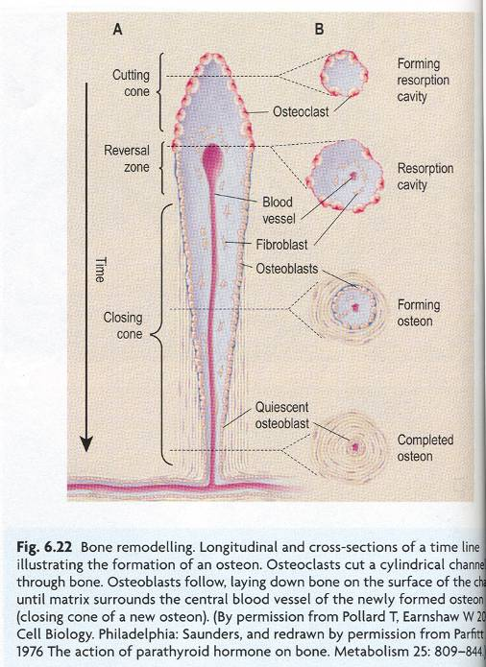
Bone remodelling

Slide 40
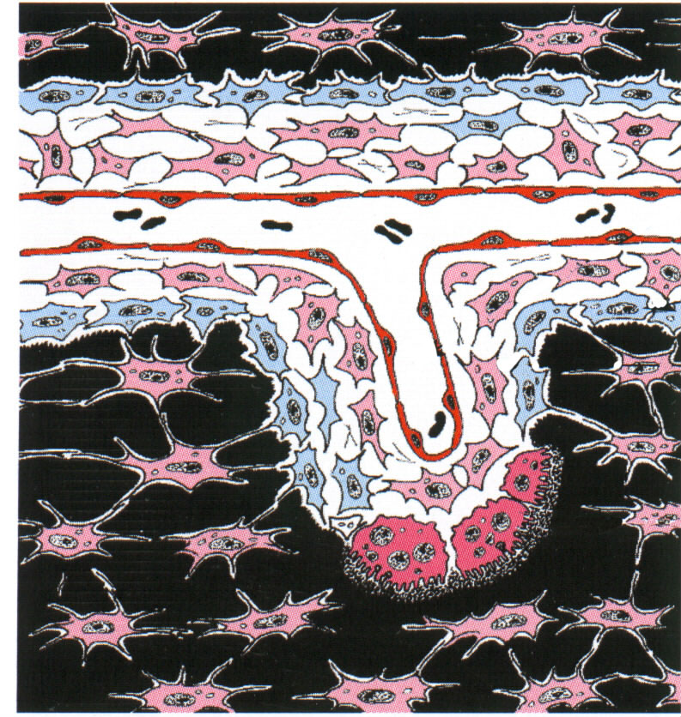
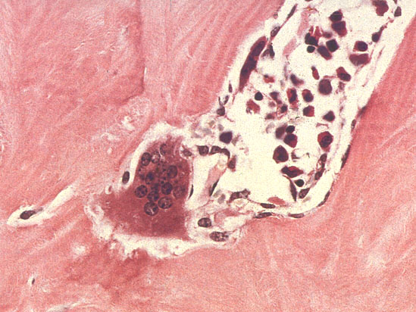
Bone remodelling

Slide 41
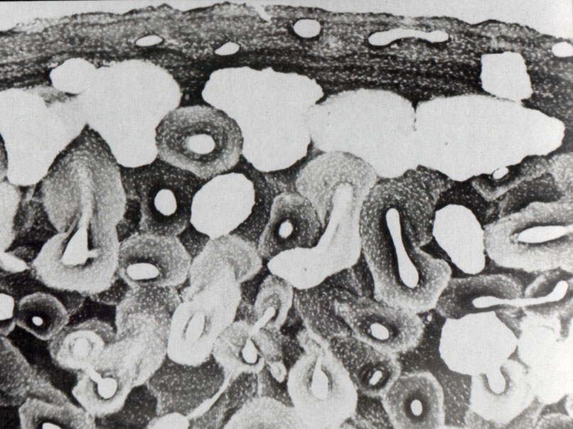
Bone remodelling

Slide 42
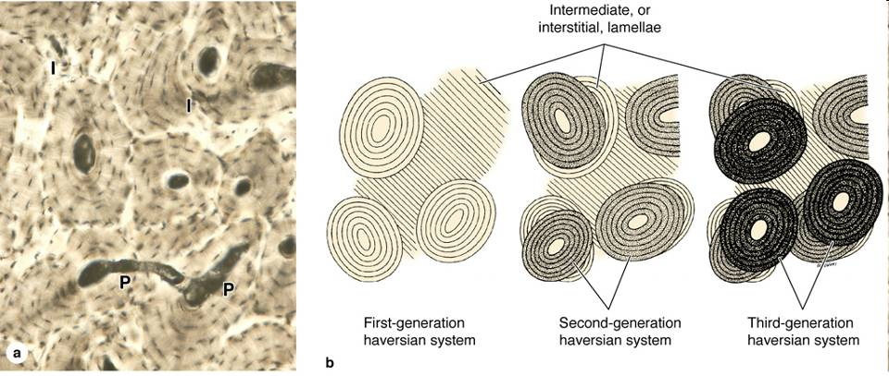
Bone remodelling

Slide 43
osteoblast
osteoclast
activity
ages

Slide 44
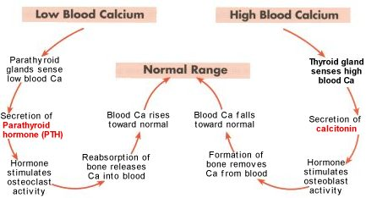
Hormonal control of bone metabolism
growth hormone, thyroxin, vitamin-D, etc.

Slide 45
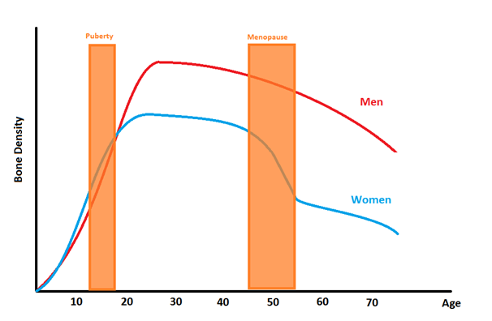
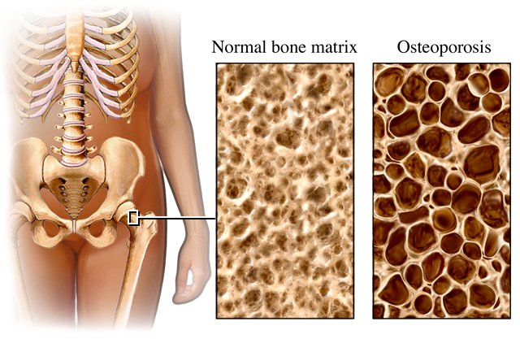
Osteoporosis

Slide 46
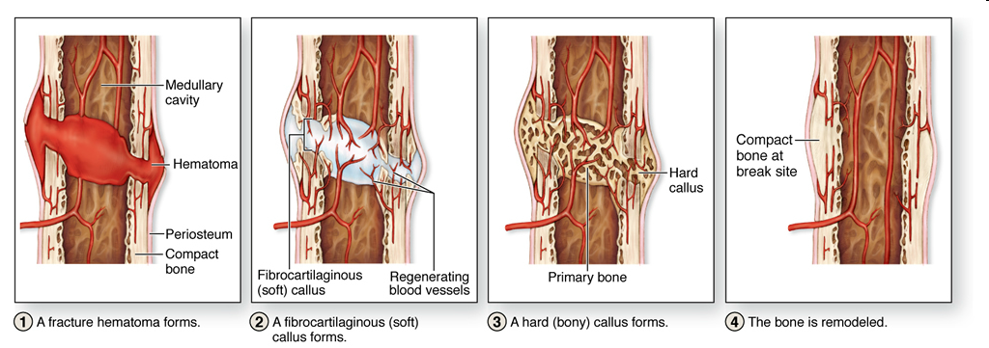
Bone regeneration

Slide 47
Literature
Röhlich Pál: Szövettan. Budapest, 1999
L.C. Junqueira et al.: Basic Histology

