Slide 1
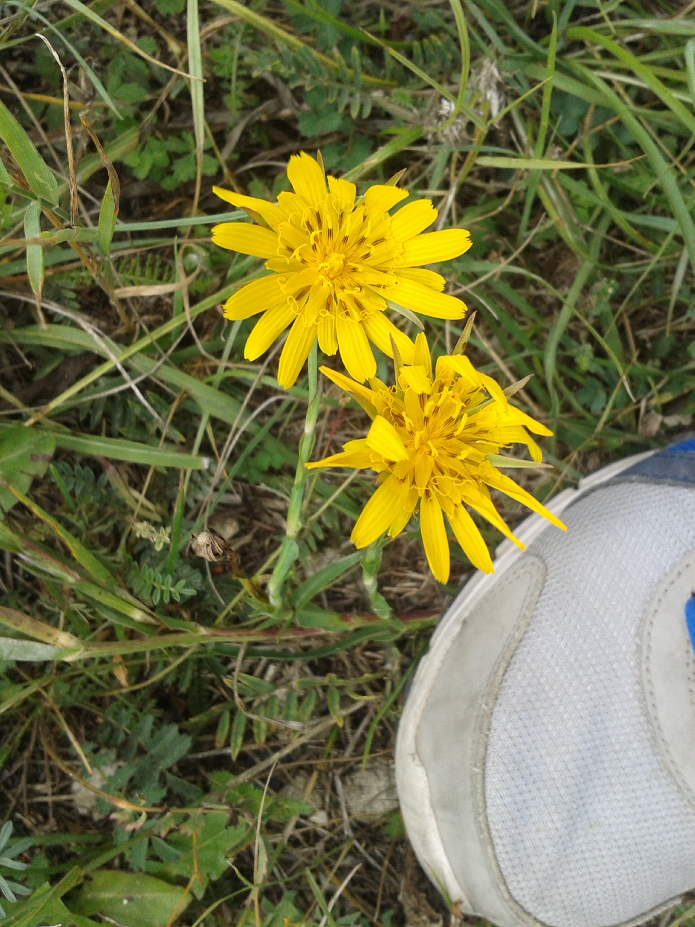
Hip joint, muscles
Semmelweis University, Faculty of Medicine
1st year, 1st semester
Department of Anatomy, Histology and Embryology
Katalin Kocsis
26/10/2017

Slide 2
Hip joint - articulatio coxae

Slide 3
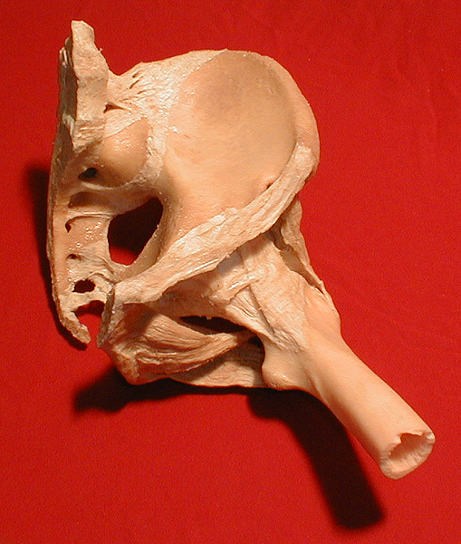
Hip joint
femur head – acetabulum
  acetabulum facies lunata + transverse acetabular lig.
  labrum acetabuli
ball and socket joint (enarthrosis)
lig. capitis femoris
ligaments: capsule thickening
  longitudinal – iliofemoral, ischiofemoral and pubofemoral lig.
  circular – zona orbicularis

Slide 4
Hip joint

Slide 5
Hip joint

Slide 6
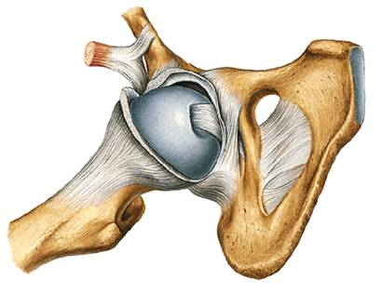
Hip joint: lig. capitis femoris
Mechanically not important
Vessels play important role
Forrás: Sobota - Atlas of Human Anatomy

Slide 7
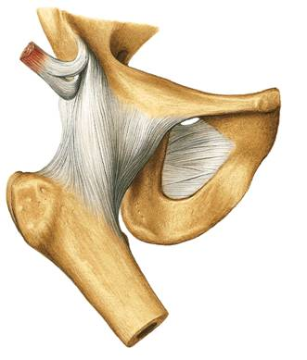
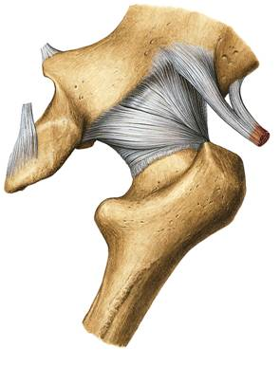
Hip joint: ligaments
Lig. iliofemorale
Lig. pubofemorale
Lig. ischiofemorale
Forrás: Sobota - Atlas of Human Anatomy
Strongest ligaments of the body, relaxed in anteflexion, limitation of retroflexion.
Deeper parts: zona orbicularis

Slide 8
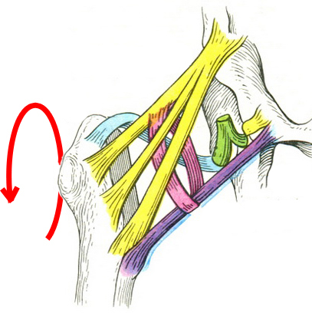
Hip joint: ligaments

Slide 9
Hip joint: ligaments

Slide 10
Hip joint: ligaments

Slide 11
Hip joint: ligaments

Slide 12
Hip joint: ligaments

Slide 13
Blood supply of the head and neck of femur
Arteries located immediately under the periosteum: often damage in case of cervical fracture of femur.
In this case, the only supply to the head is the artery in the round ligament (lig. capitis femoris – from obturator artery).
avascular necrosis
importance of quick reposition and fixation

Slide 14
Blood supply of the head and neck of femur

Slide 15
Movements of hip joint
(ante)flexion: 130° (flexed knee)
extension (retroflexion): 0-10°
abduction: 40°
adduction: 0° (extended hip)
lateral and medial rotation: 90°
circumduction

Slide 16
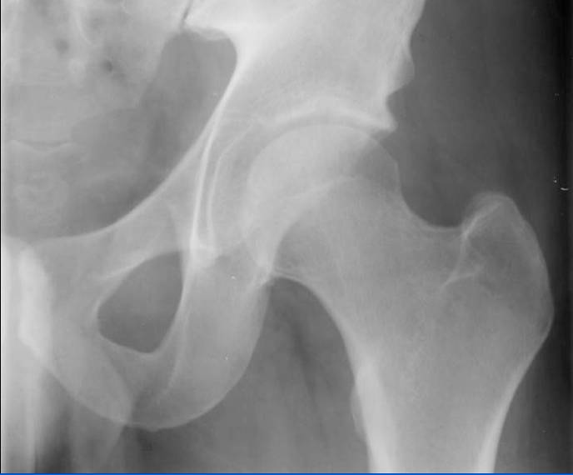
Normal X-ray
acetabulum
trochanter major
head
neck
trochanter minor

Slide 17
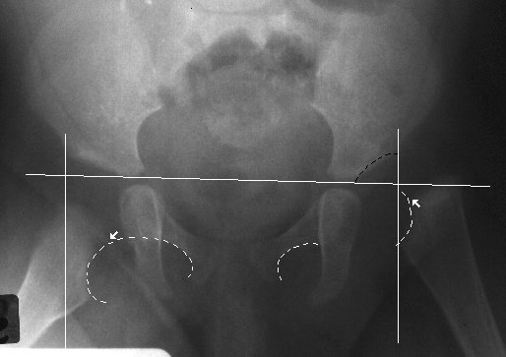
Hip dysplasia, hip dislocation
Causes: intrauterine developmental defect of acetabular fossa, not deep enough, can dislocate to relatively small forces.
(twins, oligohydramnion, ??)
Screening (physical examination, ultrasound)

Slide 18
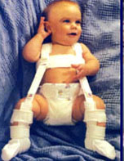
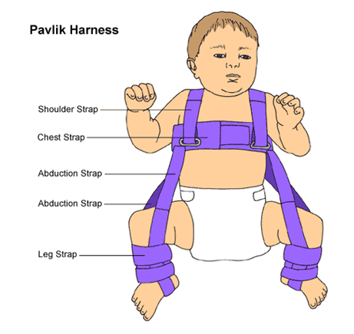
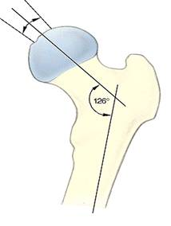
Hip dysplasia, hip dislocation
Treatment: conservative:
PavlikHarness
(anteflexio, abductio)
Force on the head of the femur deepens the socket!
Surgical intervention is usually avoided.
http://uuhsc.utah.edu/healthinfo/pediatric/orthopaedics/ddh.htm
In children the angle is wider

Slide 19
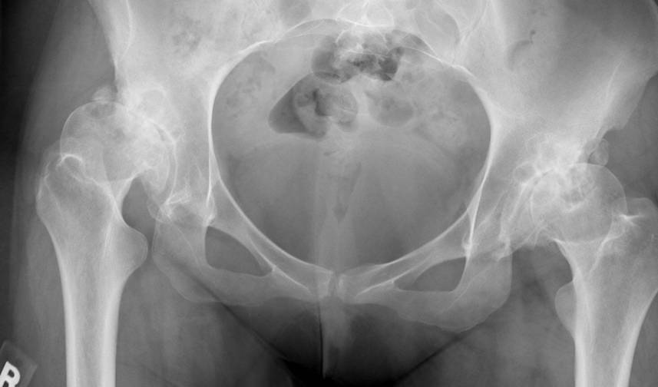
Arthrosis, hip dysplasia, untreated case

Slide 20
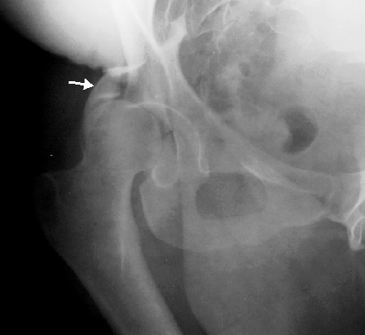
Acetabulum fracture

Slide 21
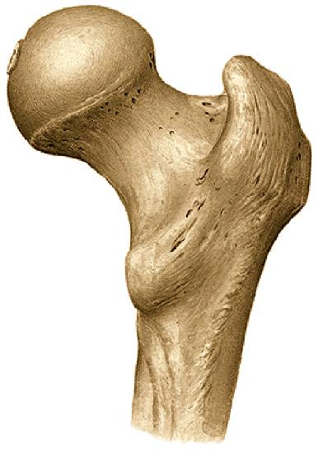
Femoral neck fractures
Medial
neck fracture
1 year mortality 20-35%!
Especially in elderly osteoporotic (female) patients.
Cadaver position!
(extremity shorter, rotated outwards)
Problems with the blood supply of the head: avascular necrosis
Quick reposition, mobilization important
(necrosis, other side-effects)
Intertrochanteric fracture
Lateral
neck fracture
Subtrochanteric fracture
Sobota - Atlas of Human Anatomy

Slide 22
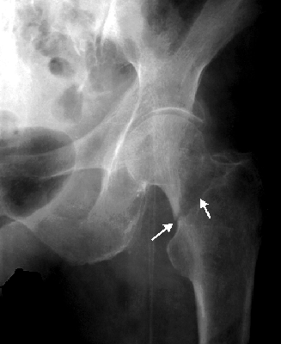
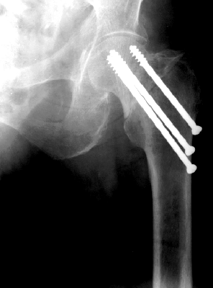
Lateral neck fracture

Slide 23
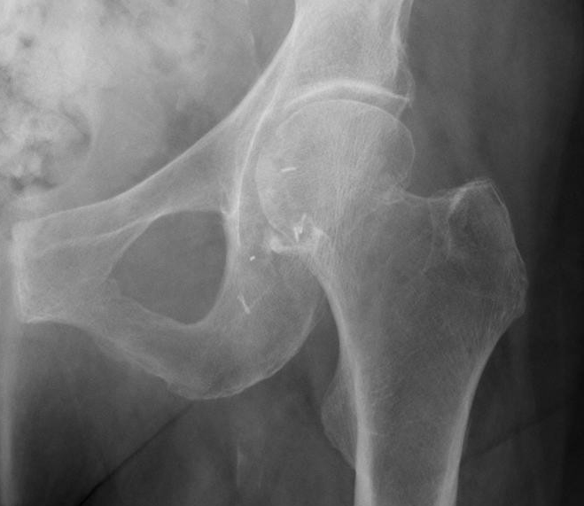
Medial neck fracture

Slide 24
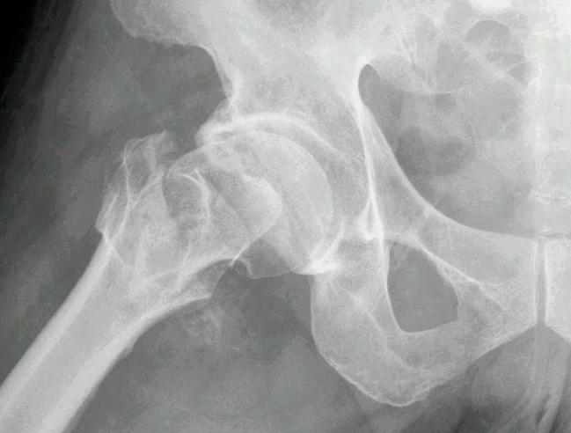
Intertrochanteric fracture

Slide 25
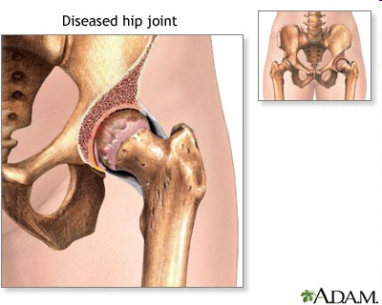
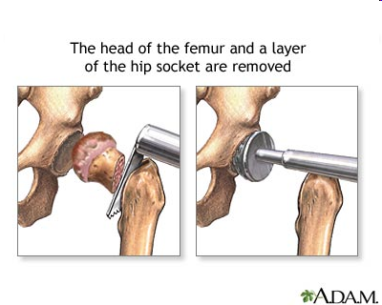
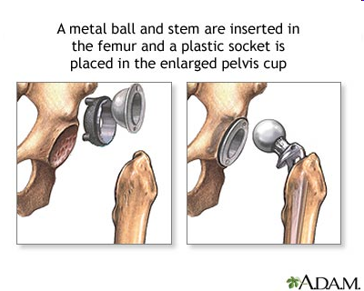
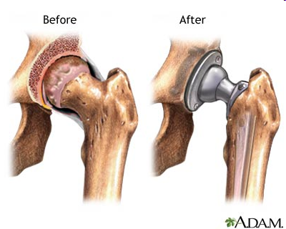
hip joint implant

Slide 26
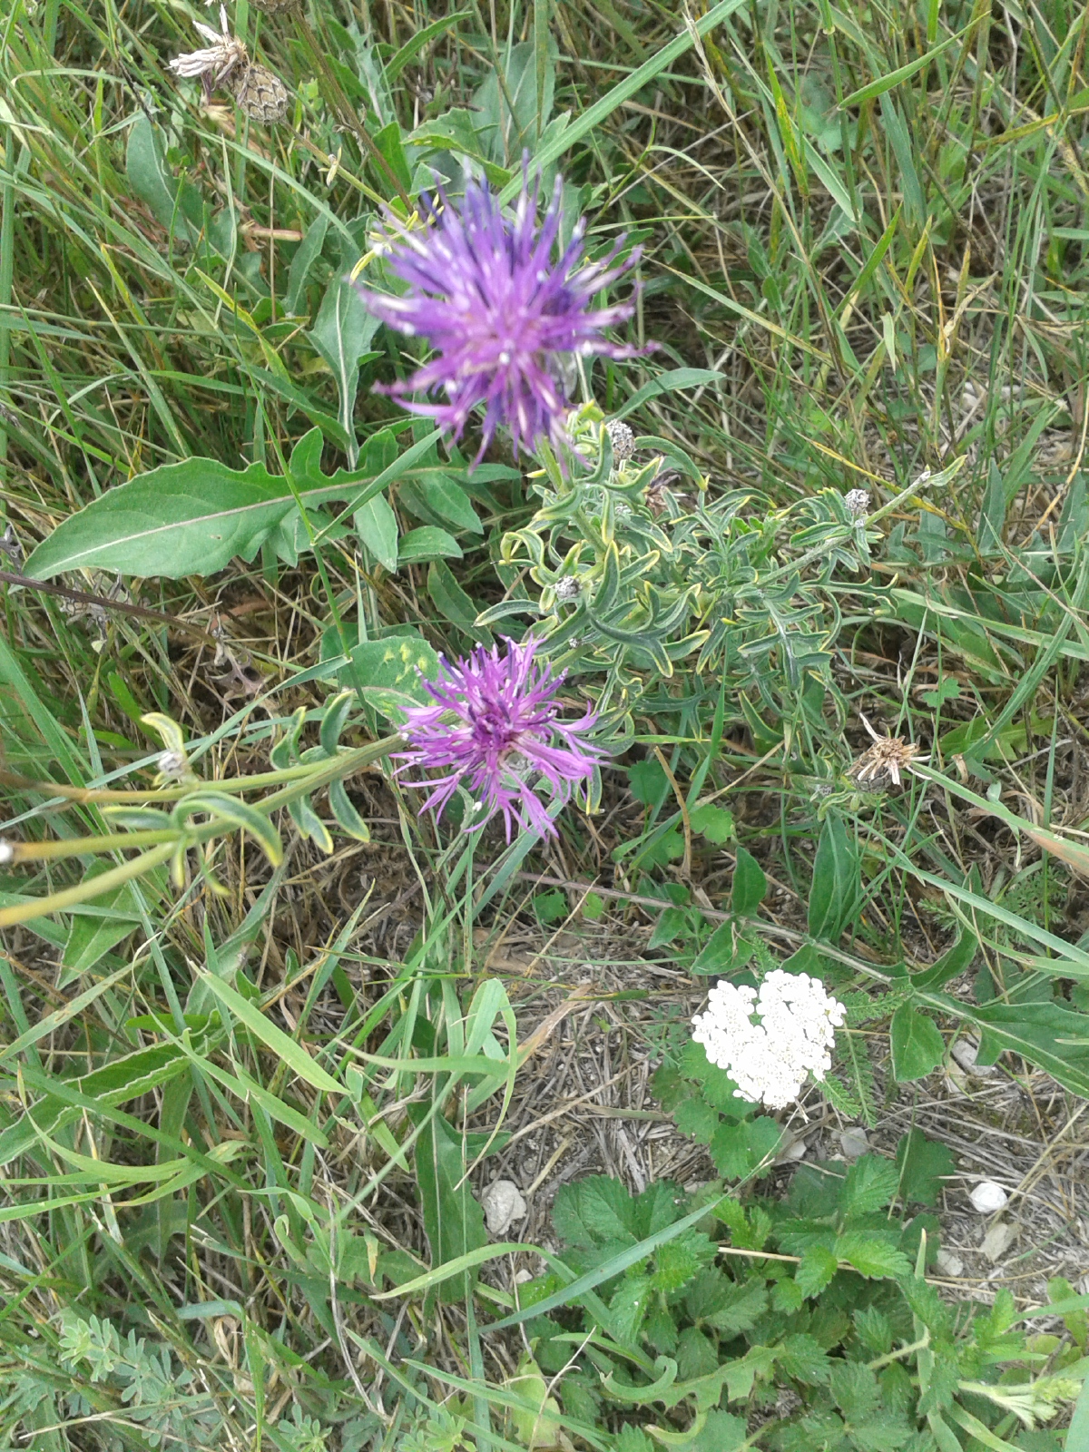

Slide 27
Muscles acting on hip joint

Slide 29
"Inner" hip muscles

Slide 34
"Outer" hip muscles

Slide 40
Trendelenburg-sign
m. gluteus medius dysfunctio
palsy or dysplasia
abduction lost

Slide 46
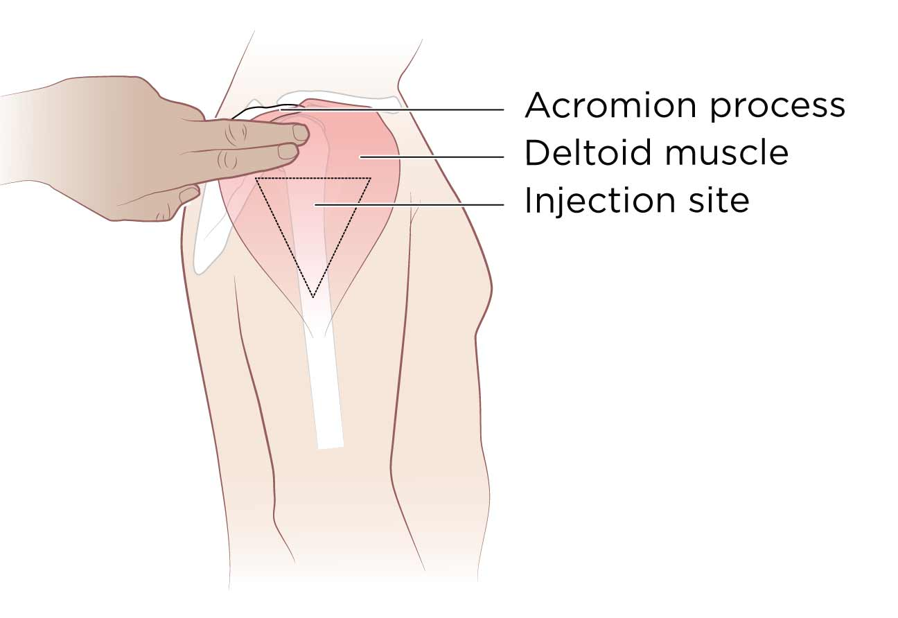
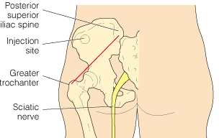
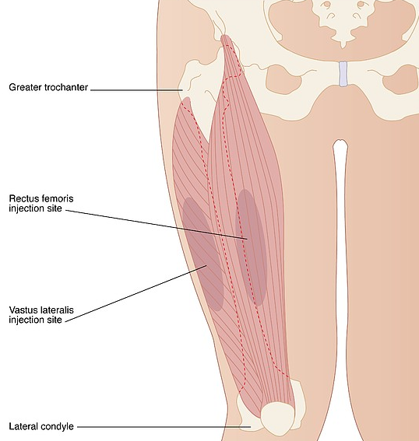
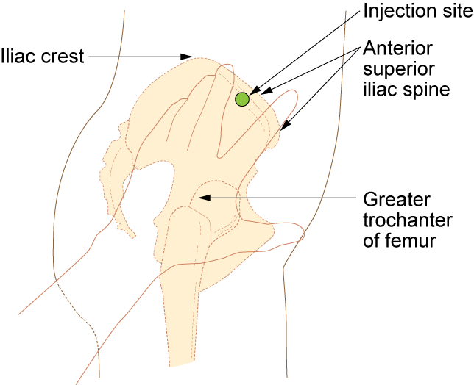
Intramuscularis injekció / Intramuscular injection

Slide 47
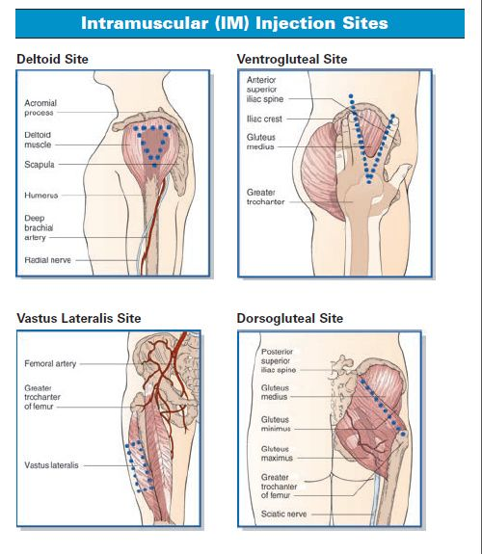

Slide 48
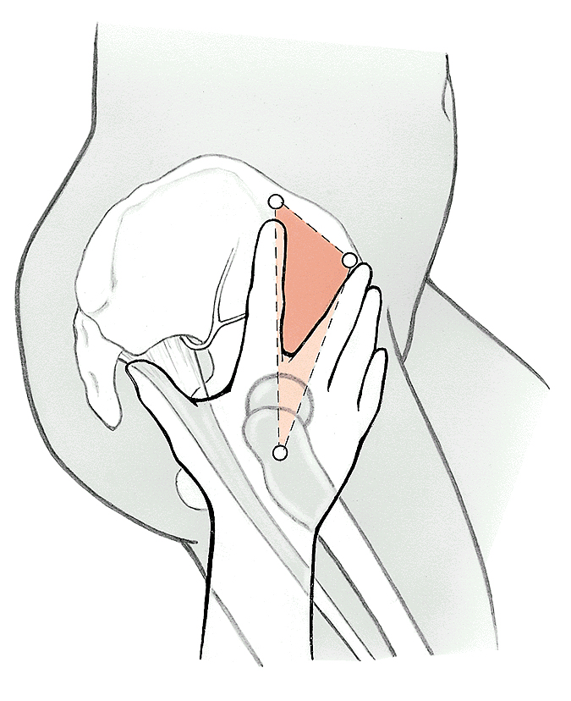
Intramuscularis injekció / Intramuscular injection
Háromszögelés
(trochanter major, spina iliaca anterior superior, crista iliaca)
Elkerülendő: a., v., n. glutea superior
Triangular technique
(trochanter major, anterior superior iliac spine, iliac crest)
NOT to hit: superior gluteal
a., v., n.
Forrás: Sobota - Atlas of Human Anatomy

Slide 49
Extensor muscles of thigh

Slide 54
Adductor muscles of thigh

Slide 58
Flexor muscles of thigh

Slide 63
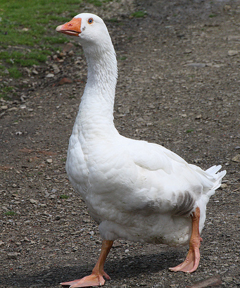
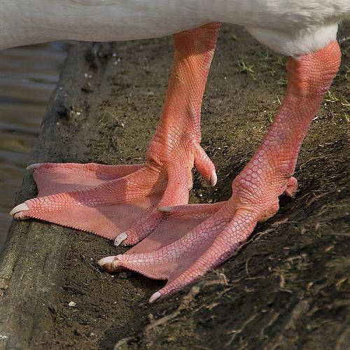
Pes anserinus (superficialis)

Slide 64
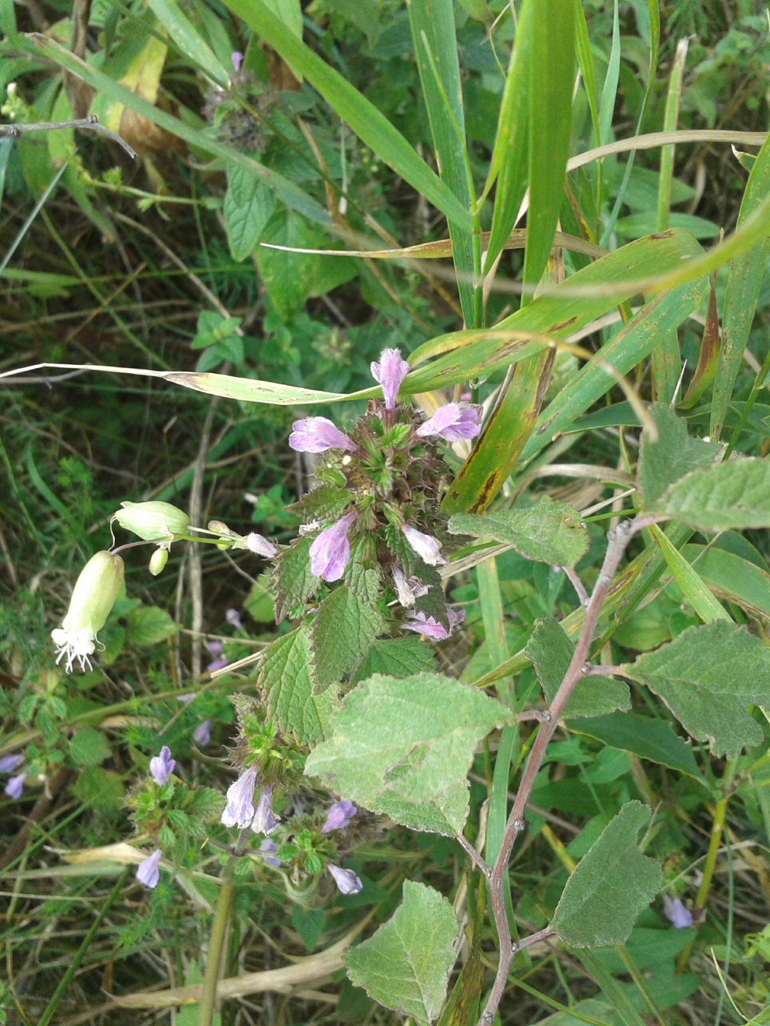

Slide 65
Movements of hip joint
(ante)flexion: 130° (flexed knee)
extension (retroflexion): 0-10°
abduction: 40°
adduction: 0° (extended hip)
lateral and medial rotation: 90°
circumduction

Slide 66
Hip joint flexor:
Iliopsoas
Tensor fasciae latae
Pectineus
Adductor longus
Adductor brevis
Gracilis
Sartorius
Rectus femoris

Slide 67
Hip joint extensors:
Gluteus maximus
Gluteus medius, minimus (posterior part)
Adductor magnus
Piriformis
Semitendinosus
Semimembranosus
Biceps femoris (long head)

Slide 68
Abduction in hip joint:
Gluteus medius
Tensor fasciae latae
Gluteus maximus
Gluteus minimus
Piriformis
Obturator internus

Slide 69
Adduction in hip joint:
Adductor magnus
Adductor longus
Adductor brevis
Gracilis
Pectineus
Gluteus maximus
Quadratus femoris
Obturator externus
Semitendinosus

Slide 70
Lateral rotation in hip joint:
Gluteus maximus
Gluteus medius and minimus (dorsal part)
Iliopsoas
Piriformis
Obturator internus
Obturator externus
Gemelli
Quadratus femoris
Adductor longus
Adductor brevis
Adductor magnus (part)
Sartorius

Slide 71
Medial rotation in hip joint:
Gluteus medius (anterior part)
Gluteus minimus
Adductor magnus (part)
Tensor fasciae latae (part)

Slide 72
Literature
Szentagothai J, Réthelyi M: Funkcionális anatómia, Medicina, 1989
Sobota - Atlas of Human Anatomy, 20th edition, Urban and Schwarzenberger, 1993
Radiologic images:
http://rad.usuhs.mil/medpix/index.html

Slide 73
