Slide 1
Sympaticus idegrendszer. Enteralis idegrendszer
DR. Fehér Erzsébet
Semmelweis Egyetem
Anatómiai, Szövet- és Fejlődéstani Intézet
Notes:
A szimp és az enteralis ir a veg ir része, melynek feladata a homeosztasis fenntartása.

Slide 2
Vegetatives Nervensystem
Cortex + Limbischessystem
Hypothalamus
Algemeyne Visceromotorische Kernnen
rostral BA
caudal BA
Preganglionäre Fasern
Medulla spinalis, Medulla oblongata
Postganglion-Zellen
Afferens
Fasern
Postganglionäre
Fasern
Viscera
Prof. Palkovits M. előadása nyomán
Notes:
2
A vegetatív ir szerveződésének több szintje van:
spinális reflex: pl fájdalom, esetén ..
Supraspinális reflex: Pl: , légzés, cardioVasculáris kontroll , hányás, köhögés
Centrális: integráció
Spec: pupillareflex, sexualis stimulisok: sex. Orientáció-pupilatágulásból megmondható.
A legfelsőbb szinten a szimpatikus és paraszimpatikus rendszer központok általában nem választhatók szét (cortex. Limbikus r, HTH.
visceral afferents
spinal interneurons
IML. Elkülönül a szomatikustól
preganglionic fibers
postganglionic fibers

Slide 3
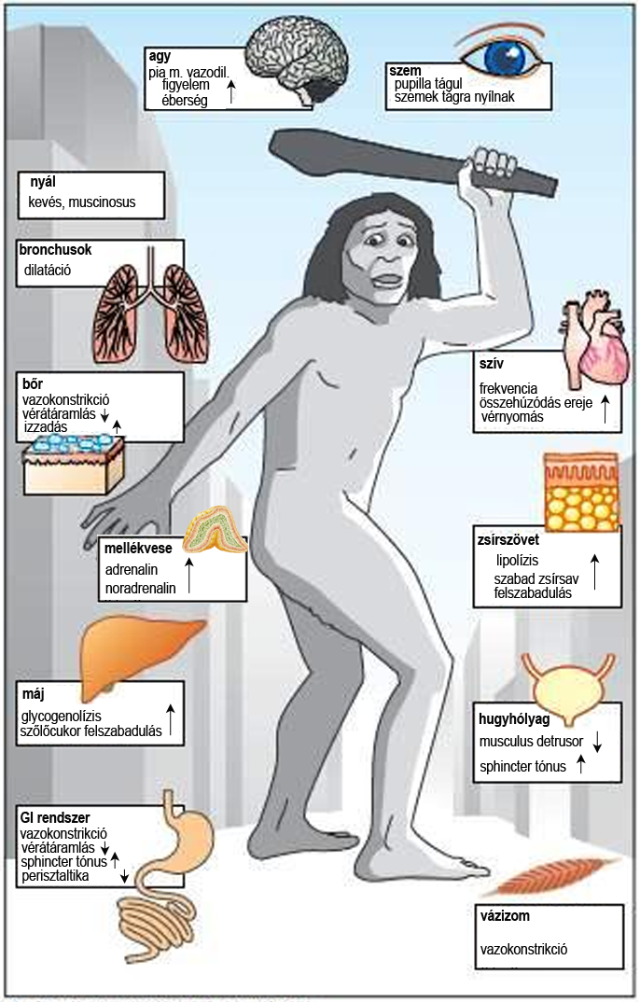
Fight or flight Reaktion
Kampf oder Flucht
(Cannon-stress Reaktion)
Energiemobiliesirung,
Flucht,
Notes:
Menekülés vagy harc, ugyanaz az autonom reakció, de a viselkedés különbözik. Vészhelyzet lehet fájdalom sérülés, vita is. Hypothalamusban integrálódik. HTH ingerléssel kiváltható. Decerebrált állat-”dühreakció”
Sympathetic nervous system
It prepares the body for an emergency. It accelerates the heart rate, causes constriction of peripheral blood vessels and raises the blood pressure. It brings about a redistribution of the blood, so that blood leaves the areas of the skin and intestine and becomes available to brain, heart, and skeletal muscle. At the same time it inhibits peristalsis of intestinal tract and closes the sphincters.
Ha nincs vészhelyzet akkor is van szerepe a szimp. idegrendszernek: pl pupilla sötétben tágul, hidegben bőrerek összehúzódnak, szőr feláll, orgazmus. stb. Szimpatikus tónus.
http://human-anatomyphysiology.blogspot.hu/2010/03/fight-or-flight-sympathetic-nervous.html
http://teleanatomy.com/introductiontoanatomy-AutonomicNervousSysteM.html
Promotes a "fight or flight" response, corresponds with arousal and energy generation, and inhibits digestioN.
Diverts blood flow away from the gastro-intestinal (GI) tract and skin via VasoconstrictioN.
Blood flow to skeletal muscles and the lungs is enhanced (by as much as 1200% in the case of skeletal muscles).
Dilates bronchioles of the lung, which allows for greater alveolar oxygen exchange.
Increases heart rate and the contractility of cardiac cells (myocytes), thereby providing a mechanism for enhanced blood flow to skeletal muscles.
Dilates pupils and relaxes the ciliary muscle to the lens, allowing more light to enter the eye and far visioN.
Provides Vasodilation for the coronary vessels of the heart.
Constricts all the intestinal sphincters and the urinary sphincteR.
Inhibits peristalsis.
Nyál: sűrű mucinosus.
Stimulates orgasM.
Noradrenalin Vasokonstrikció, adrenalin dilatáció, kismértékű aktiválódásnál egyensúly, nagy mértékúnél konrtakciót okoz az adrenalin is (más rec-t indít be).
http://www.ambehR.dk/phd_courses/articles_course7/buckwalter_clifford.pdf
There is considerable evidence to support the idea that responsiveness
of the arterial Vasculature of active skeletal muscle
is attenuated during exercise. The mechanism of exercise sympatholysis has not been fully
elucidated. It appears that presynaptic release of norepinephrine
may be diminished by products of muscle contraction, but there
is stronger evidence for an exercise-induced reduction in
postsynaptic receptor responsiveness.
Vasoconstriction-vérnyomás emelés, dilatation: oxigén ellátás.

Slide 4
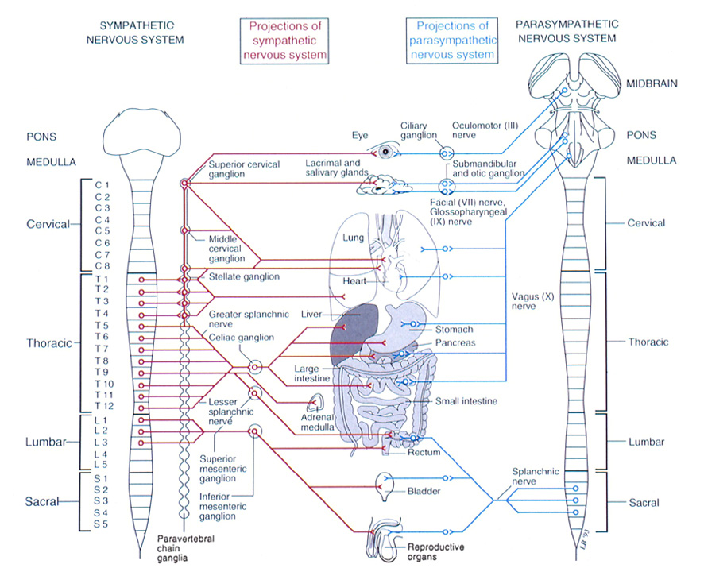
Sympathisches Nervensystem
Notes:
4
http://teleanatomy.com/introductiontoanatomy-AutonomicNervousSysteM.html
Autonomic nervous system (ANS) has two components. Minden szervet mindkét rendszer beidegzi.
Sympathetic nervous system
Fiziológiásan szelektiv a szervekre szervrendszerekre, vészhelyzetben generalizált hatás. Pl vizeletürítés, sexuális funkciók.
It prepares the body for an emergency. It accelerates the heart rate, causes constriction of peripheral blood vessels and raises the blood pressure. It brings about a redistribution of the blood, so that blood leaves the areas of the skin and intestine and becomes available to brain, heart, and skeletal muscle. At the same time it inhibits peristalsis of intestinal tract and closes the sphincters.
Parasympathetic nervous system
It conserves and restores energy. It slows the heart rate, increases peristalsis of intestines, increases glandular activity and opens the sphincters.
Általában
D:\A_PM\Előadások-ppt\PhD kurzushoz\2008-PhD\081016-eloadas\081016-Autonóm_idegrendszeR.ppt\ 45. dia

Slide 5
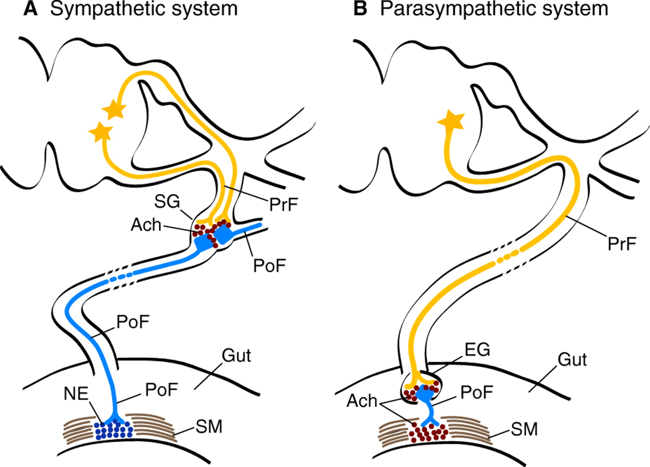
Neurotransmitter
Anatomy of the gut autonomic nervous systeM.
symp. gangl
pregangl. rost
pregangl. rost
postgangl. rost (PoR)
PoR
enteralis ganglion
bél
bél
PoR
PoR
simaizom
simaizom
Kuratani S Development 2009;136:1585-1589
Notes:
Anatomy of the gut autonomic nervous systeM. (A,B) Cross sections of an amniote neural tube (NT, top) to show (A) the sympathetic and (B) the parasympathetic (PS) systems of the vertebrate autonomic nervous systeM. (A) The sympathetic system consists of comparatively short pre-ganglionic (yellow) axons that arise at thoracic levels. (B) The PS system has longer pre-ganglionic (yellow) axons that arise at the cranial (vagal) and sacral levels of the axis. The post-ganglionic neurons form nerve networks in the gut wall called Meissner's Plexus and Auerbach's Plexus. Note the presence of the enteric ganglia in the wall of the gut. Ach, acetylcholine, EG, enteric ganglia; NE, noradrenalin; PoF, post-ganglionic fibers; PrF, pre-ganglionic fibers; SG, sympathetic ganglia; SM, smooth muscles. Redrawn, with permission, from Le Douarin (Le Douarin, 1982).
http://dev.biologists.org/content/136/10/1585/F2.expansioN.html

Slide 6
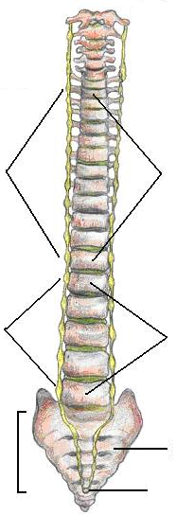
Truncus sympathicus
pars cervicalis
superius
ganglion
cervicale
medium
stellatum
pars
thoracalis
vertebrae
thoracalis
pars
abdominalis
vertebrae
lumbalis
pars pelvina
sacrum
ganglion impar
Notes:
sacralis paravertebrális dúcok: foramina sacralia anteriora előtt, kicsik nincs jelentőségük
ggl impar (ganglion terminale): a sacrum elülő felszínén, középvonalban

Slide 7
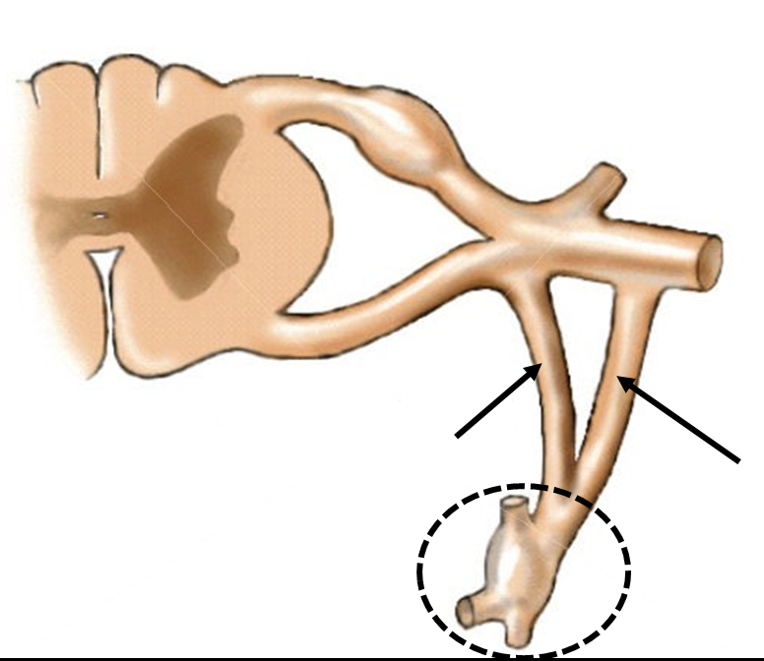
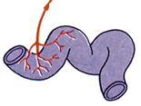
Parietaler Teil des Sympathischen Nervensystems
Radix dorsalis
ganglion spinale
ramus dorsalis nervus spinalis
interneuronok
IML
ramus ventralis nervus spinalis
visceral efferens
Radix ventralis
ramus communicans griseus
ramus communicans albus
postgangionäre Fasern
preganglionäre und afferenze Fasern
visceral afferens
ganglion
trunci sympathici
viscera
Notes:
http://teleanatomy.com/introductiontoanatomy-AutonomicNervousSysteM.html
N. Spinalis -Ramus ventralis-rami communicantes
Viscerosensoros afferensek:
Traverse many pathways, many travel with visceral efferents coursing through the sympathetic chain and reaching the spinal nerve by means of the white rami communicans. Afferent fibers travelling with the sympathetic fibers originate as ‘naked endings" in the walls of the of the organs and carry pain almost exclusively. Afferent fibers travelling with parasympathetic systems originate in the walls of the organ and consist of many encapsulated endings.
2. Stimuli do not reach consciousness during normal body homeostasis.
3. Pain or discomfort is perceived as an ache and is difficult to localize until it becomes severe.
White rami communicantes
They are white because they contain myelinated preganglionic fibers that leave anterior rami and pass to paravertebral ganglia of sympathetic trunk. White rami also contain afferent sympathetic fibers. These fibers are also myelinated. White ramus is always the distal one.
Within the trunk, the fibers of the white rami communicantes run longitudinally. They end on the nerve cells in the ganglia throughout the length of the sympathetic trunk.
Through these nerve fibers the central nervous system controls the activity of all the nerve cells in the sympathetic trunk. Thus it can alter the secretion of sweat, the amount of blood flowing through the various tissues, and the erection of hairs (goose-flesh) throughout the body by way of the processes of the sympathetic nerve cells that are distributed through the spinal (and cranial) nerves.
Gray rami communicantes
Soon after its formation, each ventral ramus receives a slender bundle of non-myelinated nerve fibers from the corresponding ganglion of sympathetic trunk. This bundle of non-myelinated nerve fibers is given the name the gray ramus communicans. It is proximal to white ramus. They are gray colored because the nerve fibers in these rami are devoid of myeliN. They bring postganglionic sympathetic fibers to ventral rami and are distributed through their branches. They also enter every branch of dorsal ramus.
Gray ramus contains non-myelinated efferent postganglionic fibers that leave the paravertebral ganglion and pass to anterior (ventral) or posterior (dorsal) ramus of spinal nerve. These sympathetic fibers supply smooth muscles of blood vessels, smooth muscles of the hair (arrector pilorum) and the sweat glands. Thus the spinal nerve supplies involuntary and voluntary structures.
The fibers in gray ramus are those that are distributed via the branches of spinal nerve to blood vessels (Vasomotor fibers), sweat glands (sudomotor fibers) and arrector pili muscles (pilomotor fibers).
Every spinal nerve receives a gray ramus
All thoracic and the upper two lumbar nerves have gray rami and white rami.
All cervical, lower lumbar and all sacral nerves do not have gray rami, because there is no sympathetic outflow from these segments of spinal cord. The ganglia with which these nerves are connected by their white rami receive their preganglionic fibers from thoracolumbar lateral horn cells whose fibers after entering sympathetic trunk have gone up or down in it

Slide 8
Ganglion cervicale superius
sympathicus
Parasympathicus
Präganglionäre Fasern
Zentrum ciliospinale
Postganglionäre Fasern
Plexus caroticus internus
Plexus caroticus externus
Plexus jugularis
Ramus communicans griseus
Vaso-, sudo-, pilomotor
Pupilla, Tarsus (M. tarsalis, orbitalis)
Drüsen
Glandula lacrimalis
Pia mater Gefäße (Plexus caroticus internus)
Hertz, Pharynx, Corpus pineale
Plexus caroticus internus
ramus c.
albus
ramus c.
griseus
nucleus salivatorius superior
Ggl. submandibulare
N. facialis
Plexus caroticus externus
chorda tympani
caudal pons
Ggl. cervicale superius
Ggl. spinale
N. spinalis
Radix ventralis
glandula sublingualis
glandula submandibularis
Notes:
C8-T2 centr ciliospinale?
http://what-when-how.com/neuroscience/the-autonomic-nervous-system-integrative-systems-part-2/
http://users.rcN.com/jkimball.ma.ultranet/BiologyPages/P/PNS.html
http://home.comcast.net/~wnor/thoraxlesson5.htm
Parotis i és könnymirigy szimp beidegzés ugyanúgy fut, mint a másik két könnymirigyé. A paraszimp. Beidegzés más.
The sympathetic fibers innervating the lacrimal gland follow the same course that was described for the sympathetic innervation of the sublingual and submandibular glands (Fig. 22-4B). The effects of activation of the sympathetic nervous system on secretion of the lacrimal glands are not clearly established.
Postganglionáris rostok artériák mentén haladnak.

Slide 9
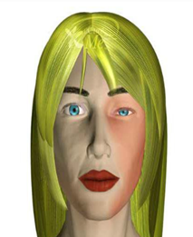
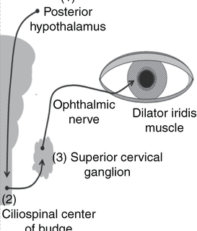
Hornersche Symptome
Ptosis
Miosis
Enophtalmos
Anhydrosis
Halb Seite Vasodilatation
hypothalamus
N. nasociliaris (III).
n
M. dilatator
Ggl. cerv. sup.
g
centrum ciliospinale
Notes:
The ciliospinal reflex (pupillary-skin reflex) consists of dilation of the ipsilateral pupil in response to pain applied to the neck, face, and upper trunk . If the right side of the neck is subjected to a painful stimulus, the right pupil dilates (increases in size 1-2mm from baseline). This reflex is absent in Horner's syndrome and lesions involving the cervical sympathetic fibers. The enhanced ciliospinal reflex in asymptomatic patients with cluster headache is due to preganglionic sympathetic mechanisms.
http://www.youtube.com/watch?v=JBVGh0gyyYc
Horner okok:
Centralis- pl sroke stb , egyéb centralis tünetek is
Preganglionáris: születési sérülés , tüdődaganat
Postganglionaris
Hosszan fennálás: világosabb azonosoldali szemszín is lehet. Vizsgálat: kokainra nem tágul a pupilla.
something were to block the sympathetic impulses into the eye, there would be an overbalance of parasympathetic supply to the eye. The result is Horner's syndrome.
First Neuron Horner's Syndrome (central lesions) can be caused by the occlusion (closure) of the posteroinferior cerebellar artery at the lower portion of the brain stem (also known as Wallenberg syndrome), by a transient ischemic attack (brief interruption of the blood supply to the brain), or by brain tumors.
Second Neuron Horner's Syndrome (preganglionic lesions) may be caused by lung cancer, thoracic tumors, phrenic nerve syndrome, thyroid enlargement, severe osteoarthritis of the neck with bone spurs, spinal cord injury or disease, neck trauma caused by injury, surgery, or severe whiplash.
Third Neuron Horner's Syndrome Group I (postganglionic lesions) may be caused by skull fracture, cluster headaches, migraines, or middle ear infections.
Third Neuron Horner's Syndrome Group II involves the facial sweating mechanisM.

Slide 10
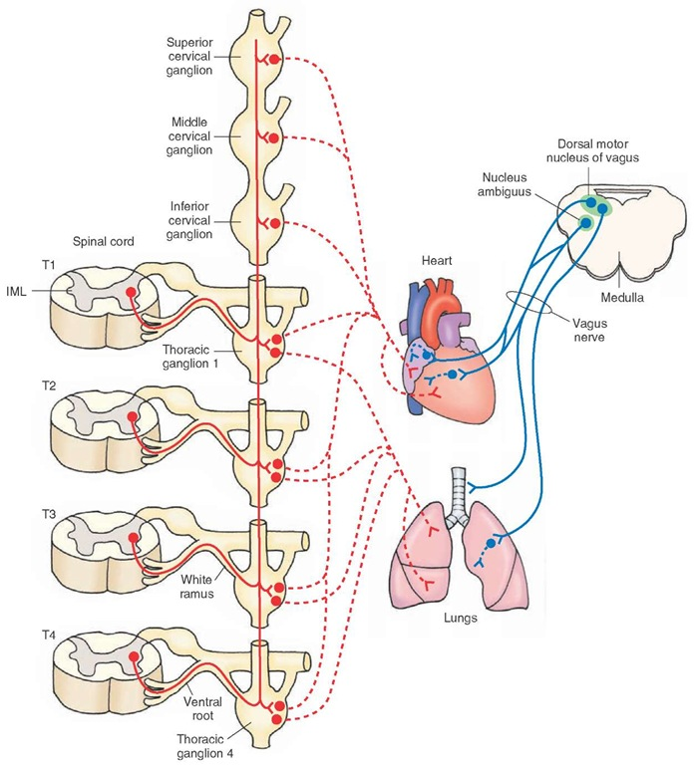
Cervikale und Thorakale Teile des Truncus sympathicus
Ggl. cervicale sup.
Ggl. cervicale med.
N. dorsalis nervi vagi
N. ambiguus
Ggl. cervicale inf.
Plexus cardiacus
N. vagus
Ggl. 1
R.c.
albus
Plexus pulmonalis
Radix ventR.
Ggl. 4
Notes:
The strength and frequency of the heart beat is controlled by the autonomic nervous systeM. Both parasympathetic and sympathetic parts of the autonomic nervous system are involved in the control of the heart.
The sympathetic postganglionic fibers arising from these ganglia innervate all regions of the heart (sinoatrial node, atria, atrioventricular node, and ventricles [Fig. 22-5]). Activation of the sympathetic nervous system results in an increase in heart rate by increasing the pacemaker activity of the sinoatrial node cells. Impulse conduction at the atrioventricular node and the contractile force of atrial and ventricular muscle fibers are increased.
The sympathetic fibers arise from segments T2-T4 of the spinal cord and are distributed through the middle cervical and cervico-thoracic (or stellate) ganglia and the first four ganglia of the thoracic sympathetic chaiN. The sympathetic fibers pass into the cardiac Plexus and from there to the SA node and the cardiac muscle. The effect of the sympathetic nerves at the SA node is an increase in heart rate. The effect on the muscle is an increase in rise of pressure within the ventricle, thus increasing stroke volume.
The vagus provides the parasympathetic control to the heart. The effect of the vagus at the SA node is the opposite of the sympathetic nerves, it decreases the heart rate. It also decreases the excitability of the junctional tissue around the AV node and this results in shttp://academic.amc.edu/martino/grossanatomy/site/NURSES/TUTORIALS/Heart/Innervation%20of%20Heart.htmlower transmissioN. Strong vagal stimulation here may produce AV block.
http://emedicine.medscape.com/article/1948973-overview
Vasomotor sympathetic fibers that supply the esophagus arise from the upper 4-6 thoracic spinal cord segments. Fibers from the upper ganglia pass to the middle and inferior cervical ganglia and synapse on postganglionic neurons. The axons of these neurons innervate the vessels of the cervical and upper thoracic esophagus.
Postsynaptic fibers from the lower ganglia pass to the esophageal Plexus to innervate the distal esophagus. Afferent visceral pain fibers travel via the sympathetic fibers to the first 4 segments of the thoracic spinal cord
Esophagus:
Sympathetic From upper 4 or 5 thoracic ganglia directly or through branches from cardiac or pulmonary Plexuses
From lower thoracic ganglia and thoracic splanchnic nerves
The sympathetic preganglionic neurons innervating the lungs are located in the IML at the T1—T4 spinal level. The sympathetic preganglionic fibers from these neurons synapse on T1—T4 ganglia in the sympathetic chaiN. Post-ganglionic fibers from these neurons innervate the smooth muscle of the bronchial tree (Fig. 22-5). Activation of the sympathetic nervous system results in bronchodilatioN.

Slide 11
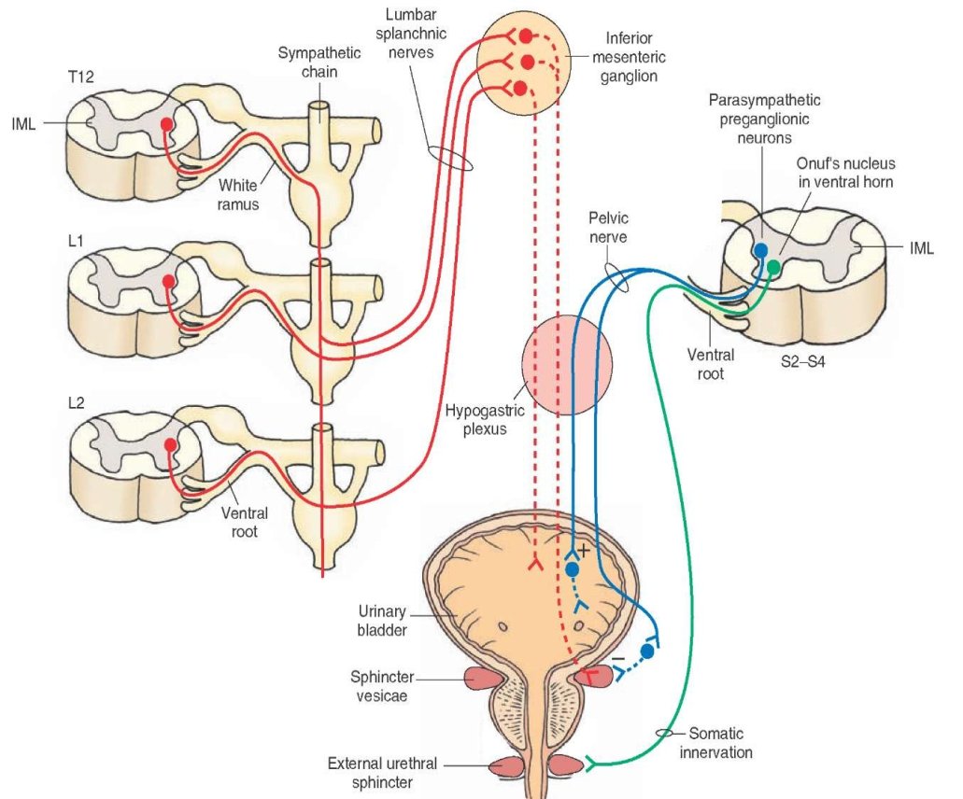
Innervation der Harnblase
Truncus sympathicus
Nn. splanchnici lumbales
Ggl. mesentericum inferius
Parasympathicus preganglionaris neuronok
R.c.
albus
Nn. splanchnici pelvini
Onuf mag
Radix ventralis
Plexus hypo-gastricus
Radix ventralis
Vesica urinaria
M. sphincter
Vesicae
M. sphincter urethrae externus
Somatomotoros innerváció
akaratlagosság!
Notes:
http://www.ncbi.nlM.nih.gov/books/NBK10886/
The autonomic regulation of the bladder provides a good example of the interplay between the voluntary motor system (obviously, we have voluntary control over urination), and the sympathetic and parasympathetic divisions of the visceral motor system, which operate involuntarily.
The arrangement of afferent and efferent innervation of the bladder is shown in Figure 21.8. The parasympathetic control of the bladder musculature, the contraction of which causes bladder emptying, originates with neurons in the sacral spinal cord segments (S2–S4) that innervate visceral motor neurons in parasympathetic ganglia in or near the bladder wall. Mechanoreceptors in the bladder wall supply visceral afferent information to the spinal cord and to higher autonomic centers in the brainstem (primarily the nucleus of the solitary tract), which in turn project to the various central coordinating centers for bladder function in the brainstem tegmentum and elsewhere.
he sympathetic innervation of the bladder originates in the lower thoracic and upper lumbar spinal cord segments (T10-L2), the preganglionic axons running to sympathetic neurons in the inferior mesenteric ganglion and the ganglia of the pelvic Plexus. The postganglionic fibers from these ganglia travel in the hypogastric and pelvic nerves to the bladder, where sympathetic activity causes the internal urethral sphincter to close (postganglionic sympathetic fibers also innervate the blood vessels of the bladder, and in males the smooth muscle fibers of the prostate gland). Stimulation of this pathway in response to a modest increase in bladder pressure from the accumulation of urine thus closes the internal sphincter and inhibits the contraction of the bladder wall musculature, allowing the bladder to fill. At the same time, moderate distension of the bladder inhibits parasympathetic activity (which would otherwise contract the bladder and allow the internal sphincter to open). When the bladder is full, afferent activity conveying this information centrally increases parasympathetic tone and decreases sympathetic activity, causing the internal sphincter muscle to relax and the bladder to contract. In this circumstance, the urine is held in check by the voluntary (somatic) motor innervation of the external urethral sphincter muscle (see Figure 21.8).
The voluntary control of the external sphincter is mediated by α-motor neurons of the ventral horn in the sacral spinal cord segments (S2–S4), which cause the striated muscle fibers of the sphincter to contract. During bladder filling (and subsequently, until circumstances permit urination) these neurons are active, keeping the external sphincter closed and preventing bladder emptying. During urination (or “voiding,” as clinicians often call this process), this tonic activity is temporarily inhibited, leading to relaxation in the external sphincter muscle. Thus, urination results from the coordinated activity of sacral parasympathetic neurons and temporary inactivity of the α-motor neurons of the voluntary motor systeM.
The central governance of these events stems from the rostral pons, the relevant pontine circuitry being referred to as the micturition center (micturition is also “medicalese” for urination). This phrase implies more knowledge about the central control of bladder function than is actually available. As many as five other central regions have been implicated in the coordination of urinary functions, including the locus coeruleus, the hypothalamus, the septal nuclei, and several cortical regions. The cortical regions primarily concerned with the voluntary control of bladder function include the paracentral lobule, the cingulate gyrus, and the frontal lobes. This functional distribution accords the motor representation of perineal musculature in the medial part of the primary motor cortex (see Chapter 17), and the planning functions of the frontal lobes (see Chapter 26), which are equally pertinent to bodily functions (remembering to stop by the bathroom before going on a long trip, for instance).

Slide 12
Innervation der Gonaden
Truncus sympathicus
Nn. splanchnici lumbales
Parasympathische preganglionäre Neurone
R.c.
albus
Nn. splanchnici pelvini
Radix ventralis
Plexus hypo-gastricus
Radix ventralis
Vas deferens
Corpus cavernosum
Prostata
Vesicula seminalis
Testis
epididymis
Sympathicus Effekt:
Ejakulation, Uterus - kontraktion,
Hemmung der Erektio
Notes:
The sympathetic preganglionic neurons innervating the male reproductive system (i.e., epididymis, Vas deferens, seminal vesicles, and prostate glands) are located in the IML at the T12-L2 level. Their preganglionic fibers pass through the sympathetic chain, exit in the lumbar splanchnic nerves, and synapse on the neurons in the inferior mesenteric ganglioN. The axons of these postganglionic neurons reach their target tissues in the male reproductive system via the hypogastric Plexuses (Fig. 22-9). Some preganglionic fibers from L1-L2 spinal segments descend in the sympathetic chain and synapse on postganglionic neurons in the hypogastric Plexus. The postganglionic fibers from these neurons then innervate the male erectile tissue (penis) (Fig. 22-1). Activation of the sympathetic nervous system causes ejaculation of spermatozoa, along with secretions of the prostate and the seminal vesicles.
male sexual organs: sympathetic: parasympathetic:
erectile tissue of penis relaxes, causes erection
Ejaculation contracts smooth muscle
of Vas deferens, seminal
vesicles, and prostate
In the female reproductive system, the sympathetic pregan-glionic neurons innervating the smooth muscle of the uterine wall are located in the IML at the T12-L2 level.
Their preganglionic fibers pass through the sympathetic chain, exit in the lumbar splanchnic nerves, and synapse on postganglionic neurons in the inferior mesenteric ganglioN. The postganglionic fibers from these neurons pass through the hypogastric Plexus and innervate the female sexual organ (vagina) and the uterus (Fig. 22-10). Some preganglionic fibers from L1-L2 spinal segments descend in the sympathetic chain and synapse on postganglionic neurons in the hypogastric Plexus. The postganglionic fibers from these neurons then innervate the female erectile tissue (clitoris [Fig. 22-1]). Activation of the sympathetic nervous system results in contraction of the uterus.
organ: sympathetic: parasympathetic:
uterus contraction of uterine musculature; Vasodilatation
Vasoconstriction
http://www.ncbi.nlM.nih.gov/books/NBK11157/
The relevant autonomic effects include: (1) the mediation of Vascular dilation, which causes penile or clitoral erection; (2) stimulation of prostatic or vaginal secretions; (3) smooth muscle contraction of the Vas deferens during ejaculation or rhythmic vaginal contractions during orgasm in females; and (4) contractions of the somatic pelvic muscles that accompany orgasm in both sexes.

Slide 13
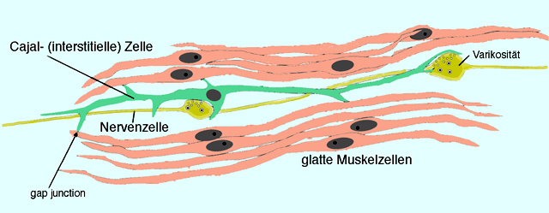
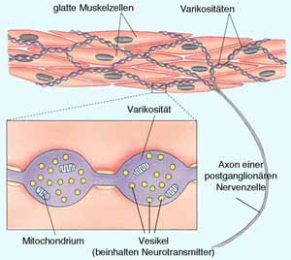
-Grundplexus
-Muskelzellen über Gap junctions
elektrisch verbunden (transzelluläre Erregungsübertragung)
Varikositäten des autonomen Nervensystems setzen - bei Aktivierung der postganglionären Fasern, zu denen sie gehören - aus ihren Vesikeln den hier gespeicherten Transmitter ins umliegende Interstitium frei ("synapse en passant"). Dadurch erreicht eine ausreichende Menge Transmitter relativ zügig viele umliegende (glatte Muskel-) Zellen.

Slide 15
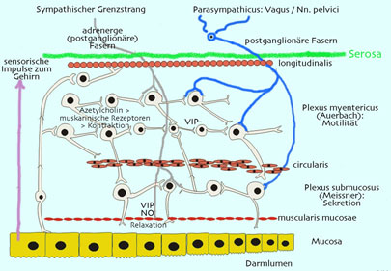

Slide 16
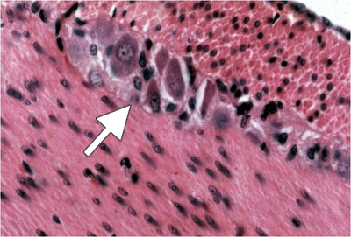
Plexus myentericus
Esophagus → M. sphincter ani internus
→ Chemo- , Mechanoreceptor
Motilität
Notes:
The Auerbach's plexus contains sensory neurons that receive information from Nerve endings in the smooth muscle layer regarding the composition of the intestinal content (chemoreceptors) and the degree of expansion of the intestinal wall (mechanoreceptors). Together with the Meissner's plexus found in the submucosa, the Auerbach's plexus is responsible for intestinal contractions.
http://www.nature.com/nrgastro/journal/v9/n5/fig_tab/nrgastro.2012.32_F2.html
16

Slide 17
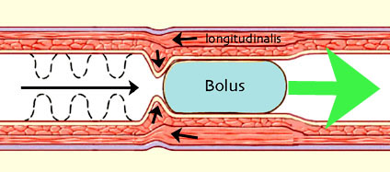
Das DarmNervensystem
- komplexes Netzwerk von der Speiseröhre bis zum Darmausgang.
- besteht aus ≈100 Millionen Neuronen
- hat einen hohen Grad an Autonomie.
Der plexus myentericus (Auerbach-Plexus) wird sowohl von sympathischen als auch parasympathischen Fasern angesteuert und dient der Steuerung der Motorik.
Der plexus submucosus (Meissner-Plexus) liegt zwischen Mukosa und Muskelschicht, er wird von parasympathischen Fasern kontaktiert und dient der Kontrolle z.B. der Sekretion. Beeinflussen enterale Motilitätsmuster, Durchblutung, Hormonproduktion, Sekretion.
Das DarmNervensystem kann verschiedene Motilitätsmuster generieren, z.B.: Propulsive Peristaltik - von Speiseröhre bis Dickdarm beobachtbar - transportiert den Inhalt in Richtung aboral Nicht-propulsive Peristaltik im Dünndarm dient der Durchmischung des Darminhalts Akkommodation - Erweiterung ohne Druckanstieg (Erschlaffung) zur intermediären Speicherung - findet sich z.B. im Fundusteil des Magens.

Slide 18
NPY Diabetic Duodenum

Slide 19
SP Diabetic Duodenum

Slide 20
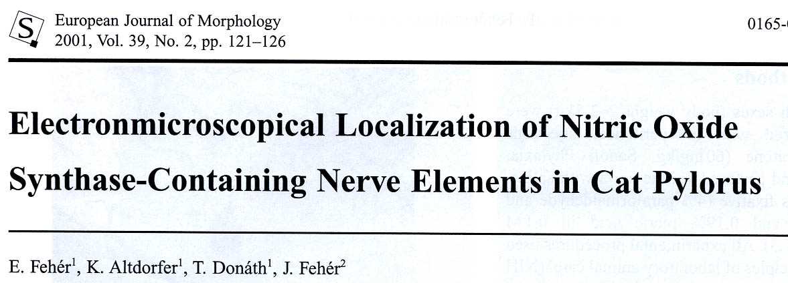
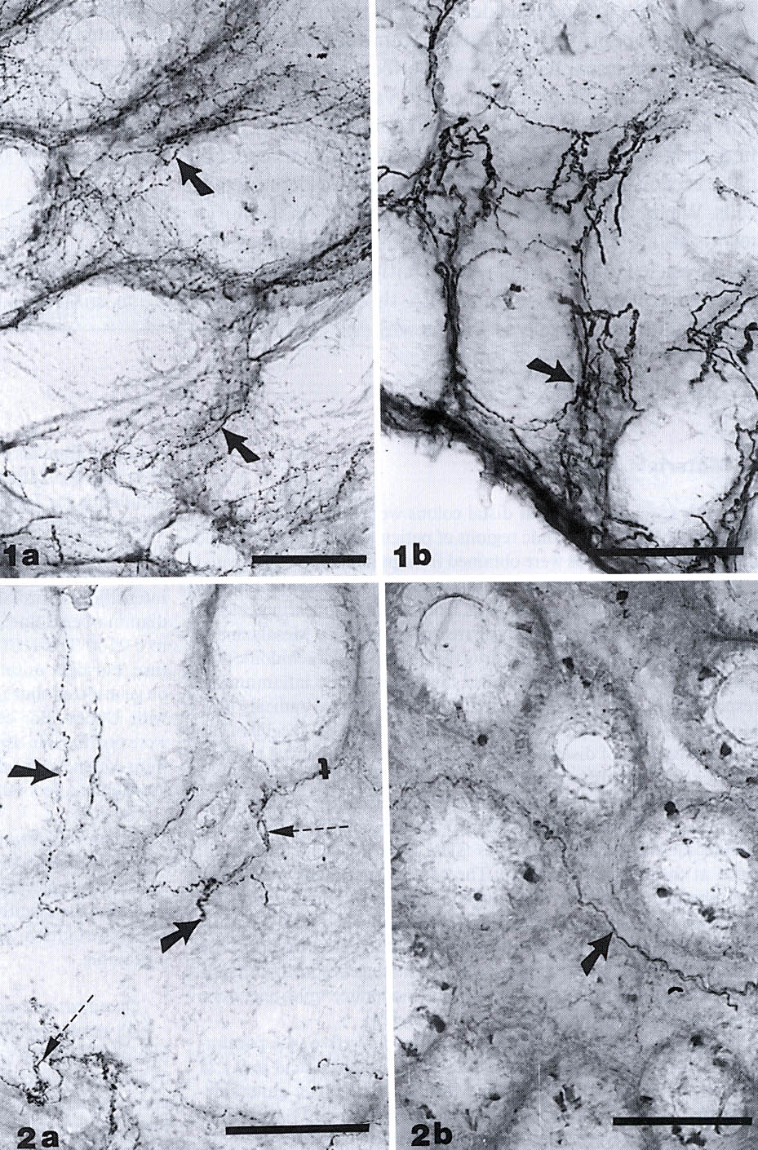
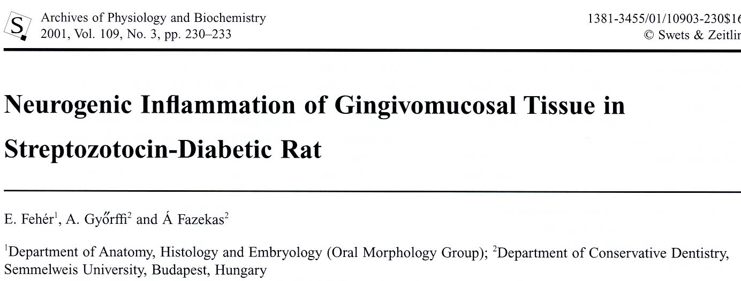
Fehér Erzsébet, Donáth Tibor
VIP
NPY
ENK

Slide 21
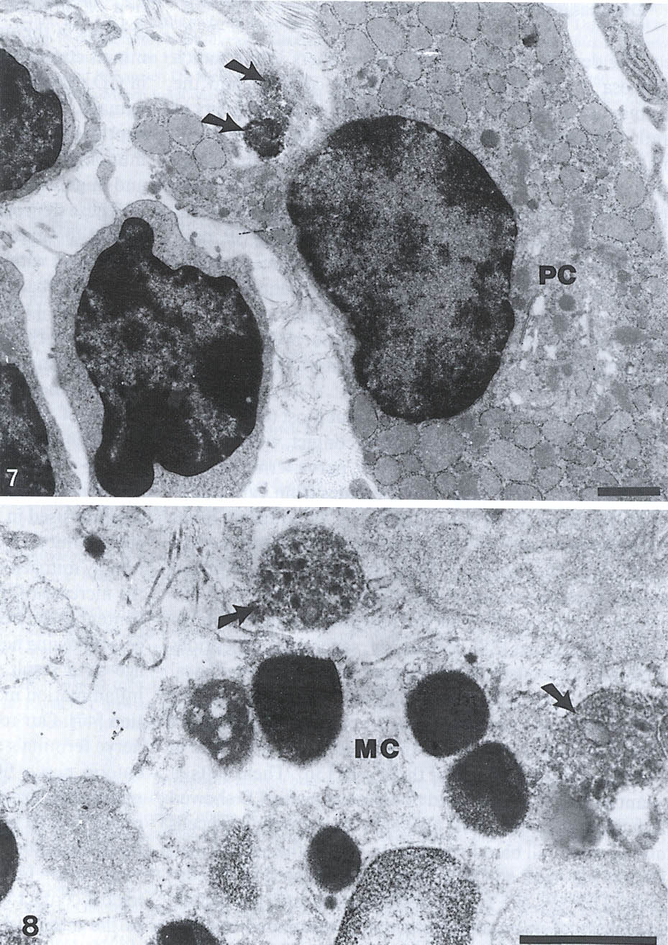
SP
SOM

Slide 22
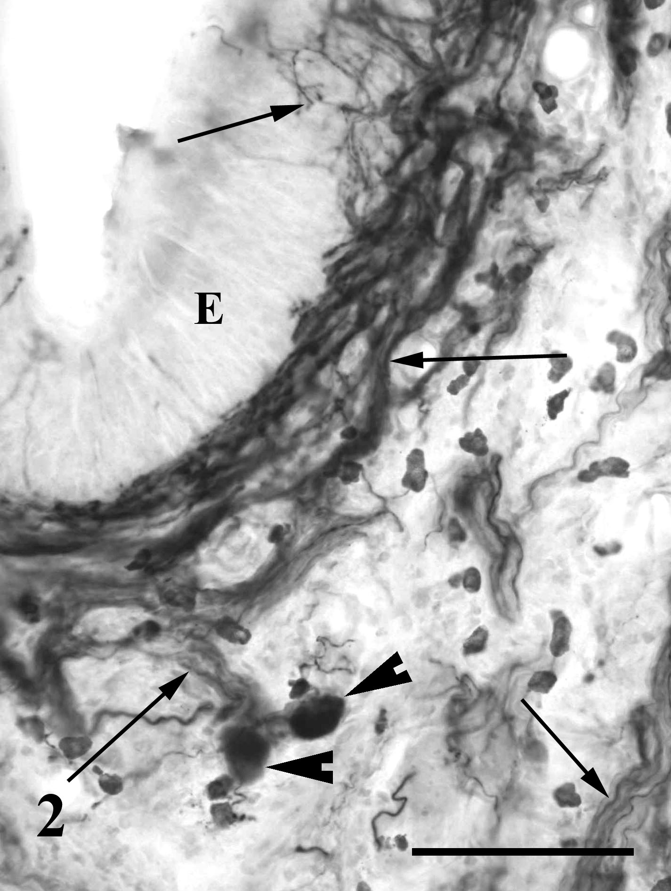
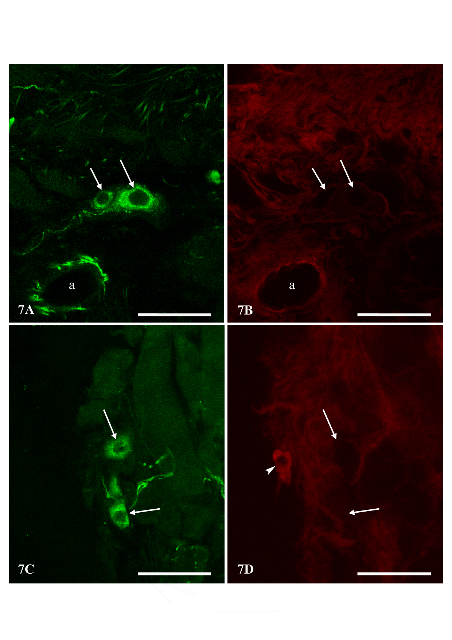
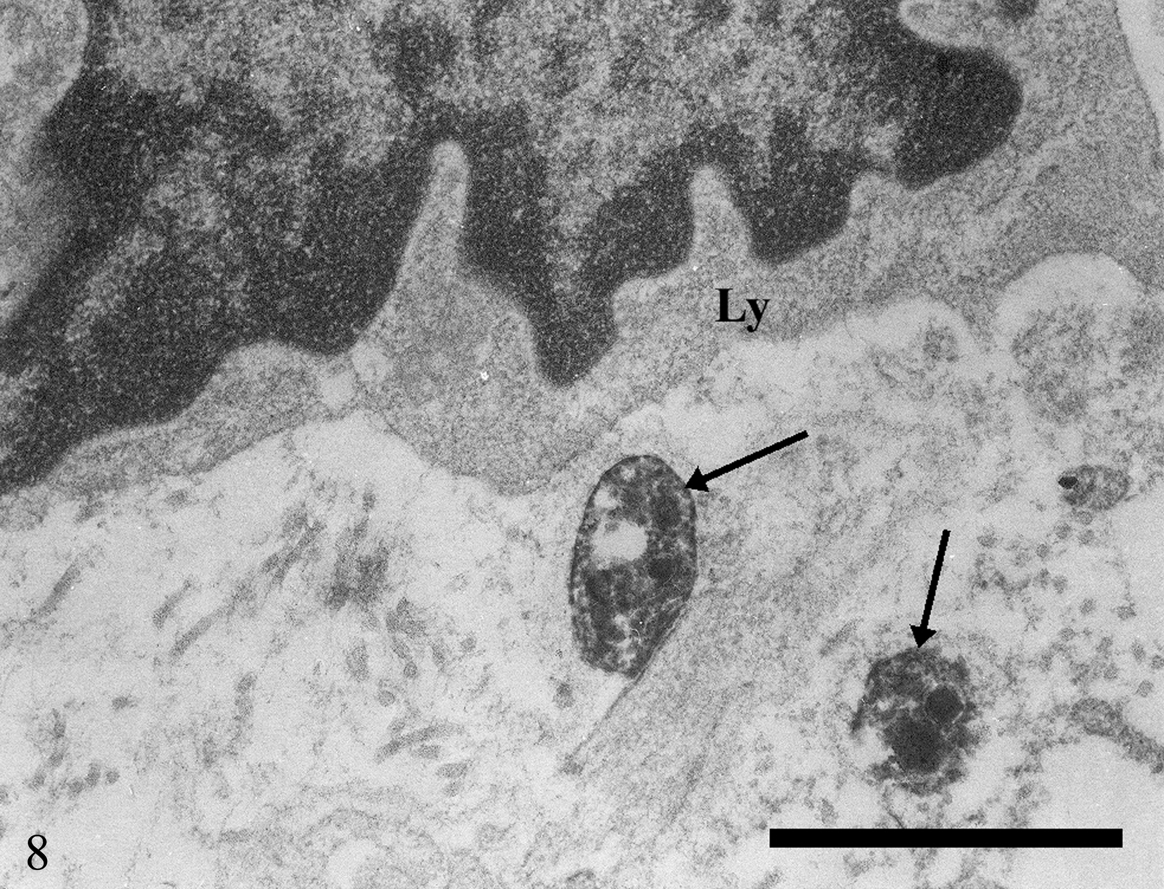
E. Fehér

