Slide 1
Motor systems I. Pyramidal tract
Dr. Ágota Ádám
Oct 10, 2017.

Slide 2
Categorization of descending motor pathways I.
‘Classic’ categories:
voluntary, goal-oriented (pyramidal tract)
corticospinal tract
corticonuclear (corticobulbar) tract
involuntary, stereotypic (extrapyramidal tracts)
reticulospinal, vestibulospinal, rubrospinal, olivospinal, tectospinal tracts

Slide 3
Categorization of descending motor pathways II.
Modern categories:
medial descending system
vestibulospinal tract
reticulospinal tract
lateral descending system
corticospinal tract
rubrospinal tract
postural control, stabilization of head and gaze
main inputs: visual, labyrinthic, proprioceptive, cerebellar
voluntary, organized movements of face and limbs
main inputs: somatosensory, cortical, basal ganglia, cerebellar

Slide 4
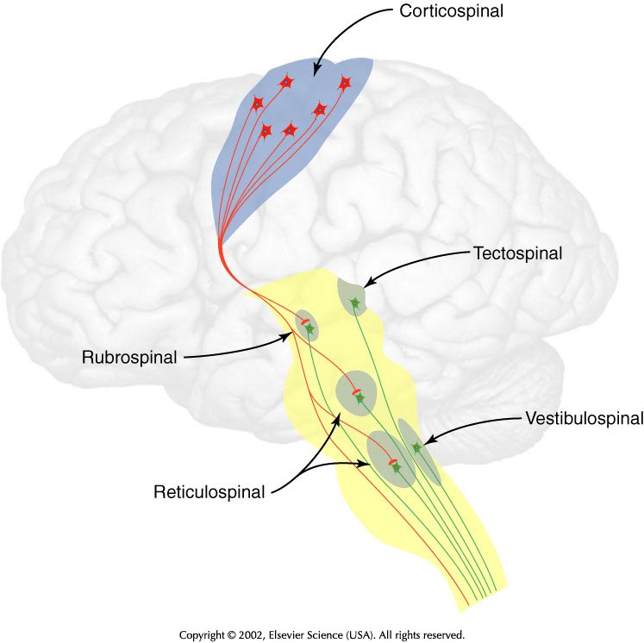
Principal descending motor tracts
Pyramidal and extrapyramidal systems can only be separated anatomically but not functionally! None of the two systems can work properly alone, they constitute one motor system together!!!

Slide 5
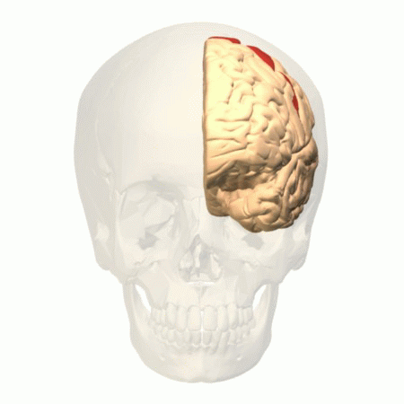
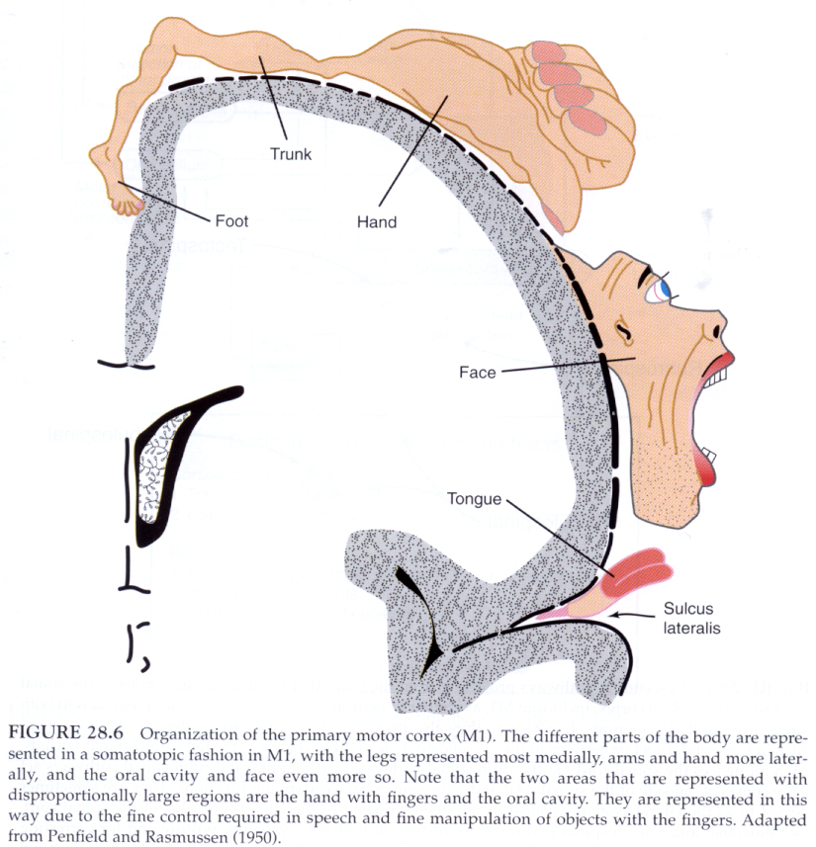
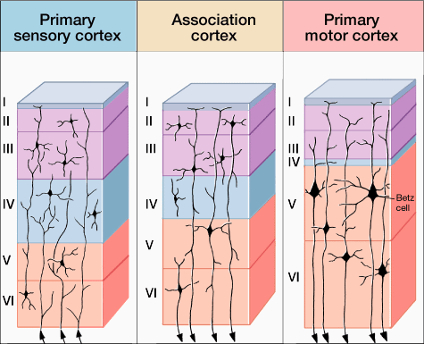
Primary somatomotor cortex
precentral gyrus (Brodmann 4 area)
somatotopic arrangement
agranular cortex (layer 2 and 4 are thin
+ giant pyramidal cells - Betz cells in layer 5)

Slide 6
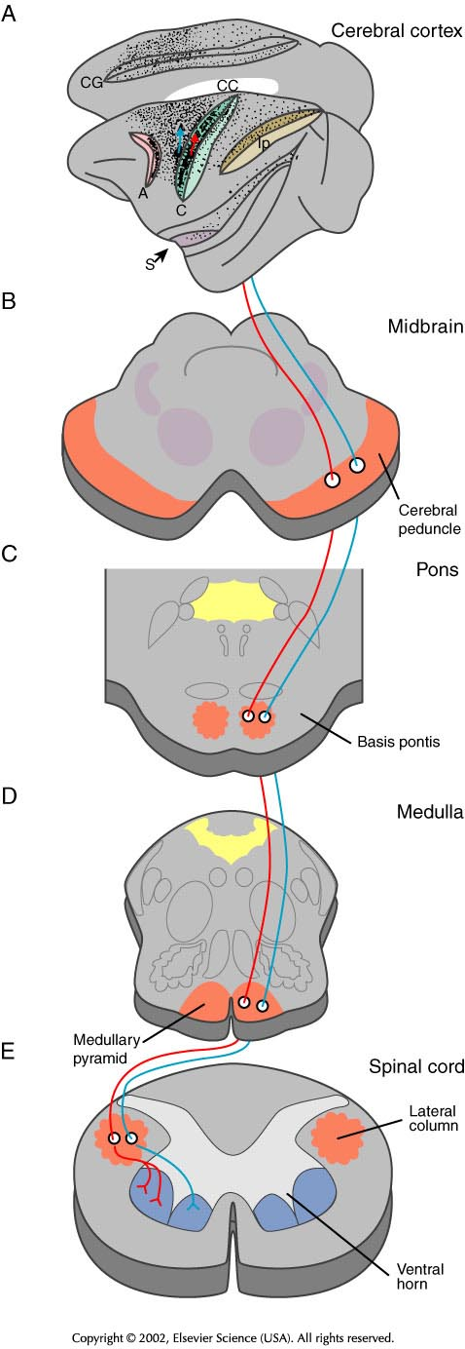
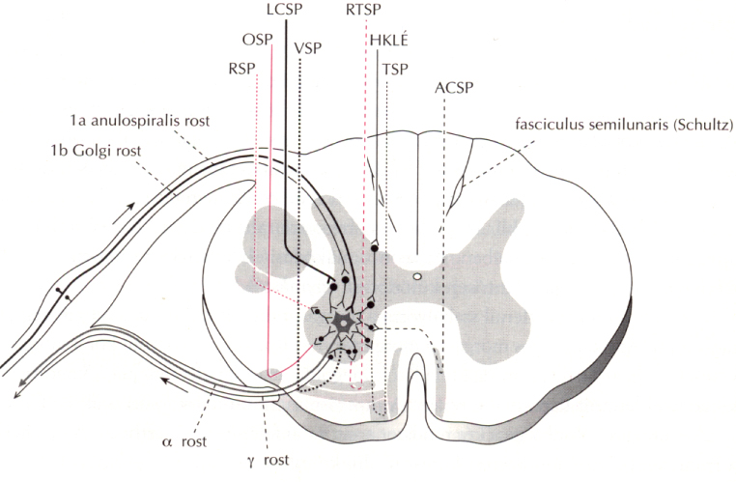
Course of the corticospinal tract
and its termination in the spinal cord
ACSP – anterior (uncrossed) corticospinal tract
LCSP – lateral (crossed) corticospinal tract

Slide 7
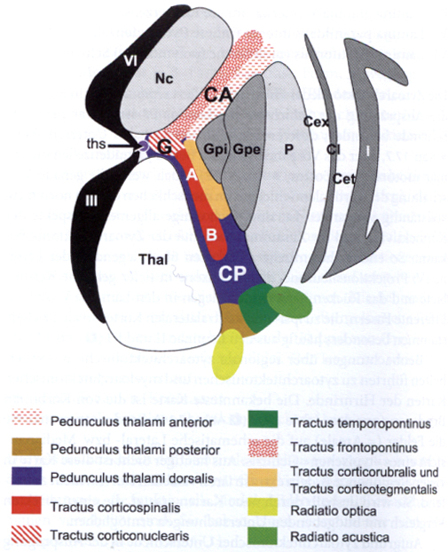
Internal capsule
Arrangement of the fibres of pyramidal tract
CA – anterior limb of IC
G – ‘knee’ (genu) of IC
CP – posterior limb of IC
G – representation of head and face
A – representation of arm
B – representation of leg

Slide 8
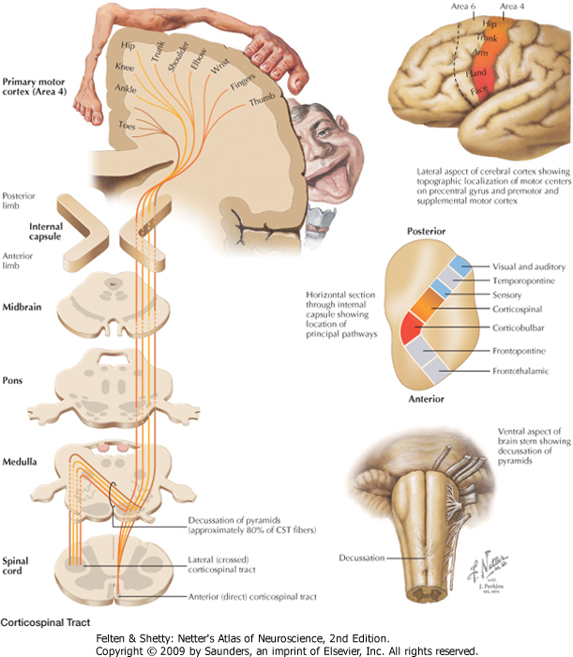
Corticospinal tract

Slide 9
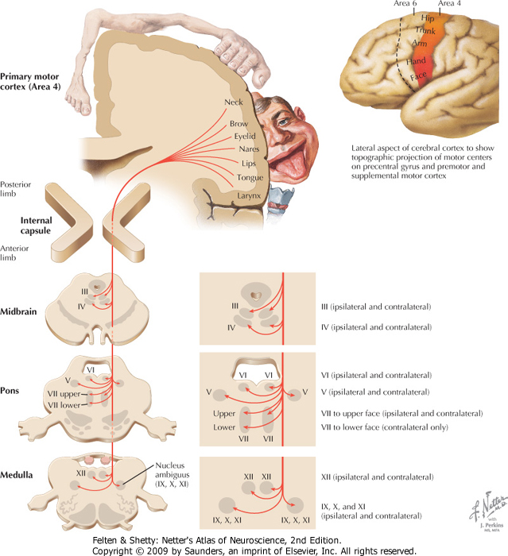
Corticonuclear tract

Slide 10
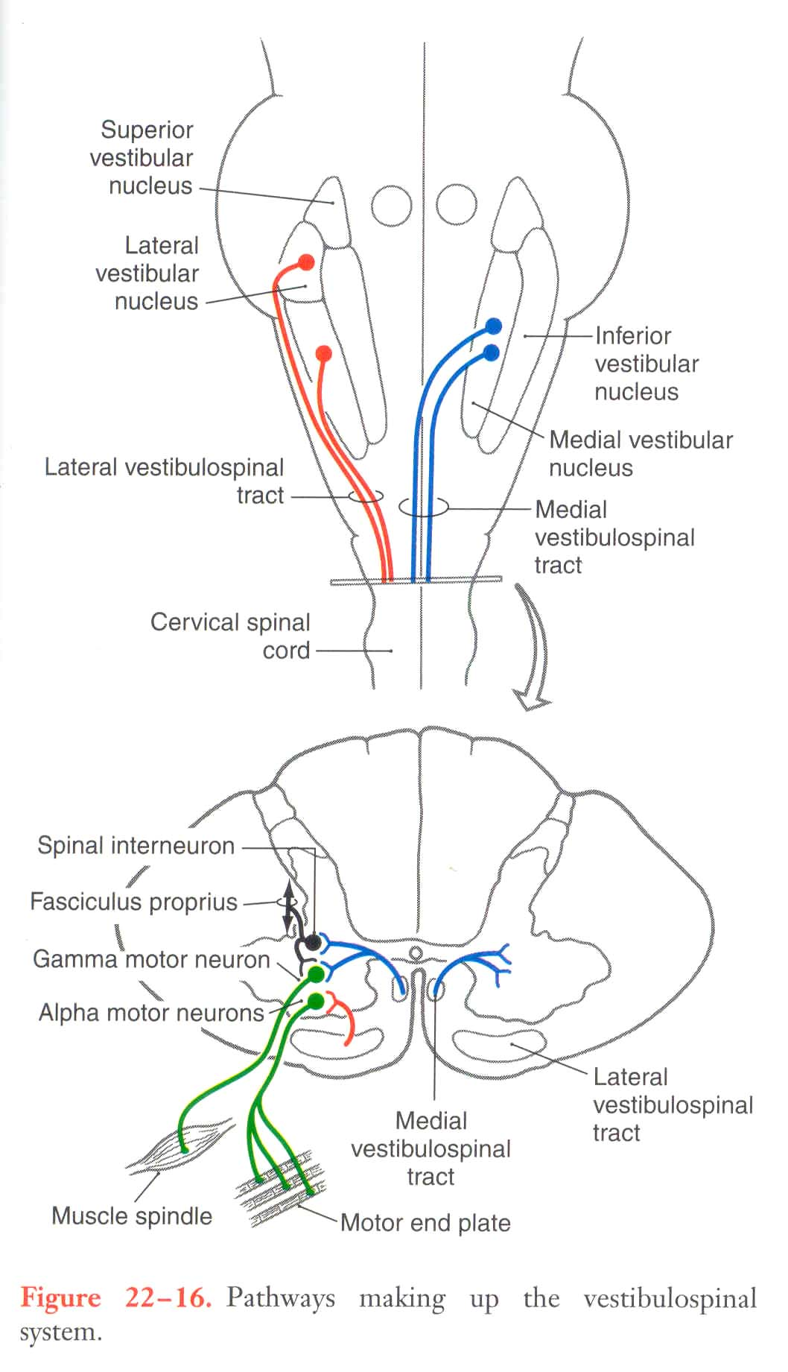
Vestibulospinal tracts

Slide 11
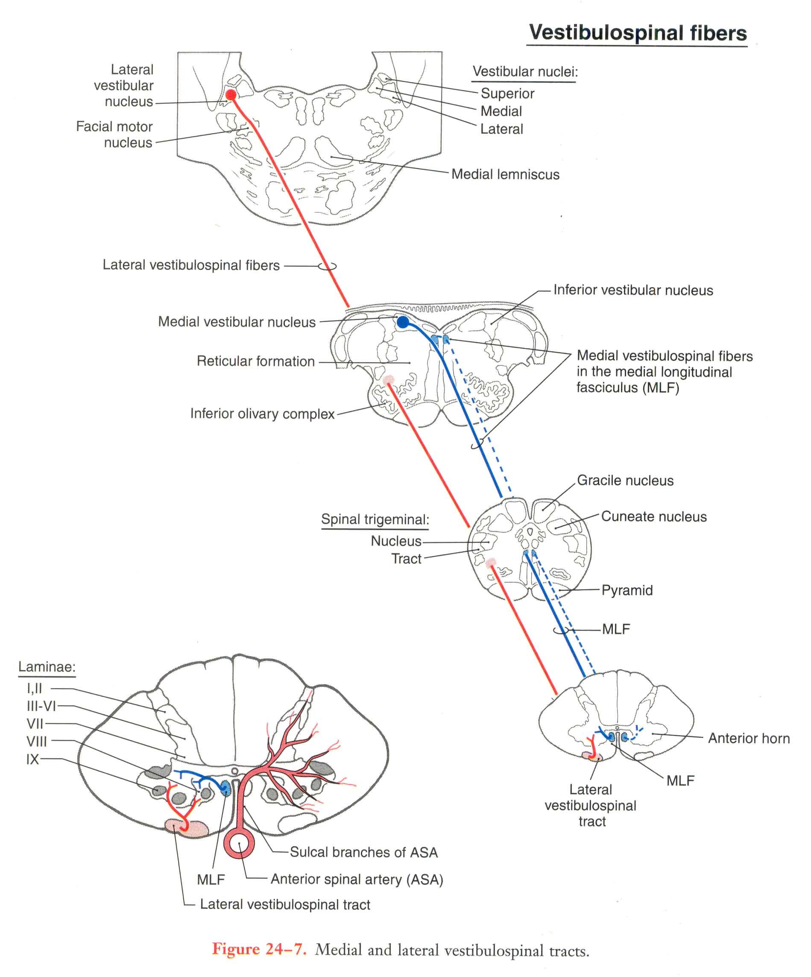

Slide 12
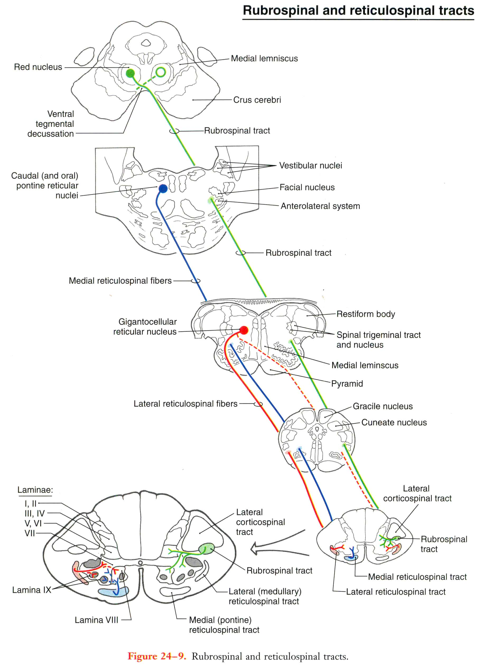

Slide 13
Clinical relevances
Central lesion to the pyramidal tract: Controlateral side: Spastic paralysis (hypertonia), enhanced stretch reflexes (hyperreflexia), Babinski sign
Peripheral lesion to the pyramidal tract: Flaccid paralysis, decreased reflexes
Internal capsule!!! Common site of cerebrovascular accidents

Slide 14
Thank you for your attention!

