Slide 1
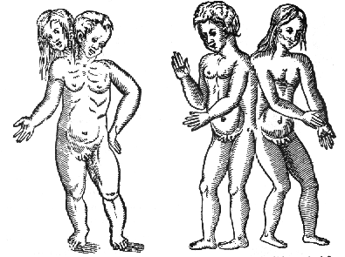
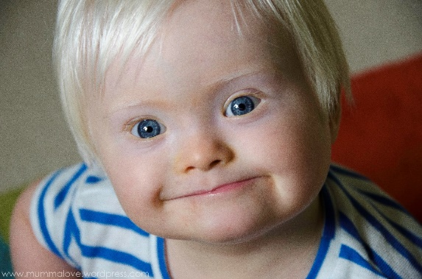
Developmental malformations
by Krisztina H.-Minkó
Semmelweis University, Faculty of Medicine,
Department of Anatomy, Histology and Embyology
2017

Slide 2
Morphogenesis versus dysmorphogenesis
The initially flat three-layered embryonic disc undergoes morphogenesis to form a three-dimensional embryo with a tube-within-a-tube body plan and the beginnings of rudiments that will form all of the adult organs and
systems.
Morphogenesis results from differential growth. Differential growth is driven by a small number of fundamental cellular behaviors such as changes in cell shape, size, position, number, and adhesivity. If these behaviors are perturbed during
embryogenesis, by a genetic mutation, environmental
insult (i.e., a teratogen), or a combination of the two, differential growth is abnormal and dysmorphogenesis
results with the formation of a structural birth defect.

Slide 3
CONGENITAL MALFORMATION, TERATOLOGY, HISTORY
Teratology is the science that studies the causes, mechanisms, and patterns of abnormal development.
teratology : development of „monsters”
In historical times the explanation of the „developmental monsters” was mainly esoteric (Devilish Souls)
First scientific descriptions: Ambroise Paré (XIV. century barber surgeon, pathologist, anatomist)
1941 Gregg (Australia) rubella infection of pregnants caused blindness, deafness , problems with heart
1960s years: Thalidomide scandal (phocomelia)
Notes:
Rubella epidemic

Slide 4
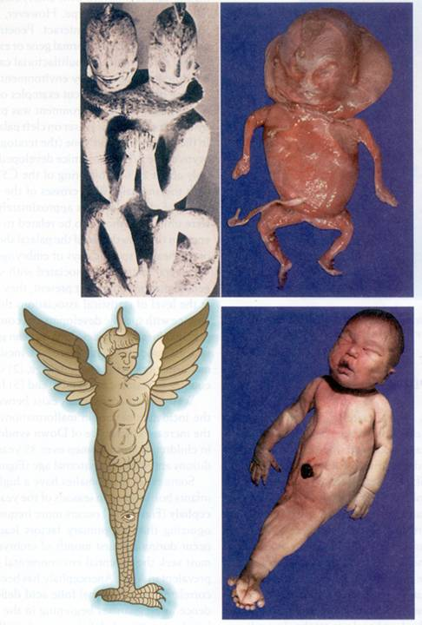
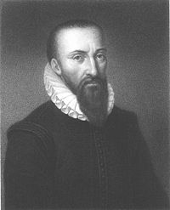
cystic hygroma colli
large cyst-like cavities containing lymph
rare
statue from Pacific Islands showing a divinity
sirenomelia („fused lower limbs”)
Ambroise Paré’ s drawing from his book (1520)

Slide 5
Sirenomelia
Caudal dysplasia, also called caudal regression syndrome, caudal agenesis, or sacral agenesis, is characterized by varying degrees of (1) flexion, inversion, and lateral rotation of the lower extremities; (2) anomalies of lumbar and sacralvertebrae; (3) imperforate anus; (4) agenesis of the kidneys and urinary tract; and (5) agenesis of the internal genital organs except for the gonads.
In extreme cases, the deficiency in caudal development leads to fusion of the lower limb buds during early development, resulting in a ‘‘mermaid-like’’ habitus called sirenomelia (Fig. 3-18)
it is believed that they all arise from defects
resulting from abnormal growth and migration during
gastrulation.
In animal models, caudal dysplasia can be induced by
both environmental factors and mutations.

Slide 6
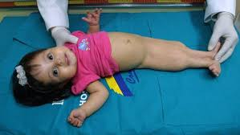
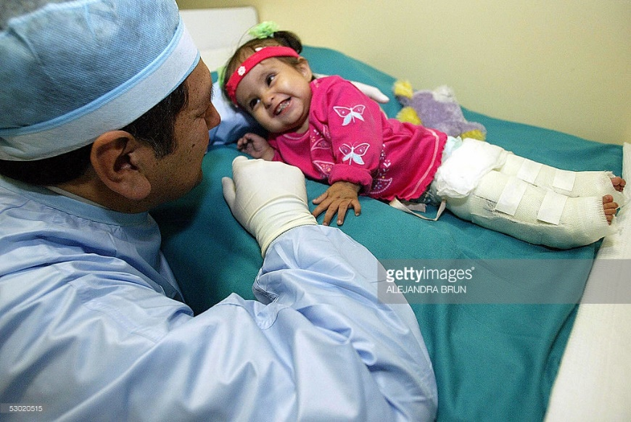
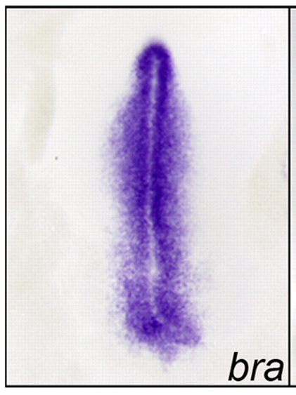
Insulin as teratogen, Brachyury mutation
In animal models, caudal dysplasia can be induced by both environmental factors and mutations.
Milagros Cerron born with sirenomelia, later underwent a successful operation to separate her legs.
Despite undergoing 150 operations during her relatively short lifetime, she still passed away in 2009 at the age of 10.
http://www.spillednews.com/2016/08/mermaid-like-foetus-woman-terminates.html

Slide 7
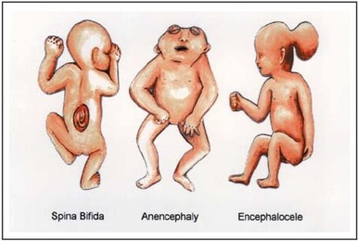
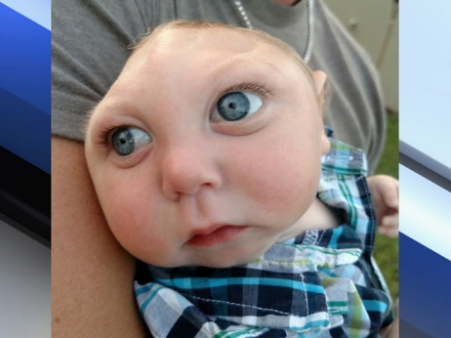
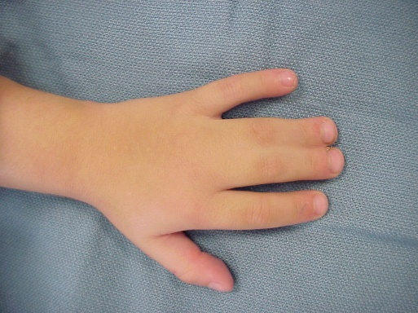
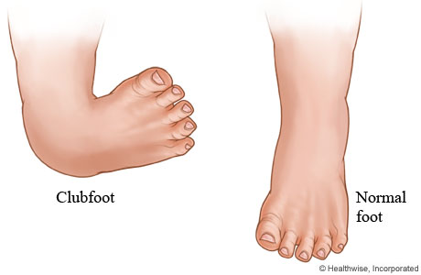
Dysmorphogenesis can result from both malformation
and deformation.
Malformations consist of primary morphologic defects in an organ or body part resulting from abnormal developmental events that are directly involved in the development of that organ or body part. For example, failure of the neural groove to close results in a malformation called a neural tube defect. Similarly, failure of the digits to fully separate results in syndactyly, that is, fusion of the digits.
Deformations consist of secondary morphologic
defects that are imposed upon an organ or body part owing to mechanical forces; that is, deformations affect the
development of an organ or body part indirectly. For
example, if insufficient amniotic fluid forms (i.e., oligohydramnios), deformation of the feet can occur due
to mechanical constraints, resulting in club foot.
Dysmorphogenesis can occur in an isolated organ or
body part or can occur as a pattern of multiple primary
malformations with a single cause. In the latter case, the
condition is referred to as a syndrome.
Common examples,
include Down syndrome (trisomy 21) and 22q11.2 deletion
syndrome, two syndromes that result from genetic mutations.
Other syndromes can result from teratogen exposure.
A common example is fetal alcohol syndrome,
also known as fetal alcohol spectrum disorder.

Slide 8
Teratogens
are environmental (i.e., nongenetic) substances
that are capable of causing a birth defect when
embryos or fetuses are exposed at critical times in
development to sufficiently high doses (concentrations).
The study of the role of environmental factors
in disrupting development is known by the unfortunate
name of teratology, which literally means the
study of (developmental) monsters.

Slide 9
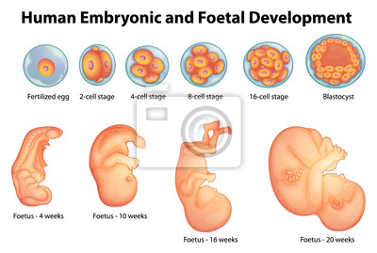
The first principle of teratology
is that an embryonic structure is usually susceptible to teratogens only during specific critical sensitive periods, which usually correspond to periods of active differentiation and morphogenesis.
Thus, a potent teratogen may have no effect on the development of an embryonic structure if it is administered before or after the critical period during which that structure
is susceptible to its action.
Because the major events of organogenesis take place during the first 8 weeks of development, that is the period during which the fetus is most vulnerable to teratogens.

Slide 10
A second principle of teratology
is that an embryonic structure is susceptible
to a critical dose of teratogen during its specific critical
sensitive period. Thus, in teratologic studies a dose response
curve is constructed for a suspected teratogen
in which lowest dose has no effect and the highest
dose is lethal to the embryo.
A third principle of teratology
is that susceptibility to a teratogen depends
on the genetic constitution of the developing embryo
or fetus.
For example, if two embryos of the same age
are exposed to the same dose of teratogen, one may
develop severe cardiac malformations whereas the
other may remain unaffected. The molecular basis
for this difference in susceptibility might, for instance,
be a genetic difference in the rate at which the enzyme systems of the two embryos detoxify the teratogen.
Thus, there is a gene-environmental interaction
underlying susceptibility to birth defects that varies
from embryo to embryo.

Slide 11
Critical periods during the pregnancy
Pre-embryonic period:
0-3. embryonic weeks (EW): „to be or not to be”, the teratogen kills the whole embryo (abortion), or only some of the early cells and these cells will be substituted (no congen. malf.)
Embryonic peroid:
3-8. EW: most vulnerable period: time of the development of the most serious (major) anomalies
Fetal period:
8. EW: minor morphological or functional defects (e.g.mental retardation).
Notes:
EW : weeks after fertilization

Slide 12
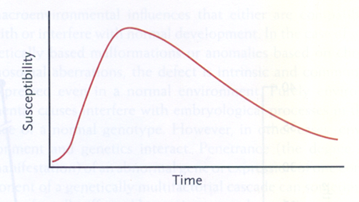
The sensitivity of the different organs are different in the time:
some organs are sensitive in early period (heart)
the others are sensitive in later periods (genitals)
and some of them are sensitive all along (nervous system).
Diagram of sensitivity period

Slide 13
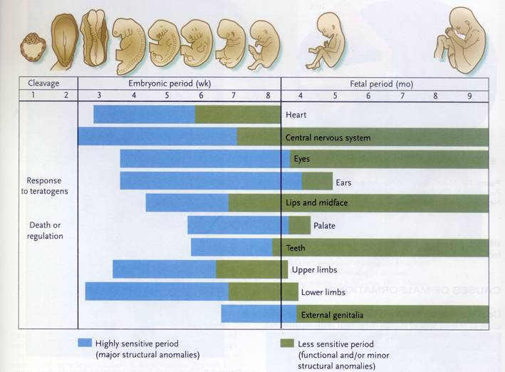

Slide 14
Incidence of abnormalities in Europe:
2-3% of all live born children at the birth, -(congenital)
but in the first year: 4-6%.
Range of CONGENITAL ANOMALIES is very vide
from the severe morfological defects
till enzime defects (no morfological picture)

Slide 15
Major malformations
drastic differences from normality
they cause prenatal or perinatal death
require surgical or medical care soon after birth
gravely physically handicapping
extreme cosmetic burden
Minor malformations
minor physical features
absence of associated major congenital malformations
little or no medical or cosmetic consequence

Slide 16
Major congenital malformations by system
Neural ~9.3%
anencephalus
spina bifida
encephalocele
microcephalus
hydrocephalus
Cardiovascular
transposition of great vessels
ventricular septal defect
hypoplastic left heart
coarctaction of aorta
~20 %
GIT/Respiratory ~ 7 %
cleft palate
cleft lip
oesophageal atresia or stenosis
small intestine atresia or stenosis
anorectal atresia or stenosis
Urinary ~6.4 %
hypospadias
renal agenesis and dysgenesis
cystic kidney disease
obstructive defects of renal pelvis, ureter
Skeletal/Muscular
congenital dislocation of the hip
limb reduction defects
diaphragmatic hernia
exomphalos
gastroschisis ~24 %
Chromosomal ~ 9.5%
trisomy 21 (Down syndrome)
trisomy 18 (Edwards syndrome)
Genital organs ~ 12 %
unicornuate, bicornuate uterus
cryptorchidism
About 3% of newborns have a "major physical anomaly",
meaning a physical anomaly that has cosmetic or functional significance
Infant mortality: over 20% subsequent upon malformation

Slide 17
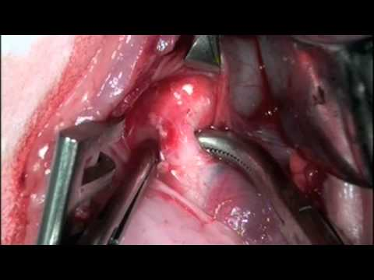
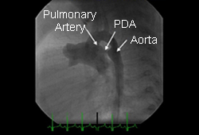
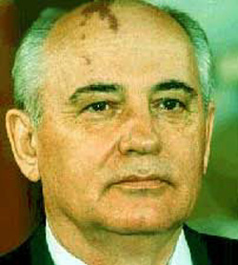
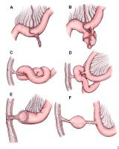
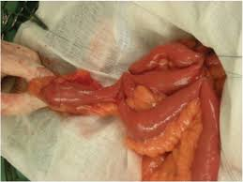
Minor Congenital Malformations
Cardiovascular system
patent ductus arteriosus or foramen ovale
(gestational age <37 weeks or birthweight <2500g)
mild, trivial, or physiological valvular regurgitation…
Skin
skin cysts
noncavernous single small hemangioma (<10cm dia.)
nevus flammeus…..
http://bestpractice.bmj.com/best-practice/
images/bp/en-gb/766-1-hlight_default.jpg
https://i.ytimg.com/vi/g_zQEQBLv_g/hqdefault.jpg
Gastrointestinal system
Hepatomegaly, splenomegaly
Meckel's diverticuluum
naevus flammeus consists
of superficial and deep dilated capillaries in the skin
https://encrypted-tbn0.gstatic.com/
images?q=tbn:ANd9GcSbU199kxnp3k1T4MrfLj1qPtoj_
OWECkknq07YFcTS_FYSfOQP
http://thehealthscience.com/
thsattachs/939954/111918441287277.jpg

Slide 18
Major Congenital Malformations

Slide 19

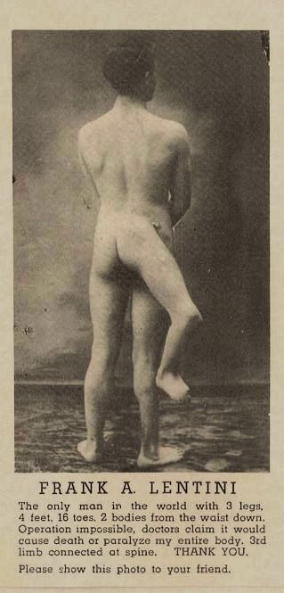
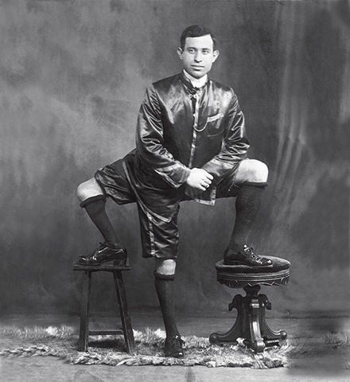
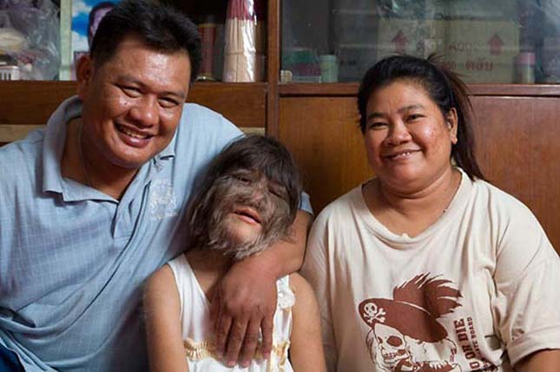
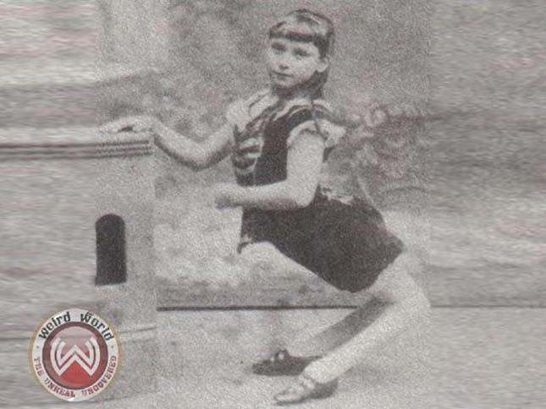
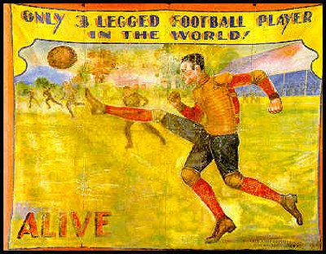
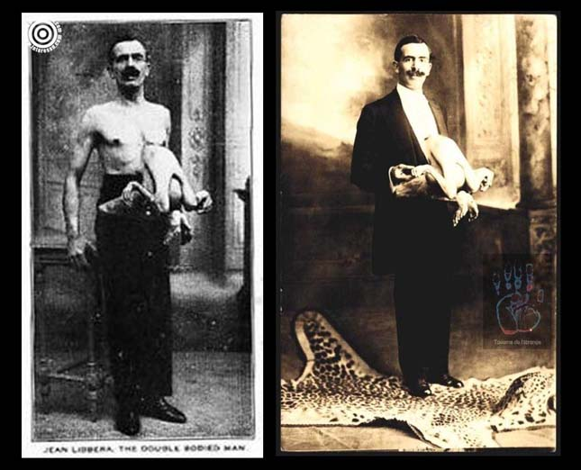
Major malformations: drastic differences from normality
Notes:
https://en.wikipedia.org/wiki/Frank_Lentini
https://www.youtube.com/watch?v=Pff544NYQkw
http://www.erdekesvilag.hu/a-legkulonosebb-rendellenessegekben-szenvedo-emberek/

Slide 20
Causes

Slide 21
Classification by causes of malformations
Genetic
Environmental.
cause of
more than half of all congenital malformations
is not known!!!!!
Large terra incognita…..
„Description is infinite and easy: explanation is limited and difficult”
Hippocrates
The Human Genome Project (HGP)
-international scientific research project
-to determine the sequence of chemical base pairs which make up DNA
-identifying and mapping the approximately 20,000–25,000 genes of the human genom
-in May 2006, the sequence of the last chromosome was published in the journal Nature

Slide 22
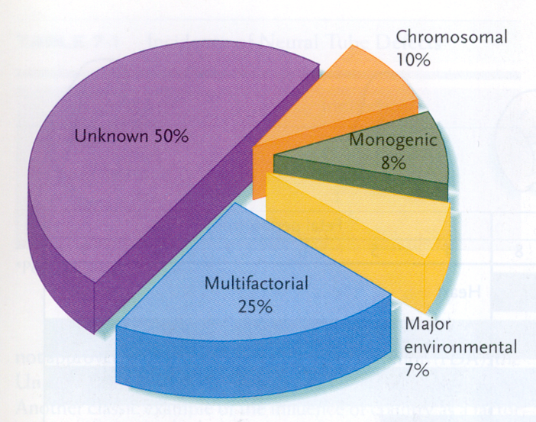
environment 7%

Slide 23
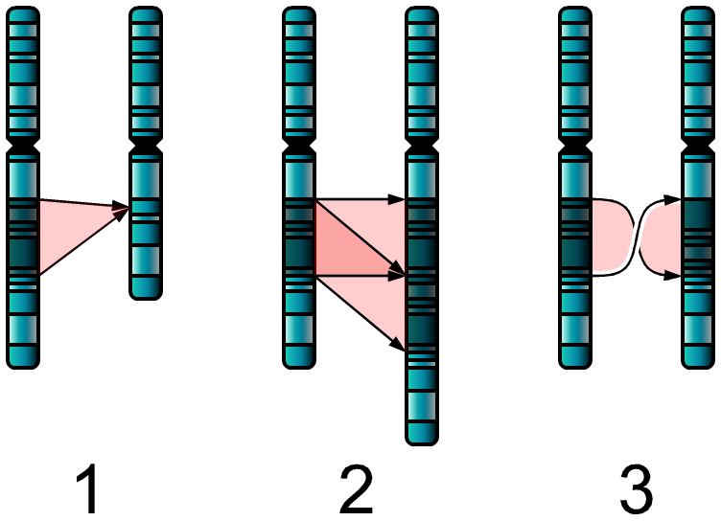
Genetic
Genetic mutation
dominant or recessive
autosomes or
sex chromosomes
Abnormal chromosome number
Abnormal
chromosome structure
Deletion
Duchenne muscular dystrophy X-chromosome
Deletion of the short arm of chromosome 5
Cri du chat syndrome
Duplication
Reciprocal translocation
Trisomy
Trisomy 21 – Down syndrome
Trisomy 13
Trisomy 18
Monosomy
Monosomy of sex chromosome
45 X0 – Turner syndrome female fenotype
sterile
autosomal recessive polycystic kidney disease
(perinatal type)
autosomal dominant
polycystic kidney disease
(adult onset) 1:400–1:1,000 individuals
X-linked recessive
hemophilia

Slide 24
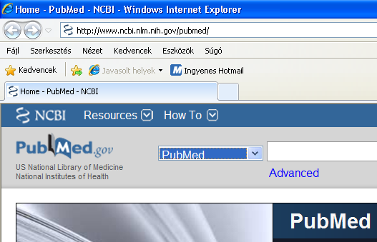
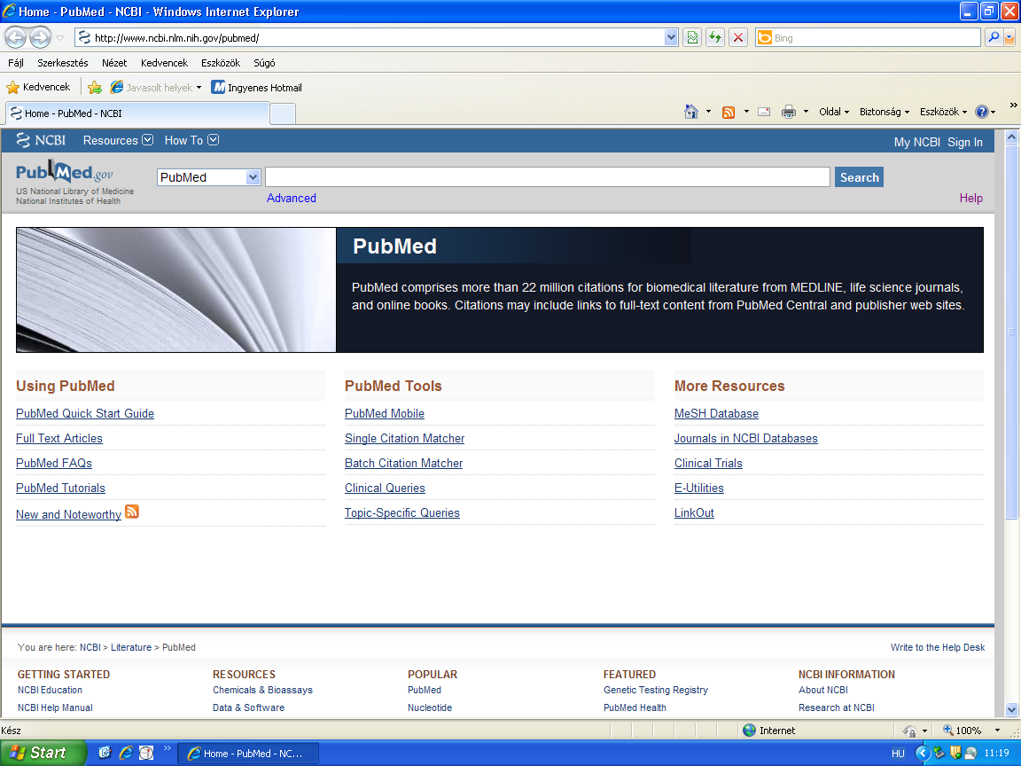
http://www.ncbi.nlm.nih.gov/pubmed/

Slide 25
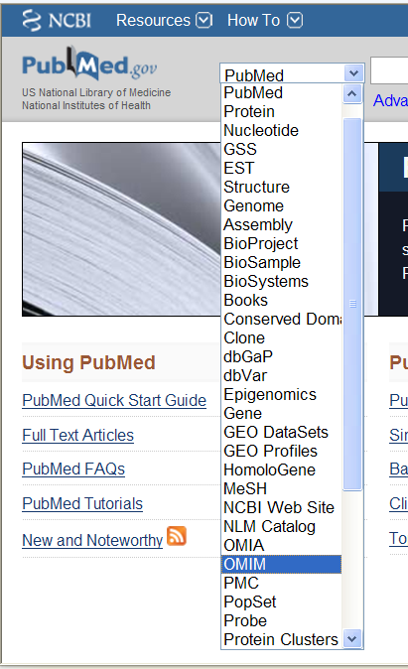

Slide 26
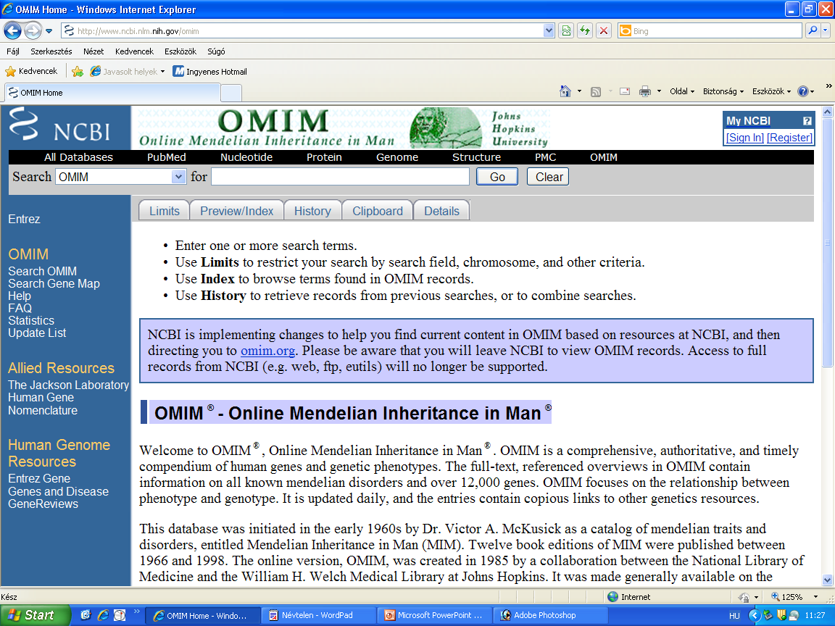

Slide 27
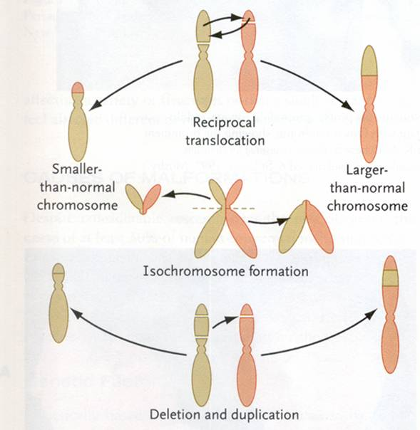
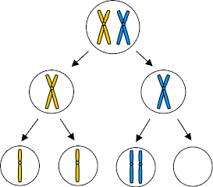
Chromosomal mutations
Aneuploidy:
in meiosis (first metaphase)
Homologues are not separated (non-disjunction)

Slide 28
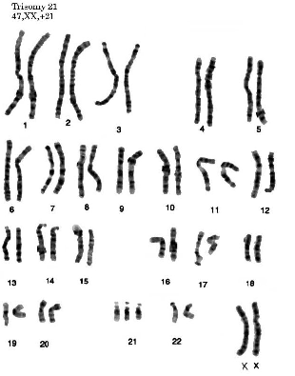
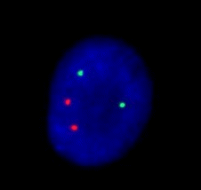
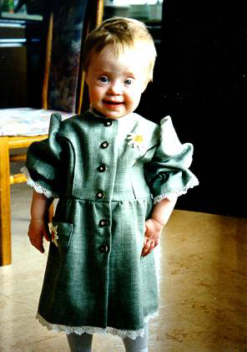
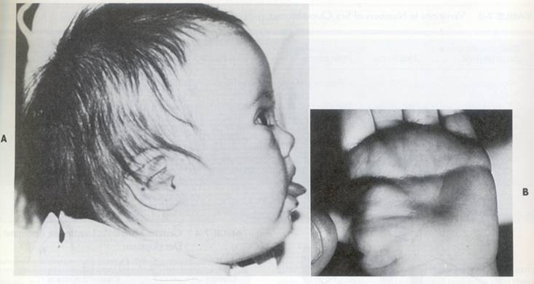
Down syndrome is one of the most common chromosome abnormalities in humans
Down syndrome: chromosome 21 trisomie
It is typically associated with physical growth delays, characteristic facial features and mild to moderate intellectual disasbility. Single crease of the palm.

Slide 29
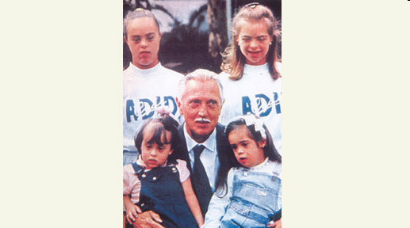
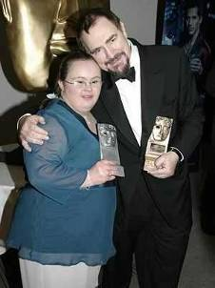
Down syndrome
21st chromosome - smallest chromosome
Only 200 to 250 genes
Genes that may have input into Down syndrome include:
Overexpression!!
COL6A1 -- overexpression may be the cause of heart defects
ETS2 -- overexpression may be the cause of skeletal abnormalities
CAF1A -- overexpression may be detrimental to DNA synthesis
DYRK -- overexpression may be the cause of mental retardation
CRYA1 -- overexpression may be the cause of cataracts
GART -- overexpression may disrupt DNA synthesis and repair
IFNAR -- the gene for expression of Interferon,
overexpression may interfere with the immune system
In 1959, Jérôme Lejeune discovered that Down syndrome
resulted from an extra chromosome.
Mosaicism!
-% of trisomic cells in the muscle may differ from
that in the brain, or in the blood or skin
-presence of cells with normal number of
chromosomes (46) may result in a less severe
Down syndrome
Sottish award-winning film and TV actress Paula Sage

Slide 30
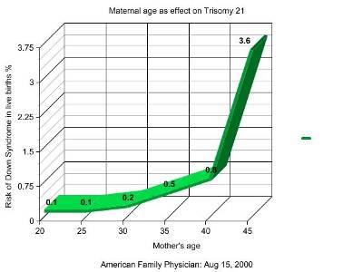
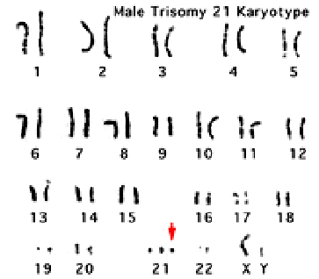
Abnormal chromosome number
Down syndrome – chromosome 21 - trisomy 21
Non-disjunction
88% coming from non-disjunction in the maternal gamete
8% coming from non-disjunction in the paternal gamete
1 per 800 to 1,000 births (earlier data)
1 in every 700 babies
Between 1979 and 2003, the number of babies born with Down syndrome increased by about 30%

Slide 31
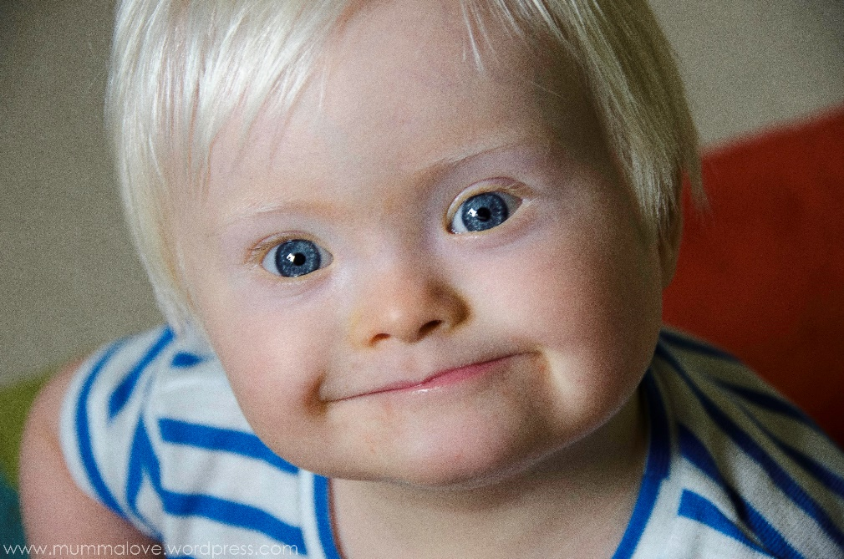
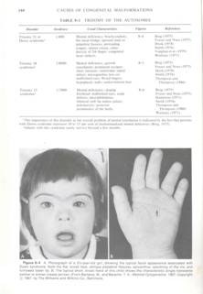
Why these signs result from the trisomy is unknown

Slide 32
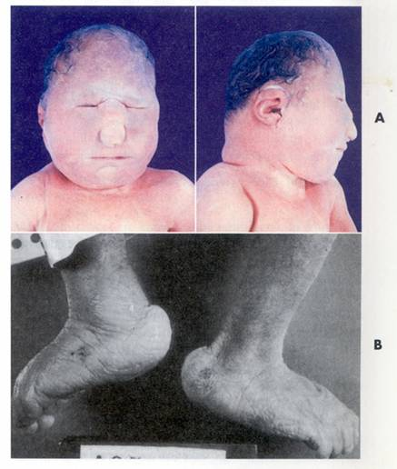
Other aneuploidies
Trisomy of 13.
Trisomy 13, also called Patau syndrome, is a chromosomal condition associated with severe intellectual disability and physical abnormalities in many parts of the body. Individuals with trisomy 13 often have heart defects, brain or spinal cord abnormalities, very small or poorly developed eyes (microphthalmia), extra fingers or toes, an opening in the lip (a cleft lip) with or without an opening in the roof of the mouth (a cleft palate), and weak muscle tone (hypotonia). Due to the presence of several life-threatening medical problems, many infants with trisomy 13 die within their first days or weeks of life. Only five percent to 10 percent of children with this condition live past their first year.
Trisomy of 18. (rocker bottom feet)
Trisomy 18, also called Edwards syndrome, is a chromosomal condition associated with abnormalities in many parts of the body. Individuals with trisomy 18 often have slow growth before birth (intrauterine growth retardation) and a low birth weight. Affected individuals may have heart defects and abnormalities of other organs that develop before birth. Other features of trisomy 18 include a small, abnormally shaped head; a small jaw and mouth; and clenched fists with overlapping fingers. Due to the presence of several life-threatening medical problems, many individuals with trisomy 18 die before birth or within their first month. Five to 10 percent of children with this condition live past their first year, and these children often have severe intellectual disability.
Notes:
https://ghr.nlm.nih.gov/condition/trisomy-13, 18

Slide 33
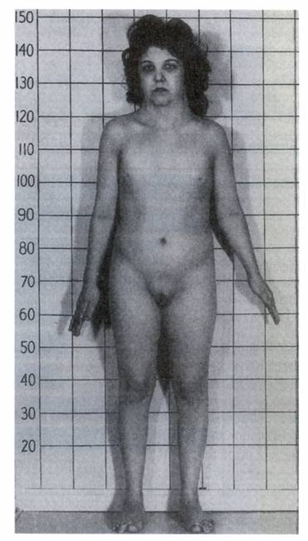
Aneuploidy of the sex chromosomes:
Turner syndrome: 45 X,O (X monosomy): female but weak fenotype, steril
Others:
XXY: Klienefelter syndrome: male, but small testis, steril, long limbs
XYY: seems to be normal male, high figure, but violent (choleric) behavior
XXX: „super women”: seems to be normal feminin habit, but mental retardation occurs

Slide 34
MONOGENIC DEFECTS

Slide 35

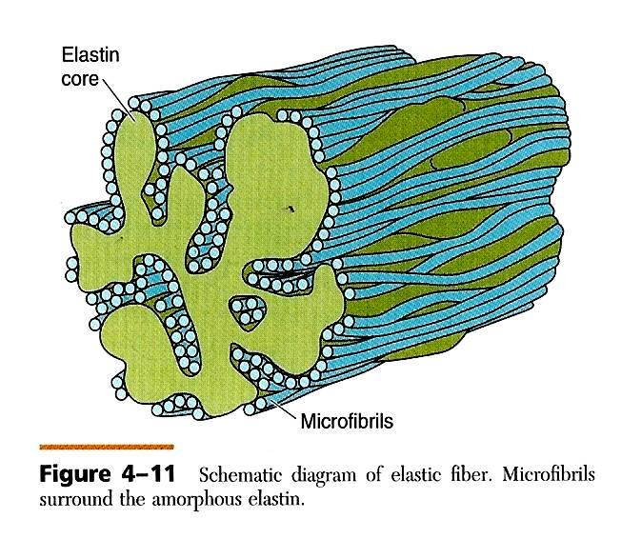
Marfan syndrome
Genetic disorder of the connective tissue. The degree to which people are affected varies. People with Marfan tend to be tall, and thin, with long arms, legs, fingers, and toes..They also typically have flexible joints and scoliosis. The most serious complications involve the heart and aorta with an increased risk of mitral valve prolapse and aortic aneurysm. Other commonly affected areas include the lungs, eyes, bones, and the covering of the spinal cord.
Abraham Lincoln had this disorder.
Autosomal dominant disorder.
About 75% of the time the condition is inherited from a parent while 25% of the time it is a new mutation. It involves a mutation to the gene that makes fibrillin which results in abnormal connective tissue.
Notes:
https://en.wikipedia.org/wiki/Marfan_syndrome

Slide 36
Polysyndactylia: HoxD13 pointmutation
Syndaktilia: az ujjak összeolvadása. Ebben a humán esetben a HOXD13 gén pontmutációja a gén kieséséhez vezetett. Az üres csillagokkal jelölt képletek kézközépcsontok, a két kicsi csillag normálisan nem létező carpalis csontokat jelöl.

Slide 37
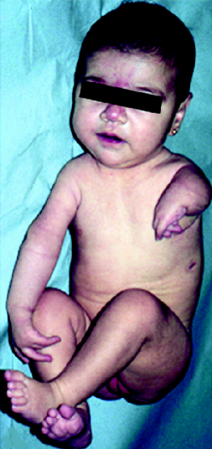
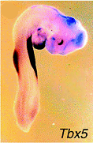

Holt-Oram syndrome
-TBX5 mutation
-1:100.000
-limb bud (100%)
phocomelia
- heart defects (67%)
Anthony Bagliano is a kicker for North High School
North kicker on Holt-Oram syndrome
- 'I'm always happy. I try to look at the positives in life'

Slide 38
CAUSES OF CONGENITAL ANOMALIES
Environmental sources (teratogens)
genetic sources
Developmental abnormalities

Slide 39
Maternal derived abnormalities
lifestyle,
environment
and nutrition
directly affect embryonic development
some effects are more subtle and relate to later life health events
⬇
low birth weight data ➔ later health outcomes of same babies
named as "fetal origins" or "programming”
⬇
diabetes

Slide 40
Chromosome mutation
10%
unknown
50%
Gene mutation 8%
multifactorial 25%
??:
- age of the parents
different ethnical groups
familiar background (genetical)
seasons
social and geographical differences

Slide 41
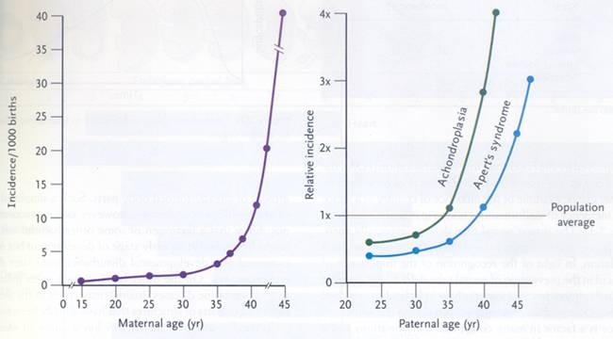
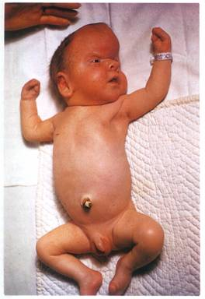
AGE
Incidence of Down syndrome is dependent on the age of mother (left figure) but the Apert syndrome is on the age of father (right blue line)
Apert syndrome: turricephalus – tower head

Slide 42

Apert syndrome
Notes:
http://www.craniokids.co.za/cranio_faq.htm

Slide 43


Apert syndrome: turricephalus – tower head
FGFR2 mutation: craniosynostosis, syndaktylia
Notes:
Larsen’s Human Embryology, 4th ed.,Elsevier, 2009

Slide 44

RACE
Incidence of cleft palate is different in different ethnical groups
far-east > (2x) caucasian > (2x) afro-american

Slide 45





Jaxon Buell: Presents pile up for 'miracle baby' who made national news
SEASON
Anencephaly is abundant in the spring:
it is caused by the deficit of the mother’s folic acid level. Given folic acid to the mothers cut down drastically the number of these fetuses.
Anencephaly = cranioschisis – anterior part of the neural tube (neuroporus anterior) is not closed the brain will not be developed.
he was born
Aug. 27, 2014.

Slide 46

Frequency of anencephaly in different countries

Slide 47
Environmental factors
1. biotic agents (bacteria, viruses, fungi)
2. drugs/chemicals
3. mechanical agents

Slide 48

1. Infectious agents as teratogens
Rubella
  German or Three-Day Measles
  First trimester – most serious
ED0 - ED60: cataracta (blindness )and heart problems
ED0 - ED120: deafness
Cytomegalovirus (CMV)
Herpes Simplex Virus (HSV)
Varicella
Human Immunodeficiency Virus (HIV)
Congenital Syphilis
Toxoplasmosis
Notes:
EYES – glaucoma, cataracts, retinopathy
EARS – loss
BRAIN – psychomotor retardation, mental retardation
HEART – congenital heart defects

Slide 49
Different organs different sensitive periods

Slide 50


Different organs different sensitive periods
Tetraciklin:
- after the 120. embrionic day (ED) : milk-teeth and adult
teeth become coloured
-after ED250: only the adult teeth become coloured
Rubella infection:
ED0 - ED60: cataracta (blindness )and heart problems
ED0 - ED120: deafness
https://drmarthaszabolcs.com/2017/03/06/first-blog-post/#jp-carousel-140

Slide 51
2. Mechanical factors as teratogens
Mechanical forces
  Restrict the mobility of the fetus
  Cause prolonged compression in an abnormal posture
  E.g. congenital dislocation of hip and clubfoot
  Malformed uterus
Notes:
Protect the embryo from most external trauma

Slide 52


Mechanical factors as teratogens
Amniotic fluid
  Absorb mechanical forces
  Oligohydramnios
    Significantly reduced fluid-quantity
    Mechanically induced deformations of the limbs
      Knee hyper-extends
  Amniotic bands
    Rings formed from amnion rupture
    Local constriction during fetal growth
    Intrauterine amputations

Slide 53
3. Drugs/chemicals
Etil-alcohol: Fetale Alcohol Syndrome (FAS): causes problems in the brain development : holoprosencephalia.
Prosencephalon is the most anterior part of the neural tube : hemispheres, hypothalamus, hypophysis , eye developed from this part
Thalidomid (Contergan): tranquillizier
Many therapeutic drugs are known to be teratogenic;
these include retinoids (vitamin A and analogs), the
anticoagulant warfarin, the anticonvulsants valproic
acid and phenytoin, and a number of chemotherapeutic
agents used to treat cancer. Most teratogenic drugs
exert their main effects during the embryonic period.
Although, as stated above, most care must be exercised
in administering certain anesthetics and other drugs
even late in pregnancy or at term, because they may
endanger the health of the fetus.

Slide 54
Fetale Alcohol Syndrome (FAS):
This disorder affects 2 in 1000 live-born infants (Fig. 5-2).
Consumption of amounts of alcohol as low as 80g per day
(i.e., between two and three shots of a grain liquor such as rum) during the 1st month of pregnancy can cause significant defects, and it has been suggested that even a single binge may be teratogenic. Common components of the disorder include defects of brain and face development, namely, microcephaly
(small head), short palpebral fissures (eye openings),
epicanthal folds (folds overeye lids), a low nasal bridge with a
short nose, flat midface, minor external ear anomalies, and jaw
anomalies including a thin upper lip with indistinct
philtrum and micrognathia (small jaw). Chronic consumption
of even quite small amounts of alcohol later
in pregnancy can result in other, less-destructive
effects, such as some degree of growth retardation
and minor physical defects.

Slide 55


FAS: holoprosencephaly and craniofacial CA.
Prosencephalon regulate not only the development of the brain but the head and face also
B: cebocephalia
C: no nose, hypotelorismus
D: cyclopia

Slide 56

Some recreational drugs are also teratogenic; these
include tobacco, alcohol, and cocaine.
Cocaine, used by alarming numbers of
pregnant women (the drug affected 300,000 to
400,000 newborns in 1990 in the United States), readily
crosses the placenta and may cause addiction in the
developing fetus. In some of the major cities of the
United States, as many as 20% of babies are born to
mothers who abuse cocaine. Unfortunately, fetal
cocaine addiction may have permanent effects on the
individual, although studies suggest that early intervention
with intensive emotional and educational support
in the first few years of life may be helpful.
high frequency of preterm labor.
Two mechanisms have been proposed by which cocaine
could cause preterm labor: cocaine, a potent constrictor
of blood vessels, may cause abruption of the placental
membranes (premature separation of the placenta from
the uterus) by partly shutting off the flow of blood to the
placenta; or as there is evidence that cocaine directly
affects the contractility of the uterine myometrium
(muscle layer), it perhaps makes the myometrium
hypersensitive to signals that initiate labor.
https://www.youtube.com/watch?v=QYICaHo6tWQ
Notes:
Pregnant women who use cocaine have higher frequencies
of fetal morbidity (disease) and mortality
(death) than pregnant women who do not. Cocaine
use is associated not only with low birthweight but
also with some specific developmental anomalies,
including infarction of the cerebral cortex and a variety
of cardiovascular malformations. However, it is
often difficult to isolate cocaine as the teratogen
responsible for a given effect, because women who
use cocaine often use other drugs as well, including
marijuana, alcohol, tobacco, and heroin.

Slide 57

Intrauterine growth restriction (IUGR),
often called small for gestational age (SGA), is a condition in
which fetal growth in markedly retarded. IUGR carries
a higher risk of perinatal mortality and morbidity, so
IUGR is a life-threatening birth defect.
A newborn is considered to be SGA if he/she weighs less than 2500 grams at term or falls below the 10th percentile for
gestational age.
involves the entire fetus
CAUSES:
teratogen exposure such as congenital viral or bacterial infections,
fetal chromosomal anomalies (e.g., Down syndrome),
maternal factors (such as preeclampsia, a condition affecting about 5% of pregnancies characterized by high blood pressure and protein in the urine),
placental factors (such as placenta previa, or ‘‘low-lying’’ placenta, a condition in which the blastocyst implants near the uterine cervix and the placenta covers part of the opening of the cervix).

Slide 58
Contergan scandal
Thalidomid (Contergan): tranquillizier thousands of pregnants used as a sleeping-pill in the 60’s
About 40 thousands person had got periferal nerve inflammation;
8-12 thousands baby born with phocomelia
among them 5 thousands grown up…
Notes:
Analysis , audit

Slide 59


Thalidomid-case: phocomelia: part of the limbs are missing
the diagram shows the amount of sold Contergan (Thalidomid), empty columns: in kilogramm!!!; stripped colums :number of phocomelia patient ,in Germany between 1956 and 1964

Slide 60

In 1964 the drug was given to patients with leprosy as the last possibility for sleeping. And the drug dissolved the distress, gave good sleeping periods and mollified the leprosy.
It seems to be very bid fair: it seems to be usable not only in leprosy but in some autoimmune deseases also
Today we know that it has antiangiogenetic effect ,
that caused the problem in the developing embryo
Notes:
Practice, adaptation

Slide 61
Both maternal diabetes and maternal obesity during pregnancy constitute risk factors for birth defects of the fetus
neural tube defects and heart defects
Notes:
Approximately 1:200 women of childbearing
age have diabetes before pregnancy (preexisting
diabetes) and another 2% to 5% develop
diabetes during pregnancy (gestational diabetes).
Women with preexisting diabetes are 3 to 4 times
more likely to have a child with a major birth defect
than are nondiabetic women. Such defects are widespread
and include neural tube defects and heart
defects. Women with gestational diabetes usually do
not have an increased frequency of children with
birth defects. However, if diabetes in either group
is poorly managed during pregnancy, there is an
increased risk of delivering a very large baby (greater
than 10 pounds). Such babies may have an increased
risk for obesity and diabetes in later life.
Maternal obesity (defined in the United States as a
body mass index greater than 30 kg/meter squared) is
also a risk factor for birth defects. Fetuses born to obese
women are 2 to 3.5 times more likely than those born to
average-weight women to have neural tube defects,
heart defects, and omphalocele.

Slide 62

Maternal obesity (defined in the United States as a
body mass index greater than 30 kg/meter squared)
is also a risk factor for birth defects.
Fetuses born to obese women are 2 to 3.5 times more likely than those born to average-weight women to have neural tube defects, heart defects, and omphalocele.

Slide 63




Thank You for attention!

Slide 64
List of important malformations
Gamete production, meiosis:
trisomy 21, trisomy 18, Klinefelter- (47, XXY), Turner- (45, X) syndrome
22q11 Deletion
ectopic or extrauterin pregnancy
gastrulation: situs inversus
neurulation: anencephalia, spina bifida
ectopias (ectopia cordis)
somites: lumbalisation, sacralisation, preatlas
placenta: preeclampsia
strangulations
oligo- and polyhydramnion
Skull: hydrocephalus, craniosynostosis

Slide 65
References
T.W. Sadler: Langman’s Medical Embryology, 7th edition, 1995, Baltimore, Maryland, USA – képek
Carlson’s embryology book
Lectures of Dr. Ágnes Csáki, Dr. Attila Magyar, Dr. Nándor Nagy, Dr. Ágnes Nemeskéri

