Slide 1
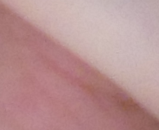
Das Cre-loxP System
Medizinische Embryologie I
2017-2018, Wintersemester
5B
dr. Attila Magyar
31.10.2017

Slide 2
Sehr effektives System für Detektieren LEBENDE Zellen
Cre Rekombinase, die erkennt
loxP Sequenzen (das System stammt aus Bakteriophagen)
Einbauen von loxP Sequenzen im Genom („floxen”: das Werb kommt aus flankieren mit loxP Sequenzen); solche, mit loxP Seq. flankierte Gene sind floxed=gefloxt.

Slide 3
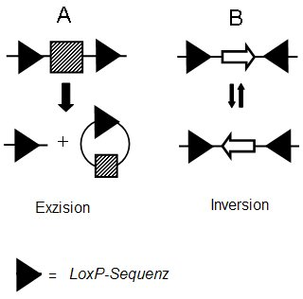
Gen
Gen
Cre
Cre
Je nach Orientierung der loxP-Sequenz katalysiert Cre die Exzision oder Inversion Wikipedia

Slide 5
1
http://mouseclique.jax.org/crelox-breeding-for-dummies/
Notes:
Here is the most efficient breeding scheme for generating Cre/lox tissue-specific or inducible knockouts. To generate mice that are heterozygous for a loxP-flanked allele and hemizygous/heterozygous for thecre transgene, mate a homozygous loxP-flanked mouse of interest to a cre transgenic mouse strain (see Figure 1 below). Approximately 50% of the offspring will be heterozygous for the loxP allele and hemizygous/heterozygous for the cre transgene.

Slide 6
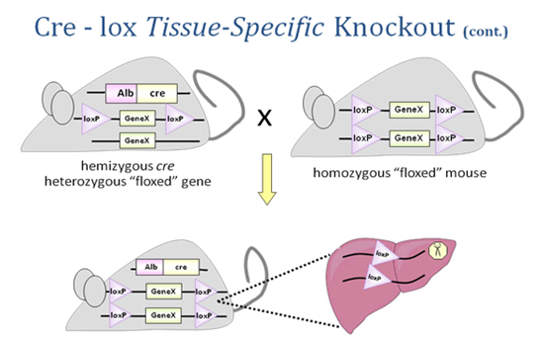
2
http://mouseclique.jax.org/crelox-breeding-for-dummies/
Notes:
Mate these mice back to the homozygous loxP-flanked mice (see Figure 2 below). Approximately 25% of the progeny from this mating will be homozygous for the loxP-flanked allele and hemizygous/heterozygous for the cre transgene. These will be your experimental mice.

Slide 7
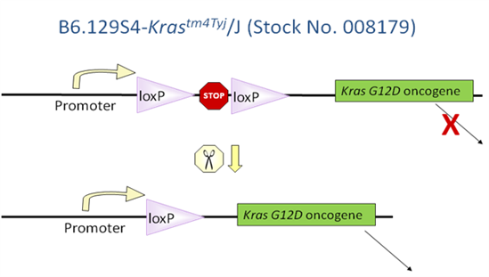
3
http://mouseclique.jax.org/crelox-breeding-for-dummies-part-ii/
Notes:
The proper insertion of a loxP-flanked “stop” sequence (transcriptional termination element) between the promoter and transgene coding sequence blocks the expression of the gene. For a few examples of such strains, check out 008179 and 006481. Cre recombinase removes the stop sequence, so the transgene is expressed only in the cells where Cre is active (see Figure 1 below).

Slide 8
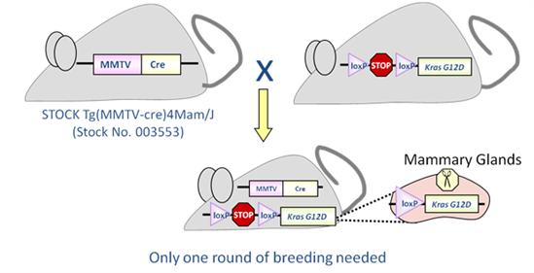
4
http://mouseclique.jax.org/crelox-breeding-for-dummies-part-ii/
Notes:
The Cre/lox system can also be used to produce strains in which a transgene is either inducible or expressed only in certain tissues. For example, mating the transgenic strain in Figure 1 to a strain that expresses Cre recombinase in mammary tissue produces double transgenic offspring that express theKras oncogene only in the mammary glands (Figure 2). Notice that only one generation of breeding is required

Slide 9
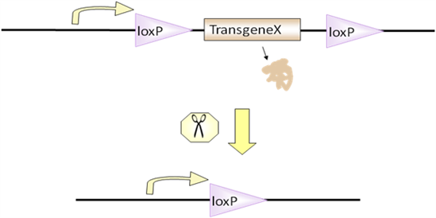
5
http://mouseclique.jax.org/crelox-breeding-for-dummies-part-ii/
Notes:
he Cre/lox system can be used to turn off a transgene. Such a transgene is designed with loxP sites flanking all or part of it. As an example, see 008917. In this example, expression of Cre recombinase removes the transgene

Slide 10
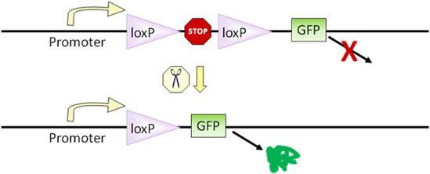
6
http://mouseclique.jax.org/crelox-breeding-for-dummies-part-ii/
Notes:
When researchers started creating Cre recombinase mouse strains to generate tissue specific knockout mice, they needed an easy way to confirm that Cre recombinase was active only in certain tissues. This need led to the development of Cre reporter strains. These strains are designed to express a visible marker, such as green fluorescent protein (GFP) or LacZ, only after Cre recombinase excises a loxP-flanked stop sequence

Slide 11
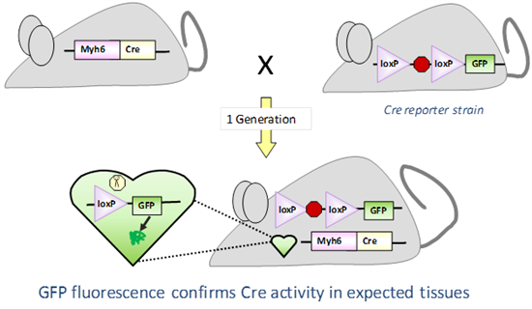
7
http://mouseclique.jax.org/crelox-breeding-for-dummies-part-ii/
Notes:
When such a reporter strain is mated to a Cre-expressing strain, it produces offspring in which the visible marker is expressed only in tissues with Cre activity (Figure 5). Again, only one generation of breeding is required

Slide 12
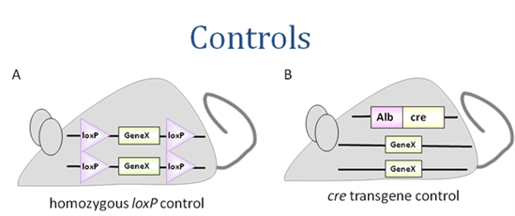
8
http://mouseclique.jax.org/crelox-breeding-for-dummies/

Slide 13
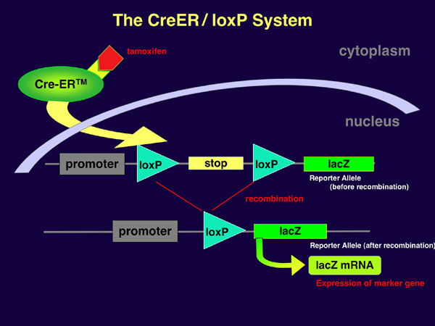
http://www.nips.ac.jp/eng/contents/release/entry/2006/10/post-84.html
Notes:
In several mouse studies, tamoxifen is used to induce the Cre recombinase; in this case Cre is fused to a portion of the mouse estrogen receptor (ER), which is naturally localized to the cytoplasm via its interactions with chaperone proteins such as heat shock protein 70 and 90 (Hsp70 and Hsp90). Tamoxifen binds to ER and disrupts its interactions with the chaperones. That allows the Cre-ER fusion protein to enter the nucleus and act on the floxed gene.

Slide 14
Comparison of the Krox20-expression area with the pBC
Krox20-cre line crossed to cre-reporter lines: 1. R26-mTmG (double fluorescetn line)
On serial sections: SST and NK1R staining

Slide 15
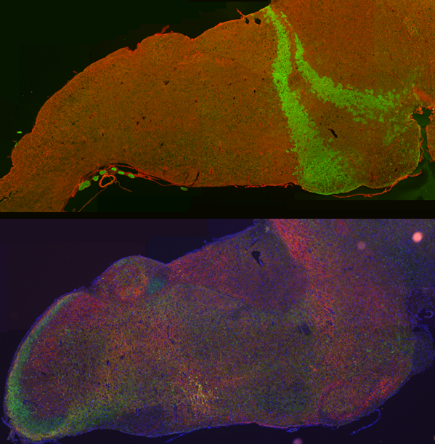
Krox20 expression area
pBC with SST and NK1R

Slide 16
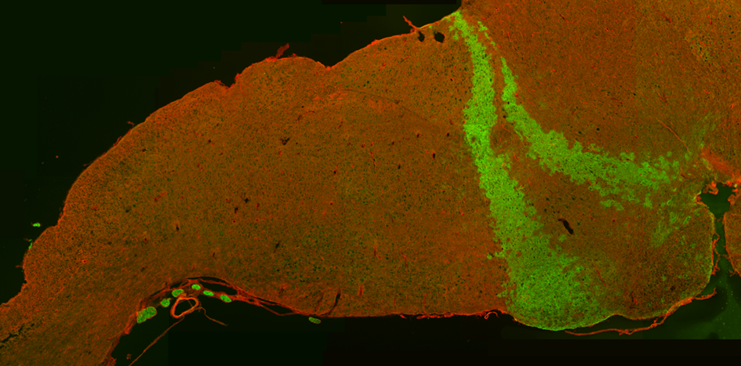

Slide 17
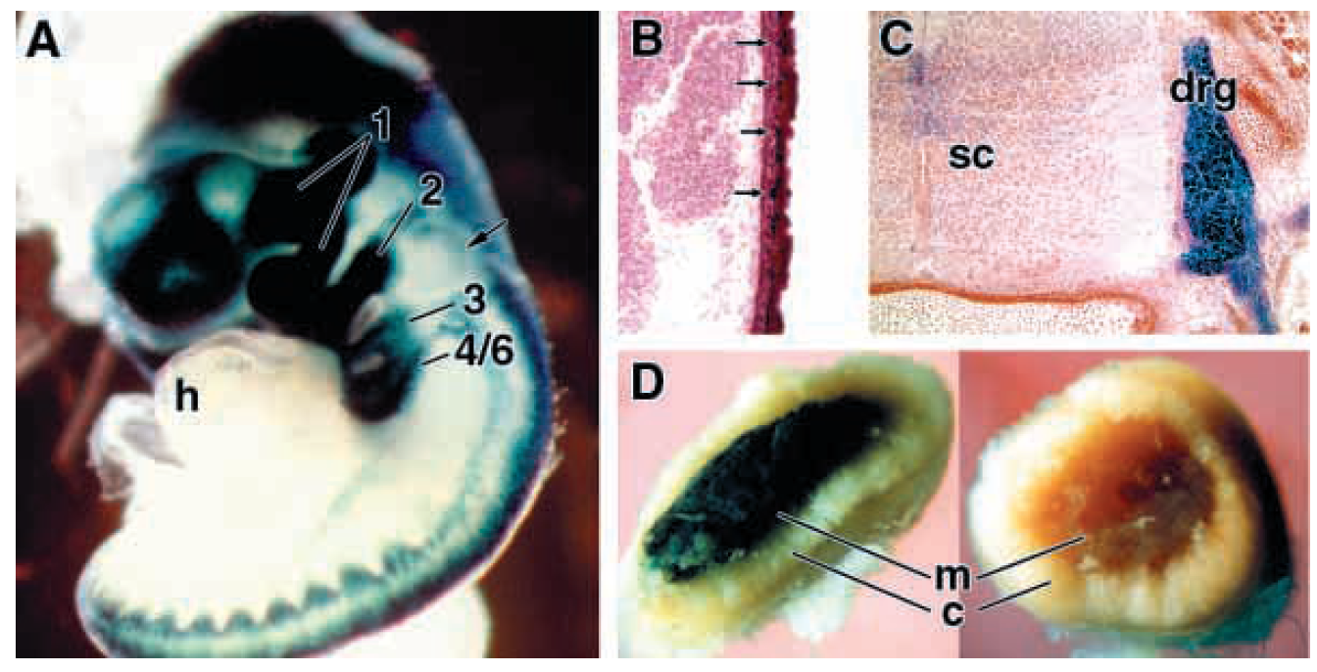
Wnt1-Cre und R26R Mauslinien wurden gekreuzt
Jiang, Development 127, 1607-1616 (2000)
Notes:
Specificity and efficiency of neural crest marking by the Wnt1-Cre and R26R genes.
(A) Whole-mount staining of a E9.5 embryo. Labeling is seen in the pharyngeal arches (numbered), dorsal neural tube and migratory neural crest in the trunk. The heart (h) is unlabeled, but is in obvious proximity to the pharyngeal arches. The arrow indicates the otic vesicle.
(B,C) Staining in a E15.5 embryo. The arrows in B point to labeled cells scattered in the epidermal layer, which are presumptive melanocytes, and C illustrates a dorsal root ganglion (drg) lateral to the spinal cord (sc). (D) Staining of adrenal tissue from a Wnt1-Cre/R26R adult (left) and a nontransgenic control adult (right). Only the adrenal medulla (m) is labeled, and not the adrenal cortex (c).

Slide 18
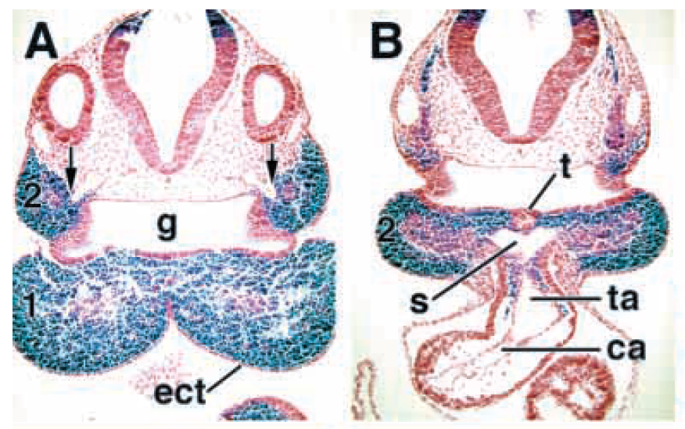
Jiang, Development 127, 1607-1616 (2000)
Notes:
Initial migration of neural crest into the heart. (A-D) Serial sections of an embryo at E9.5, taken at the level of the first pharyngeal pouch and the origins of the second pharyngeal arch arteries (A), the second pharyngeal pouch (B).
Numbers indicate pharyngeal arches. Note the extensive labeling of pharyngeal arch mesenchyme, but not ectoderm, foregut endoderm or vascular endothelium. Neural crest cells can be seen populating the truncus arteriosus in B,C, but not the cushions of the conus arteriosus. The arrows in A point to the junction between the dorsal aortae (surrounded by unlabeled cells) and the second arch arteries (surrounded by labeled cells). The thyroid diverticulum is apparent in B at the ventral floor of the second pharyngeal pouch.

Slide 19
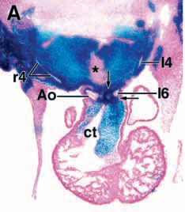
Notes:
Distribution of neural crest during aorticopulmonary and conotruncal septal formation. Sections shown are from an embryo at E11.5 (A,B)
At E11.5, a mass of labeled mesenchyme surrounds the left and right fourth (A) and sixth (B) arch arteries. The staining pattern is symmetric in this embryo, but
the sectioning was slightly off-angle. Labeled cells forming the aorticopulmonary septum (indicated by two arrows in A) which separates the outflow tract into the nascent aorta and pulmonary trunk at the origin of the left sixth arch artery, and diffuse cells in the conotruncal cushions are evident.

Slide 20
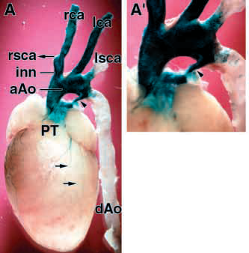
Notes:
Ultimate fate of the cardiac neural crest. (A) Distribution of labeled cells in a 7 week adult heart stained in whole mount (A’ is a higher magnification of A). Note the extensive staining in the ascending aorta and the arch of the aorta, in the innominate and left and right carotid arteries, but not in the dorsal aorta or in the left
subclavian artery except for scattered cells near the arch of the aorta. The ligamentum arteriosum (indicated by the arrowhead) is heavily stained. The right subclavian artery was torn away from the innominate artery during dissection, but its location is indicated by the leftward-pointing arrow. The labeled structures on the ventricular surface are nerve fibers (see also D).

Slide 21
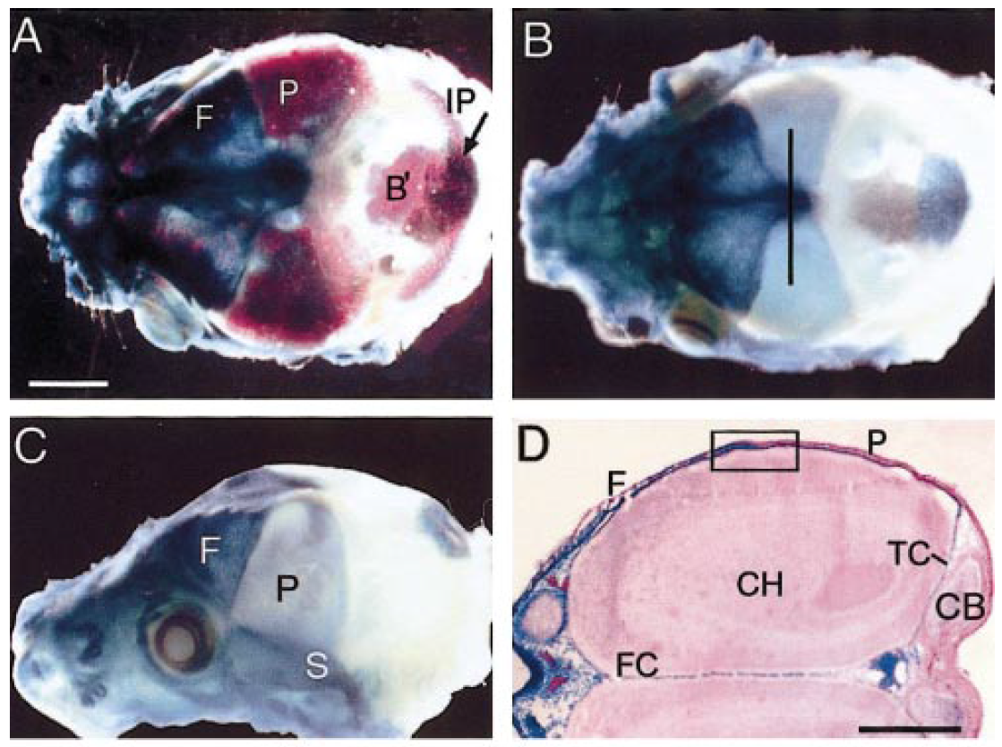
Jiang, Developmental Biology 241, 106–116 (2002)
Notes:
Tissue origins of the mouse skull vault. X-Gal staining identifies neural crest-derived tissues in Wnt1-Cre/R26R mice. (A) Combined X-gal and Alizarin red S staining shows that the frontal bone (F) coincides with a strongly X-gal-stained area; in contrast, the parietal bone overlies a lightly stained area and extends just caudal to it. The entirely mesodermal basioccipital bone can be seen through the unossified part of the skull vault; the centre of the interparietal bone, and a patch of dermis rostral to it, is also X-gal-positive. (B) Similar specimen but without Alizarin staining, showing strong staining in the skeletogenic membrane between the parietal bones (sagittal suture); the orientation of the section shown in (F) is indicated by the line. (C) Side view, showing X-gal staining of the frontal, alisphenoid, and squamosal bones; the line shows the position and orientation of (E). (D) Low-power transverse section through the cerebral hemispheres at the level of the
olfactory lobes (left) and upper cerebellum (right); neural crestderived meninges surround the cerebral hemispheres and form the falx cerebri and tentorium cerebelli. The boxed area indicates the area shown at higher magnification in (E). (E) The coronal suture is formed between two bones of different origins, the neural crestderived frontal bone and the mesodermal parietal bone (outlined); both overlie the neural crest-derived meninges covering the cerebral hemispheres. (F) Coronal section showing that the sagittal suture consists of a neural crest-derived membrane between the two mesodermal parietal bones. (G) Transverse section through part of the interparietal bone (midline is to the left), showing the neural crest-derived central area (left), mesodermal area (right), and underlying cartilage of mixed origin; noncartilaginous parts of the inner layer are also of neural crest origin in the central region, but the meningeal covering of the cerebellum is mesodermal. (H) Summary diagram showing neural crest contribution to the skeletal elements and sutures of the mouse skull vault. A, alisphenoid; B, mineralised bone; B9, basioccipital; C, cartilage; c, coronal suture; CB, cerebellum; CH, cerebral hemispheres; D, diencephalon; F, frontal; FC, falx cerebri; IL, inner layer of skeletogenic membrane; M, meninges; m, metopic suture; N, nasal; nc, nasal cartilage; P, parietal; S, squamosal; SS, sagittal suture; TC, tentorium cerebelli. Scale bars: A–D, 1 mm; E, F, 100 mm.

Slide 22
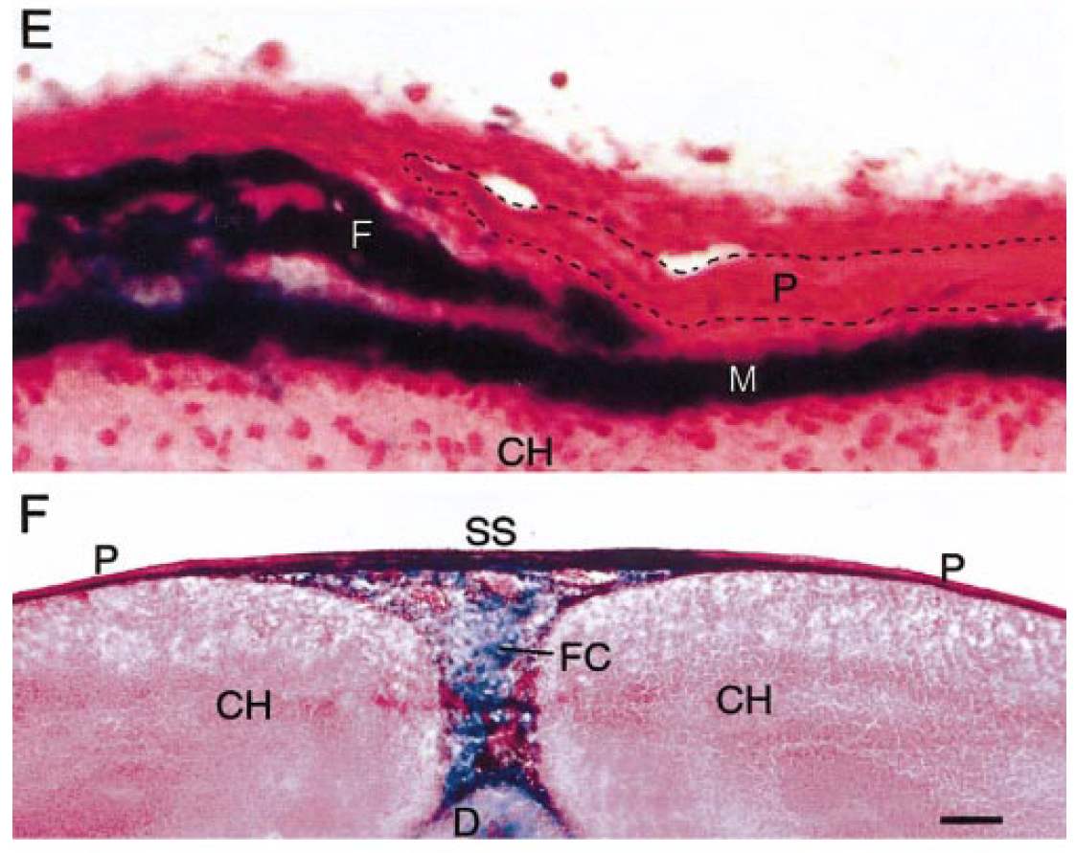
Jiang, Developmental Biology 241, 106–116 (2002)
Notes:
Tissue origins of the mouse skull vault. X-Gal staining identifies neural crest-derived tissues in Wnt1-Cre/R26R mice. (A) Combined X-gal and Alizarin red S staining shows that the frontal bone (F) coincides with a strongly X-gal-stained area; in contrast, the parietal bone overlies a lightly stained area and extends just caudal to it. The entirely mesodermal basioccipital bone can be seen through the unossified part of the skull vault; the centre of the interparietal bone, and a patch of dermis rostral to it, is also X-gal-positive. (B) Similar specimen but without Alizarin staining, showing strong staining in the skeletogenic membrane between the parietal bones (sagittal suture); the orientation of the section shown in (F) is indicated by the line. (C) Side view, showing X-gal staining of the frontal, alisphenoid, and squamosal bones; the line shows the position and orientation of (E). (D) Low-power transverse section through the cerebral hemispheres at the level of the
olfactory lobes (left) and upper cerebellum (right); neural crestderived meninges surround the cerebral hemispheres and form the falx cerebri and tentorium cerebelli. The boxed area indicates the area shown at higher magnification in (E). (E) The coronal suture is formed between two bones of different origins, the neural crestderived frontal bone and the mesodermal parietal bone (outlined); both overlie the neural crest-derived meninges covering the cerebral hemispheres. (F) Coronal section showing that the sagittal suture consists of a neural crest-derived membrane between the two mesodermal parietal bones. (G) Transverse section through part of the interparietal bone (midline is to the left), showing the neural crest-derived central area (left), mesodermal area (right), and underlying cartilage of mixed origin; noncartilaginous parts of the inner layer are also of neural crest origin in the central region, but the meningeal covering of the cerebellum is mesodermal. (H) Summary diagram showing neural crest contribution to the skeletal elements and sutures of the mouse skull vault. A, alisphenoid; B, mineralised bone; B9, basioccipital; C, cartilage; c, coronal suture; CB, cerebellum; CH, cerebral hemispheres; D, diencephalon; F, frontal; FC, falx cerebri; IL, inner layer of skeletogenic membrane; M, meninges; m, metopic suture; N, nasal; nc, nasal cartilage; P, parietal; S, squamosal; SS, sagittal suture; TC, tentorium cerebelli. Scale bars: A–D, 1 mm; E, F, 100 mm.

Slide 23
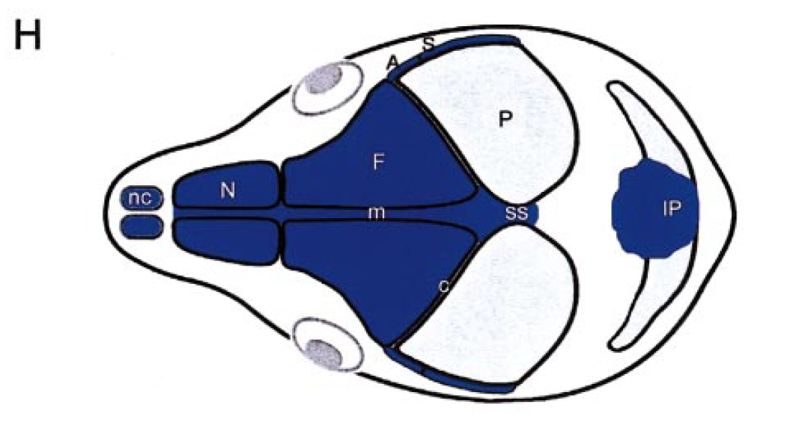
Jiang, Developmental Biology 241, 106–116 (2002)
Notes:
Tissue origins of the mouse skull vault. X-Gal staining identifies neural crest-derived tissues in Wnt1-Cre/R26R mice. (A) Combined X-gal and Alizarin red S staining shows that the frontal bone (F) coincides with a strongly X-gal-stained area; in contrast, the parietal bone overlies a lightly stained area and extends just caudal to it. The entirely mesodermal basioccipital bone can be seen through the unossified part of the skull vault; the centre of the interparietal bone, and a patch of dermis rostral to it, is also X-gal-positive. (B) Similar specimen but without Alizarin staining, showing strong staining in the skeletogenic membrane between the parietal bones (sagittal suture); the orientation of the section shown in (F) is indicated by the line. (C) Side view, showing X-gal staining of the frontal, alisphenoid, and squamosal bones; the line shows the position and orientation of (E). (D) Low-power transverse section through the cerebral hemispheres at the level of the
olfactory lobes (left) and upper cerebellum (right); neural crestderived meninges surround the cerebral hemispheres and form the falx cerebri and tentorium cerebelli. The boxed area indicates the area shown at higher magnification in (E). (E) The coronal suture is formed between two bones of different origins, the neural crestderived frontal bone and the mesodermal parietal bone (outlined); both overlie the neural crest-derived meninges covering the cerebral hemispheres. (F) Coronal section showing that the sagittal suture consists of a neural crest-derived membrane between the two mesodermal parietal bones. (G) Transverse section through part of the interparietal bone (midline is to the left), showing the neural crest-derived central area (left), mesodermal area (right), and underlying cartilage of mixed origin; noncartilaginous parts of the inner layer are also of neural crest origin in the central region, but the meningeal covering of the cerebellum is mesodermal. (H) Summary diagram showing neural crest contribution to the skeletal elements and sutures of the mouse skull vault. A, alisphenoid; B, mineralised bone; B9, basioccipital; C, cartilage; c, coronal suture; CB, cerebellum; CH, cerebral hemispheres; D, diencephalon; F, frontal; FC, falx cerebri; IL, inner layer of skeletogenic membrane; M, meninges; m, metopic suture; N, nasal; nc, nasal cartilage; P, parietal; S, squamosal; SS, sagittal suture; TC, tentorium cerebelli. Scale bars: A–D, 1 mm; E, F, 100 mm.

