Slide 1
Classification of mental disorders
Istvan Bitter
02 October, 2013

Slide 2
Purpose of Diagnosis in Psychiatry
Order and Structure
Communication
Predict Outcome
Decide Appropriate Treatment
Assist in the search for pathophysiology and etiology
Notes:
Helps simplify our thinking and reduce complexity in psychiatry…give out copy of list of dx…there are major classes of dx..i.e.—anxiety disorders, mood disorders, substance abuse disorders which are subdivided into specific disorders, GAD, , MDD, etc.
-dx do not necessarily defined in terms of etiology or pathophy. But SYDROMES!!
Diagnosis summarized information for clinician to understand each other.
--i.e.—pt has BPAD.. Know they have manic and depressive episodes
3. Many psych illness have a predictable course and outcome..
BPAD_-episodic illness
SP—chronic
Certain meds for certain dx
Researchers use dx to reduce heterogeneity in their samples and to separate groups of patients who might share a mechanism or cause that produces their symptoms

Slide 3
Procedural considerations for Assessment
Classification and diagnosis usually follow clinical interviewing to determine diagnosis
(i.e. a diagnostic interview)
A diagnostic interview is the most widely used assessment tool in clinical psychiatry

Slide 4
Assessments
Psychological: Clinical interviews and reports: Interactional style; empathy, Situational factors, paradigm
Biological: Scanning brain function (PET, CT, MRI, FMRI, Neurochemical;
Psychophysiological measures

Slide 5
Components of Psychiatric Assessment
Identifying data
Chief Complaint
History of Present Illness
Past Psychiatric History
Past Medical History
Medications
Allergies
Family History
Social History
Medical Review of Systems
Mental Status Exam
Diagnosis (incl. comorbidities)
Treatment Plan

Slide 6
Interview topics- mental status examination
General appearance - Memory
Speech and thought - Attention/concentration
Consciousness - General information fund
Mood and Affect - Perception
Insight and judgement
Obsessions and compulsions
Intelligence/higher intellectual functioning

Slide 7
General Appearance and Behavior
Describe appearance/behavior
Grooming, hygiene, facial expressions
Jewelry, tattoos,
Attitude towards examiner
Does pt look stated age?

Slide 8
Psychomotor Activity
Posture
Describe motor activity
Does s/he sit quietly or agitated
Note abnormal movements
Tics
EPS (extrapyramidal symptoms)
mannerisms
catatonia
TD (tardive dyskinesia)

Slide 9
Speech
Note patient’s speech
RRR (regular in rate and rhythm)
Pressured, slow, normal
Loud, soft
Poverty of speech/content of speech
Latent
Echolalia
Aphasia
May want to include a sample of speech

Slide 10
Thought Form
Describe thought process—this is inferred by pattern of speech
Logical and goal directed
Concrete
Preservative
Circumstantial, tangential
Flight of ideas
Poverty of content
Thought blocking

Slide 11
Mood
Mood is determined by PATIENT’S REPORT
Mood is an emotional attitude that is relatively sustained
Euthymic
Depressed
Anxious
Euphoric
Irritable

Slide 12
Affect
Affect refers to way pt conveys her/his emotional state, what is OBSERVED
Appropriate vs inappropriate
Full
blunted
flat

Slide 13
Thought Content
Describe Content of Thought
Hallucinations (auditory, visual, olfactory, gustatory, tactile + one: conaesthesia or conaestopathia)
Delusions
Ideas of Reference
Obsessions and Compulsions
Phobia
Distorted body image
Poverty of content
Suicidal incl. passive death wish/ Self Harm/ Homicidal ideation

Slide 14
Sensorium and Cognition
Mini Mental Status Exam covers most of the components
Describe level of alertness
Orientation
Memory
Very short term: repeat 3 items
Short term: recall 3 items
Long term: events that occurred in past

Slide 15
Sensorium and Cognitive Function
General Information
List 5 past presidents, current events
Calculations
Serial 7’s vs 3’s
Capacity to Read and Write
Read text, write a sentence
Visuospatial Ability
Copy design

Slide 16
Sensorium and Cognitive Function
Attention
Serial 7’s, spell WORLD backwards
Abstraction
Interpret proverb
Don’t cry over spilt milk

Slide 17
Insight and Judgment
Insight: does the pt understand her/his illness,understand need for treatment
Judgment: does the person make good choices?
Ask question: If you found a stamp, addressed envelope, what would you do?”

Slide 18
PANSS: Positive and Negative Syndrome

Slide 19
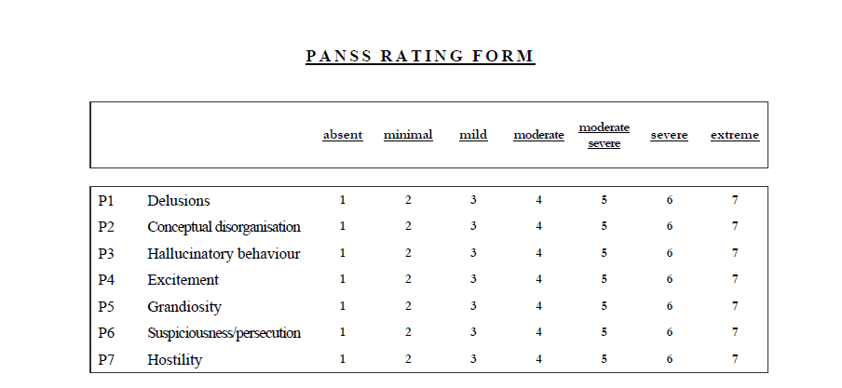

Slide 20
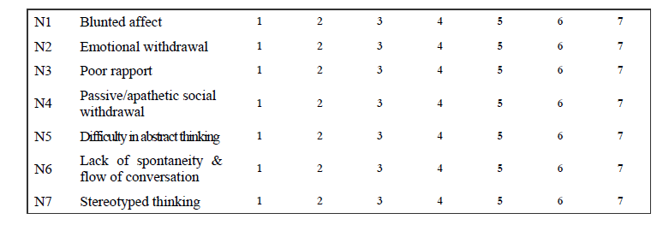

Slide 21
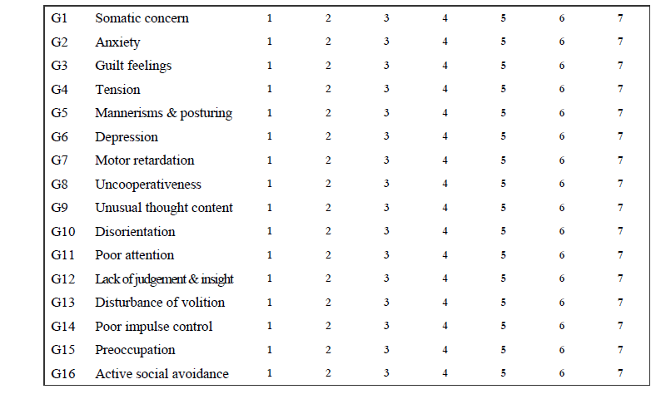

Slide 22
The Mini Mental State Examination (MMSE)
Permission is hereby granted to reproduce this
material for not-for-profit educational purposes only, provided
The Hartford Institute for Geriatric Nursing, Division of Nursing, New York University is cited as the source.
Available on the internet at www.hartfordign.org. E-mail notification of usage to: hartford.ign@nyu.edu.

Slide 23
The Mini-Mental State Exam
Patient___________________________________ Examiner ____________________________ Date____________
Maximum Score
Orientation
5
( )
What is the (year) (season) (date) (day) (month)?
5
( )
Where are we (state) (country) (town) (hospital) (floor)?
Registration
3
( )
Name 3 objects: 1 second to say each. Then ask the patient
all 3 after you have said them. Give 1 point for each correct answer.
Then repeat them until he/she learns all 3. Count trials and record.
Trials ___________
Attention and Calculation
5
( )
Serial 7’s. 1 point for each correct answer. Stop after 5 answers.
Alternatively spell “world” backward.
Recall
3
( )
Ask for the 3 objects repeated above. Give 1 point for each correct answer.
Language
2
( )
Name a pencil and watch.
1
( )

Slide 24
MMSE (2)
Repeat the following “No ifs, ands, or buts”
3
( )
Follow a 3-stage command:
“Take a paper in your hand, fold it in half, and put it on the floor.”
1
( )
Read and obey the following: CLOSE YOUR EYES
1
( )
Write a sentence.
1
( )
Copy the design shown.
_____
Total Score
ASSESS level of consciousness along a continuum ____________
Alert Drowsy Stupor Coma

Slide 25
Diagnostic Manuals - A history
Diagnostic and Statistical Manual of Mental Disorders, (5th Edition, 2013) – DSM-5, American Psychiatric Association
International Statistical Classification of Diseases, Injuries and Causes of Death (10th version - 1993) – ICD-10, World Health Organization

Slide 26
History of DSM
DSM I (1952)
established mainly by psychoanalysts to distinguish groups of psychoneurotic disorders, such as anxiety.
Interpretations of psychoneurotic disorders were mainstream Freudian (defence mechanisms).
Discourses of ‘reactions’ predominated.

Slide 27
DSM II (1968)
1950’s - 1960’s - psychoanalysis still dominated. Psychoneurotic problems became defined as ‘neurotic’ disturbances (e.g. hysteria)
In 1973, homosexuality was removed, replaced by ‘sexual orientation disturbance’
There was little in the way of clear descriptions of ‘disorders’. All ‘symptoms’ were defined as ‘symbolic’ (of unconscious processes)

Slide 28
DSM III (1980)
Completely new directions in psychiatry - instead of symptoms defined as ‘symbols’ - they were viewed as natural disease categories
Return to the world of medicine
Aims: research driven; operational criteria; based on ‘symptoms’ check list, not symbolic gestures
Outcome: the production of a science driven document – ego-dystonic homosexuality still included
Translated into 20 languages

Slide 29
DSM-III Paradigm Shift
Descriptive
Non-etiologic focus
Diagnostic criteria
Multiaxial system
Multiple diagnoses
Reliability

Slide 30
DSM III R (1987)
+ self-defeating personality disorders
Post-traumatic stress disorder was introduced to account for repeated trauma in Vietnam veterans
Pressure groups altered the course of the DSM – ego-dystonic homosexuality removed

Slide 31
DSM-IV
Diagnostic and Statistical Manual of Mental Disorders, (4th Edition 1994) – DSM-IV, American Psychiatric Association

Slide 32
DSM-IV (1994)
Neurosis as a term is no longer in existence
Mental disorders included
DSM II = 85 disorders
DSM III = 265 disorders
DSM III-R = 292 disorders
DSM IV = 297 disorders

Slide 33
DSM-IV TR, 2000
Minor changes

Slide 34
DSM-5, 2013
Major changes summarized:
http://www.dsm5.org/Documents/changes%20from%20dsm-iv-tr%20to%20dsm-5.pdf

Slide 35
Reliability and Validity
Reliability
Consistent diagnoses
Interrater reliability
Clear methods of assessment, standardised symptoms
Validity
Construct validity
Etiological Validity: Consistent Causal Factors
Predictive Validity: Successful prognosis - most people with bi-polar respond well to lithium carbonate, suggesting coherence in diagnostic group

Slide 36
DSM and ICD
Advantages
Improve reliability of dx
Clarify dx and facilitate history taking
Clarify and facilitate process of differential diagnosis
Disadvantages
False sense of certainty
May sacrifice validity for reliability
RELIABILITY: capacity of individuals to agree
VALIDITY: capacity to make useful predictions
Treat dx like checklist and forget about patient as a person
Notes:
Disadvantages:
Dx are arrived at by a group of experts, based on data but we don’t have all data… dx are arbitrary!! … dx are a useful tool… use with some skepticism
Validity: capacity to make useful predictions
Reliability: capacity of individuals to agree on what they see

Slide 37
Multi-Axial Classification System
The first two axes are used to present the clinical disorders actually listed in the manual.
Axis I lists the majority of mental disorders.
Axis II is reserved for persistent or chronic conditions
The separation is intended to assure that more chronic conditions are not overlooked.

Slide 38
Multi-Axial Classification System
The diagnoses are listed in order of their importance to the person’s social functioning.
In instances where there are diagnoses in both Axis I and Axis II, it is assumed that Axis I is the principal diagnosis unless Axis II specifically labeled as such (personality disorders).
DSM allows for communicating the level of uncertainty regarding a particular diagnosis.

Slide 39
Multi-Axial Classification System
Axis III is designed to present general medical information.

Slide 40
Multi-Axial Classification System
Axis IV is designed to present specific information about the client’s current psychosocial environment.
A number of global categories of problems are suggested in the DSM text.
Practitioners are encouraged to include specific information on Axis IV in addition to such global characterizations.

Slide 41
Multi-Axial Classification System
Global Assessment Functioning (GAF) score is listed on Axis V.
This 100-point scale is presented in DSM.
In some situations, an individual’s functioning can be at very different levels depending on which aspect is emphasized.
It is recommended that in those instances, the client’s potential for danger to self or others should take precedence in determining the GAF score.

Slide 42
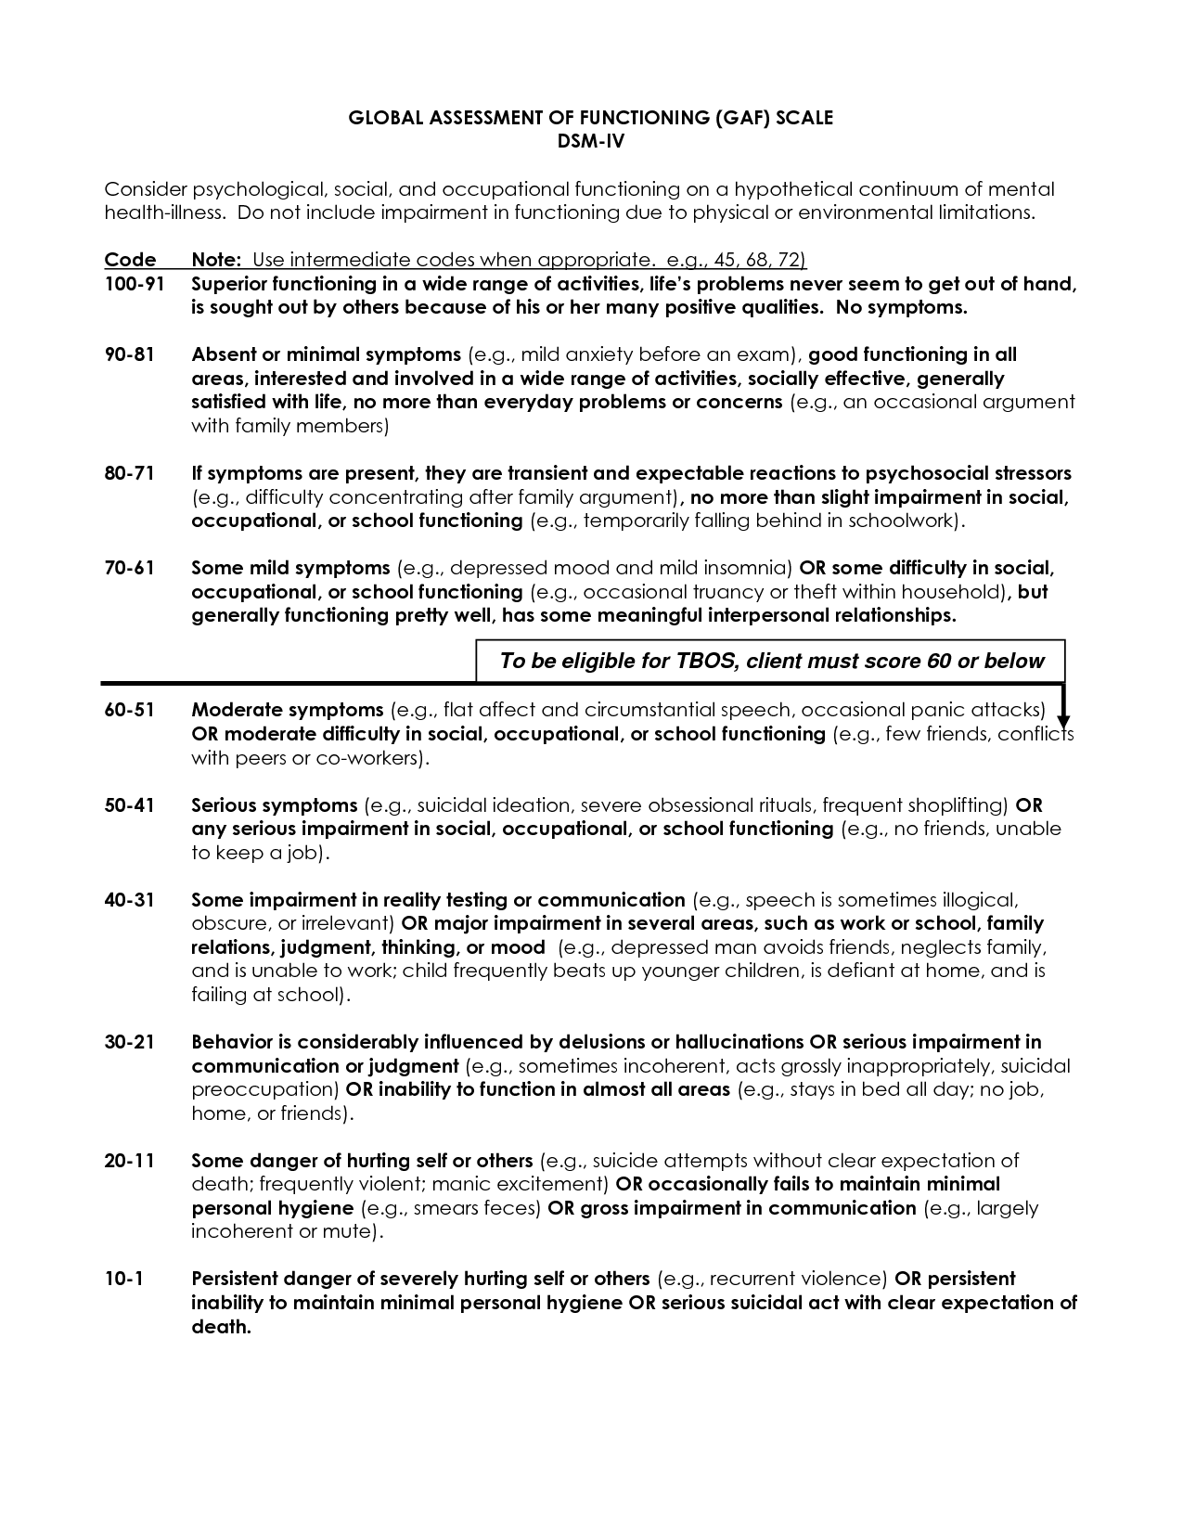

Slide 43
ICD-10
International Statistical Classification of Diseases and Related Health Problems 10th Revision (ICD-10) Version for 2010
Chapter V Mental and behavioural disorders (F00-F99)
http://apps.who.int/classifications/icd10/browse/2010/en#/V

Slide 44
Thank you for your attention

